Slide 1
Presentation on Participatory Governance Assessments in Nigeria
By
Ms. Folake Oluokun, UNDP-Nigeria and Odigha Odigha, REDD+ Focal Point, Nigeria during the Regional Workshop on Strengthening Transparency and Accountability for REDD+ in Africa, Lusaka, Zambia, 24 – 26 April 2012

Slide 2
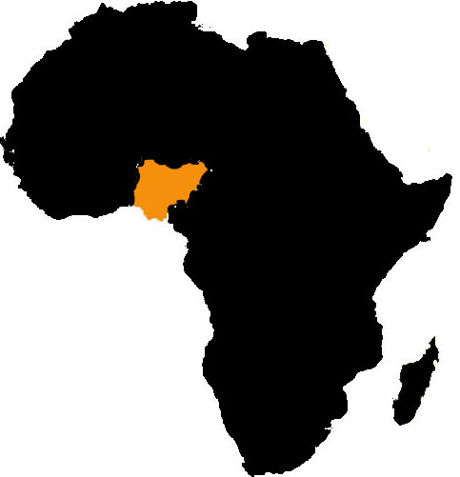
Context
Federation of 36 States + FCT
Estimated Population: 167 million
Land area: 923,769km2 (76% arable)
6th largest deposit of gas, 8th largest producer of petroleum in the world.

Slide 3
In spite of immense resources...
    Human Development Index (HDI 2011) - 0.459 ranks 156 out of 187 countries
    Poverty level– 54.4 % (2004), 69% (2010), growing level of unemployment from 12.3% in 2006 to 23.9% in 2011
    Poverty is a main driver of deforestation and environmental degradation
    Corruption as a key driver of deforestation
    Transparency International’s CPI Rankings: 130th (2009), 134th (2010), 143 (2011)
Corruption in Nigeria is an endemic, pervasive and systemic problem.

Slide 4
Challenges
  Wavering political will at national level to combat corruption, varying levels at State level.
  Insufficient involvement of ordinary citizens in the fight against corruption
  Weak institutions to cope with forest law enforcement
  Irregular practices in natural resource management responsible for massive degradation of Nigeria’s environment.
  Inexistent/weak systems and institutional frameworks to reduce corruption and increase transparency and accountability. Will affect the utilization of National resources as well as potential benefits from REDD

Slide 5
Ongoing Participatory Governance Assessments…
  Assessment of Good Urban Governance in Nigeria:
    Objective: Enhance the capacity of local governments and other stakeholders for good governance and increased accountability.
  Corruption Risk Assessments in the water, health and education sectors at Federal level and in Selected States:
    Objective: Identify and proffer recommendations to address vulnerable areas in the pilot sectors that are prone to corruption - anti-corruption agencies, Ministries, Departments and Agencies (MDAs), CSOs.
  Tools, approaches, methodologies are relevant and beneficial to REDD+

Slide 6
Other interventions that can benefit the REDD initiative...
Identifying and addressing corruption risks at State level (including to ensure effective utilisation of REDD benefits).
Strengthened public procurement systems at National and State levels
National, State strategies to combat corruption
Increasing community participation in the management of resources at all levels (awareness creation, fighting corruption, participatory budgeting, increased participation in electoral processes etc).

Slide 7
REDD+ in Nigeria
By Law, forest resource management is a function of the State government .
Different states are on different levels as far as forest management is concerned.
Cross River State hosts more than 50% of Nigeria’s remaining rain forest and mangrove and there is overwhelming political will to protect them.
This has informed the two track approach which makes Cross River State the model for implementation of the REDD for other States.

Slide 8
Key Benefits of Participatory Assessments for REDD+
Stakeholder involvement: involve government at all arms and levels, communities, CSOs, media, academia, development partners
  Creates awareness, ownership, responsibility, sustainability.
  Increased openness, transparency and accountability in the management of resources for the benefit of the people.

Slide 9
Working together…
The REDD implementing departments, stakeholders and anti- corruption agencies to review existing tools and adopt PGA tools to address the risks associated with REDD.
Incorporating REDD concerns into ongoing anti-corruption programmes and initiatives

Slide 10
Next Step for REDD+ in Nigeria
Policies and legislations
Institutional capacity of State government (assessment of corruption risks of relevant institutions e.g. Forestry Commission).
Participation of forest dependent communities in REDD+ (including natural resource management, effective utilisation of reforest)
Establishment of equitable benefit distribution systems

Slide 11
Thank you

