Slide 1
A Comparative Overview of REDD+ Policy and
Governance Approaches Across the Africa Region
Johanna Wehkamp, Mercator Fellowship on International Affairs
( study conducted with Carole Megevand, Erik Winter Reed and Rajesh Koirala)

Slide 2
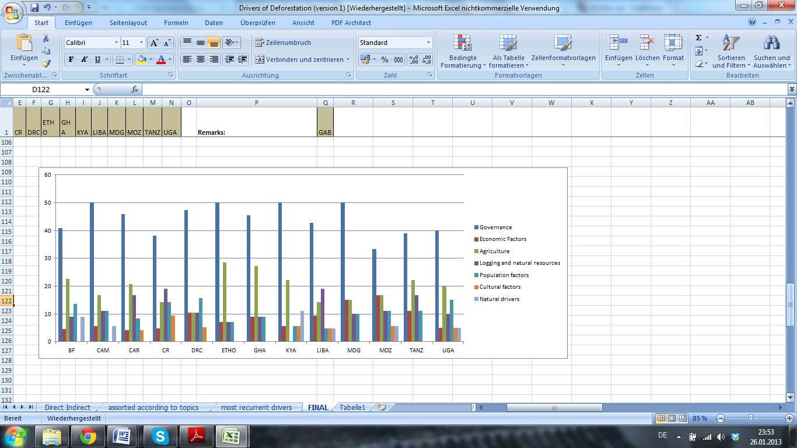
1. Governance issues are a central driver of deforestation for African countries
Relative frequency of different drivers of deforestation (as mentioned in the R-PPs)

Slide 3
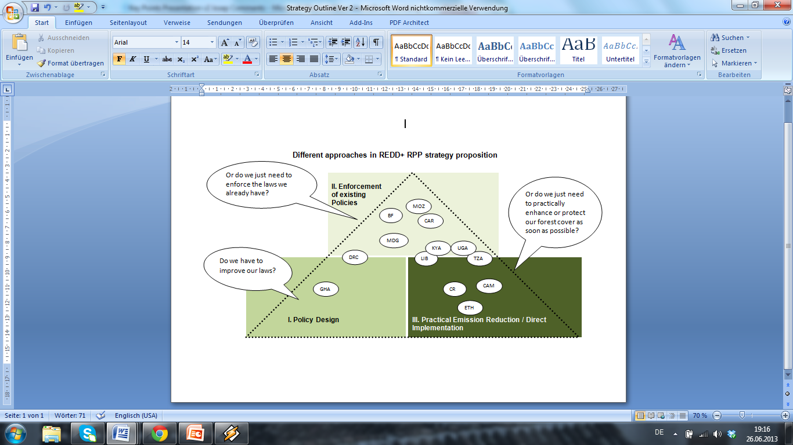
2. African countries have different priorities in their REDD+ strategies

Slide 4
Mapping African countries approaches to carbon ownership and benefit sharing
State Ownership | Individual /Community Ownership | Both approaches are considered | Issue has not been explored yet
Burkina Faso Cameroon Ghana Liberia | Kenya Madagascar Mozambique Uganda | Central African Republic Republic of the Congo DR Congo | Ethiopia Tanzania
Carbon Ownership
Benefit Sharing
National benefit sharing mechanism | National redistribution fund | Local BS managed by a decentralized state authority | Local or project level benefit sharing with a share to the state | Not yet clarified
Burkina Faso CAR (1) Ghana | DRC Madagascar | Republic of the Congo | Cameroon CAR (2) Liberia | Ethiopia, Kenya Mozambique Tanzania Uganda
Notes:
The definition of CR :
National , Individual / Community Level : Both levels imply a certain risk for corruption

Slide 5
Concluding Observations
Governance weakness is a central driver of deforestation, but at the same time the political discussions and institutional tool-set are not developed enough in order to provide solutions to this central driver of deforestation.
For many countries a certain degree of perplexity could be observed with regards to defining the different elements of the implementation framework in a precise manner
(Kenya: “The international REDD+ mechanism expected to be finalized in the coming months [will likely clarify the modalities by which Kenya will be able to access funding for REDD+ strategies it may select.”)

Slide 6
Thank very much you for your attention!
johannawehkamp@gmail.com

