Slide 1
STRATEGY IN THE MAKING
Lessons and Experiences from Zambia
Presented by the Zambia UN-REDD Team on Behalf of
Mr. Ignatius Makumba, Director of Forestry
July 7th, 2014

Slide 2
A
OUTLINE
Zambia at a Glance
Context for REDD+: Opportunities and Challenges
Zambia’s Response and What It Needs to Do
Approach to REDD+ Strategy Development
Key Outcomes and Results Expected
Lessons, Experiences and Key Messages
Next Steps and Way Forward
Towards the REDD+ Strategy

Slide 3

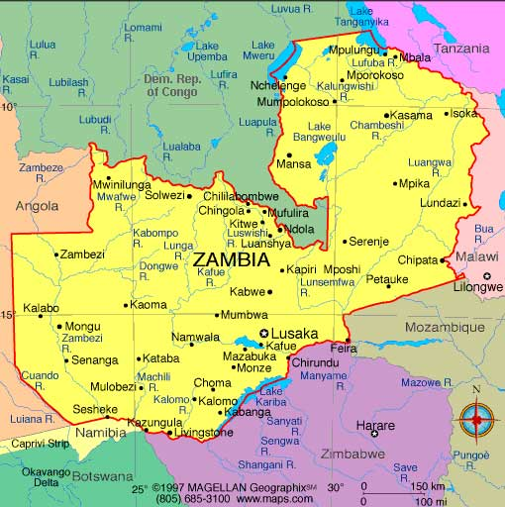
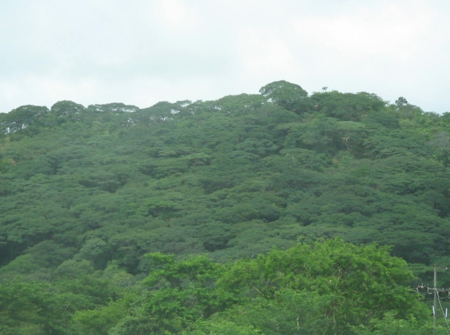
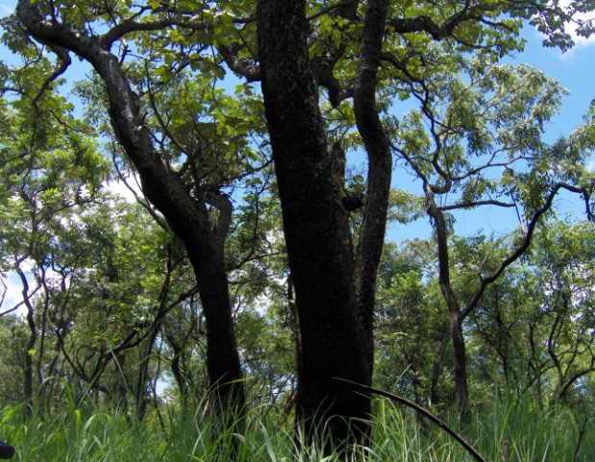
B
ZAMBIA AT A GLANCE
:

Slide 4
C
CONTEXT FOR REDD+: OPPORTUNITIES & CHALLENGES
Surface Area:
Forest Cover:
Vegetation Type:
Plantations:
Carbon Stocks (current):
752,614Km² with a population of 13 million
49.9 million ha (66% of land cover)
Miombo (Semi-evergreen forests); Baikiaea, Munga, Mopane, Kalahari woodlands (Deciduous Forests), Ripian, Swap, Parinari, Itigi, Lake basin Chipya (Evergreen forests), Termitary associated bushes (Shrub thickets), grasslands, and wooded grasslands
61,000 ha
2.9 billion m³of growing stock
5.6 billion tonnes of biomass (below and above)
434 million tonnes as dead wood biomass
TOTAL: 6 billion tonnes (ILUA 2008)
About 2.8 billion tonnes of Carbon stored in forests
Towards the REDD+ Strategy

Slide 5
Tranboundary Ecosystem:
Water Resources:
Livelihoods
Environment and Climate Change :
Drivers of deforestation:
Livelihood impact
Has unique ecosystems shared with Angola, Botswana, the Democratic Republic of Congo (DRC), Malawi, Mozambique, Namibia, Tanzania and Zimbabwe
Holds 30-40% of water resources in Southern Africa which originates from forested watersheds
Forests are major source of livelihood especially for the rural communities
-Impacted by drought, land degradation and deforestation
-Forests are under increased pressure. Between 250,000 and 300,000 hectares of forest are lost every year
Main drivers of deforestation & forest degradation are: agrilculture expansion, infrastructure development, charcoal production and late fires
Deforestation impacts on the economy and overall livelihoods in terms of food, water and energy security
Towards the REDD+ Strategy

Slide 6
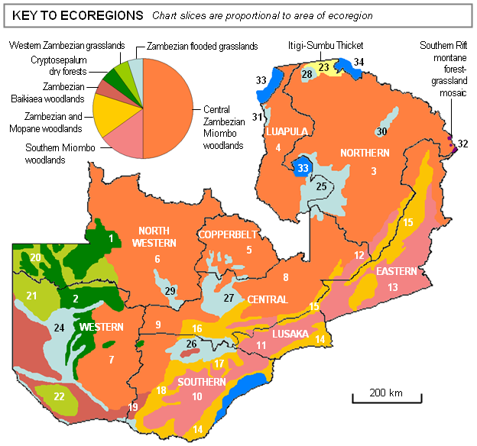
Towards the REDD+ Strategy

Slide 7
ZAMBIA’S RESPONSE
D
Prepare a national strategy or action plan aimed at reducing deforestation and forest degradation;
Develop a national forest reference emission level and/or forest reference level (interim measure, sub national) in order to establish the national level of emissions
Develop a robust and transparent national forest monitoring system for the monitoring and reporting of the REDD + activities (interim measure, sub national)
Develop a system for providing information on how the safeguards (environment and social) will be addressed and respected
Towards the REDD+ Strategy

Slide 8
ZAMBIA APPROACH TO REDD+ STRATEGY
E
.
01
05
Background to the REDD+
Connecting the dots:
readiness process
bringing analytical work
together
02
06
Defining a strong national
Partnership building
vision to guide REDD+
and coordination
strategy
Zambia’s approach
to REDD+ strategy
03
07
Bringing REDD+ strategy
Institutionalization of the
development into the core
REDD+ developmet
of REDD+ Readiness
process
04
08
Development of a REDD+
strategy roadmap
Stakeholder engagement
09
Mainstreaming and
support to legal and policy
processes

Slide 9
1
Defining a strong national vision to guide strategy development
2
Connecting the dots and bringing the analytics together
3
Mainstreaming of REDD+ into broader national development processes
4
Partnership building, coordination and stakeholder engagement
Towards the REDD+ Strategy

Slide 10
1
Defining a Strong National Vision to Guide Strategy
Aligning REDD Strategy with with other strategies such as climate change financing framework
Ensuring harmonized approach to REDD Strategy development (National Forest Inventory, methodological approaches for GHG reporting, linking Global UN-REDD support to National Programme)
Bringing REDD+ Strategy into the core of the Readiness process
Establishing a partnership forum where actors working on REDD can dialogue on issues of common interest
Building on existing institutional structures such as the Inter-ministerial Climate Change Secretariat and instituitionalizing REDD+ processes (Central Statistics Office and FLES surveys to include safeguards)
Towards the REDD+ Strategy

Slide 11
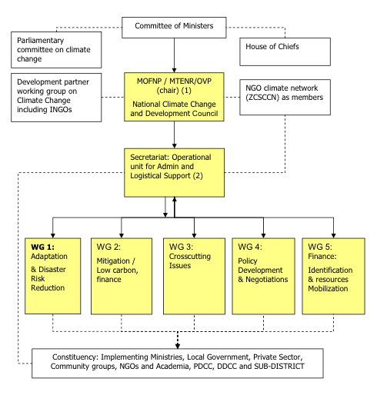
Example of Institutional Arrangement for CC Governance
Towards the REDD+ Strategy

Slide 12
2
Connecting the dots and bringing the analytics together
Developing a national REDD Strategy that is based on sound analytics and evidence
Conducting key analytical work with particular attention to key prerequisites for REDD+ Strategy
Sequencing activities to ensure proper forward and backward linkages
Preparing an Issues and Options report to draw key elements from analytics and to provide the foundation for the national REDD Strategy
Towards the REDD+ Strategy

Slide 13
Forest LOSS
Agricultural expansion
Shifting cultivation
Agriculture extensification
Infrastructure development
Settlements
Urban expansion
Wood extraction
Charcoal production
Wood fuel collection
Logging
Environmental factors
Uncontrolled fires
DIRECT or PROXIMATE DRIVERS
Policy & Legal framework
Inconsistencies
Weak
Socio-economic
Poverty
Low employment opportunities
Insecure land tenure
Demographic
Population growth
Immigration
Population density
Institutional
Poor funding
Low staffing levels
Lack of transport
Low staff morale
Environmental
Climate variability
Soils
Topography
UNDERLYING DRIVERS

Slide 15
3
Mainstreaming of REDD+ into broader national development processes
Supporting national policy and legal processes such as National Forest Bill (currently under revision)
Mainstreaming REDD+ into national Climate Change policy, Agriculture policy, National Agriculture Investment Programme and donor co-operation frameworks with government
Holding national dialogue on key issues of importance to REDD+ to galvanise support in addressing key drivers of deforestation (e.g. charcoal)
Integrating REDD+ into Provincial and District Development Coordinating Commitees and decentralized processes
Towards the REDD+ Strategy

Slide 16
4
Partnership building and Coordination
Strenghthening inter-agency partnerships through joint planning, programming, sequencing of activities (FAO, UNDP, UNEP)
Financing partnerships (GEF 5, World Bank, USAID, Finland, ILUA II, UNDP-LECB)
Research partnerships with CIFOR
Programmatic partnerships (ILUA II, UNDP-LECB)
Learning partnerships (IDLO, GCP, BioCarbon Partners)
Towards the REDD+ Strategy

Slide 17
F
Key Outcomes and Expected Results
A result oriented strategy based on requisite analytical work and sequencing of activities
A well-defined and coordinated approach to key REDD+ actions which links different sectors and institutions to ensure effective reporting at the national level
A robust partnership framework with the potential for resource mobilization and multiplier effects through new and emerging programmes such as the BioCarbon Fund, UNDP supported programmes, USAID supported programmes, and Finnish programmes
A space for innovation, learning, scaling up and replication especially on forest monitoring and MRV work, and stakeholder engagement processes;
Long-term sustainability, given that the UN-REDD Programme has built on existing institutional structures
A conducive enabling environment for investments in REDD+ and potential results based payments from BioCarbon Fund
Towards the REDD+ Strategy

Slide 18
Lessons Learned
G
Avoid overambitious programme design because REDD+ can only solve specific problems based on what drives deforestation and forest degradation.
Address conceptual issues at the beginning to avoid over expectations and uncoordinated approach to REDD+ readiness process and distinguish it from REDD+ implementation.
Involve key stakeholders from the beginning of the REDD+ readiness process so that they clearly understand their and others roles and responsibilities.
It takes time to set up structures. Therefore, it is important to plan the start-up phase of REDD+ readiness programmes including recruiting, seconding or attaching teams to implement such programmes.
Towards the REDD+ Strategy

Slide 19
The government should lead and own the REDD+ readiness process to ensure full support to the process and enhance stakeholder ownership of the process.
Promote synergy among different programmes in order to respond to the national vision and national circumstances, to avoid duplication and thinly spreading out resources.
REDD+ should not be seen as a separate development agenda or a stand-alone initiative but should be considered an important opportunity to mainstream, strengthen and consolidate existing efforts all levels
UN-REDD Programme collaborating agencies should work in a synergistic manner in the interest of the national REDD+ programme and not in silos.
Towards the REDD+ Strategy

Slide 20
Next Steps & Way Forward
H
Finalization of the strategy: By advancing its REDD+ strategy to be completed by December 2014, the country is demonstrating its global and national commitments to promote REDD+ through strategic options and targets.
Design of a UN-REDD Programme phase II: To mobilize financial support and investments to transit from REDD+ readiness to REDD+ implementation.
Support from Policy Board/UN-REDD: It is imperative that, Zambia with the near conclusion of the REDD+ Strategy, is supported with: a) financing for REDD+ implementation (e.g. low hanging fruits); and b) transitional plan from Readiness to implementation. This is to ensure that the years of hard work are capitalized on and leveraged with minimal or no gaps.
Mobilization of strategic partnerships: The government, with support of UN and development partners, will be developing proposals and concept notes for engaging with key development partners in support of REDD+ implementation in Zambia.
Towards the REDD+ Strategy

Slide 21
THANK YOU

