Slide 1
Results-Based Finance in the context of the Warsaw Framework for REDD+
Lima, 5th of July 2014

Slide 2
Key question 1
What are the prerequisites to access Results-based finance for REDD+?

Slide 3
What are the prerequisites to access Results-based finance?
Decision 9/CP.19 recalls that for developing country Parties undertaking the results-based actions referred to in decision 1/CP.16, paragraph 73[1], to obtain and receive results-based finance, those actions should be fully measured, reported and verified;
In accordance with decisions 13/CP.19 on guidelines and procedures for the technical assessment of submissions from Parties on proposed forest reference emission levels and/or forest reference levels and with
Decision 14/CP.19 on measuring, reporting and verifying anthropogenic forest-related emissions by sources and removals by sinks, forest carbon stocks, and forest carbon stock and forest-area changes resulting from the implementation of REDD+ activities
In addition, developing country Parties should have all of the elements referred to in decision 1/CP.16, paragraph 71, in place, in accordance with decisions 12/CP.17 and 11/CP.19:
  A national strategy or action plan;
  A national forest reference emission level and/or forest reference level
  A national forest monitoring system
  A system for providing information on how the Cancun safeguards are being addressed and respected throughout the implementation of REDD+ activities
Lastly, developing country parties should provide the most recent summary of how the Cancun safeguards have been addressed and respected.

Slide 4
What are the prerequisites to access Results-based finance?
What
National Strategy (NS) or Action Plan (AP)
National FREL / FRL
UNFCCC Channel
None
Reference level submission
NFMS including MRV
Safeguard (SG) Information
Technical Annex BUR
National Communication
Process
No further action
Technical assessment in context of RBP
Technical assessment in context of RBP
Timing
No further action
Reference
When seeking RBP
Country submits when ready (especially when seeking RBP)
Every two years
Approximately every four years
9/CP.19 para 3 & 11 (c)
9/CP.19 para 3 & 11
9/CP.19 para 3 & 11 (b)
13/CP.19
9/CP.19 para 3 & 11 (a) & (e)
14/CP.19
Information Hub
Summary of information on addressing & respecting SG
As appropriate, link to NS or AP
FREL/RL Submission & final assessment report
Final technical report

Slide 5
Key question 2
What Results-based finance for REDD+ is out there under the UNFCCC?

Slide 6
What Results-based finance?
Normative background:
Warsaw Political Decisions
  Work programme on results-based finance for the full implementation of REDD+ activities
  Coordination of support
Green Climate Fund
  Where does the GCF stand?
  Access modalities and accreditation
  Project/program cycle
  Results and performance indicators

Slide 7
Warsaw Decisions: Results-based finance (Dec.9 CP.19)
Key role of the GCF but recognizing other ‘financial entities’
Diversity of sources of finance (markets and non-markets)
UNFCCC ‘information hub’ centralizing information on results-based payment (“inserted on the information hub in consultation with the developing country Party concerned”)
Notes:
Prerequisites to access finance:
actions should be fully measured, reported and verified, in accordance with SBSTA decisions from COP 19
Developing countries should have all of the elements referred to to in decision 1/CP.16 p 71 in place and in accordance to decisions 12/CP.17 and -/CP.19
Parties should provide the most recent summary on how all safeguards referred to in decision 1/CP.16 have been addressed and respected before they can receive results-based payement

Slide 8
Warsaw Decisions: Coordination of support(Dec.10 CP.19)
National entities or focal points nominated to liaise with Sec & convention bodies & may nominate their entities to receive RBP
Coord. needs & functions recognized
Focal point’s meetings (Dec 2014 onwards)
SBI to review outcomes of meeting and consider governance arrangements for coordination of support
Notes:
Instead of the ‘REDD body’!
National entities & focal points to act as liaison with the Secretariat and the relevant bodies under the Convention on the coordination of support for the implementation of REDD+ activities

Slide 9
Green Climate Fund: Where do we stand?
8 essential requirements set for the fund to receive, manage, program and disburse financial resources (decided at the 5th meeting of the Board) ☑
Policies, frameworks and procedures – evolving
Resource mobilization process – launched

Slide 10
GCF Access Modalities: an opportunity for REDD+ funds?
International (regional or international entities) or direct (sub-national or national)
Further distinction among:
  Implementing entities
  Intermediaries
  Funding entities (a special type of intermediary)
Will play different roles and be accredited accordingly based on fiduciary capacity basic and specialized, as well as environmental, social safeguards
Notes:
Basic fiduciary capacity:
Key admin and financial capacities (general management and admin, financial management and accoutning, internal and external audit, control frameworks, procurement)
Transparency and accountability (disclosure of conflicts of interest, code of ethics, capacity to prevent or deal with financial mismanagement or malpractice, investigations, anti-money laundering, anti-terrorism)
Specialized fiduciary criteria:
Project management (project preparation and appraisal, oversight and control, M&E, project-at-risk system and related project risk management)
Grant award and/or funding allocation mechanisms (procedures, transparent allocation of financial resources, access to info on beneficiaries and results, good standing with regard to multilateral funding through PERs)
On-lending and/or blending (registration and licensing by regulator, track record with international and multilateral resources, creditworthiness, due diligence processes, financial resource management including lending portfolio analysis, access to info, investment management, transparent fund management, financial risk management incl. Asset/liab. Management, governance)
ESS – IFC performance standards on an interim basis.

Slide 11
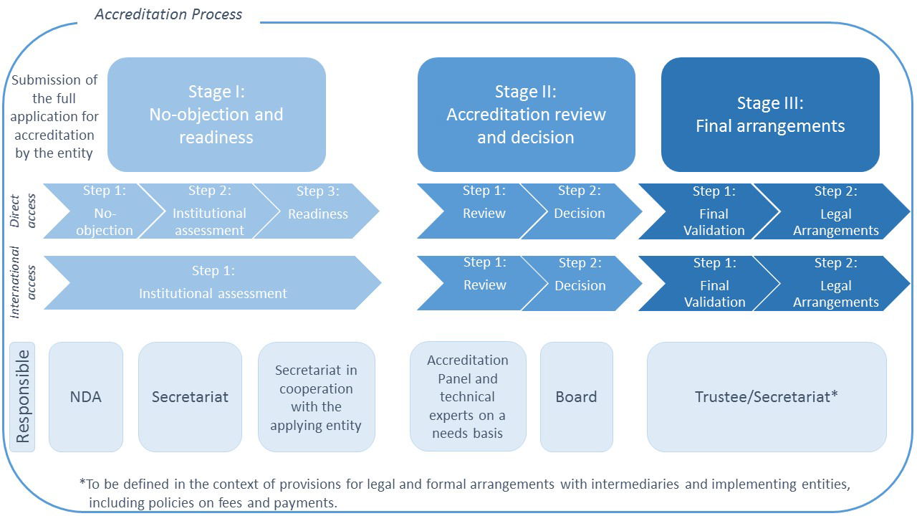
GCF - Accreditation
Notes:
Fast Tracking is possible: the GCF will elaborate an assessment (including a gap analysis) of insitutions accredited by other relevant funds and in line with the GCF’s objectives against the interim ESS and initial fiduciary standards with recommendations on their potential accreditation or fast tracking – DECISION in October 2014 (Dec. B.07/02. (l) (i))

Slide 12
GCF Project/program cycle
0.1. NDA submits country work program
0.2. Secretariat compiles WPs for information of the Board
1. Secretariat launches calls for proposals
2.1. IEs, intermediaries or EE submit concept notes
3.2. IEs, intermediaries submit proposals
3.1. Non-objection from NDA on submission of funding proposal
2.2. Secretariat & NDA provide recommendations on concept note
4. Secretariat assesses and submit to Board
5. Board decides
6.1 Legal arrangements between Secretariat and IE or intermediary
6.2. Trustee issues letter of commitment
Notes:
NDA may inform the Secretariat of preferred accredited IE or intermediaries
Unsollicited bids can also be submitted

Slide 13
GCF RESULTS framework and the place of REDD+
Paradigm shift objective for mitigation: low emission development
FUND LEVEL IMPACTS
1.0
Energy
2.0
Transport
3.0
Buildings, cities industries, appliances
4.0
REDD+ (SFM not SMF)
PROJECT/
PROGRAM LEVEL OUTCOMES
Improved management of land and forest areas contributing to ER

Slide 14
GCF performance INDICATORS and the place of REDD+
Paradigm shift indicators for mitigation: tCO2e, tCo2e/US$ and leverage ratio
FUND LEVEL INDICATORS
4.0
REDD+: tCO2e reduced from forest/land use
PROJECT/
PROGRAM LEVEL INDICATORS
Forest area under improved management and reduced carbon emission practices
Trends in women’s/men’s livelihood from sustainable forestry

Slide 15
GCF performance INDICATORS and the place of REDD+
During its last meeting the Board requested the Secretariat of the GCF
“to develop a logic model and performance framework for ex-post REDD+ results-based payments, in accordance with the methodological guidance in the Warsaw framework for REDD+, for consideration at the 3rd Board meeting of 2014” (to take place in 15-17 October 2014)

Slide 16
What is missing?
Indication on the size of payment per unit of result ($/tCO2)?
Indication of how risks will be treated? (e.g.uncertainty, reversals, and displacement if subnational)
Double counting rules? (scattered finance with multiple buyers requires consolidated national accounting?)
Payment modalities (e.g. options for “advance payment”?)
Other things????

Slide 17
Implications for REDD+ countries
Need to be able to adapt to the evolving framework for international results-based payments for REDD+
  Legal, financial, institutional innovation
Need to coordinate multiple scattered sources of results-based finance
  Importance of national REDD+ strategy or action plan
  Nomination and accreditation of entities to receive RBP (ensure coherence between GCF and REDD+ under UNFCCC)
Possible solution is to create a national fund that can draw on the multiple scattered sources of results-based finance to channel them towards the implementation of the National REDD+ Strategy or Action Plan.

Slide 18
Bruno Guay
Bruno.guay@undp.org
Berta Pesti
berta.pesti@undp.org
Merci!
Köszönöm
Website: http://www.un-redd.org

