Slide 1
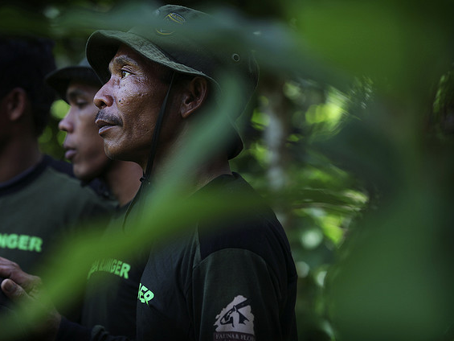

GOVERNANCE OF FORESTS INITIATIVE
Indicator Toolkit
Oslo Governance Forum
4 October 2011
CRYSTAL DAVIS
Institutions & Governance Program
World Resources Institute
Notes:
Photo: (Indonesia - ex-illegal logger turned forestry ranger) http://www.flickr.com/photos/dfid/4114996979/in/photostream/

Slide 2
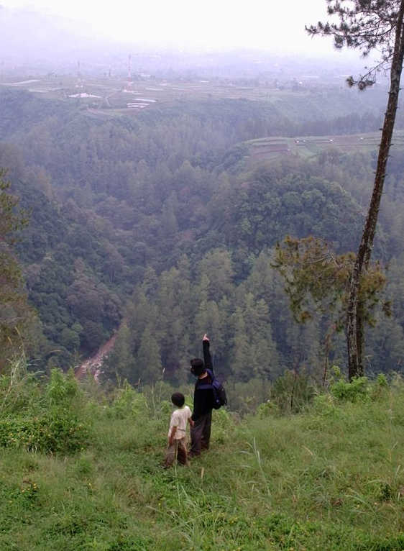
Outline
Methodology
Pilot phase
Lessons learned
Links to REDD+
Notes:
Photo: (Indonesia – forest/develop) http://www.flickr.com/photos/21372148@N00/458731562/

Slide 3
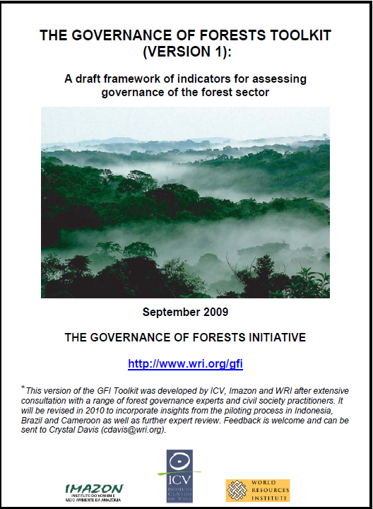
Qualitative
Comprehensive
Evidence-based
Adaptable

Slide 4
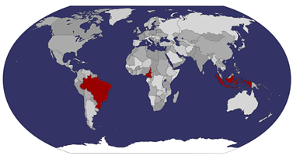
Pilot Phase

Slide 5
Indicator |  | Governance Assessment | Strengths | Weaknesses
Actors | FM2. Independence of forest management agencies | Weak | Clear codes of behavior for staff Transparent procedures for public tender | No clear criteria and transparent procedures for hiring and promotion, especially in the appointment of high officials No requirement of disclosure of interests No transparency of salaries
Rules | FM11. Clear and comprehensive policies to reduce deforestation and degradation | Moderate | Good quality information Main drivers of deforestation and degradation addressed Clear objectives Description of the means to achieve the objectives | Lack of definition concerning financial capacity Lack of clear authority for the implementation
Practices | FM21. Effective information systems as a basis for forest management | Weak | Comprehensiveness of the data in information systems Centralization of information Effective information sharing mechanisms | No regular updating mechanism Lack of precision and accuracy of information Underuse of information systems, especially in Pará
 | FM22. Public access to information about forest management | Moderate | Comprehensiveness of the on line information Useful format of accessible information Relevant language of accessible information Useful scale of accessible information | Lack of timely answer to public requests
 | FM23. Local community participation in forest management | Weak | Inclusion of community representatives in local forest meetings | Lack of financial or technical assistance programs Absence of adapted communication on forest related legislation Absence of communication mechanism between state and community
 | FM25. Effective management of protected areas and indigenous lands | Weak | Clarity as to what activities allowed and not allowed within the area | Lack of boundaries enforcement; Imperfections in the delineation Lack of access to adequate scientific and technical information Absence of comprehensive and appropriate management plan Lack of financial, human and logistical resources Absence of mechanisms to resolve disputes
Lesson Learned #1:
Comprehensive governance assessments can generate useful new insights, but there are trade offs between comprehensiveness and depth.

Slide 6
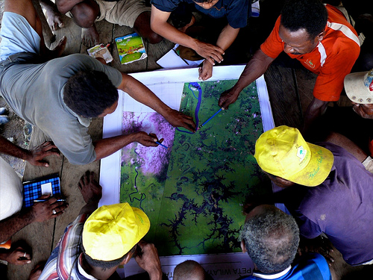
Lesson Learned #2:
Evidence-based governance assessments can create a “safe”
space for multi-stakeholder dialogue, particularly when the methodology
is transparent and credible.

Slide 7
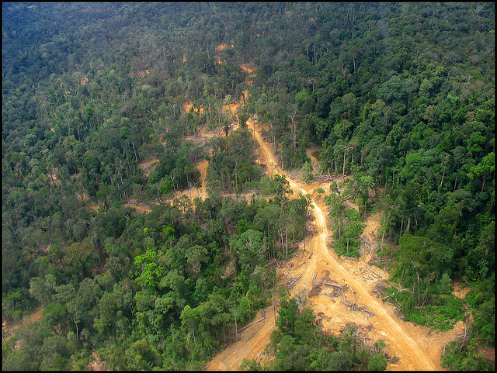
Lesson Learned #3:
Global methodologies can facilitate cross-country learning and enhance credibility, but they need to be flexible and support bottom-up approaches.

Slide 8
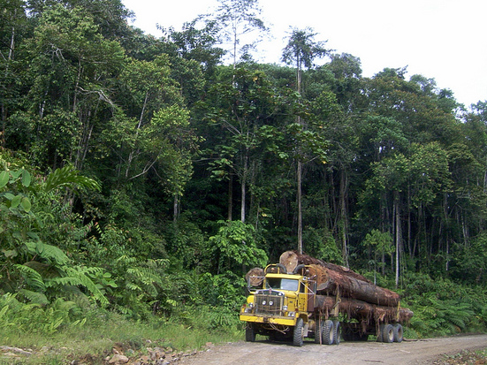
Lesson Learned #4:
Evidence-based assessments can be a tool for transparency and accountability, but collecting robust data is difficult. There is a need to share experiences and generate methodological guidance for governance data collection.
Notes:
Photo: (indonesia) http://www.flickr.com/photos/cifor/5655985105/in/photostream/

Slide 9
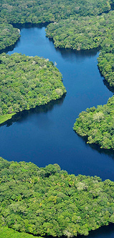
Links to REDD+
Increasing demand for information about forest governance
GFI can contribute
  A globally relevant and tested methodology
  A comprehensive menu of indicators
  Guidance on data collection and analysis
  Independent information generated by civil society

Slide 10
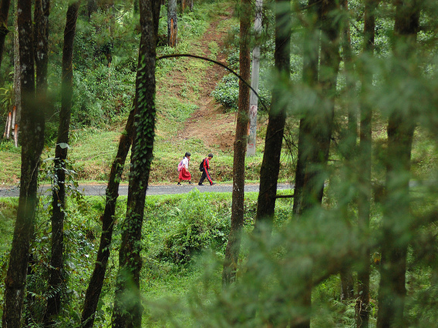
Crystal Davis cdavis@wri.org Institutions & Governance Program
World Resources Institute
wri.org/gfi
Notes:
PHOTO: (Indonesia) http://www.flickr.com/photos/cifor/5594698696/in/photostream/

