Slide 1
Vietnam National Policies in forest management and future direction
Regional Dialog
Bangkok, 11-12 November 2010

Slide 2
Introduction
Forests and forestland: 16.2 million ha (49%) were covered by various forest ecosystems with high biodiversity: tropical rain forest, sub-tropical forest, mangrove forest, Melaleuca forests
Forests are home to some 20 million people
Forests contribute significantly to environmental protection, biodiversity conservation, socio-economic development and poverty alleviation in rural forested areas;

Slide 3
Introduction
Vietnam is identified as one of the most severely affected by negative impact of climate change in the world;
GoV has strongly engaged in the international efforts to respond to climate change;
National Target Program to Respond to Climate Change is issued on 2nd Dec. 2008;
Vietnam is selected to be a pilot country of both the QuickStart Initiative of the UN-REDD Programme and the FCPF;

Slide 4
Wood processing Industry
A strong development in the industry and significant growth in the export turnover (the 5th after crude oil, garment, shoes and fishery);
export to more than 120 countries worldwide. In 2009, the 4 largest markets are the U.S. ($ 1.1 bill.), EU ($700 mill.) , Japan ($ 371.7 mil.) and China ($ 197.9 mill.) ;
Change in revenue: $0.6 bill. (2003) –$2.6 bill. (2009) and about $4 bill. (2011). Target $7 bill. (2020);
Shortage of raw material: 70-80% are imported (about 4-5 mill m3 per year);

Slide 5
Timber import and export trends
1999-2005
It is estimated that VN wood processing industry will need 10-12 mill m³ of round-wood by 2010, revenue of $3 billion

Slide 6
Forest Changes in last decades
Forest cover decreased from 43% (1943) to 27% (1990) BUT increased to 39.1% (2009)
Forest quality is continuously degraded;
Deforestation is till severe in the Central Highlands and southern provinces;

Slide 7
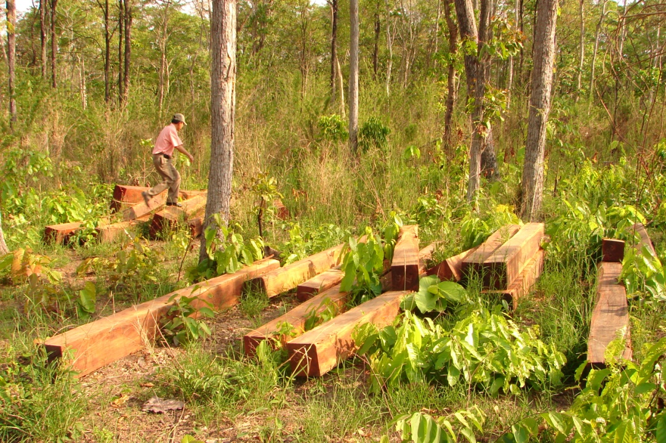
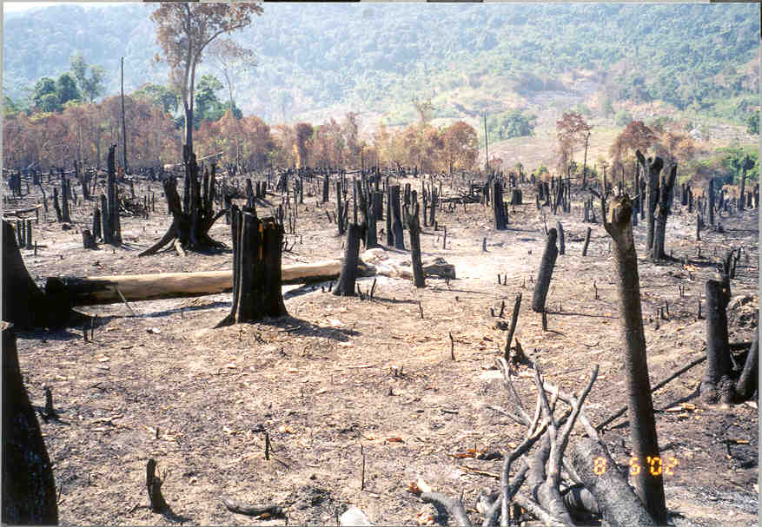
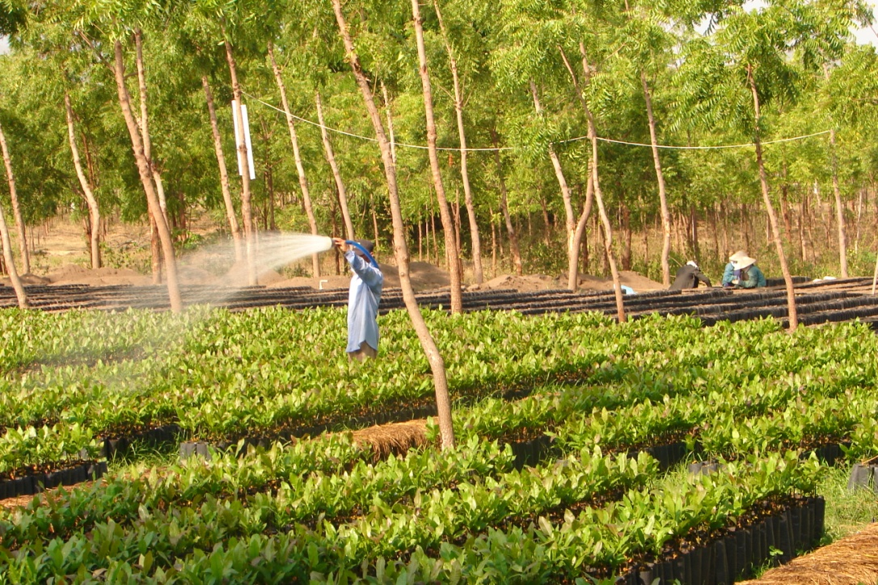
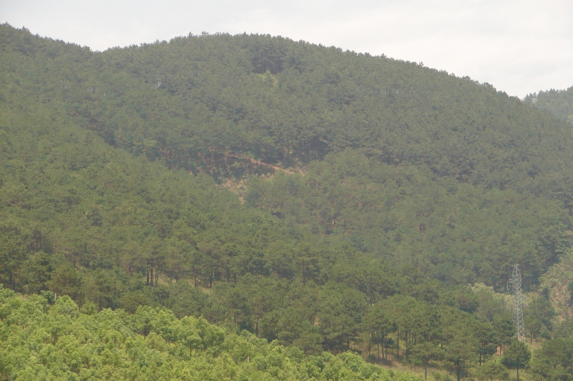
Contrast situations in different regions

Slide 8
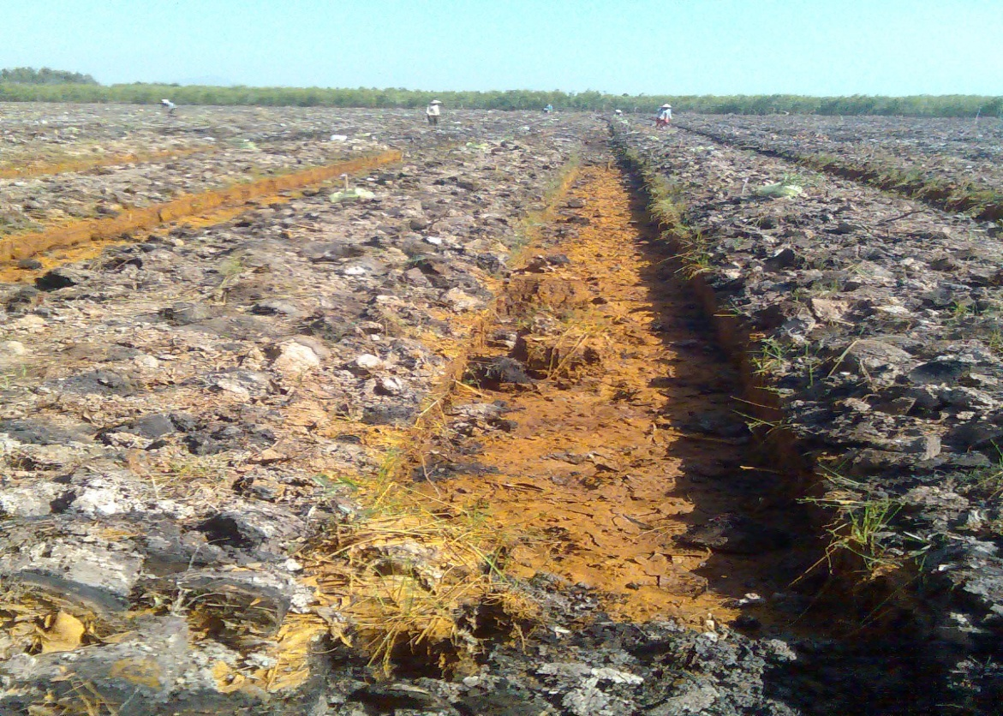
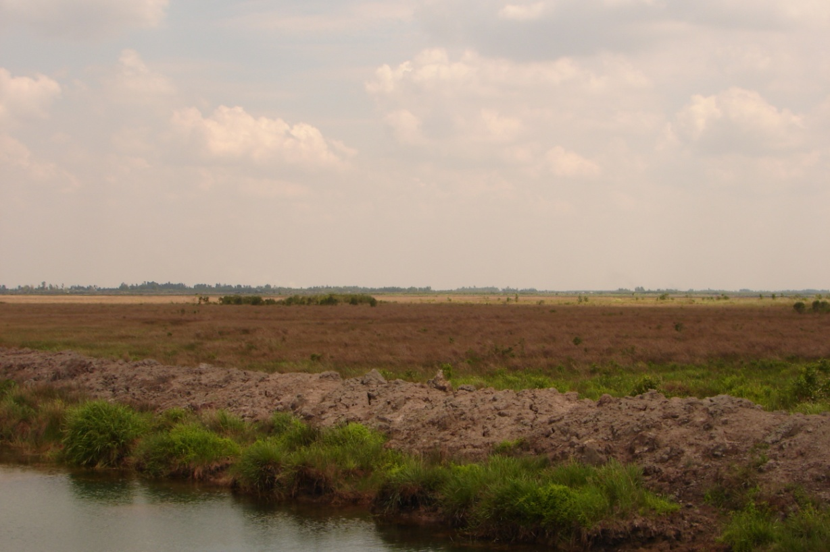
Conversion of peatland forests to agriculturally cultivated land and shriming farms causes huge CO2 emission and soil degradation

Slide 9
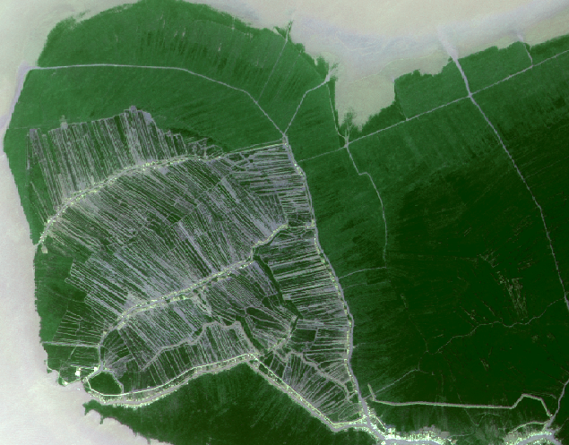
Conversion of Mangrove forest to shrimp farms in Ca Mau Peninsular

Slide 10
Major driving forces behind forest changes
Major causes of (gross) deforestation
  Conversion of forests into other land uses
  Unsustainable logging
  Infrastructural development
  Insufficient capacity in forest management, lack of law enforcement
Major causes of degradation
  Unsustainable logging (either legal and illegal)
Reasons of forest expansion
  Restricted timber harvest and raw timber export
  Forest allocation, investment of Gov (progs 327, 661, 147)and private entities in reforestation
  Increase in agricultural productivity (…)
  Poverty alleviation and livelihood alternatives
  Market demand

Slide 11
Forest-related Policies
Past and current policies:
  Forest land allocation since 1994
  Reforestation programs since early 1990s
  Harvest quota and a ban on raw timber export
  Privatization of SEFs & promotion of wood processing industry
  Pilot PES, re-zoning forests and Biodiversity
  FLEGT – Lacy Act: WWF, TRAFFIC, GFTN (USAID), EFI (EC), VN-German Forestry Program (GTZ)

Slide 12
Forest-related Policies
Policies are issued very soon:
  SFM for forest enterprises & Continuation of reforestation programs aimed to provide 80% raw materials for wood processing industry by 2020;
  Nation-wide PES implementation, including forest C sequestration and conservation
  New national program on forest management and protection
  New cycle of NFI with REDD+ elements (2010-2020)

Slide 13
Forest-related Policies
Regional and international cooperation:
  Target of a full VPA on FLEGT with EC by 2012
  Public awareness on Lacy Act and FLEGT
  SFM agreement with ASEAN
  Support for bringing the declaration of the ASEAN on CC at the 16th summit;
  Agreement with Lao DPR on cross-border illegal logging control, Climate change
  On-going discussion with Cambodia

Slide 14
National Institutional Arrangements
Multi-sectoral approach not only forestry sector
REDD Strategy supports for REDD+ and Non-REDD activities – SFM (UN-REDD, EC, USAID)
Current and future arrangement for the implementation of REDD+ : National Steering Committee for REDD+ and chaired by Deputy PM
Proposal on establishment of National Office for FLEGT

Slide 15
Thank you very much for your attention!

