Slide 1
How the UN-REDD Programme supports country approaches to safeguards
San Salvador, 13th August 2013
Robert Munroe, UNEP-WCMC

Slide 2
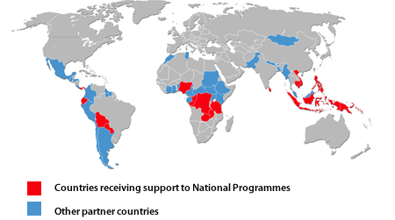
UN-REDD Programme
UN collaborative initiative (FAO, UNDP, UNEP) supporting nationally-
led REDD+ readiness processes in 47 countries:
  Design and implementation of UN-REDD National Programmes (16 countries)
  Targeted support for partner countries

Slide 3
UN-REDD Global Work Areas
  Global work on common approaches, analyses, methodologies,
  tools, data and best practices:
MRV and monitoring
National governance systems
Accountable management of REDD+ funding
Participatory decision making, strategy development and implementation
Safeguards and multiple benefits
Green economy and REDD+
Knowledge management

Slide 4
Objectives of UN-REDD Work on Safeguards
To address social and environmental issues in UN-REDD National Programmes and other UN-REDD funded activities
To support countries in developing country approaches to safeguards in line with the UNFCCC

Slide 5
Themes of UNFCCC ‘Cancun’ Safeguards
Broad statements which cover:
  Consistency with national objectives and international undertakings
  Transparent forest governance structures
  Respect for indigenous peoples and local communities
  Effective participation of relevant stakeholders
  Conservation of natural forests and biodiversity
  Enhancement of social and environmental benefits
  Permanence of REDD+ actions
  Displacement of emissions

Slide 6
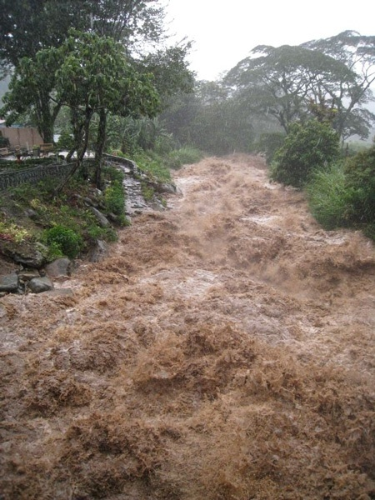
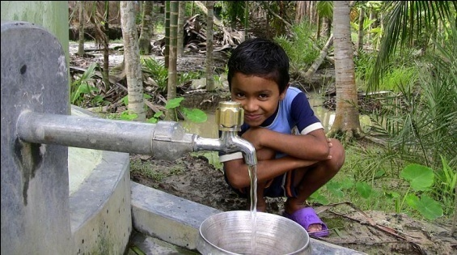

Safeguards
REDD+ safeguards are needed to reduce potential risks
from REDD+ and enhance potential benefits
Vary with REDD+ activity and spatially
multiple benefits work

Slide 7
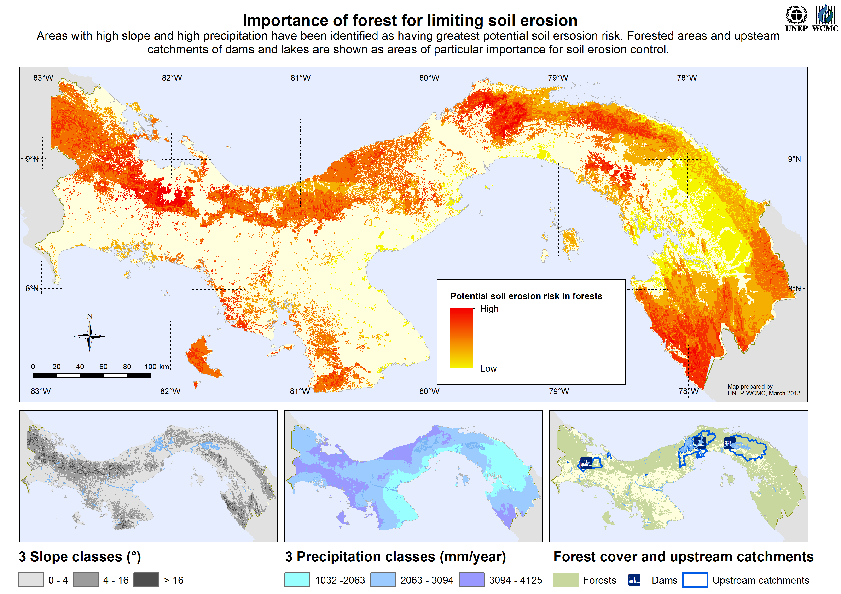

Slide 8
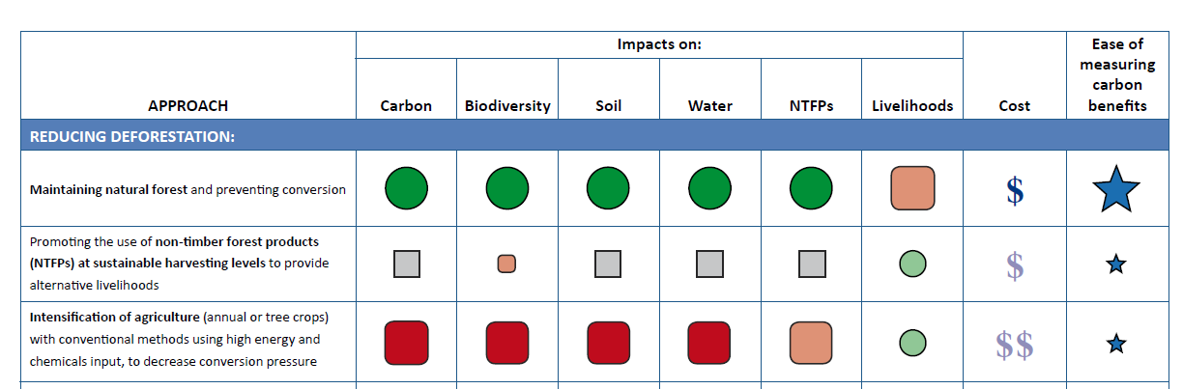
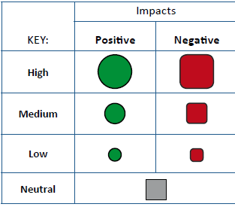
REDD+ activity benefits and risks

Slide 9
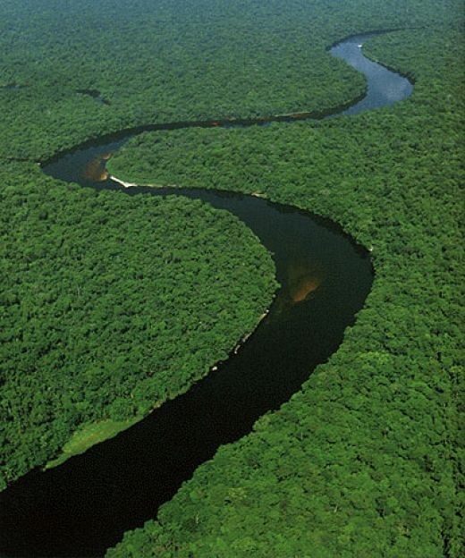
Development of a Country Approach to Safeguards
No fixed, linear path
Steps to take will depend on:
  what is in place
  objectives defined by the country
Throughout the process, effective
participation will be essential

Slide 10
Core Elements of a Country Approach to Safeguards
Institutions
Processes and Procedures
1.Identification/ development of relevant safeguards to be addressed and respected:
Policies, laws and regulations (PLRs), either existing or those created for REDD+
2. Safeguard Information System (SIS):
Existing or new indicators, methodologies for collecting information, and framework for provision of information

Slide 11
Generic steps for development of a country approach to safeguards
1.Gap analysis of existing systems
2.Development of indicators
3.Data collection/ information provision approaches
Institutions
Safeguards Information System
1. Defining the goals of the safeguards approach
2. Gap analysis of existing social/ environmental PLRs and procedures
3. Creation of new PLRs and procedures (if necessary)
Policies, Laws and Regulations
Processes and procedures

Slide 12
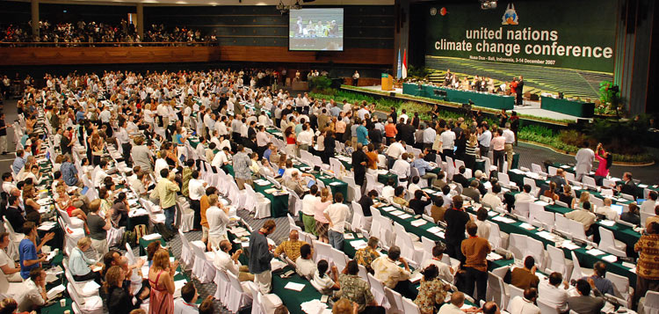

Defining the goals
Why is the REDD+ safeguards approach being established?
Interpret UNFCCC decision from country perspective and links to other processes
Consideration of social and environmental risks and benefits of activities from initial REDD+ strategy
Responding to other objectives, e.g. donor or investor policies
UN-REDD Social and Environmental Principles and Criteria (SEPC) can help add
detail to the broad principles of Cancun Safeguards

Slide 13
Social and Environmental Principles
1 . Apply norms of democratic governance, as reflected in national
commitments and Multilateral Agreements
2. Respect and protect stakeholder rights in accordance with
International obligations
3. Promote sustainable livelihoods and poverty reduction
4. Contribute to low-carbon, climate-resilient sustainable
development policy, consistent with national development
strategies, national forest programmes, and commitments under
international conventions and agreements

Slide 14
Social and Environmental Principles
5. Protect natural forest from degradation and/or conversion
6. Maintain and enhance multiple functions of forest including
conservation of biodiversity and provision of ecosystem services
7. Avoid or minimise adverse impacts on non-forest ecosystem
services and biodiversity

Slide 15
SEPC Principle 4 – policy coherence
REDD+
Adaptation
Other mitigation
National climate policy
Criterion 14 – Ensure consistency with and contribution to national climate policy objectives, including those of mitigation and adaptation strategies and international commitments on climate

Slide 16
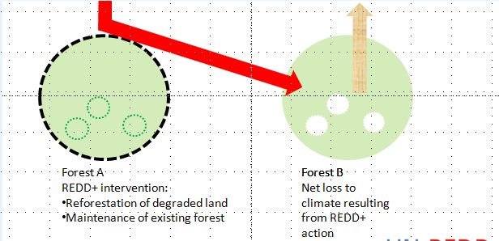
SEPC Principle 5 – natural forest degradation or conversion
Criterion 20 – Avoid or minimise indirect land-use change impacts of REDD+ activities on forest carbon stocks, biodiversity and other ecosystem services

Slide 17
UN-REDD Tools to Support Country Approaches to Safeguards
Defining goals of the country safeguards approach
UN-REDD tools
SEPC
UN-REDD/Forest Carbon Partnership Facility Stakeholder Engagement Guidelines
UN-REDD FPIC Guidelines
How tool can contribute
Detailed criteria that can be used to ‘unpack’ the Cancun safeguards
Guidance on how participation of stakeholders can be ensured in UN-REDD activities, including how to apply the principle of free, prior and informed consent (FPIC); could be used by countries in the development of REDD+ PLRs
Framework for applying the principle of FPIC at community and national levels

Slide 18
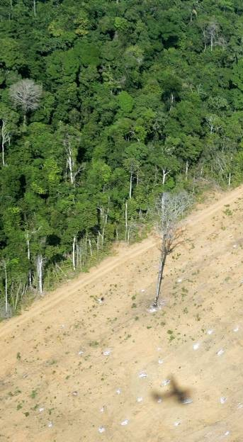
Defining/developing policies, laws, and regulations (PLRs)
Gap analysis of existing PLRs
What PLRs already address goals?
What is the effectiveness of the existing system – what processes/institutions are missing?
SEPC Benefit and Risks Tool (BeRT) draft revision:
When considering how PLRs relate to reducing the
displacement of emissions:
Are there any agreements with neighboring countries on
export of forest products?

Slide 19
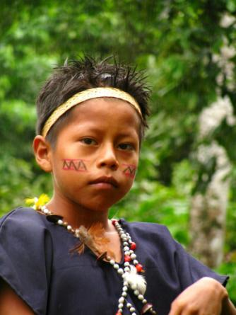
Defining/developing policies, laws, and regulations (PLRs)
Development of new PLRs
What PLRs and associated processes and institutions need to be in
place to achieve the goals?
e.g. few countries have clear policies on how
carbon rights are defined and protected

Slide 20
UN-REDD Tools to Support Country Approaches to Safeguards
Defining or developing safeguard policies, laws and regulations –
Gap analysis of existing PLRs
UN-REDD tools
Benefit and Risks Tool (BeRT)
Participatory Governance Assessment
Draft Guidance on Conducting REDD+ Corruption Risk Assessment
How tool can contribute
List of questions in order to assess existing PLRs
Process for participatory evaluation of governance systems relevant to REDD+
Detailed framework for assessing corruption risks in REDD+

Slide 21
UN-REDD Tools to Support Country Approaches to Safeguards
Defining or developing safeguard policies, laws and regulations – Development of
new PLRs
UN-REDD tools
Free, Prior and Informed Consent (FPIC) Guidelines
Guidelines on Strengthening/Establishing National-Level Grievance Mechanisms
Participatory Law Development (LEG-REDD+)
How tool can contribute
Framework for applying FPIC at community and national levels; primarily designed for UN-REDD activities but could be adopted in REDD+ PLRs
Guidance on how to assess and strengthen existing PLRs and institutional capacity to address REDD+ related grievances
Participatory approach for formulating legal and policy reforms and drafting new PLRs in response to REDD+

Slide 22
Generic steps for development of a country approach to safeguards
1.Gap analysis of existing systems
2.Development of indicators
3.Data collection/ information provision approaches
Institutions
Safeguards Information System
1. Defining the goals of the safeguards approach
2. Gap analysis of existing social/ environmental PLRs and procedures
3. Creation of new PLRs and procedures (if necessary)
Policies, Laws and Regulations
Processes and procedures

Slide 23
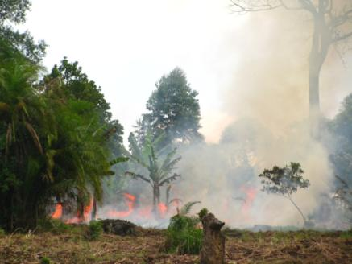
Safeguard Information System (SIS)
Approach for collecting and providing information on how REDD+ safeguards are being addressed and respected throughout REDD+ implementation
Build on existing systems
Development ideally follows goal setting and gap analysis of PLRs

Slide 24
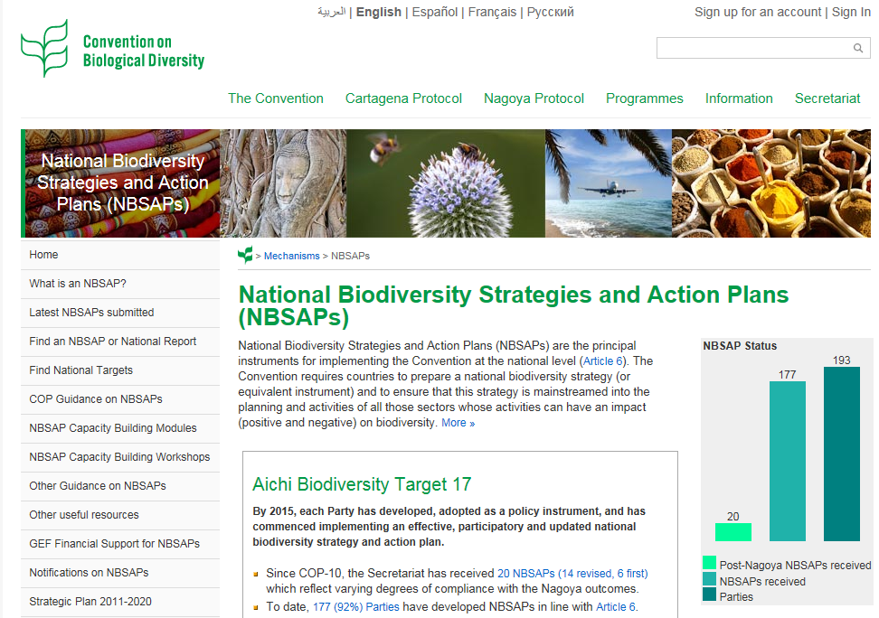
SIS – Gap analysis of existing systems
Review for:
Information sources and systems related to each of the safeguards
  Indicators
  Data collection and measurement approaches
Other systems supporting national implementation of other international conventions (CBD - NBSAPs)
Quality of sources/systems
Gaps
What kinds of new institutions/processes will be necessary?

Slide 25
SIS – Decisions to be taken on data collection
What data to collect (including scale considerations)
Methods to be used (e.g. household surveys; participatory approaches, such as participatory biodiversity monitoring)
Who will collect data / institutional roles
Frequency of data collection
How will information be stored
Provision of information framework (UNFCCC, country level, key stakeholders)
Quality assurance / internal evaluation process

Slide 26
UN-REDD Tools to Support Country Approaches to Safeguards
SIS – Development of indicators
UN-REDD tools
Participatory Governance Assessment
Framework for assessing and monitoring forest governance
How tool can contribute
Participatory approach for developing governance indicators for REDD+ schemes
Tool for designing robust and comprehensive sets of governance indicators

Slide 27
UN-REDD Tools to Support Country Approaches to Safeguards
SIS – Methodologies for collecting information
UN-REDD tools
Draft Guidelines for monitoring the impacts of REDD+ on biodiversity and ecosystem services
Draft manual on the collection of forest governance data
How tool can contribute
Draft guidelines useful for establishing aspects of SIS relevant to biodiversity and ecosystem services
Practical considerations, methods and available resources for collecting governance data

Slide 28
Examples of UN-REDD support to countries on safeguards
‘Targeted support’ activities in 2013
Costa Rica
Reconciling the needs of different safeguard approaches (e.g. UN-REDD, Forest Carbon Partnership Facility, REDD+ Social and Environmental Standards) within the design of a single safeguard information system
Activities include:
  Analysis of different safeguard approaches
  Stakeholder analysis
  Review of PLRs
  Developing indicators and establishing information sources

Slide 29
Examples of UN-REDD support to countries on safeguards
Ecuador (National Programme)
Proposal for a multiple benefits monitoring system as part of a national System of Information and Monitoring for Safeguards and Multiple Benefits
Activities include:
  National and sub-national consultation workshops on identification and prioritization of multiple benefits and risks
  Identification of information requirements for different safeguards
  Identification of potential indicators for priority benefits and risks

Slide 30
Examples of UN-REDD support to countries on safeguards
‘Targeted support’ activities 2013
Peru
“Design and initial implementation of a participatory monitoring
system for social and environmental safeguards.” Capacity building for
indigenous peoples on monitoring
Argentina
Reconciling the needs of different safeguard approaches (e.g. UN-
REDD, FCPF) within the design of a single safeguard information
system. Consultations in four different regions will take place.

Slide 31
Examples of UN-REDD support to countries on safeguards
Tanzania (National Programme)
Linkages between the national forest inventory and the development of spatial analyses to inform REDD+ environmental safeguards and development of an Safeguard Information System (SIS)
Activities include:
  Analysis of current forest inventory methodology to identify how the information collected can feed into an SIS
  Analysis of existing forest inventory data to derive spatial information on the potential for environmental benefits from REDD+

Slide 32
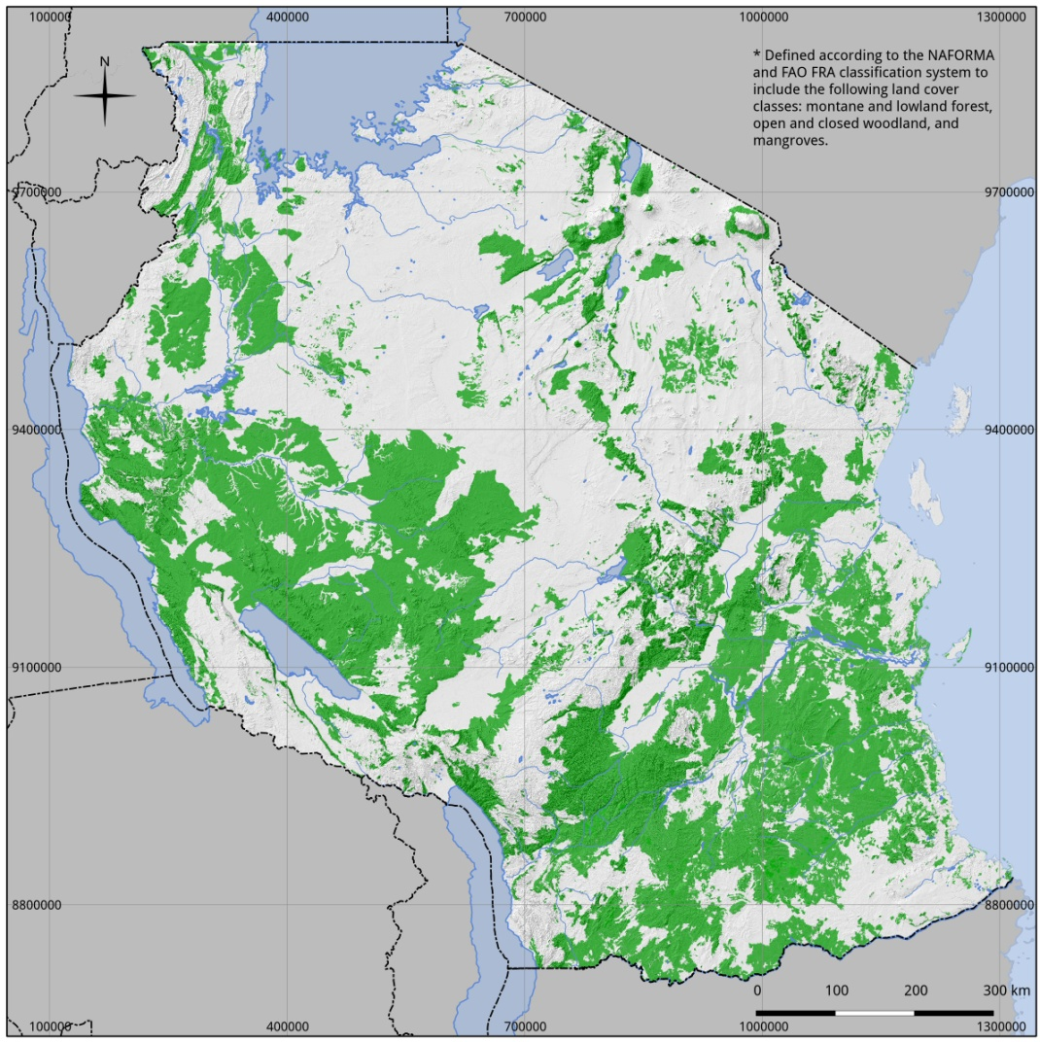
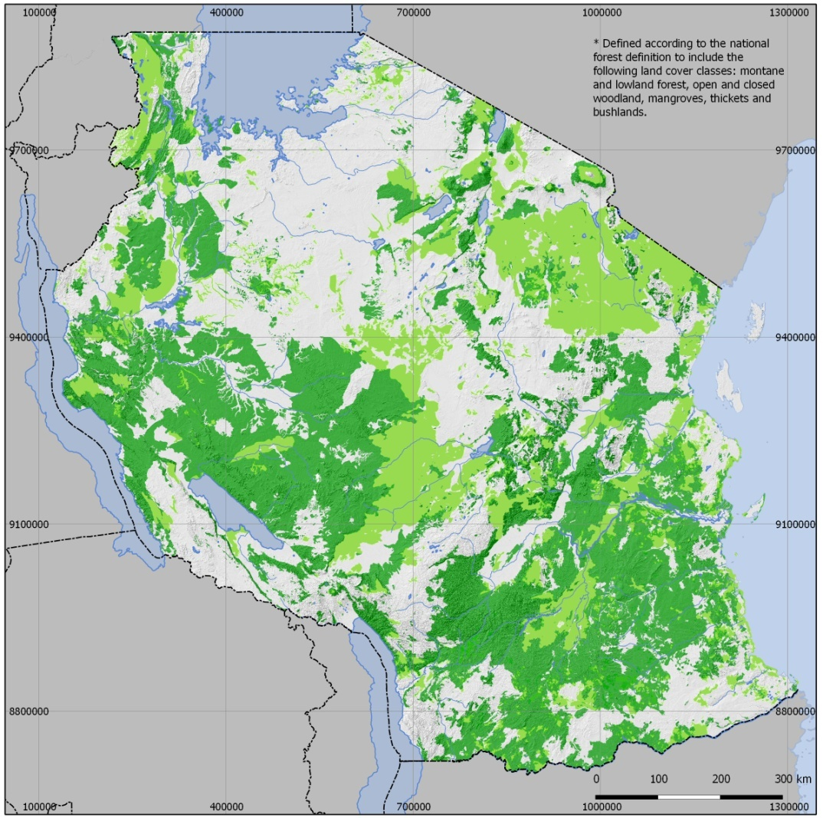
Tanzania
Natural forest estimation
National definition of forest
(10% canopy cover + 2 m height)
Montane & lowland forest
Woodland
Mangrove
Bushland (>2m)
Thickets (>2m)
FAO FRA
(10% canopy cover + 5 m height)
Montane & lowland forest
Woodland
Mangrove
Map source: Derived form landcover classes in NAFORMA landuse landcover map 2010.

Slide 33
Summing up…
Countries carrying out REDD+ will need to develop a country approach to safeguards consistent with UNFCCC guidance and that satisfies all of the country’s priorities
The UN-REDD Programme has developed general guidance for creating country approaches
For each of these steps, tools and approaches have been developed, which are available to all countries online
Partner countries to the UN-REDD Programme can also receive financial and technical support on REDD+ safeguards and multiple benefits
UN-REDD LAC Regional Workshop including further discussion on safeguards

Slide 34
Robert Munroe
robert.munroe@unep-wcmc.org
Muchas gracias
Sitio web: http://www.un-redd.org

