Slide 1
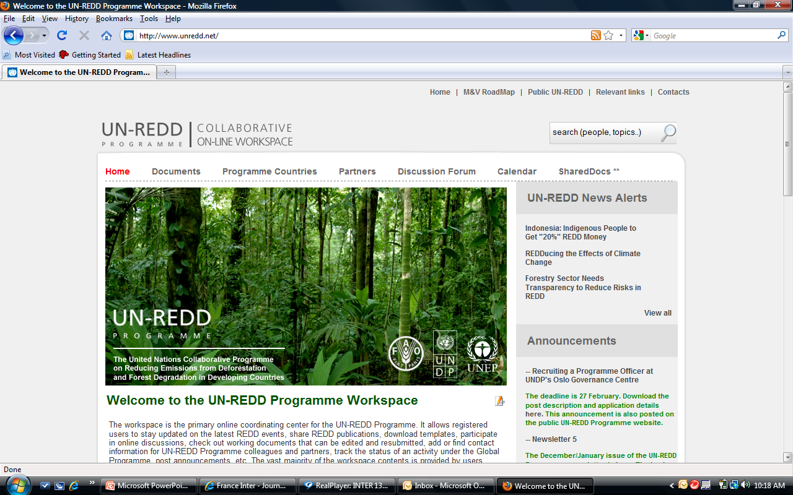
UN-REDD Online Collaborative Workspace
Why, who, how?
Estelle Fach
10 Mars 2010, FAO, Rome

Slide 2

The Workspace
www.unredd.net
Collaborative, flexible knowledge repository and creation platform
Linkage to other platforms
Tool for
  Partnership (3 agencies + Secretariat)
  Other stakeholders (donors, partners, national counterparts)

Slide 3
Why ?
Collaborative partnership
Accountability system
Community of Practice
Knowledge creation

Slide 4
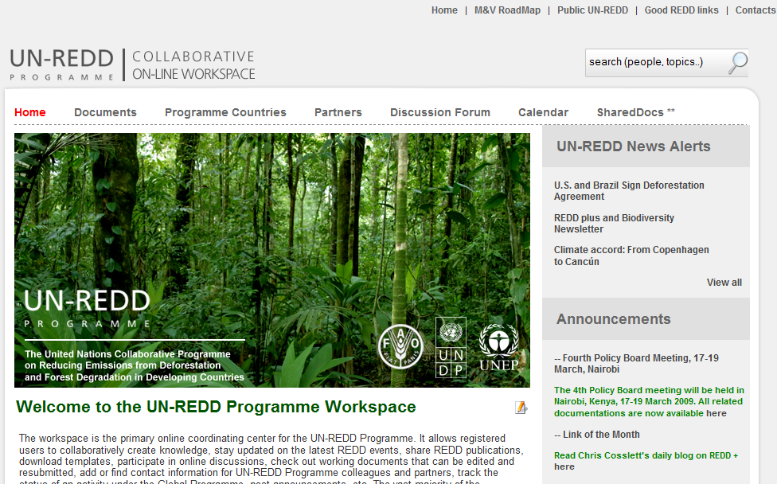
What ?

Slide 5
Most popular, least popular
360 users
Membership and stable usage
Documents
  Global : 404
  National : 277
  Policy Boards : 260
  Publications : 93
Calendar
SharedDocs
Country pages
Partners
Country wiki pages
Discussion forum
Notes:
On average 20-30 users a day
Visits: high 1300 a month (September), average 550 since May
(Norway : 28 visits per month over the last 5 months)
Countries visiting most: (Thailand), Indonesia, Viet Nam, Panama - language
Mission reports: DRC 986, Tanzania 796, Bolivia 676
Request to participate : 1663

Slide 6
Who?
 | HQ | Regional & country | Partners | National Counterparts
Global Programme | Responsible | Information | Information | Information
National programme | Accountable | Responsible | Mostly Information | Consultation
Calendar | Responsible | Responsible | Responsible | Information
Contacts | Responsible | Responsible | Responsible | Responsible
Partners pages | Information | Information | Responsible | Information
Wiki pages | Responsible | Responsible | X | X

Slide 7
SWOT
Strengths
Adaptable
Flexible
Convivial
Complete
Secure
Weaknesses
Speed
Compatibility & linkages
Language
Opportunities
Reaching critical mass
Trainings
Knowledge Sharing picking up
Disclosure Policy
New platforms (Teamworks, REDD Desk, etc)
Threats
Incomplete uptake
(lack of) sharing culture

Slide 8

Moving forward
Online Sharing
  Thematic Spaces (MRV etc)
  Country workspaces and websites
  Facilitating linkages
    To web site
    To country offices website
    To other knowledge platforms

Slide 9
Thanks and..
What’s missing?
How will you use it?
Encouraging others

