Slide 1
Introduction to REDD+, status in Asia-Pacific, and the UN-REDD Programme
Tim Boyle
UN-REDD Regional Coordinator
UNDP Regional Centre,
Bangkok

Slide 2
Outline of Presentation
What is REDD+?
What is the UN-REDD Programme?
Status of REDD+ readiness in Asia/Pacific

Slide 3
What is REDD+?
Definition:
Reducing Emissions from Deforestation and Forest Degradation; and the role of conservation, sustainable management of forests and enhancement of forest carbon stocks
+ = conservation, SFM and enhancement of stocks

Slide 4
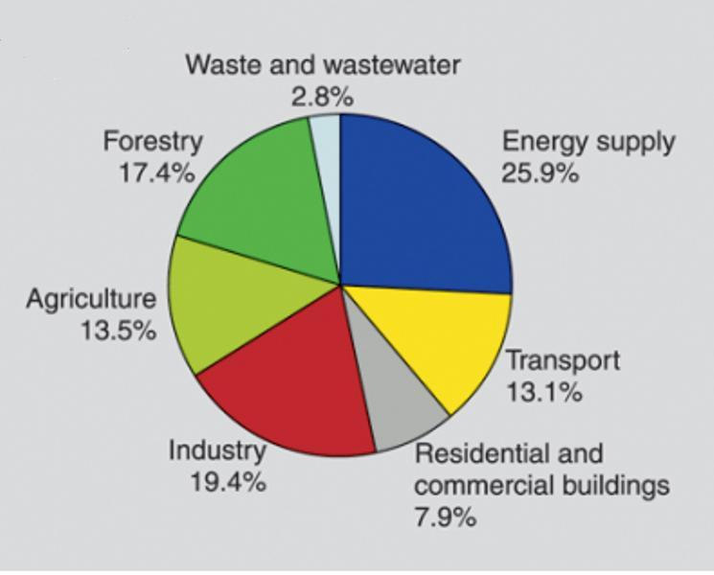
What is REDD+?
Justification:
Emission from forests significantly higher than from transportation; virtually equal to industry

Slide 5
What is REDD+?
How it will work:
Reference level
Credits for conversion to revenues (market or fund)
Emissions
Actual
Time

Slide 6
What is REDD?
Rationale:
Relative to other ways of reducing emissions, reducing emissions from the forest sector is:
  Cost effective – cost of reaching 2°C goal reduced by up to 50% globally if forest sector included
  Immediate impact – emission reduction techniques and approaches well known and available
Protecting remaining tropical forests has huge co-benefits
  Biodiversity conservation
  Improved livelihoods
  Adaptation to climate change

Slide 7
What is REDD? Conceptual Framework
CO₂
Environmental Safeguards, including:
Social Safeguards, including:
MRV/FIS
CO₂
No conversion of natural forests
Capture of multiple benefits
Avoidance of displacement and reversals
Stakeholder participation
Respect for rights of IPs (including FPIC)
Transparent governance (including anti-corruption)
CO₂
Policies and Measures
National/International Policy and Institutional Framework
Benefit distribution
National REDD+ Strategy
Social Safeguards, including:
Stakeholder participation
Respect for rights of IPs (including FPIC)
Transparent governance (including anti-corruption)
National REDD+ Strategy

Slide 8
What is REDD?
UNFCCC Status
Cancun Agreement (Dec. 2010): basic structure and safeguards
Note: Safeguards do not mention “anti-corruption” explicitly, but do include “Transparent and effective national forest governance structures”
Three phases: (1) Development of strategies/action plans; (2) Implementation and further capacity building; (3) results-based actions with MRV

Slide 9
What is REDD?
UNFCCC Status
Discussions on-going on market vs fund vs mixed; and on public vs private sources of funding
Likely to be a window under the Copenhagen Green Fund
Methodologies (e.g. for MRV) under development
Learning lessons from the past – e.g., CDM

Slide 10
What is REDD+? How will it work on the ground?
Very high
Boundary of administrative planning unit (e.g., province, district)
REDD planning may take place at several spatial scales
High
This simplistic example demonstrates the principles of mainstreaming REDD into socio-economic planning
First it is necessary to know where the forest is!
Medium
Forest
Low
Then it is necessary to know where the carbon is!
Non-forest

Slide 11
What is REDD+? How will it work on the ground?
Deforestation:
Driver = Ag. Expansion (coffee, pepper)
Opportunity cost $100/ha
Degradation:
Driver = Unsustainable logging
Opportunity cost $220/ha
Then it is necessary to know where the deforestation and degradation is occurring, the drivers in each case, and opportunity costs of alternative land uses
Deforestation:
Driver = Industrial crops (rubber, oil palm)
Opportunity cost $2300/ha

Slide 12
What is REDD+? How will it work on the ground?
Then you need to consider other development priorities
New road
Option A
Option B
The 5-year socio-economic development plan calls for the construction of a new road from an urban centre to the border with the neighbouring administration. Two equal cost options have been identified
Optimum location for new reservoir
Major city
A new reservoir is required to meet the increasing demands for water and/or to generate hydro-power

Slide 13
What is REDD+? How will it work on the ground?
Also helps to identify preferred socio-economic development options
Super-imposing all this information yields priorities for REDD interventions …
New road preferred option (equal cost, but lower carbon density)
First priority for interventions to reduce deforestation
(REDD revenues can counter drivers of deforestation)
First priority for interventions to reduce degradation
(High and medium carbon density area)
Also priorities for NO REDD action! …
Emissions from loss of forest in creation of new reservoir should be incorporated into REL
No immediate plans to address deforestation (socio-economic benefits of conversion outweigh REDD benefits)

Slide 14
What is REDD+? How will it work on the ground?
Project 1 (Financial investment company)
Main orang-utan habitat
Project versus Planning Approach:
If a project-based approach:
Project 2 (NGO)

Slide 15
What is REDD+? How will it work on the ground?
Intervention 1
Main orang-utan habitat
Project versus Planning Approach:
If a planning-based approach:
Intervention 2

Slide 16
What is REDD+? How will it work on the ground?
Model | Pros | Cons
Project developer-led: | Quick and easy to implement Likely to attract investment | Not very efficient in conserving carbon Problems with ensuring safeguards and rights Not able to effect changes in enabling conditions Reduced benefits to local stakeholders Potential for conflict among those communities with and without projects
Government-led, planning based: | More efficient in conserving carbon Can assure systematic approach to application of safeguards and rights Can ensure appropriate changes in enabling environment Greater benefits to local stakeholders Risk of community conflict reduced | Requires greater initial investment, and therefore slower start-up May not be able to attract initial investment

Slide 17
What is UN-REDD?
Collaborative programme: FAO/UNDP/UNEP (One-UN)
Launched September 2008
To help countries and the international community gain experience with REDD
Contribution to the UNFCCC process
Coordinated with other initiatives, e.g., FCPF

Slide 18
What is UN-REDD?
Quick Start: Two components:
1. National Programmes
2. Global Programme
Capacity building for readiness
35 countries (currently, 13 with national programmes)
$4-6 million per country
Guidelines, advice, regional/ international dialogue, analyses
⇒ that support country action
⇒ that support the UNFCCC process on a global scale

Slide 19
What is the Status in Asia/Pacific?
For example, REDD+ Strategies (or similar) now available for:
Indonesia, Philippines, Viet Nam, Fiji

Slide 20
What is the Status in Asia/Pacific?
UN-REDD Programme has 12 partner countries, and a 13th (Myanmar) has applied

Slide 21
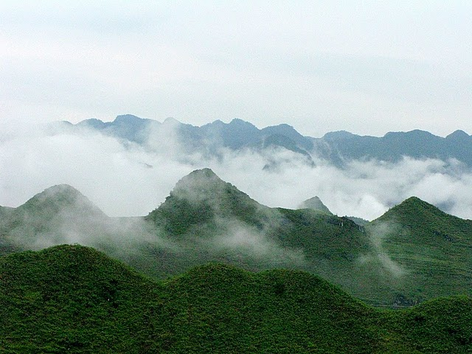
What is UN-REDD?
Status of Country Programmes
Country | UN-REDD member | UN-REDD funding | FCPF member | Major bilateral funding
Bangladesh | ✓
Bhutan | ✓
Cambodia | ✓ | ✓ | ✓
Fiji |  |  |  | ✓
Indonesia | ✓ | ✓ | ✓ | ✓
Mongolia | ✓
Nepal | ✓ |  | ✓ | ✓
Pakistan | ✓
PNG | ✓ | ✓ | ✓ | ✓
Philippines | ✓
Solomon Islands | ✓ | ✓
Sri Lanka | ✓ | (✓)
Thailand |  |  | ✓
Vanuatu |  |  | ✓
Viet Nam | ✓ | ✓ | ✓ | ✓

