Slide 1
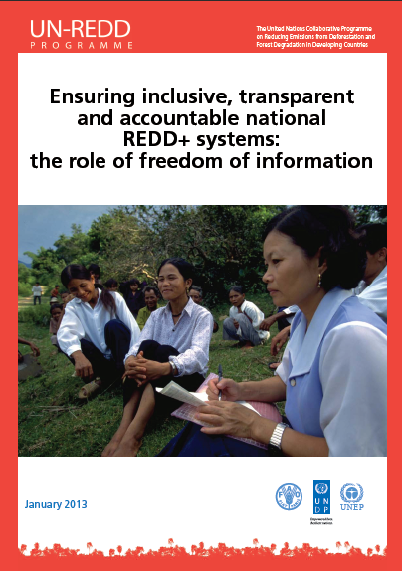
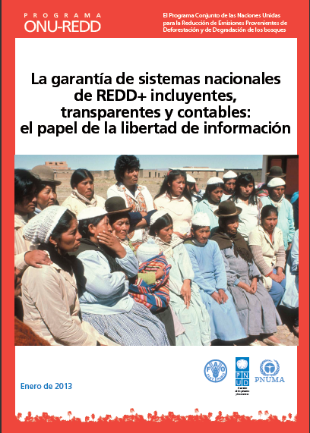
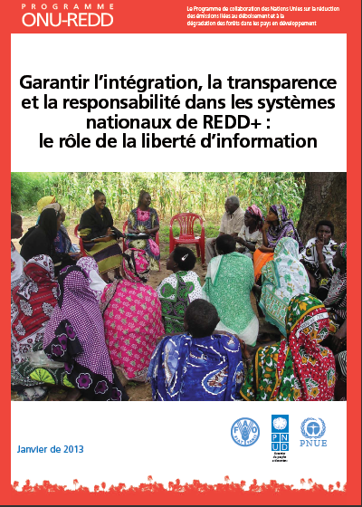
Participation, transparency, accountability: The role of freedom of information in REDD+
Key messages - May 2013

Slide 2
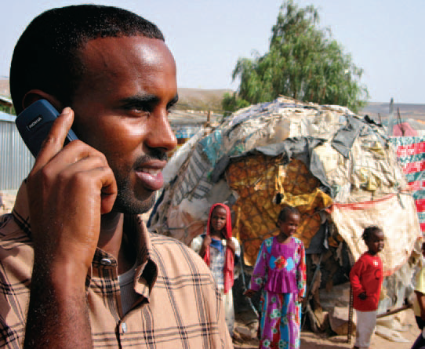
How fundamental is access to REDD+ information?
Access to information (A2I) is a prerequisite for transparency, accountability and meaningful engagement of stakeholders, all underpinning the success of REDD+
It is part of human rights, anti-corruption and environmental international conventions and treaties to which the overwhelming majority of REDD+ countries have committed
Systems to provide information about safeguards are called for in the Cancun Agreements

Slide 3
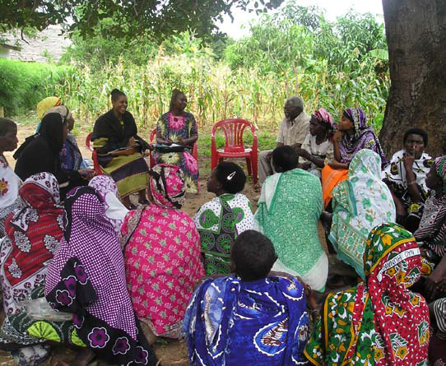
Information about …what ?
  How REDD+ works and how it will affect local and indigenous communities
  What funding is received for REDD+ and how it is used
  Which government agencies, non-governmental organizations or representatives of the private sector are legitimate intermediaries or interlocutors
  How are decisions made, including on land tenure, benefit sharing and selection of demonstration sites
  What are the (predicted or observed) environmental and social impacts of REDD+ activities

Slide 4
Information about what ? (c’td)
  How the right to free, prior and informed consent is implemented
  How funds or benefits flow from the national to the local level – including the amounts, frequencies and beneficiaries
  What are the methods, data and assumptions that underlie results-based estimates
  How safeguards are addressed and respected
  What are REDD+ related legal rights, such as carbon rights when/if they are developed, and what the modalities are for exercising them

Slide 5


How ? Good practices in REDD+ countries developing and implementing A2I laws
  Make most of the information available proactively rather than by request
  Ensure the format and languages are adapted to different stakeholders : publishing online in national language(s) is rarely sufficient
  Have dedicated information officers accountable for information flows
  Set clear time limits and low or no fees to access information
  Organize awareness campaigns to empower civil society on how to access and request information
  Check the effectiveness of information channels: monitor how information is used, when, and by who

Slide 6
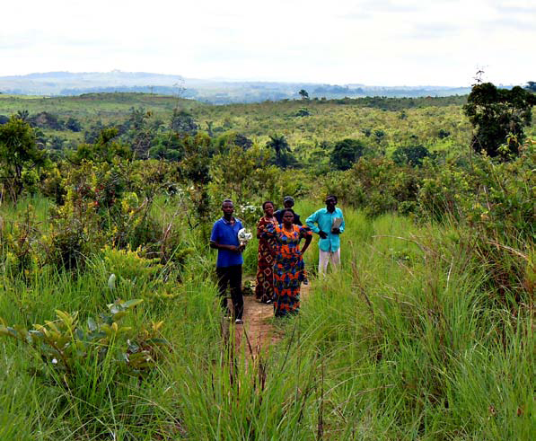
Experiences in REDD+ countries
Half of REDD+ countries have A2I laws…
.. but their application to climate change, forests and REDD+ varies widely
All countries preparing for REDD+ have Information, Education and Communications plans that constitute a basis for A2I
Countries are exploring innovative online systems : REDD+ registries, National Forest Management systems, REDD+ information web sites, REDD+ online listserv, discussion fora…

Slide 7
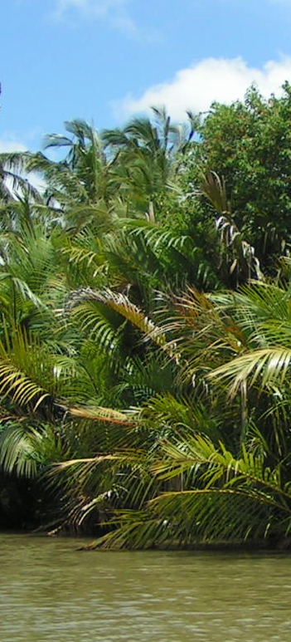
What can REDD+ countries do ?
Examine their obligations under national A2I laws for REDD+
Develop plans, with stakeholders, to define what information is needed when and in which format
  With clear roles and responsibilities and dedicated personnel
  Learning from their own experience on how information reaches (or not) stakeholders
Use best practices in the implementation of A2I laws to inform safeguard information systems

Slide 8
What (else) can REDD+ countries do ?
Establish transparency platforms that allow for feedback : web-based, cell-phone based, posters, institutionalized dialogues, regular town hall meetings etc
REDD+ information resides (or will) with various government, civil society and private sector stakeholders: coordinated efforts to avoid fragmentation of information are necessary

Slide 9
Access to information in [country]
If Cameroon, Colombia, DRC, Ecuador, Guatemala, Indonesia, Kenya, Mexico, Peru, or the Philippines : Please consult the report
If another UN-REDD partner country, please contact estelle.fach@undp.org: short A2I analyses are available upon request

Slide 10
How can UN-REDD help?
Access to information laws, when they exist in a REDD+ country, are part of legal preparedness for REDD+
Targeted support is available , e.g. to conduct national consultations to answer questions on what information, when, to whom and how
Technical inputs can be offered on draft regulations/measures on access to REDD+ information
Support to the development of SIS can include technical inputs to make sure safeguards information reaches the right stakeholders in the right timeframe

Slide 11
For questions please contact estelle.fach@undp.org
Access the report (right click and select “open hyperlink”):
English: full report // executive summary // press release
Français : étude entière // résumé
Español : informe // resumen

