Slide 1
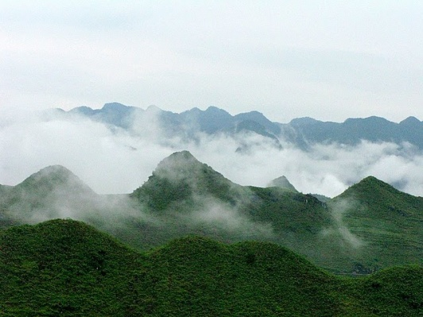

Survey Results and Introduction to Group-Work
Tsegaye Lemma
Anti-corruption specialist, UNDP

Slide 2
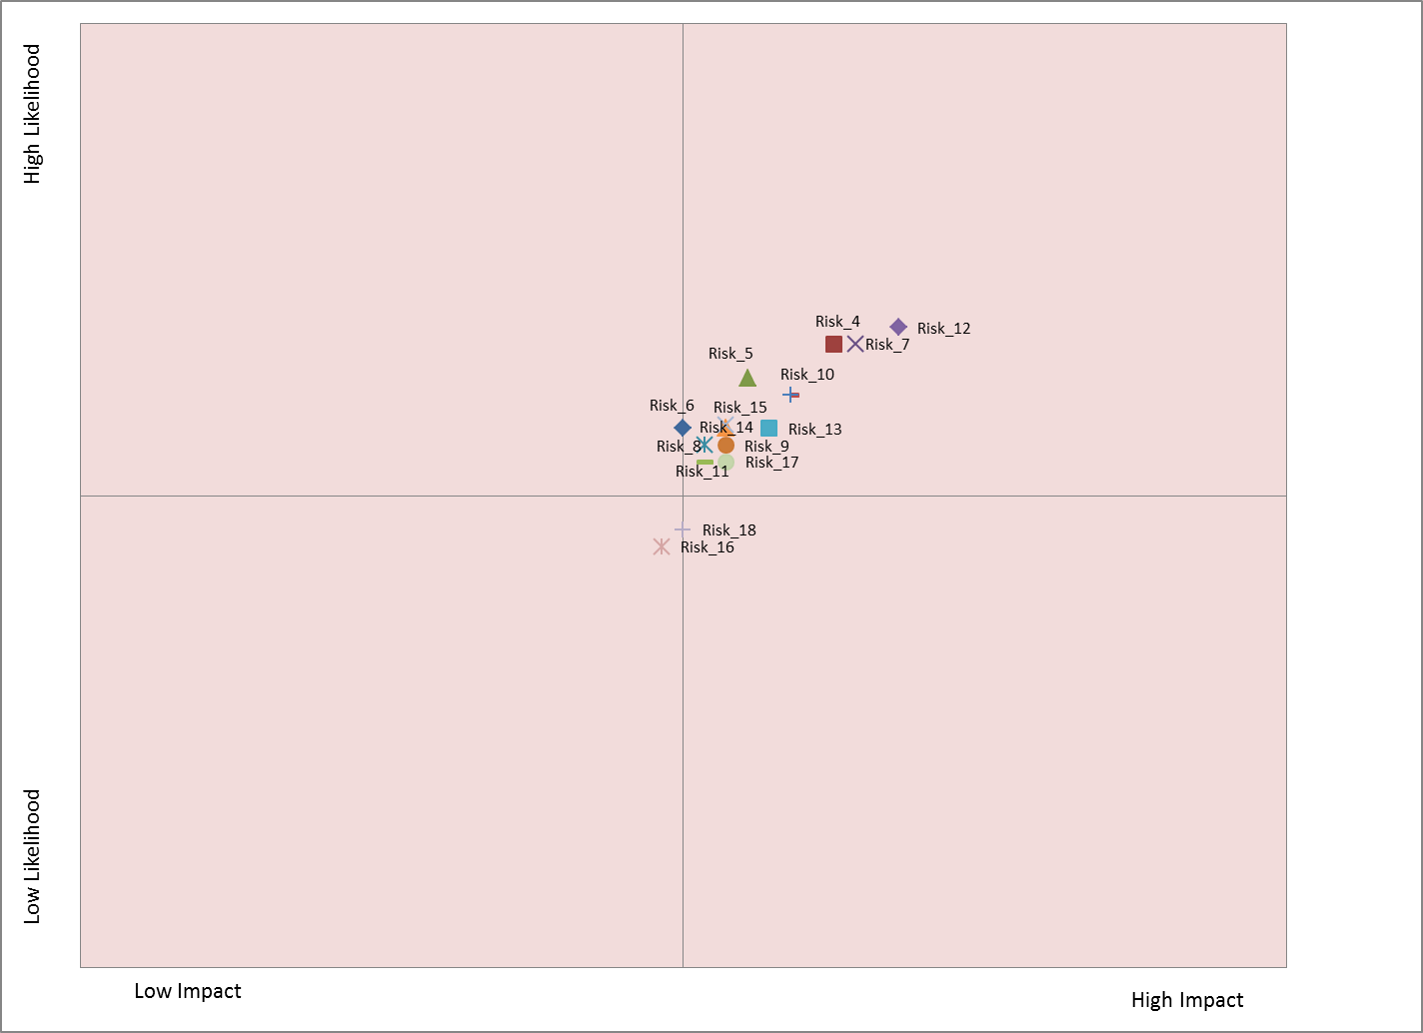

Slide 3
The “Biggies”!
 | High Likelihood | High Impact
R_12 BDSs are designed behind closed doors to the disadvantage of deserving beneficiaries | 1 | 1
R_7 Project developers or interest groups bribe public officials to ensure that the land areas they own are allocated to, or excluded from, REDD+ plans | 2 | 3
R_4 Loggers exert undue influence to exclude large areas of high value timber from areas designated for conservation | 3 | 2
R_3 Powerful individuals influencing the design of the overall national REDD+ framework to benefit from it | 4 | 5
R_10 powerful actors exert undue influence to obtain fraudulent licenses, land titles or carbon rights | 5 | 6

Slide 4
The “Biggies”!
 | Low Likelihood | Low Impact
R_16 Actors bribe public officials to register the carbon rights in the name of the corrupt actor | 1 | 1
R_6 those responsible for managing REDD+ payments embezzle REDD+ revenues | 2 | 7
R_18 Project developers attempt to bribe public officials to falsify claimed emission reductions from projects and therefore to secure additional revenues | 3 | 2
R_8 public actors intentionally distort information related to the distribution of benefits from REDD+ revenues | 4 | 5
R_11 political elites exert undue influence to link carbon rights to State ownership of forests | 5 | 4

Slide 5
Additional Risks
Project developers fail to disclose to participants full revenue accruing from sale of credits
Project developers intentionally develop benefit distribution models that favour certain participants
For a country to completely miss the opportunity to participate in the scheme because of all of the above creating conflicts
Community elites could divert community benefits. Civil Society agents can abuse their privileges and work against the community interest and the general REDD goal
Displacement and grabbing of land from the poor communities

Slide 6
Preliminary Country Results

Slide 7
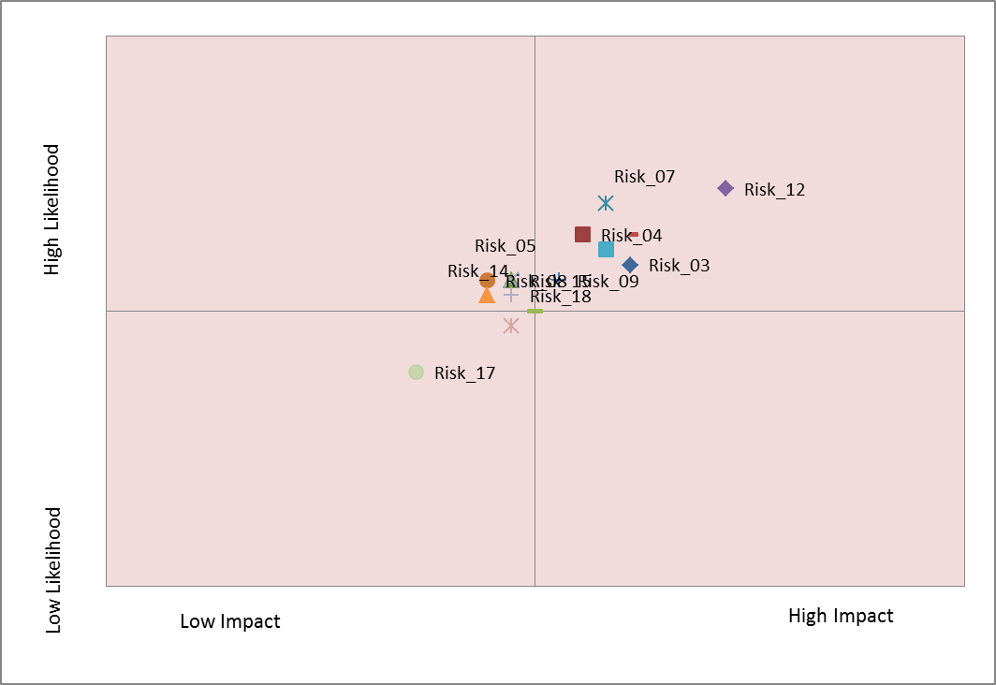
Zambia

Slide 8
Zambia
R_12 BDSs are designed behind closed doors to the disadvantage of deserving beneficiaries
R_3 Powerful individuals influencing the design of the overall national REDD+ framework to benefit from it
R_10 powerful actors exert undue influence to obtain fraudulent licenses, land titles or carbon rights
R_7 Project developers bribe public officials to ensure that the land areas they own are allocated to, or excluded from, REDD+ plans
R_13 political elites and the private sector agree to misrepresent national circumstances in a way that favours certain types of activities (such as plantations)

Slide 9
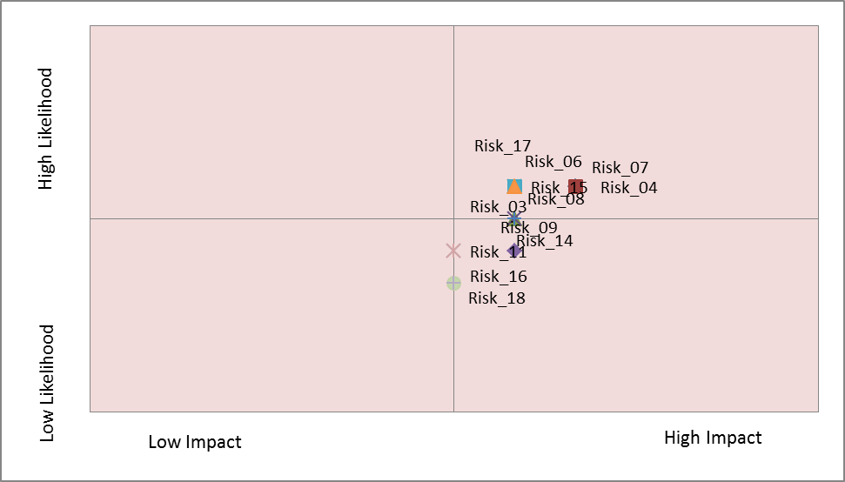
DRC

Slide 10
DRC
R_4 Loggers exert undue influence to exclude large areas of high value timber from areas designated for conservation
R_7 Project developers bribe public officials to ensure that the land areas they own are allocated to, or excluded from, REDD+ plans
R_6 those responsible for managing REDD+ payments embezzle REDD+ revenues
R_17 powerful individuals bribe or influence judges addressing conflicts related to customary land issues
R_12 BDSs are designed behind closed doors to the disadvantage of deserving beneficiaries
R_10 powerful actors exert undue influence to obtain fraudulent licenses, land titles or carbon rights

Slide 11
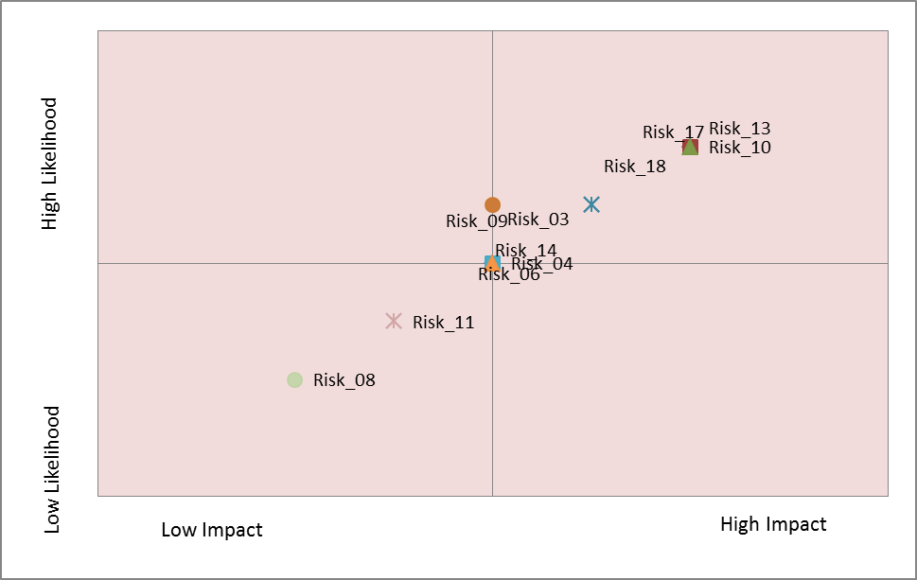
Republic of Congo

Slide 12
Republic of Congo
R_12 BDSs are designed behind closed doors to the disadvantage of deserving beneficiaries
R_17 powerful individuals bribe or influence judges addressing conflicts related to customary land issues
R_13 political elites and the private sector agree to misrepresent national circumstances in a way that favours certain types of activities (such as plantations)
R_14 actors involved in the carbon MRV system manipulate the data to over-estimate the emission reductions
R_5 Actors exert undue influence and bribery of public officials who are responsible for implementing REDD+ to ignore breaches of REDD+ regulations

Slide 13
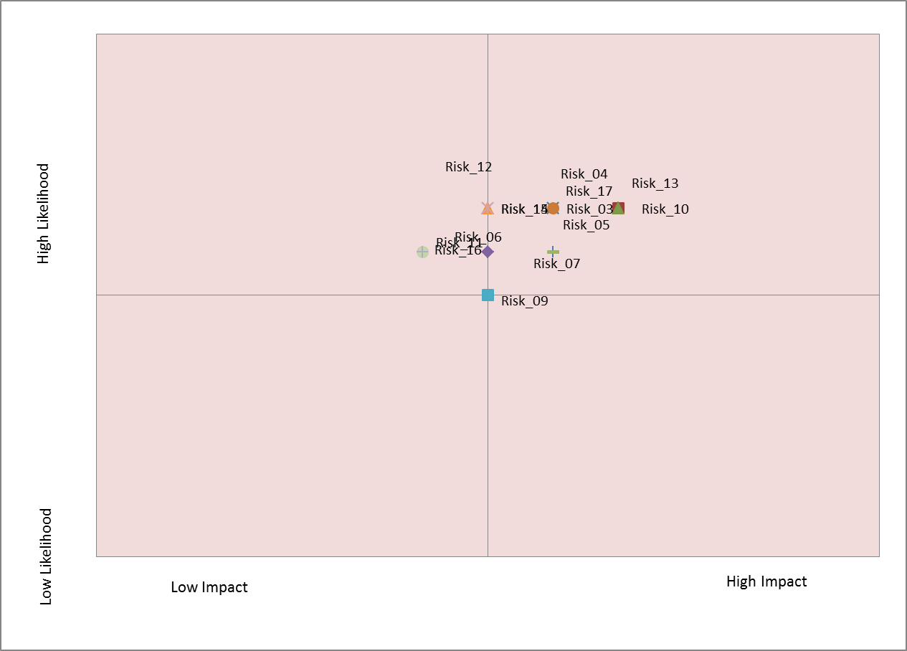
Nigeria

Slide 14
Nigeria
R_10 powerful actors exert undue influence to obtain fraudulent licenses, land titles or carbon rights
R_13 political elites and the private sector agree to misrepresent national circumstances in a way that favours certain types of activities (such as plantations)
R_17 powerful individuals bribe or influence judges addressing conflicts related to customary land issues
R_3 Powerful individuals influencing the design of the overall national REDD+ framework to benefit from it
R_4 Loggers exert undue influence to exclude large areas of high value timber from areas designated for conservation

Slide 15
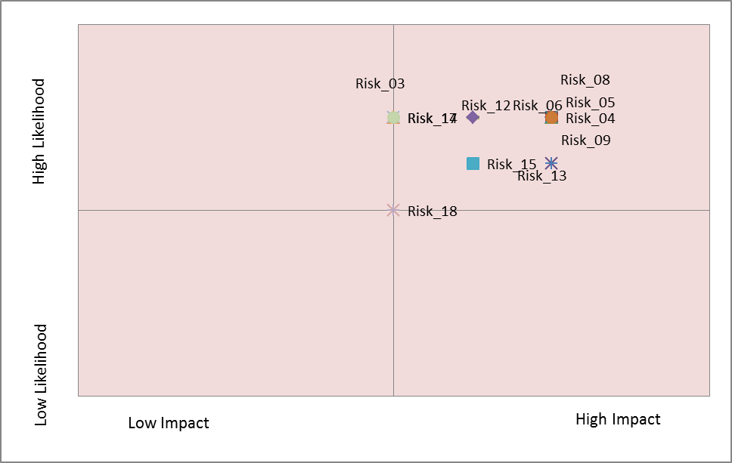
Kenya

Slide 16
Kenya
R_8 : powerful actors exert due influence and/or bribe public officials to create fraudulent licenses, land titles and carbon rights attributed to them instead of the appropriate rights holders
R_5 Actors exert undue influence and bribery of public officials who are responsible for implementing REDD+ to ignore breaches of REDD+ regulations
R_4 Loggers exert undue influence to exclude large areas of high value timber from areas designated for conservation
R_9 : political elites exert undue influence to link carbon rights to state ownership of forests thus excluding any claims to carbon rights by those holding or asserting customary tenure
R_6 those responsible for managing REDD+ payments embezzle REDD+ revenues
R_12 BDSs are designed behind closed doors to the disadvantage of deserving beneficiaries

Slide 17
Global
R_7 Project developers bribe public officials to ensure that the land areas they own are allocated to, or excluded from, REDD+ plans
R_10 powerful actors exert undue influence to obtain fraudulent licenses, land titles or carbon rights
R_16 project developers, logging companies or local elites bribe public officials to register the carbon rights over particular parcels of land in the name of the corrupt actor
R_4 Loggers exert undue influence to exclude large areas of high value timber from areas designated for conservation
R_5 Actors exert undue influence and bribery of public officials who are responsible for implementing REDD+ to ignore breaches of REDD+ regulations

Slide 18
Group Discussions
We have grouped countries according to:
Similarity in “risk profiles”
Geography
Equality in numbers!

Slide 19
Group Discussions
Group 1 in room Kafue
  Zambia
Group 2 in room Luangwa
  DRC
Group 3 in room Chambeshi
  Republic of Congo
Group 4 in room Zambezi
  Nigeria
Group 5 in room Zambezi
  Kenya
Free-floating
  Ethiopia and Tanzania
Corruption risks (identified in survey) | Baseline (Actions already taken, for each risk) | Actions (for each risk or aggregated) | Actor (for each action)
1. 2. 3. 4.

