Slide 1
Zambia’s Experience in Promoting Participation, Transparency and Accountability in the Forestry Sector
24 April 2012
Presented by:
Deuteronomy Kasaro, National REDD+ coordinator
Forestry Department, Ministry of Land, Natural Resources and Environmental Protection, Zambia
and
Festus Chipungu, Director
Community Education Department, Anti Corruption Commission, Zambia

Slide 2
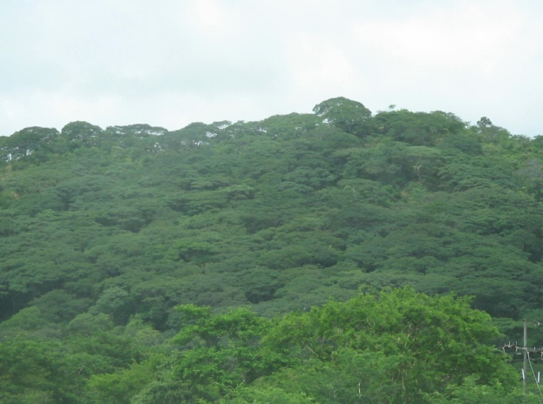
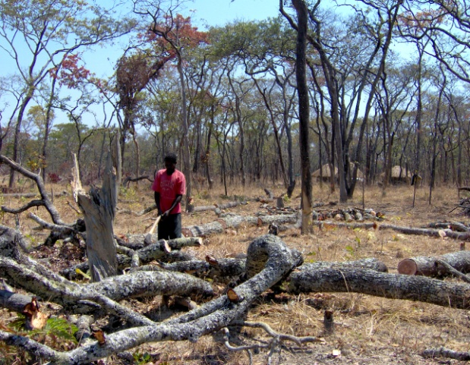
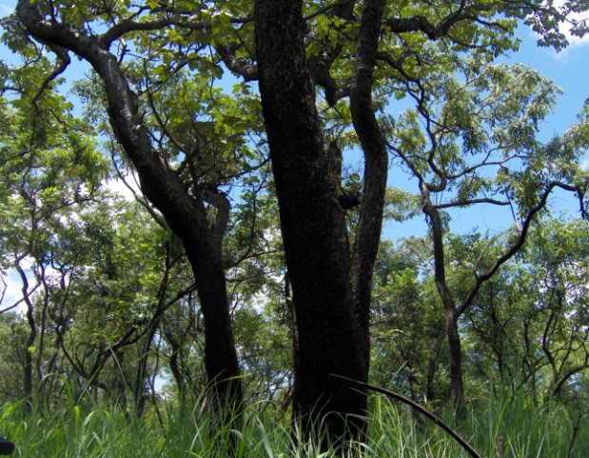
Forest Resources in Zambia
Zambia surface land area is 752,614Km²
Forests cover about 49.9 million ha (66% of land cover),
The forest vegetation type is mainly Miombo (Semi-evergreen forests); Baikiaea, Munga, Mopane, Kalahari woodlands (Deciduous Forests), Ripian, Swap, Parinari, Itigi, Lake basin Chipya (Evergreen forests), Termitary associated bushes (Shrub thickets), grasslands, wooded grasslands.
Plantations cover about 61,000 ha ( 7,000 ha by the Forestry Department and 50,000 ha under ZAFFICO, the rest by communities, farmers, schools etc.)
2.9 billion m³ of growing stock, 5.6 billion tonnes as national biomass(below and above), 434 million tonnes as dead wood biomass. TOTAL: 6 billion tonnes (ILUA 2008).
About 2.8 billion tonnes of Carbon stored in forests

Slide 3
What is REDD+?
Not only a Policy Framework with the goal of creating an economic value for the carbon in standing forests; and
But also an innovative system that motivates multi-sectoral actors to address the drivers of deforestation

Slide 4
REDD+ Specifications
Principles
Scope of REDD+
Safeguards
Country-driven
National circumstances
Consistent with National development goals
Consistent with adaptation needs
Equitable etc. financing
Results-based
Reduce Deforestation
Reduce Forest Degradation
Conservation of Forests
Sustainable Forest management
Enhancement of Carbon stocks
Consistent
Transparent & Effective Governance
Rights of local Communities
Stakeholder Participation
Biodiversity conservation and management
Ensure minimum risk for Reversals
Avoid Displacement

Slide 5
Actions required in the Readiness Phase
(as per the Cancun Agreements under the UN Convention on Climate Change)
Develop :
  A national strategy
  A national forest reference emission level and/or forest reference level (interim measure, sub national)
  A robust and transparent national forest monitoring system for the monitoring and reporting of the REDD + activities (interim measure, sub national)
  A system for providing information on how seven social and environmental safeguards will be addressed and respected

Slide 6
Importance of REDD+ in Zambia
Deforestation in Zambia is currently estimated to be between 250,000ha to 300,000ha per year and REDD+ will help manage forest sustainably - Will help promote natural regeneration which has a high potential in Zambia
Since REDD+ is an incentive based mechanism and focusing on respecting the rights of local communities, it is expected that rural livelihoods may be enhanced
There is potential for investment in sectors that drive deforestation and hence economic and rural development.
Enhancement of foreign exchange earnings
It will contribute to the implementation of public, private and community partnerships

Slide 7
Policy and Legislation Governing Forests in Zambia
Forest management in Zambia is supported by a national policy and legislation.
  The Forestry Department is mandated to administer forests on behalf of government
  The Forestry Policy of 1998 provides policy guidance on the management of forestry in Zambia and promote participatory forest management
  The Forests Act of 1973 and now a new Forests Bill 2012 provides for legal guidance to manage the forests in Zambia

Slide 8
POTENTIAL ILLEGAL ACTIVITES IN THE IMPLEMENTATION OF REDD+
Illegal logging (including removal of forest cover)
Wild fires
Tax evasion (under reporting of carbon stocks)
Export and import of illegally sourced timber or timber products, including charcoal
Presentation of misleading data by sponsors and communities
Inappropriate assurance of offset credits
Over stating awarded emissions
Fraudulent verifications and validations

Slide 9
CORRUPTION LEVELS IN ZAMBIA
The Anti-Corruption Commission of Zambia generates an average of 500 and prosecutes an average of 50 cases and secures about 20 convictions per year.
The World Bank presents Zambia’s score in controlling corruption at 30%
Transparency Zambia pegs Zambia’s Bribe Payers Index at 14% (An individual has 14% chances of encountering a bribery situation)
The National Governance Baseline Survey of 2004 reported that 40% of the respondents indicated having been asked for a bribe
Auditor General’s annual report shows huge sums of money amounting to hundreds of billions of kwacha misappropriated, stolen, mismanaged or unaccounted for every year.
The 2007 World Bank report estimated that 30% of the firms having paid a bribe to secure contract.

Slide 10
CORRUPTION VULNERABLE AREAS
Bidding process for concessions for harvesting hardwood especially in Western, Southern and North Western Provinces of Zambia
Acquisition of land rights through traditional systems
Declaring timber volumes, cutting outside timber areas and tax evasion
Exporting of unprocessed timber
Exploiting of the forest for charcoal and exporting of Charcoal
Issuing of permits and licenses.

Slide 11
CAUSES OF CORRUPTION IN THE FOREST SECTOR
Dishonesty, greed, desire for personal wealth etc.
Exclusion of the public from decision making process due to lack of information, resources, capacity and influence
High monetary returns from corruption and the evading of statutory obligations
High demand for cheap timber by the International Market.
Appointment of officials to high level positions who make decisions in favor of the appointing authorities

Slide 12
ZAMBIA’S EFFORTS IN COMBATING CORRUPTION
Campaigns involving civil society organizations
Educational programs targeting Traditional rulers
Reengineering of cultural and traditional beliefs and practices which promote corruption.
Corruption prevention interventions which include setting up of integrity committees, operating system reforms, participative monitoring of vulnerable operations
Investigating and prosecuting perpetrators of crimes
Signing MoU with AG’s office or the sharing of information
Integrating governance issues in the school syllabus.

Slide 13
NEW DEVELOPMENTS STRENGTHENING THE FIGHT AGAINST CORRUPTION
Enactment of the Public Interest disclosure Act (whistle blower protection)
Enactment of the Forfeiture of the proceeds of Crime Act
Restoration of the Abuse of office and possession of unexplained property provisions in the law.

