Slide 1
Safeguards workshop 26-27 Nov Recap
Lucy Goodman, UNEP-WCMC
19 Feb 2013

Slide 2
Attendees
Participants from the federal and state level
Government
  Forestry Commission (CRS)
  National REDD+ Secretariat
  Climate Change Dept (couldn’t come due to last minute commitments)
Civil society
  Mbe COMMUNITY
  EKURI COMMUNITY
  Mangrove Community
  Youth For the Environment Initiative
  Women Environmental Program
  Community Emergency Response Initiative
  Africa Rep at UN-REDD policy Board
Academia

Slide 3
Objectives
Progress work on output 4.3 of Nigeria’s REDD+ Readiness Programme “Cross River State established as a centre of excellence & learning on REDD+” and the related work streams on:
  Developing social and environmental safeguards for Cross River State
  Identification of priority benefits from REDD+ to support land use planning
Capacity building and awareness raising with key stakeholders on multiple benefits and risks - REDD+ safeguards
Evaluate what further work is needed on these topics to meet CRS and national needs within the framework of the UN-REDD Programme.

Slide 4
Topics covered
Safeguards – what are they?
Safeguard information systems – what is it?
“Multiple benefits” from REDD+ - what are they?
Spatial planning for REDD+
Communication

Slide 5
What are the REDD+ Cancun Safeguards?(COP16, 2010)
(a) Policy coherence (national & international)
g) Carbon leakage risks
(c) Knowledge and rights of indigenous peoples & local communities
Elements of the Cancun Safeguards
(f) Permanence
(b) Forest governance (transparency & effectiveness)
(d) Full and effective participation of relevant stakeholders
(e) Conservation, biodiversity, social & environmental benefits
Notes:
Cancun safeguards are a list of topics/themes that should be promoted and supported when undertaking REDD+

Slide 6
What is a Safeguard Information System?
Approach for collecting and providing information on how REDD+ safeguards are being addressed and respected throughout REDD+ implementation
Possible components:
  Indicators
  Methodologies for collection of information
  Framework for provision of information
Should build on existing systems to the extent possible
A system for providing information on how the safeguards (...) are being addressed and respected throughout the implementation of the activities (...)
(Cancun Agreements, Decision 1/CP.16, Para. 71. (d))
Notes:
We should demonstrate how safeguards are being promoted and supported through a “safeguard information system” which illustrates how the safeguads are being addressed and respected

Slide 7
What are multiple benefits?
The potential benefits from REDD+ that may come, including climate change mitigation
Other benefits can include:
  Socio-economic benefits
    Forest Governance improved
    Alternative livelihoods may be provided
  Environmental benefits
    Biodiversity conservation
    Ecosystem service (soil erosion control) preservation and enhancement

Slide 8
Spatial planning for REDD+
Maps can help us to:
  Identify where areas might be at risks from some REDD+ actions
  Identify the benefits that might come from some REDD+ actions, in order to enhance them
Other linkages
  Information from safeguards information systems might feed data into maps for REDD+ planning
  Spatial planning as a mitigation of risk option

Slide 9
What would the Nigeria example be?
Principle 6
Criterion 21 – Ensure that land-use planning for REDD+ explicitly takes account of potential synergies and trade-offs between the multiple functions of forest and the benefits they provide, respecting local and other stakeholders’ values

Slide 10
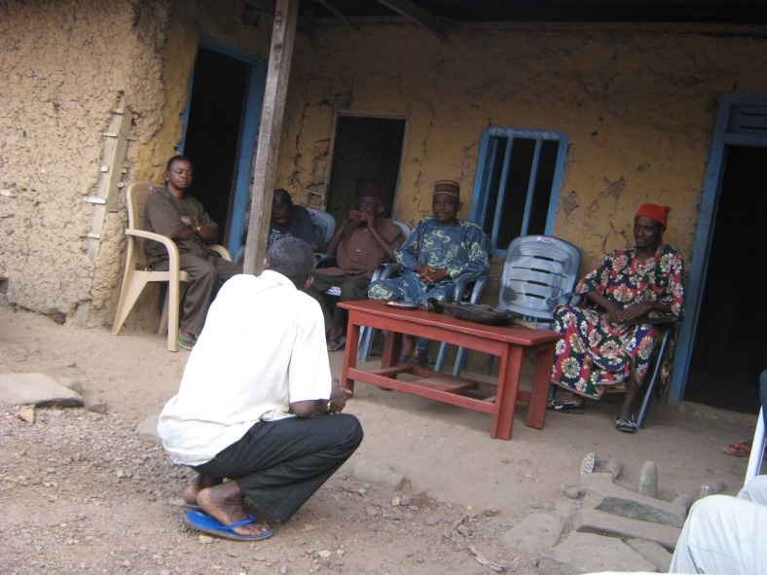
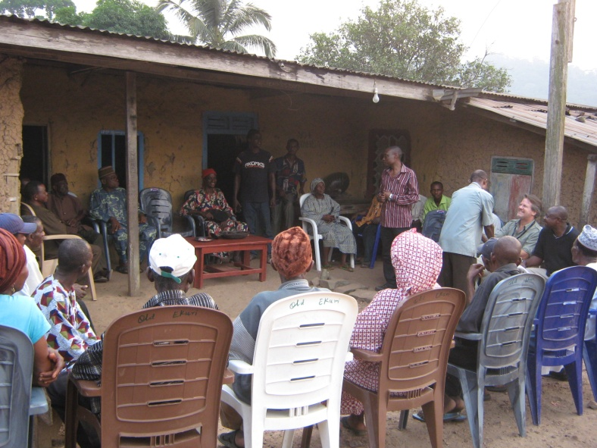
Ways of communicating about REDD+
Government
conferences, workshops, training, website;
Local communities
village meetings; direct messaging through posters, brochures, radio/TV; and school involvement;
General public
public service announcements (TV and radio); competitions; and opinion/editorial articles;
International community/donors
lessons learned materials (brochures/videos); reports and international conferences.

Slide 11
Next steps
Step up a safeguards task force
  Design a country approach to safeguards that includes identifying policies laws and regulations relating to safeguards and a safeguard information system
  Make linkages to PGA
Draft REDD+ communication materials that include maps

Slide 12
Thank you!
lucy.goodman@unep-wcmc.org

