Slide 1


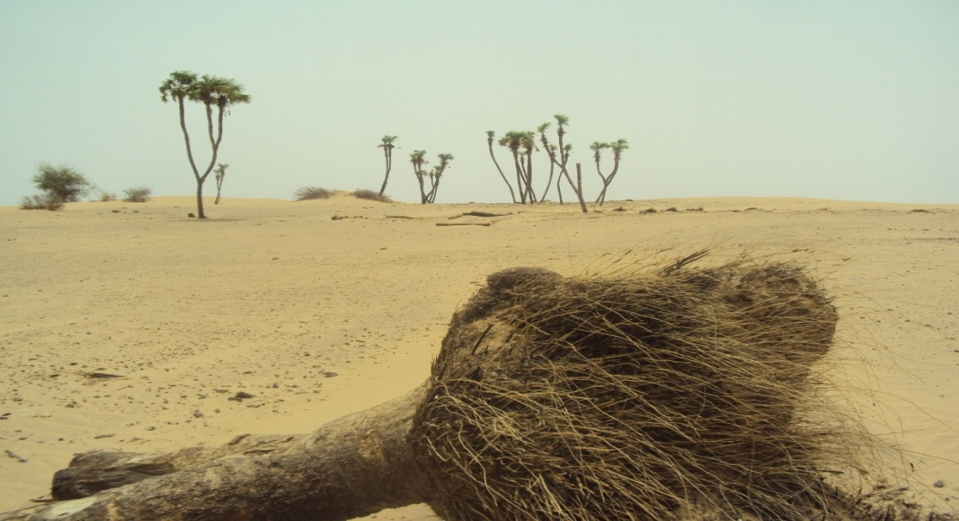
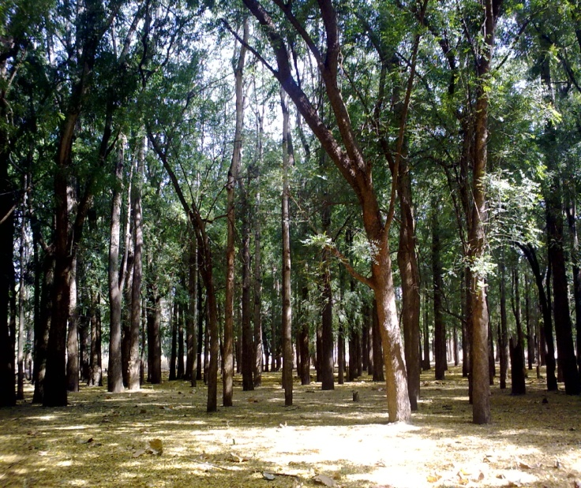
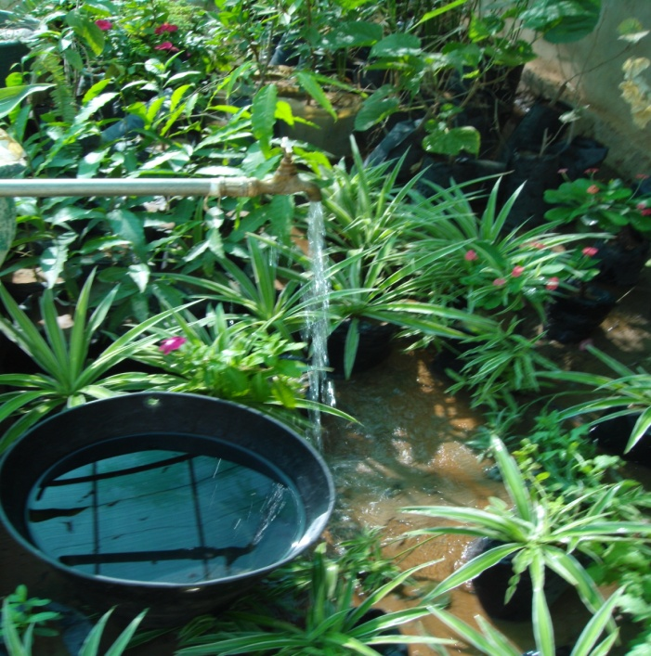
FNC
Sudan’s feedback on UN-REDD Programme’s Social and Environmental Principles and Criteria (SEPC)- A Benefit and Risks Tool (BeRT)

Slide 2
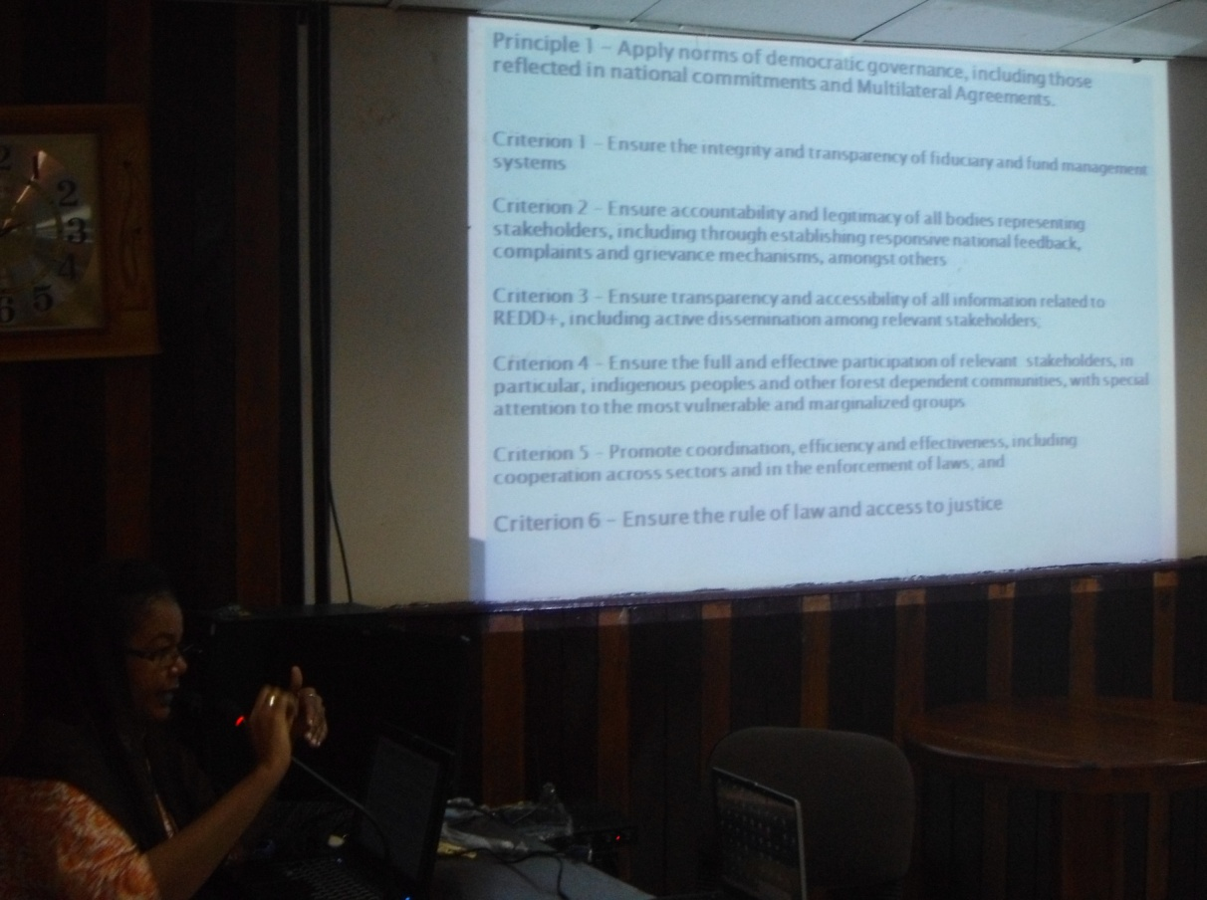
Sudan Testing SEPC Tool
A two-day workshop, including: 8 participants from FNC (three from HQ and others from eastern and western Sudan); 1 from NGO; and 1 from UNEP as technical support and facilitator; and
Six-day field work expedition within Western Sudan.

Slide 3
The main objectives of SEPC workshop:
1. To identify the SPEC tool’s benefits for designing The Sudan National REDD programme;
2. To explore the useful of SEPC tool on the ground, in accordance with the context in the Sudan context and its utility in designing the REDD+ national programme;
3. To combine and receive SEPC feedback from the ground (indigenous people, forest dependants and local communities; and
4.To comment on the suitability of tool within Sudan.
Workshop programme:
1st Day (10 Jan.2012)
9:00 – 12:00 | 1- Brainstorming (Sudan National program for REDD plus)
Break
12:30 – 2:30 | Group 1 | Principle 1,2
3:00 0 4:00 | Discussion and comments | All the group
2nd Day (11 Jan. 2012)
9:00 - 11 | Group 2 | Principle 3, 6, 7
Break
12:00 – 2:00 | Group 3 | Principle 4,5
2:00 – 3:00 | Discussion and comments

Slide 4
Implementation of the tool
Nabag Forest Reserve

Slide 5
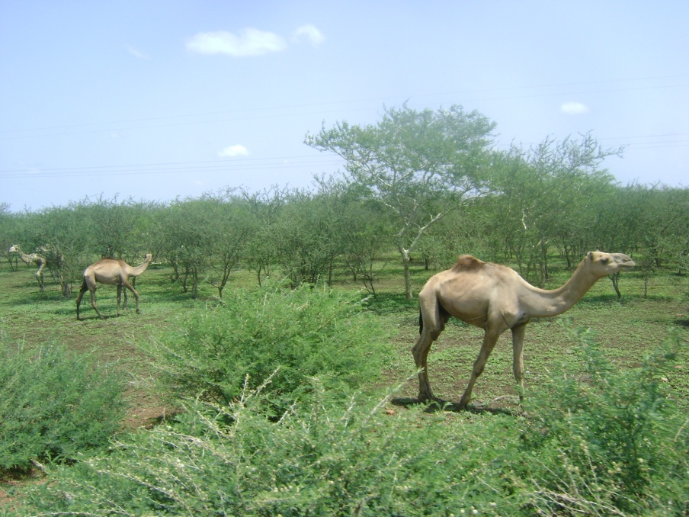
Rehabilitation of Nabag Forest by local communities(Activities similar to REDD+)
Location: South Kordofan State, West Sudan (gum arabic belt)
Area: 4000 ha
Objectives: Rehabilitation of degraded forest for the protection, conservation, production and sustainable management of Nabag forest for the purpose of poverty reduction and environmental conservation
Rehabilitation started 2004 through agroforestry farming system
500 families out of 13 villages were involved (4000 persons 35% are women)
Families selection based on: Landless people, poor, Gender

Slide 6
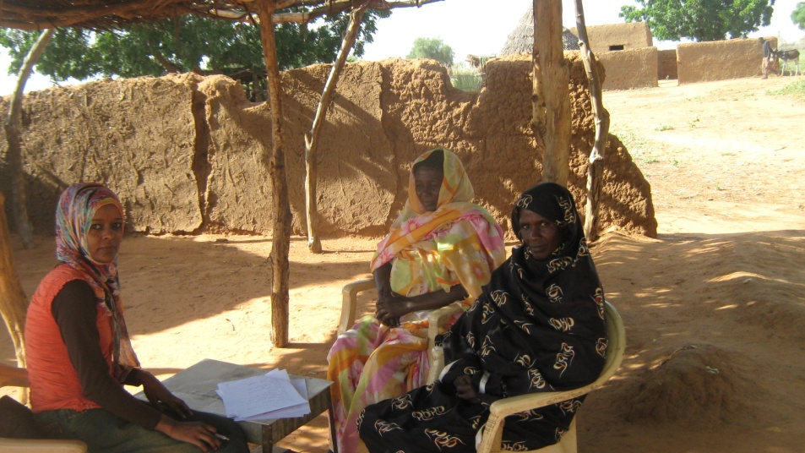
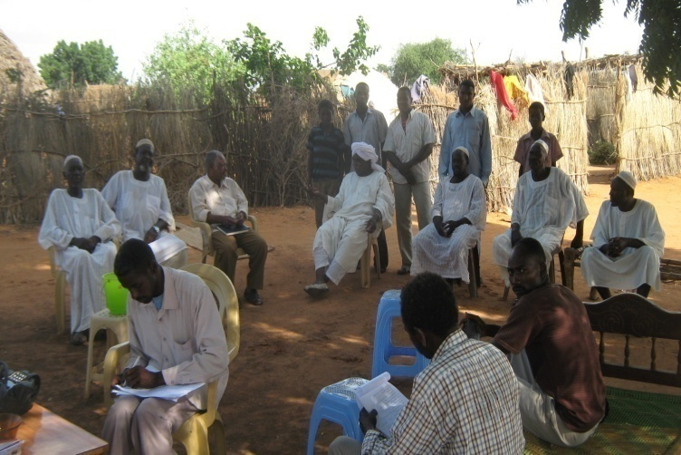
Methodologies used to test the Tool
Questionnaire
Meetings
Group Discussion
Main issues tested
Socio economics aspect
Environmental aspects
Future Participatory Forest Management
Sustainability of activities in the future

Slide 7
Outcomes
Stability of the community around the forest (during the rainy season for agroforestry and during drought season for gum production
Increase in income by 145%
Increase in agricultural crops production by 50% compared with area outside the forest
Reduction in fuelwood consumption by 30%
High awareness about role of forest
High degree of willingness to contribute in protection, conservation and management of the forest
Activities found to be sustainable(continuation of income generated from forest)
Revenue can be calculated from
Crop production
Gum production
Seeds production
Fodder production
Carbon sequestration and storage (rotation of Acacia senegal=23 years)
Wood production at the end of the rotation

Slide 8
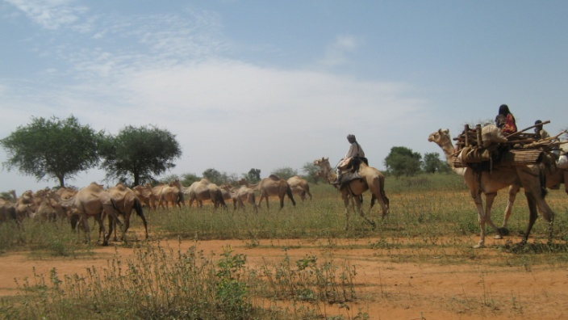

Activities implemented
Awareness raising and training (Agroforestry, tree planting, …etc)
Community organization setup: Gum Arabic Producers Cooperatives (25 GAPCs) and village committees(selected by GAPCs)
Agroforestry
Forest protection
Gum production
Energy program (using alternatives and improved stoves )

Slide 9
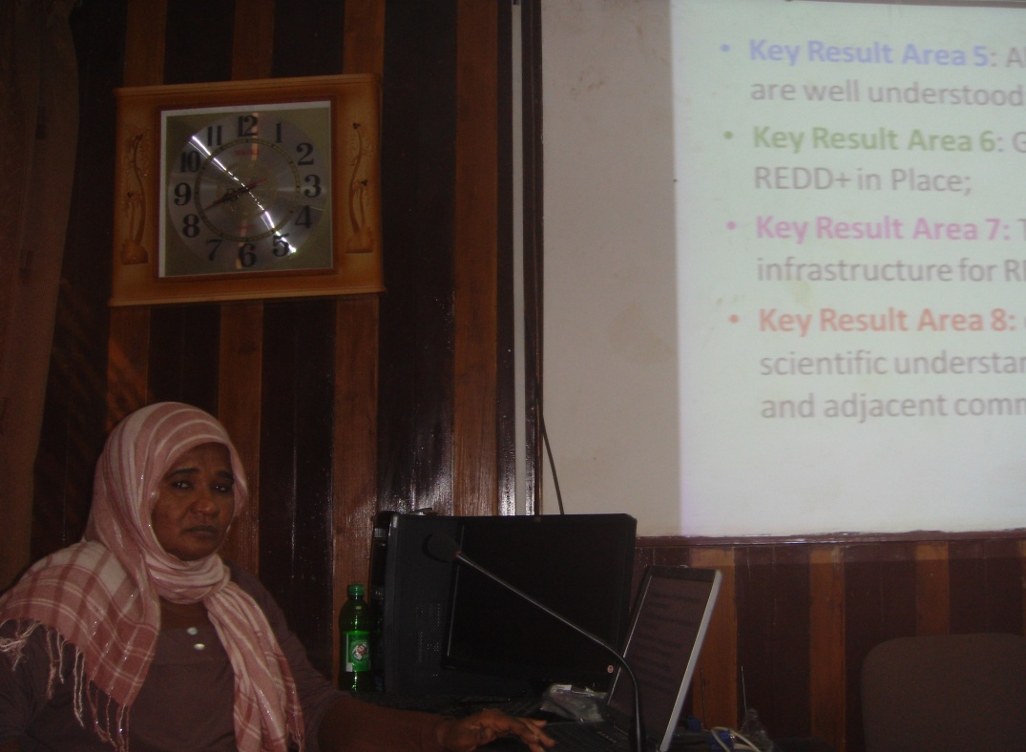
General Comment
The SEPC tool is very useful to be used as a safeguard, implementing of REDD+ activities, national frame work and help in monitoring system, but it should consider the variety of contexts within developing countries:
  Different circumstances, environments and interests;
  Ensure sustainability as major factor ; and
  High need to nationalize the tools accordingly to specific need based country.
  There is no criterion to assess the sustainability of the REDD+ issues and activities in the future

Slide 10
Detailed comments
Principle | Criterion | Comments
Principle 1: Apply norms of democratic, governance, including those reflected in national commitments and agreements | Criterion 1
 | Criterion 2 | Integration of indigenous and national systems and legal pluralism.
 | Criterion 3 | Ensure equal and easy accessibility to information related to REDD+, with consideration to illiterate and remote people in the rural areas.
 | Criterion 4 | This is applicable in Sudan community forests.
 | Criterion 5 | In the part of enforcement of law, it could be better to add enforcement of plural and combatable laws (Indigenous and national laws).
 | Criterion 6 | Integration of indigenous and national systems.
Principle 2: Respect and Protect stakeholders rights, including human rights, statutory and customary rights, and collective rights | Criterion 7
 | Criterion 8 | Adding gender mainstreaming in all REDD+ activities .
 | Criterion 9 | Information accessibility should consider illiterate people by using radio and other media.
 | Criterion 10 | Ensure there is no compulsory resettlement as a result of REDD+.
 | Criterion 11

Slide 11
Principle | Criterion | Comments
Principle 3: Promote and enhance forests’ contribution to sustainable livelihoods | Criterion 12
 | Criterion 13 | High consideration to win-win approach, socio-economic development and REDD+ should meet the stakeholder’s needs during 15 years as minimum.
Principle 4: Contribute to low-carbon, climate-resilient sustainable development policy, consistent with national development strategies, national forest programmes and commitments under international conventions and agreements. | Criterion 14 | Community based adaptation and mitigation/ Indigenous knowledge should be included.
 | Criterion 15 | REDD+ reversal impact drivers should include the drivers in short term (4 years); medium term (7) and long term (15).
 | Criterion 16
 | Criterion 17

Slide 12
Principle | Criterion | Comments
Principle 5: Protect natural forest from degradation and/or conversion to other land uses, including plantation forest | Criterion 18 | Each country's needs should be considered as they pertain to afforestation as means of livelihood, such as in South Sudan and Congo, the top priority is to meet the people basic needs. The focus should be how to meet the REDD+ activates and local people's needs, though promoting new sustainable livelihoods, intensive for social development and reducing forest degradation (not to be changed to other land use , extraction of fuel for local people is a part of the natural ecosystem , moreover extraction of some of deadwood and grasses enhance natural regeneration and reduce the fire risk).
 | Criterion 19 | Suggestion: instead of using only infrastructure development, it could be better using physical developments.
 | Criterion 20
Principle 6: Maintain and enhance multiple functions of forest to deliver benefits including biodiversity conservation and ecosystem services | Criterion 21 | Co-benefits
 | Criterion 22 | Add: sustainability – managed for long-term.

Slide 13
Principle | Criterion | Comments
Principle 7: Minimise adverse impacts (direct and indirect) on non-forest ecosystem services and biodiversity | Criterion 23
 | Criterion 24
 | Criterion 25 | Applying REDD+ in the land that has been depredated by mechanized agricultural schemes could recover and rehabilitate quickly the land.

Slide 14
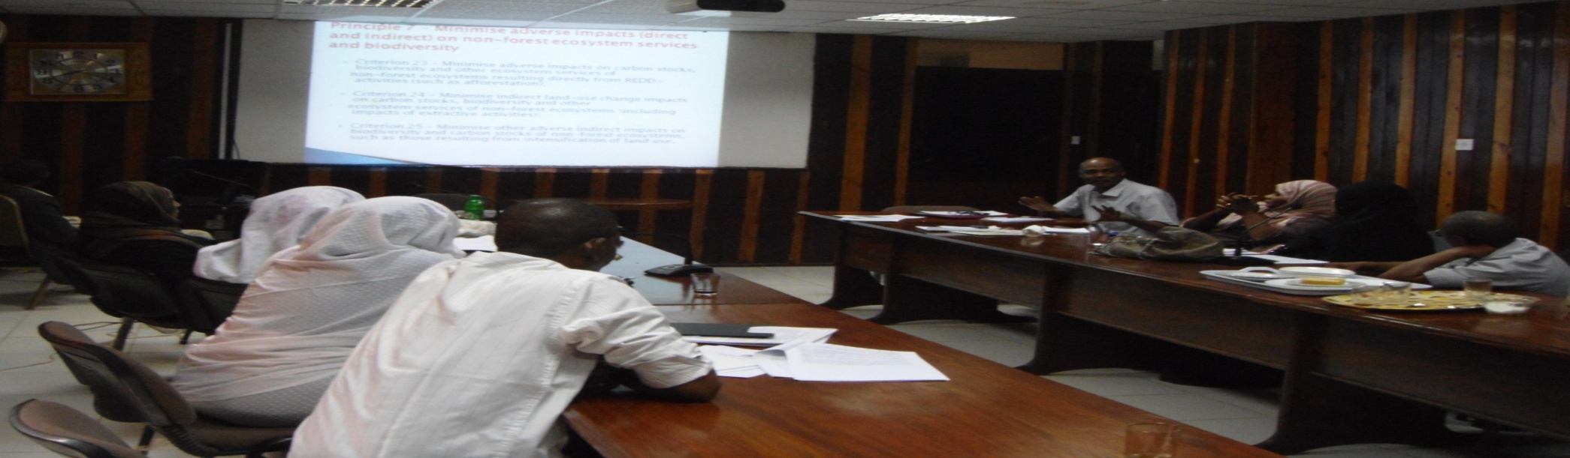
SEPC BeRT Sudan Group
Name | Gender | Organization
Dr. Abdalla Gaafar | M | Chief of TS, FNC
Dr. Mey Ahmed | F | UNEP-Climate Change and Peace Building Focal Point
Dr. Sayeda Khalil | F | Sudan REDD+ Desk, FNC
Fatima Mohamed | F | Kordofan State Forests
Mona Mohamed | F | Kordofan TS, FNC
Mustafa Yousif | M | Central, TS, FNC
Taghreed Ali | F | Gadaref State Forest
Mohamed Ahmed | M | Central, TS, FNC
Sawsan Ali | F | NGO, Sudanese Social Forest Society

Slide 15
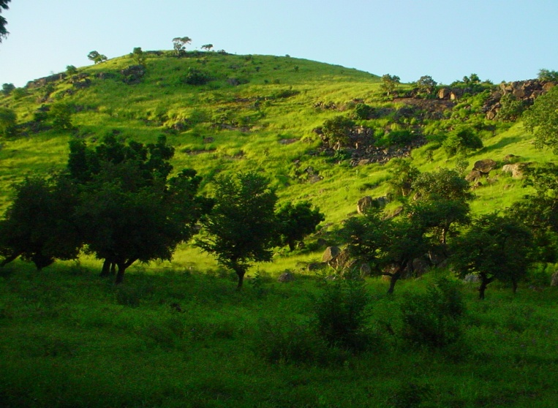
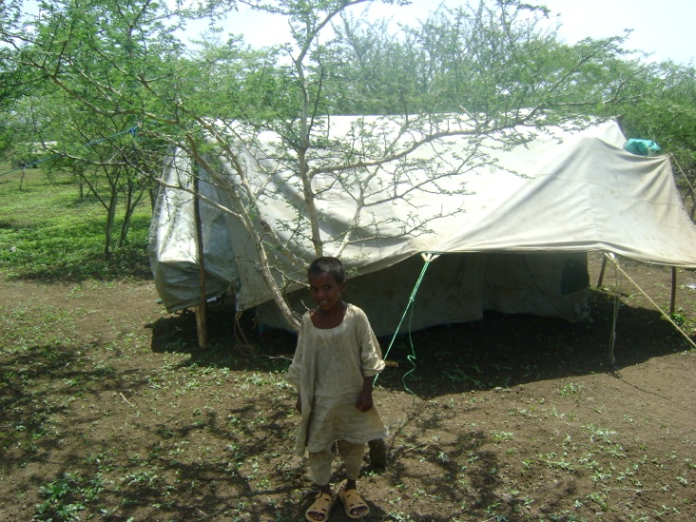
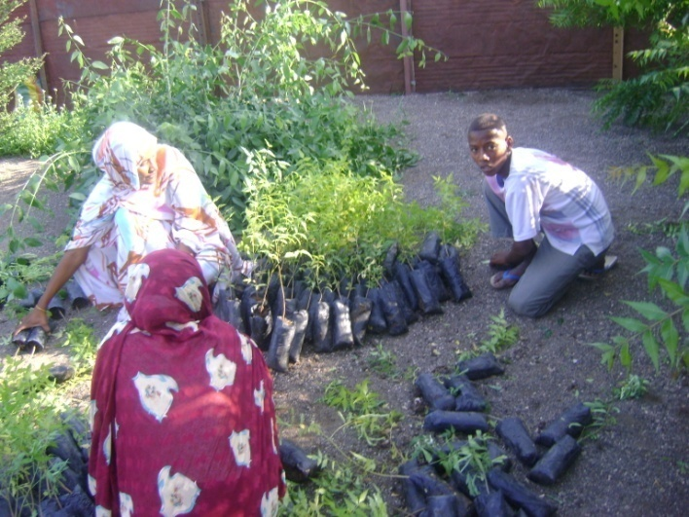
THANKS

