Slide 1

Status of Forest Carbon Rights and Implications for Communities, the Carbon Trade, and REDD+ Investments
Presentation to UNREDD Policy Board
Andy White, Coordinator, RRI
July 7, 2014

Slide 2
Outline
Background:
    Recent milestones for REDD+ & implications for rights
    Nexus of carbon rights and tenure rights
Findings from recent studies by RRI and the Ateneo School of Government, the Philippines
Some conclusions

Slide 3
Warsaw Agreement
  Approval of Cancun Safeguards
  Will require national REDD agencies to monitor transactions, ensure outcomes, and provide institutional safeguards for IP and community rights
  The requirement of a safeguard information system (SIS) is a critical step to ensure respect of those rights, with some remaining questions, regarding monitoring, enforcement, grievance mechanisms
  UNFCC has not yet explicitly grappled with carbon rights

Slide 4
World Bank Carbon Fund’s Methodological Framework
  Methodological Framework is essentially driving the development of a new asset class – the carbon credit.
  Profound implications in terms of property rights (carbon, forests, land, soil).
  Definition of Framework and implementation procedures currently in process.

Slide 5
Questions of Forest Tenure Recognized as a Major Concern by REDD+ Initiatives
  15/21 (countries with R-PP, R-PIN, or NPDs) identify lack of clear tenure as a driver of deforestation and forest degradation.
  17/19 (with proposed strategies) identify clarification of tenure as a component.

Slide 6
Growing Recognition of Need to Address the Legal Issues
REDD+ Law Project (Baker & McKenzie and the Cambridge Centre for Climate Change Mitigation Research, University of Cambridge), REDD+ High Level Policy Brief: Summary of Key Issues. March 2014
“…work to directly build and implement the specific and necessary legal frameworks at a national level has not occurred in a manner that can facilitate the actual development and implementation of REDD+ programmes." "…complex legal issues such as those related to land tenure, carbon benefits and benefit sharing, constitutional compliance and conflict resolution as they relate to REDD+ have not been addressed in the level of detail required to provide certainty about the domestic rules that will guide REDD+ implementation. This is particularly the case in terms of developing jurisdictional approaches to REDD+ at the national and sub-national level.”
“the focus on legal frameworks has been minimal.”

Slide 7
Nexus of Carbon & Tenure Rights
  Historic/simple approach: presumption of “carbon goes with the trees, and trees with the land’.
  Splitting carbon rights from other tenure rights (e.g. to trees, land, soil) is a complicated challenge –
      These rights need to be specifically defined in law.
      Introducing a distinct property right adds substantial administrative burden on governments and rights-holders.
      Numerous questions arise regarding the rights and responsibilities of landowners, communities, governments – including how to ensure protection of rights of people who are not directly involved.

Slide 8
Nexus of Carbon & Tenure Rights
Preceding questions are more or less moot if governments recognize that local communities are the legal owners of the carbon (along with the trees and land).
If governments nationalize the carbon (and become the legal rights holder to sell or trade carbon), and assume role of allocating ‘benefits’, or provide only piecemeal recognition for communities, there are risks for:
        Creating a monopoly (state-owned), creating disincentives for private and community action
        Becoming a tool of dispossession of local rights and livelihoods
        Adding to existing tenure confusion and conflict.

Slide 9
Some Lessons from New Zealand and Australia
New Zealand attempted to create a state monopoly on carbon in 2002 - led to protest and perverse outcomes where landowners cut trees to avoid regulation.
Policy was changed in 2008 which devolved carbon rights to forest owners.
Australia’s reforms established carbon rights for landholders.
Very detailed and adequate, though quite costly and cumbersome to manage, which brings into question its viability if carbon prices are low, and the potential replicability in lesser developed countries.

Slide 10
What’s Status of Tenure Reform and Carbon Rights?

Slide 11
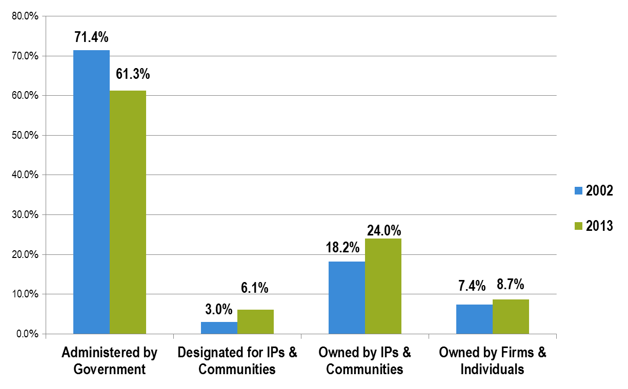
Progress in Forest Tenure Reform in Low and Middle Income Countries
2002-2013
From 21% - 30 % of forest estate under community ownership or control since 2002

Slide 12
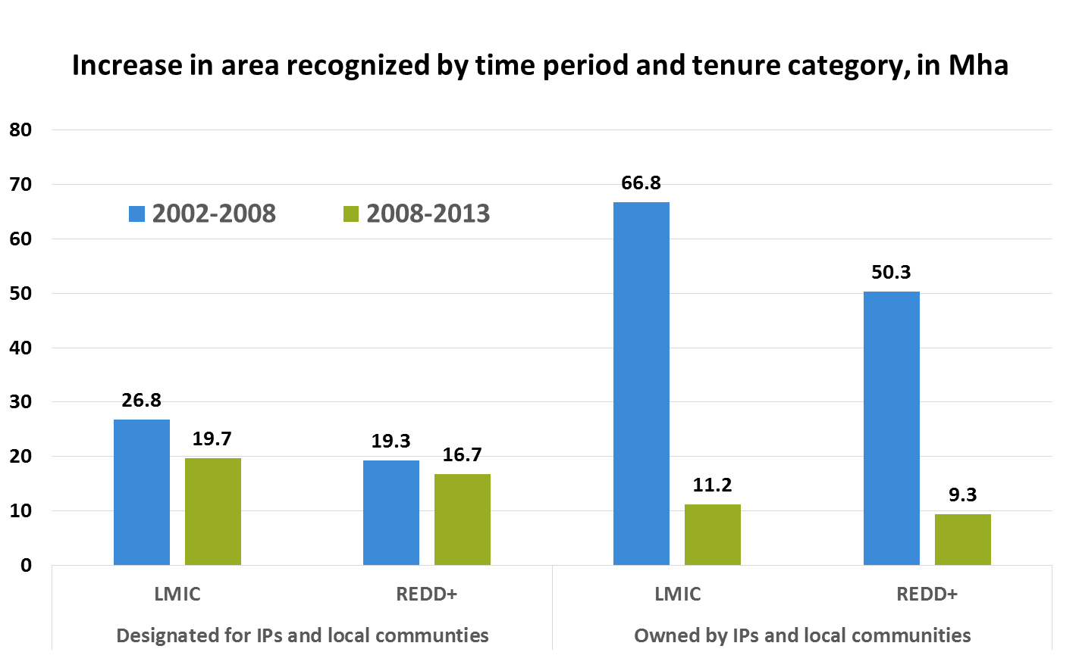
But Recent Slowdown in Recognition of Community Rights in LMICs and REDD+ Countries Since 2008

Slide 13
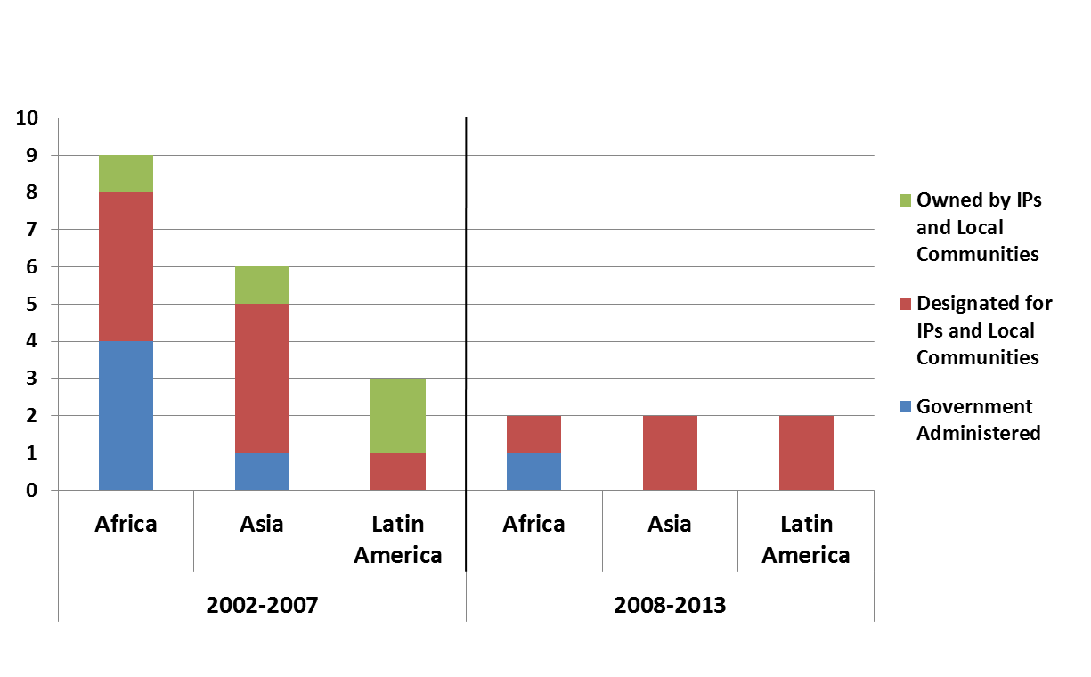
Fewer and weaker tenure instruments created since 2008
Tenure instruments created since 2002, by region and category
None of the frameworks created since 2008 confer ownership

Slide 14
RRI & Ateneo School’s Carbon Rights Research: 3 Questions
Have the countries passed national-level laws defining carbon rights and establishing regulatory frameworks for carbon trade?
What legal tools are available to assist the carbon trade? Are these tools sufficient to address its complexities?
Do existing legal instruments to recognize Indigenous Peoples and local communities’ rights provide a sufficient foundation for them to engage in the carbon trade?
Notes:
Stora Enso’s troubled experience – as one of the good guys -- proves a lesson to all investors going forward. Problems with international land acquisitions have grown faster than their rewards, despite considerable investment from the IFC to guard them against conflict. This just proves that much more needs to be done to ensure compliance including strengthening IFC’s own position on the ever growing risks of ignoring forest tenure rights..

Slide 15
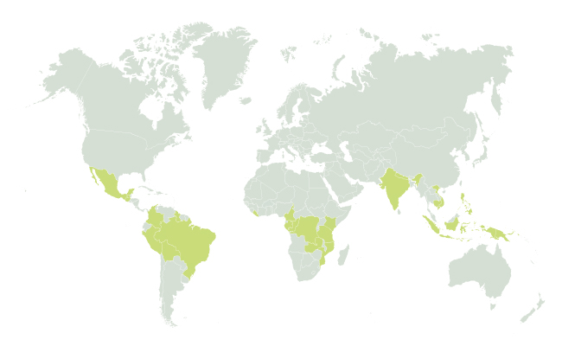
23 Countries, Across 3 Continents
  Africa: Cameroon, DRC, Rep of Congo, Gabon, Kenya, Liberia, Mozambique, Tanzania, Zambia
  Asia: Cambodia, India, Indonesia, Nepal, Papua New Guinea, Philippines, Vietnam
  Latin America: Bolivia, Brazil, Colombia, Guatemala, Guyana, Mexico, Peru
51 national experts contributed to findings
Notes:
To achieve this outcome in 2013–2017 we are:
Engaging more strongly with the private sector, especially major agricultural businesses and international investors in infrastructure and extractive industries, and with the governments of key emerging economies, such as Brazil, China and the Republic of Korea, to help them set norms for their global investments.
Assisting agricultural, food, and forestry companies to shift to sustainable supply chains, leveraging their connections and public commitments to advance tenure, governance, and market reforms.
Expanding support for gender justice in natural resource management and tenure reform.
Strengthening and expanding multistakeholder collaborative platforms in developing countries, and collaboration with civil-society organizations.
Supporting the development of public–private initiatives and investment mechanisms to raise private funds to implement tenure reform.

Slide 16
23 Countries, Across 3 Continents
1
Have the countries passed national-level laws defining carbon rights and establishing regulatory frameworks for carbon trade?
  2 have passed legislation defining carbon rights (Guatemala and Mexico)
  0 have a national legal framework establishing regulations for carbon trade
  6 have draft laws – at various stages of development

Slide 17
23 Countries, Across 3 Continents
2
What legal tools are available to assist the carbon trade? Are these tools sufficient to address its complexities?
  Most countries have some transactional basis of law for the carbon trade – mainly through contract law
  These laws have not yet been harmonized to reflect complexity of the carbon trade
  The necessary safeguards/institutions to arbitrate grievances are not present
  Ambiguity prevails in law on who has the right to trade
  Opaque legal systems do not work in favor of IPs and communities

Slide 18
23 Countries, Across 3 Continents
3
Do existing legal instruments to recognize Indigenous Peoples and local communities’ rights provide a sufficient foundation for them to engage in the carbon trade?
  19/60 confer ownership rights to forest/land
  41/60 undermine the security of community rights in some way, which could impact viability of REDD+ (exclusion rights, limited duration of tenure)

Slide 19
Conclusions
Confusion reigns within most of the current legal frameworks regarding which actors have the rights to carbon, and the rights to trade carbon.
Regulations for the carbon trade have not been passed in national law in vast majority of countries.
Tenure rights have not yet been sufficiently clarified over land and other tangible resources (e.g. water, forests, minerals) – adding another set of rights to something as abstract as carbon – without preparing the necessary groundwork, risks adding to the confusion and conflict.
Securing land, forest, and carbon rights has clearly not been a priority of international REDD+ initiatives, or of participating governments
"Global Slowdown" in recognition of IP and community rights especially worrisome; reversing trend. Instigating new efforts to secure land, forest and carbon rights should be a priority of all REDD+ initiatives.

Slide 20
Thank you.
Questions?

