Slide 1
ROLE OF FORESTS IN CLIMATE CHANGE
Presentation made at the
REDD+ ORIENTATION WORKSHOP FOR ZAMBIA
LUSAKA, 27 – 29 JUNE 2011
By
Emmanuel N Chidumayo
Makeni Savanna Research Project Lusaka, Zambia

Slide 2
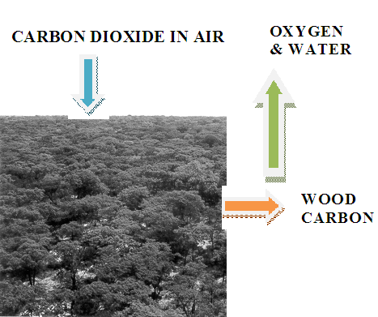
CLIMATE AFFECTS FORESTS AND FORESTS AFFECT CLIMATE

Slide 3
Forest trees through photosynthesis therefore capture carbon dioxide (CO₂) to produce carbon compounds that constitute much of the woody biomass.

Slide 4
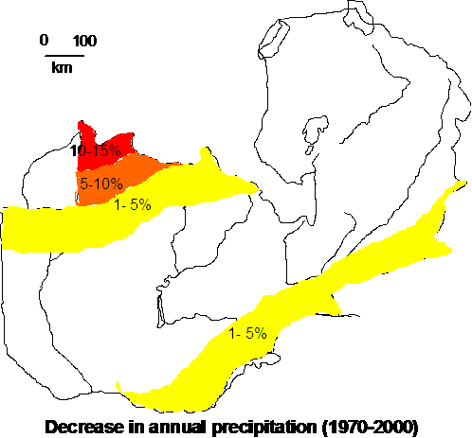
CLIMATE CHANGE IN ZAMBIA:
CHANGES IN RAINFALL

Slide 5
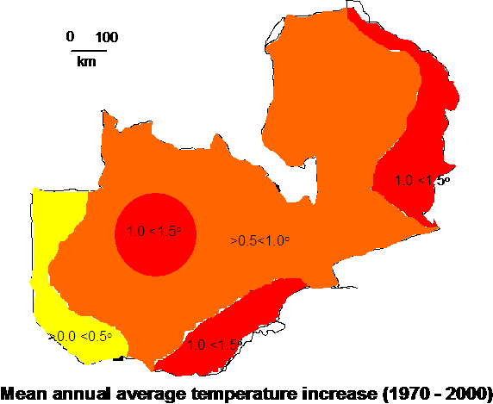
CLIMATE CHANGE IN ZAMBIA:
CHANGES IN TEMPERATURE

Slide 6
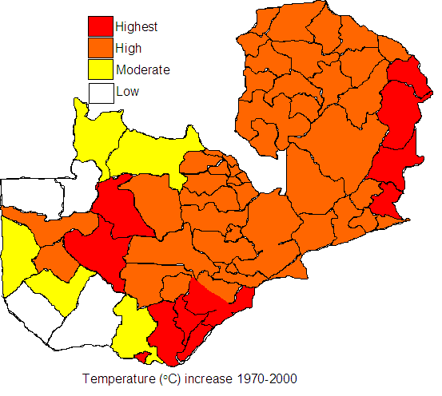
WARMING BY DISTRICT:
1970 TO 2000

Slide 7
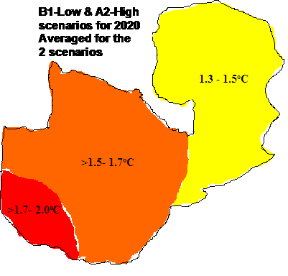
HADMC MODELS PREDICTION FOR 2020:
TEMPERATURE ANOMALIES OVER 1960-90 MEAN

Slide 8
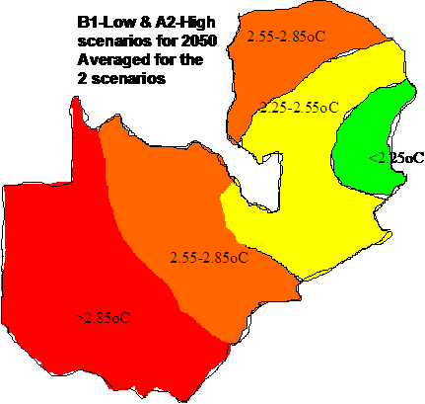
HADMC MODELS PREDICTION FOR 2050:
TEMPERATURE ANOMALIES OVER 1960-90 MEAN

Slide 9
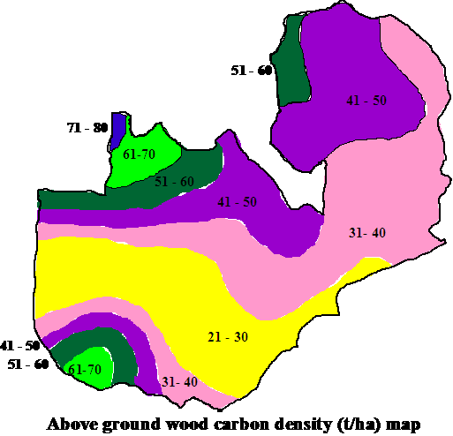
WOOD BIOMASS IN OLD-GROWTH FORESTS IN ZAMBIA

Slide 10
Increasing the carbon stocks in existing forests can be achieved by
silvicultural treatments
protecting secondary forests and other degraded forests whose biomass and soil carbon densities are below maximum capacity

Slide 11
THREATS TO FORESTS
DEFORESTATION & FOREST DEGRADATION AND
CLIMATE CHANGE

Slide 12
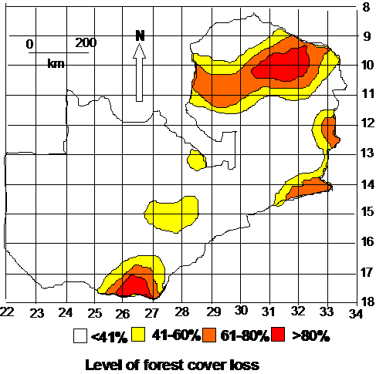
FOREST COVER LOSS IN ZAMBIA

Slide 13
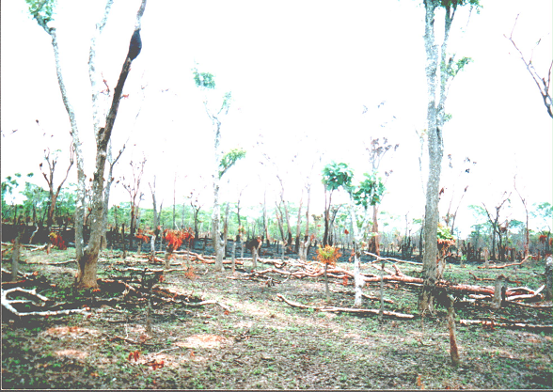
SOME CAUSES OF FOREST COVER LOSS: citemene

Slide 14
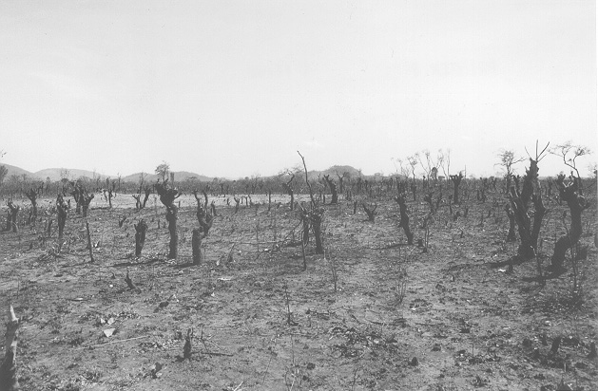
SOME CAUSES OF FOREST COVER LOSS: citemene and fire

Slide 15
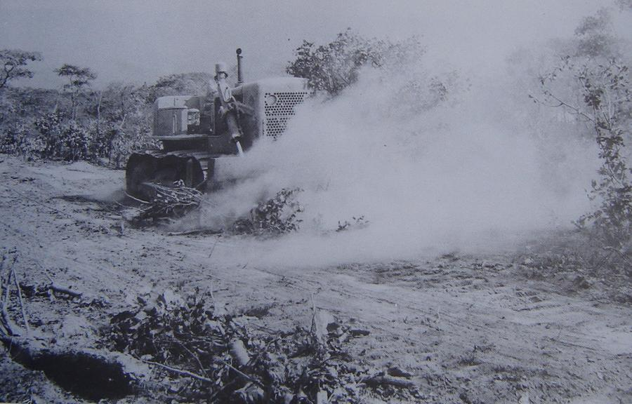
SOME CAUSES OF FOREST COVER LOSS:
Land clearing for permanent agriculture

Slide 16
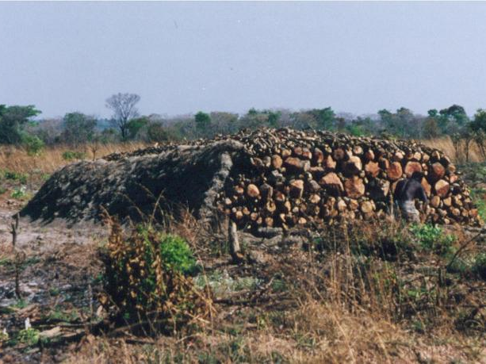
SOME CAUSES OF FOREST COVER LOSS:
Charcoal production

Slide 17
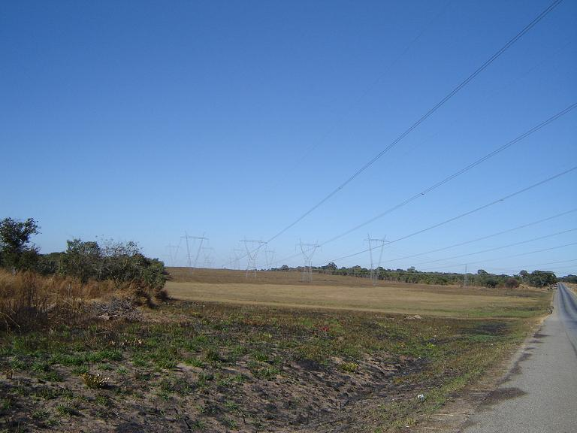
SOME CAUSES OF FOREST COVER LOSS:
Infrastructure development

Slide 18
OPPORTUNITIES
FORESTS IN ZAMBIA REGENERATE EASILY FOLLOWING WOOD HARVESTING AND CLEARING FOR CULTIVATION
Regeneration occurs through natural seedlings/saplings and resprouts from trunks, stumps & roots

Slide 19
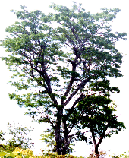
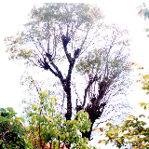
CANOPY RECOVERY AFTER LOPPING FOR CITEMENE

Slide 20
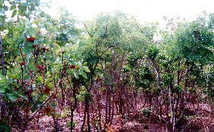
FOREST REGENERATION AFTER CITEMENE CULTIVATION

Slide 21
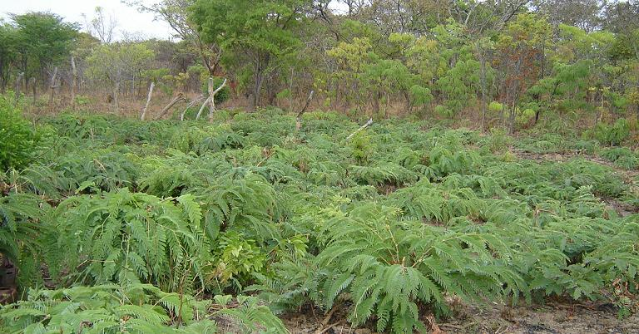
FOREST REGENERATION FROM STUMP RESPROUTS

Slide 22
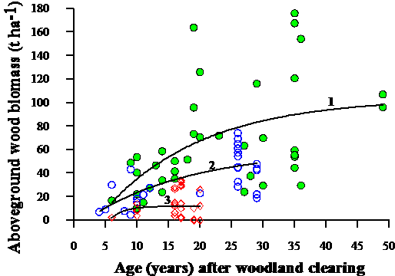
CARBON ACCUMULATION IN FOREST REGROWTH DEPENDS ON MANAGEMENT LEVEL

Slide 23
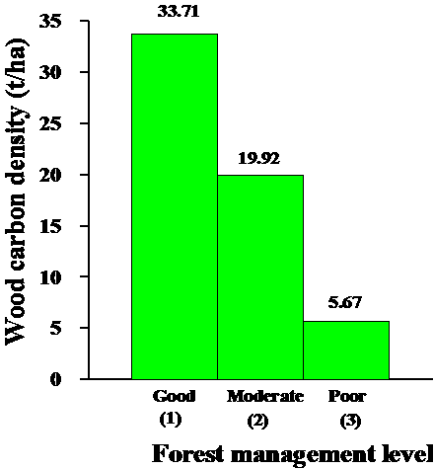
CARBON ACCUMULATION IN REGROWTH OF 20 YEARS OLD

Slide 24
UNDER GOOD MANAGEMENT REGENERATING FOREST
CAN CAPTURE AND STORE MORE CARBON FROM THE ATMOSPHERE
THAN MATURE FOREST

Slide 25
CLIMATE CHANGE THREATS
Forest vulnerability to climate change refers to the degree to which the forest system and its constituent species are susceptible to or unable to cope with adverse effects of climate change, its variability and extreme events.

Slide 26
CLIMATE AND CLIMATE CHANGE AFFECT TREE AND FOREST PHENOLOGY AND HEALTH
Fruit & seed production
Seed germination
Seedling survival
Tree growth
Grass production
Bush fire intensity & therefore tree survival and carbon stocks
Forest diseases & pests

Slide 27
Currently little is known about the potential of forests in Zambia to adapt to climate change

Slide 28
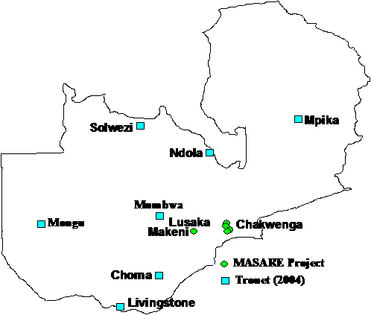
SITES WHERE CLIMATE-TREE PHENOLOGY AND GROWTH HAVE BEEN STUDIED

Slide 29
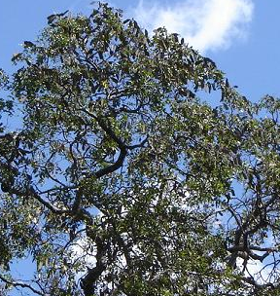
RESPONSES OF TREES TO CLIMATE FACTORS: Brachystegia species (muputu, kampela, manga, mpazhi, muputi, mutuya, mupuchi mputi musewe)

Slide 30
Climate factors affecting growth of Brachystegia spiciformis in Zambia
Location | Climate factor(s)
Choma | Rainfall and temperature
Livingstone | Rainfall and temperature
Mongu | Rainfall and temperature
Mumbwa | Temperature
Chakwenga | None
Mpika | Rainfall

Slide 31
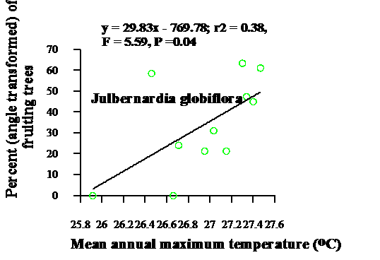
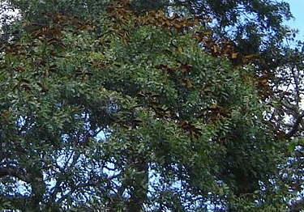
Fruiting response to maximum temperature in Julbernardia globiflora (mpasa, katondomumba, mwanza, kabunga, kamponi, mumba sandwe)

Slide 32
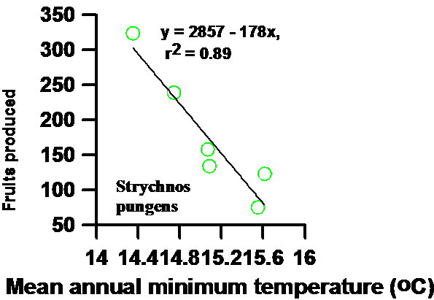
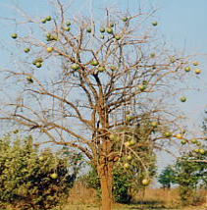
Fruiting response to minimum temperature in Strychnos pungens (muzimbili)

Slide 33
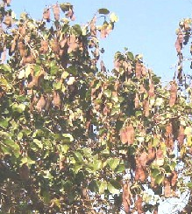
Climate responses of different growth stages in Piliostigma thonnigii (musekese, mufumbe, kifumbe, mubaba, kanungi)
Life history phase | Demographic/growth parameter | Significant climate factor(s)
Seed | Germination rate | Maximum temperature
Seedling | Mortality | Minimum temperature
Sapling | Radial growth | Maximum temperature and rainfall
(i)of seedling origin | Radial growth | Minimum temperature
(ii)of coppice origin | Radial growth | Minimum temperature

Slide 34
Climate models suggest that climate change will cause shifts in the distribution of forest communities
But it is also possible that different species respond differently to climate factors and
Therefore species may respond differentially to climate change.

Slide 35
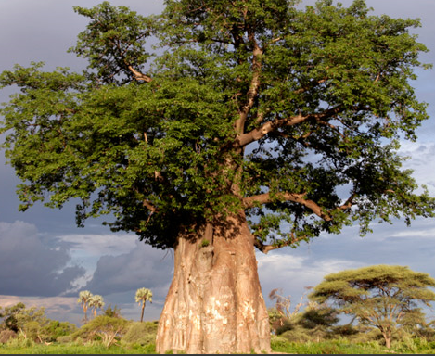
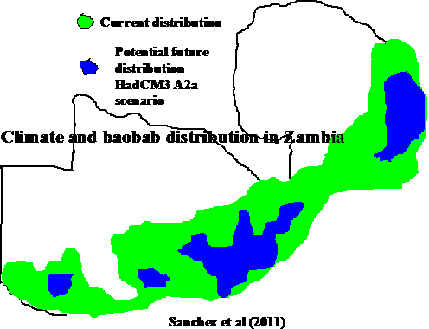
Current and projected changes in distribution of baobab (mubuyu, muyu, mlambe, mkulukumba) due to warming and land use change

Slide 36

THANK YOU FOR LISTENING

