Slide 1
REDD+ IN ZAMBIA : OPTIONS AND CHALLENGES

Slide 2
OPTIONS
FOREST CONSERVATION
SUATAINABLE FOREST MANAGEMENT
ENHANCEMENT OF CARBON STOCKS
PARTERNERSHIPS WITH OTHER PROGRAMMES:
CDM PROJECTS
CONSERVATION FARMING
ADAPTATION PROJECTS

Slide 3
SETTING ASIDE FOREST RESERVES
AVOIDING DEFORESTATION

Slide 4
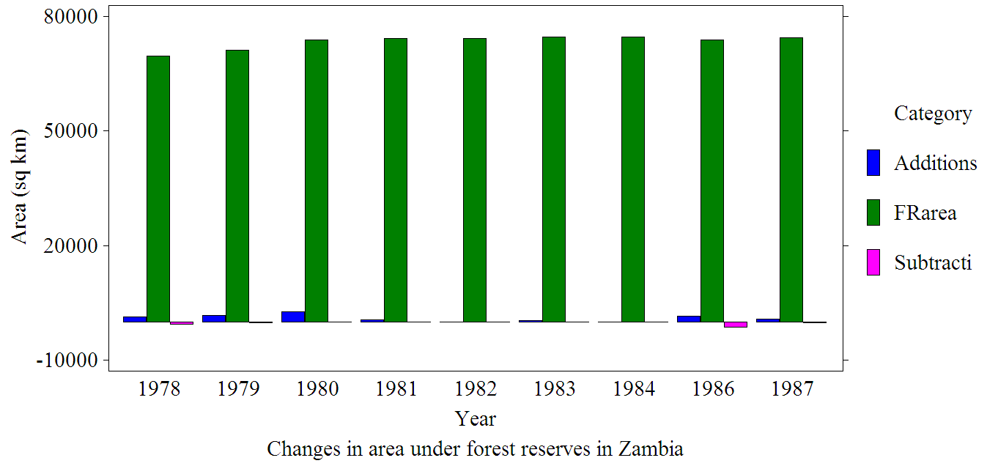
FOREST RESERVATION IN ZAMBIA

Slide 5
TWO MAIN CATEGORIES OF FOREST RESERVES:
LOCAL FORESTS (306) AND NATIONAL FORESTS (184)

Slide 6
LOCAL FORESTS AIM AT MEETING THE NEEDS FOR FOREST PRODUCTS FOR PRESENT AND FUTURE GENERATIONS OF LOCAL PEOPLE THROUGH SUATAINABLE FOREST MANAGEMENT

Slide 7
NATIONAL FORESTS ARE AIMED AT PROTECTING AND CONSERVING MAJOR WATER CATCHMENTS AND THEIR BIODIVERSITY: AVOIDED DEFORETSTION

Slide 8
CHALLENGE
HOW TO MAINTAIN THE INTEGRITY OF NATIONAL FORESTS

Slide 9
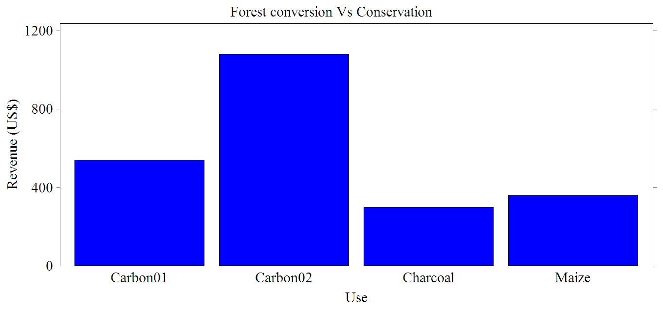
FOREST CONVERSION

Slide 10
CHALLENGE
HOW TO ENSURE THAT BENEFITS GO TO THE LOCAL PEOPLE AND FOREST OWNERS

Slide 11
FOREST CONSERVATION CHALLENGES

Slide 12
47% of National Forests have been encroached by human settlements and agricultural activities as of end of 1990s.

Slide 13
59 Botanical Reserves
15% have been significantly disturbed by man
24% have been encroachment

Slide 14
FOREST MANAGEMENT IN ZAMBIA STARTED TO DECLINE IN THE LATE 1970S FOR A NUMBER OF REASONS

Slide 15
General decline in the national economy :
Decline in budgetary allocations to the forest sector.
SAP reduction in staff establishment in Forest Department

Slide 16
CHALLENGE
HOW TO RAISE THE PROFILE OF THE FOREST SECTOR AND
INCREASE INVESTMENT IN THE SECTOR

Slide 17
Forest management in natural forests
Selective cutting for timber and poles and clear cutting for woodfuel
Protection from damaging fires in the late dry season by conducting early dry season burning

Slide 18
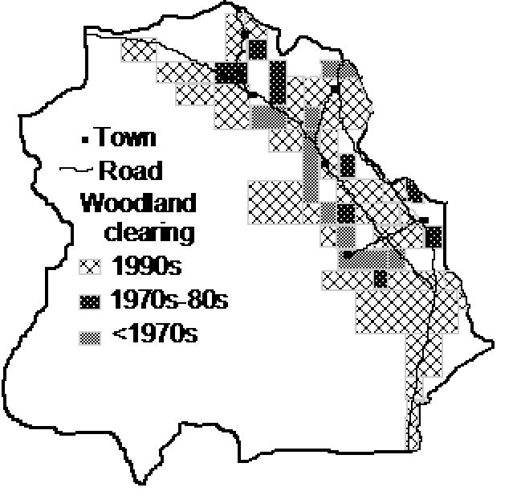
Urban population explained 36% (P < 0.001) of the variation in decadal change in forest clearing Distance to town explained 60% of the variation Additive effects of the two factors explained 67% (P < 0.001) of the variation in forest clearing

Slide 19
CHELLENGE
MONITORING DEFORESTATION IS A CHANGE

Slide 20
SUSTAINABLE FOREST MANAGEMENT

Slide 21
Forest management focused on 4 aspects
Control of felling to prevent waste
Ensuring regeneration of cut over areas

Slide 22
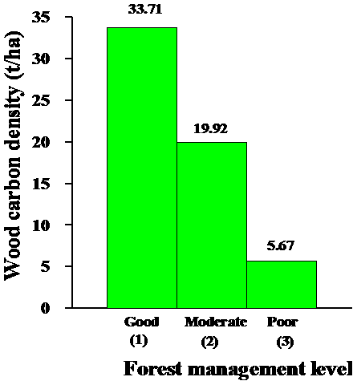
CARBON ACCUMULATION IN REGROWTH OF 20 YEARS OLD

Slide 23
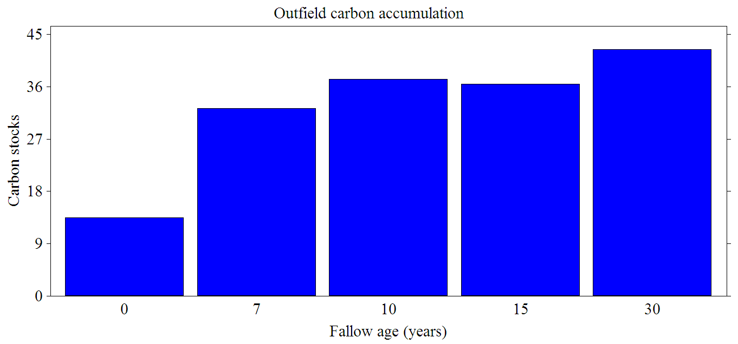
CARBON ACCUMULATION ON CITEMENE FALLOWS

Slide 24
PARTERNERSHIPS WITH OTHER PROGRAMMES
Lignite ash project in Luapula
Save 80 stove in Lusaka
Conservation farming

Slide 25
LIGNITE ASH TO REPLACE WOOD ASH FOR CROP PRODUCTION IN MANSA

Slide 26
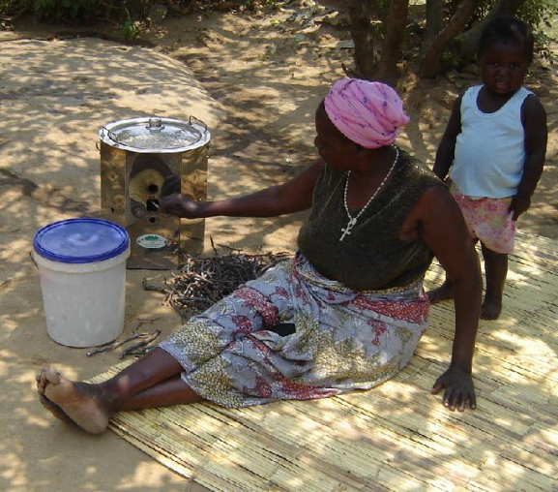
COOKING WITH A SAVE 80 TWIG STOVE

Slide 27
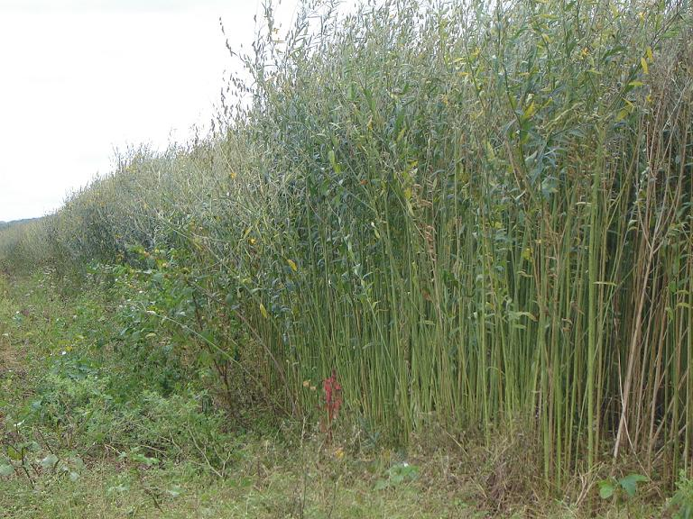
SUNHEMP STAND IN CHONGWE

Slide 28
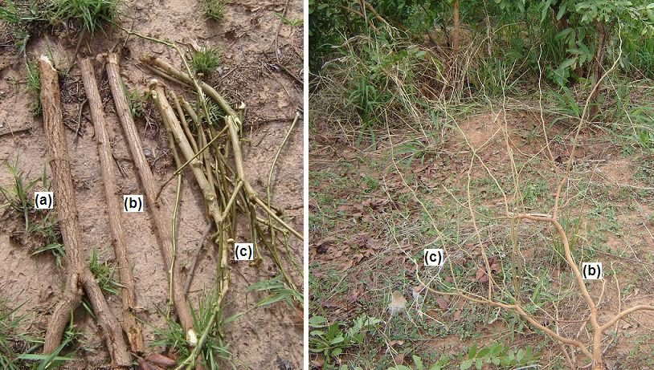
Harvesting annual twigs in natural regrowth stands: annual cut = regrowth

Slide 29
CONSERVATION FARMING

Slide 30
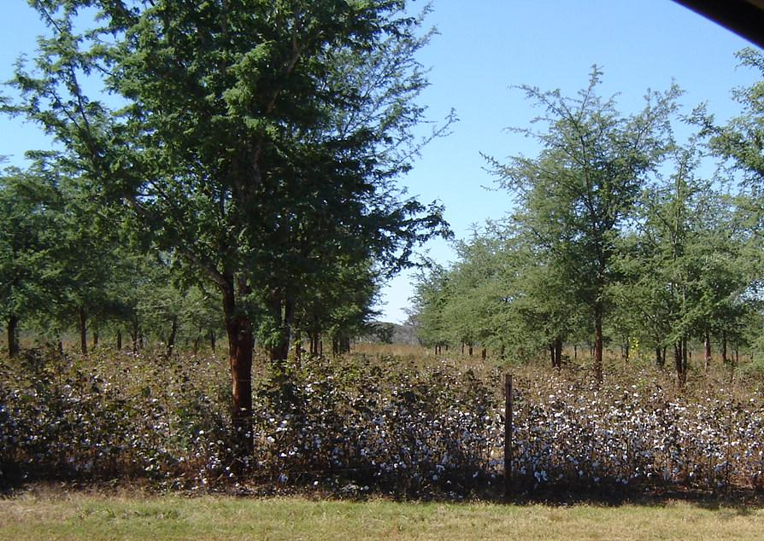
CROP PRODUCTION AND CARBON STORAGE IN AGROFORESTRY TREES

Slide 31
CHALLENGE
HOW REED+ CAN ADD VALUE TO OTHER INITIAVES OR VICE VERSA

Slide 32
END

