Slide 1
Contract Monitoring Program
Michael Jarvis, World Bank Institute
Oslo Governance Forum, October 4, 2011

Slide 2
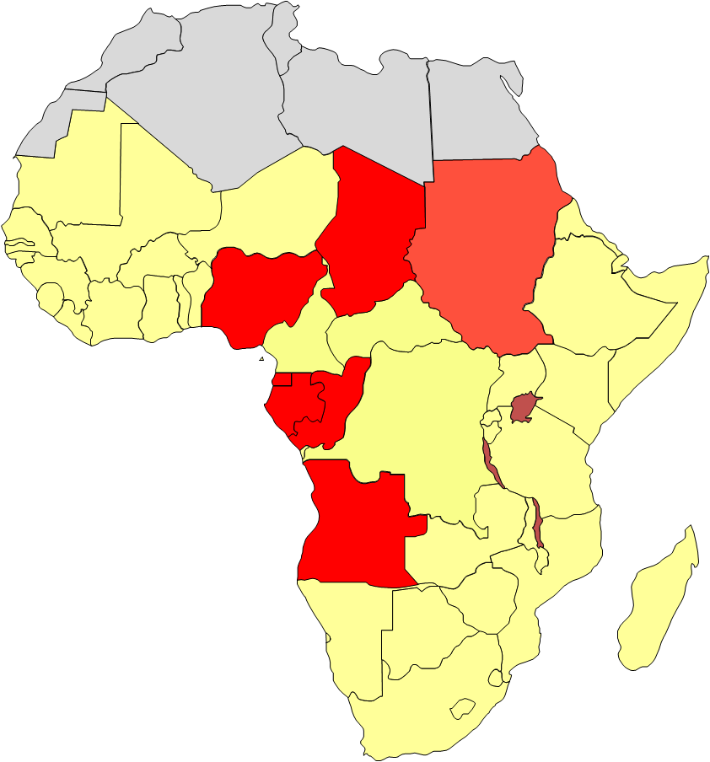
Depletion & Discovery in Africa:
A Decade of Transformation?
Oil Producers 2005 to 2015 (projected)
TUNISIA
Mediterranean Sea
MOROCCO
WESTERN
ALGERIA
LIBYA
EGYPT
SAHARA
Red
MAURITANIA
Sea
MALI
NIGER
SENEGAL
ERITREA
THE
CHAD
SUDAN
DJIBOUTI
GAMBIA
BURKINA
GUINEA
GUINEA
BISSAU
BENIN
NIGERIA
SIERRA
COTE
TOGO
CENTRAL
ETHIOPIA
LEONE
DTVOIRE
GHANA
AFRICAN
LIBERIA
CAMEROON
REPUBLIC
EQUATORIAL
REP. OF
DEMOCRATIC
UGANDA
KENYA
SOMALIA
GUINEA
THE
REPUBLIC
GABON
CONGO
OF THE CONGO
Indian
(ZAIRE)
RWANDA
South
BURUNDI
TANZANIA
Ocean
ANGOLA
Atlantic
Ocean
MALAWI
ANGOLA
ZAMBIA
ZIMBABWE
MOZAMBIQUE
MADAGASCAR
NAMIBIA
SOUTH AFRICA
BOTSWANA
Walvis Bay
Source: Ross (2011)
LESOTHO
SWAZILAND
Indian
SOUTH
AFRICA
Ocean

Slide 3
Multi-Stakeholder Monitoring
“There is an opportunity to build capacity to enable joint government, industry and community involvement in compliance monitoring”
GOVERNMENT
CIVIL SOCIETY / COMMUNITIES
PRIVATE SECTOR

Slide 4
Contract Monitoring Roadmap
Use of Monitoring Data
Reflection on Process
Monitoring Activities
Understanding Content
Accessing Documents
Documents Needed

Slide 5
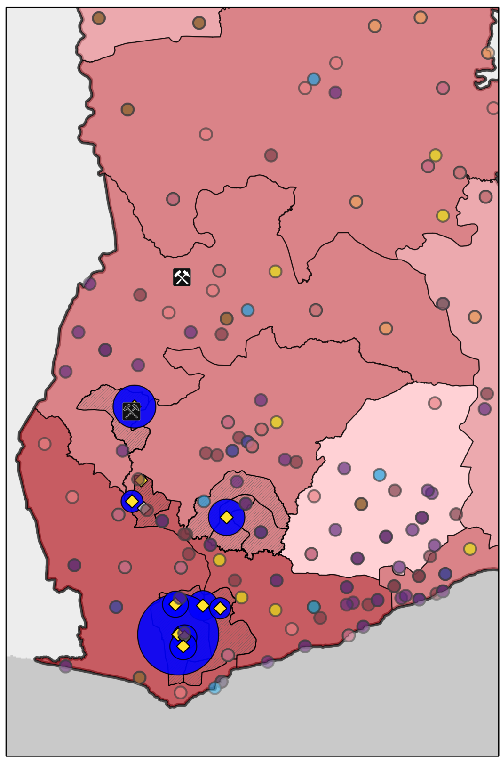


GIS Tools
Users can build custom maps showing:
Data
Company name | Newmont Mining Corporation
Mineral type | Gold
Production (2008) | 524,000 oz
Government receipts reported (2008) | GHC 12,658,757
Company payments reported (2008) | GHC 12,658,757
Active mines, oil and gas wells
Mineral, oil and gas concessions
Government revenues
Socioeconomic indicators
Accra
Industrial mines
Mining royalties paid (2008)
Socioeconomic indicator:
Regional unemployment
Donor projects – mining

Slide 6
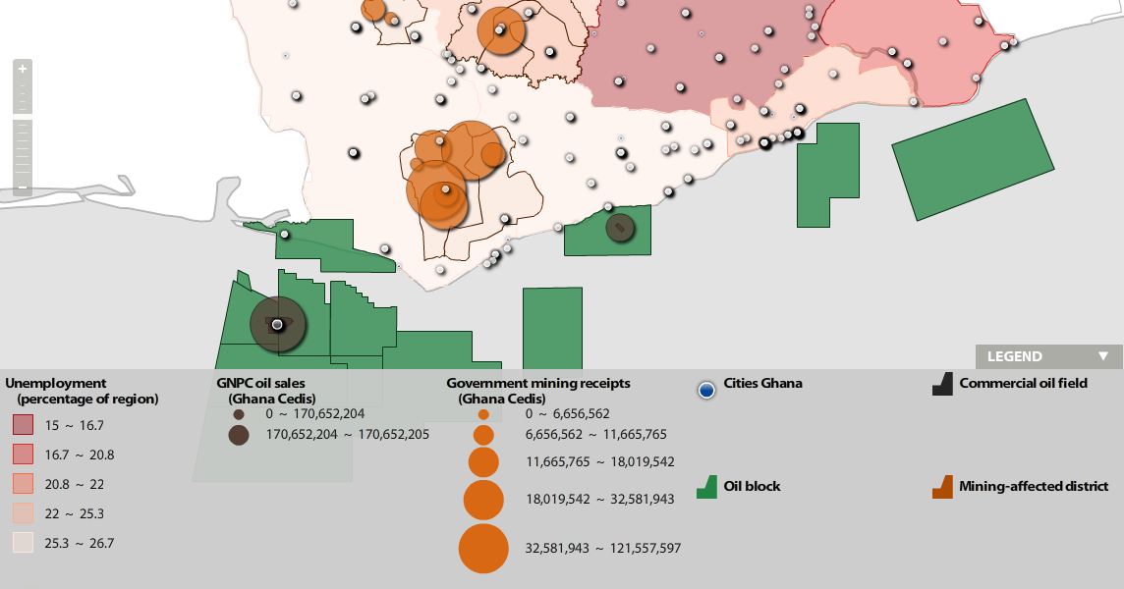
Sales, revenue and unemployment
2. Overview of the mapping platform
Côte d’Ivoire
Ghana

Slide 7

COLLABORATION PLATFORMS

