Slide 1
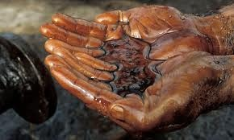
Extractive Industries Transparency Initiative
Oslo Governance Forum
4 October 2011

Slide 2
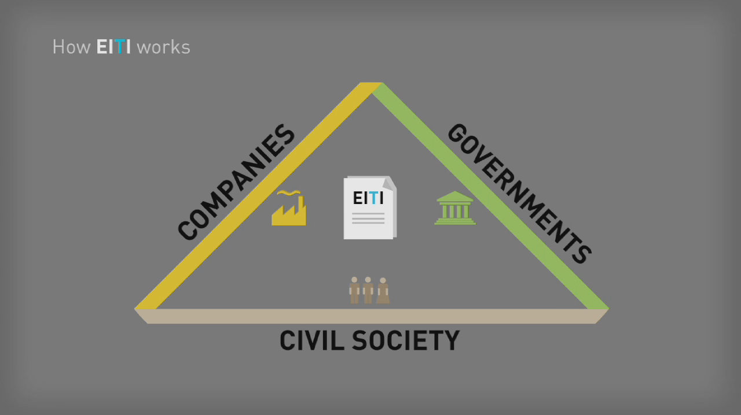

Slide 3
How the EITI works
Companies disclose payments
Government discloses receipt of payments
Government Spending
Award of licenses
&
contracts
Regulation
&
monitoring of operations
Independent verification of tax & royalty payments
”EITI report”
Revenue
distribution
& management
Implementation of sustainable development policies
Oversight by a
Multi-Stakeholder Group
The EITI provides a forum for dialogue and a platform for broader reforms
Notes:
3
This slide: Key elements in every implementing country (companies disclose, governments disclose), independently and credibly verified and reconciled
Process overseen (by multi-stakeholder group of government, companies, civil society), process published → thoroughly discussed
[Press again] EITI: forum for dialogue and platform for boarder reforms
[Press again] – Example: the government along with stakeholders may decide to work for more transparency: in the award of licensing and contracts, and monitoring of the sector
[Press again] – Might push for; more transparency (the distribution of government spending)
[Press again] – Link up with other elements of governance (reform of the public financial and budgeting system)
These additions; entirely up to them. Blue elements: the EITI ‘core’. Power of the multi-stakeholder process; help focus on ‘governance chain’ in the most need of transparency.

Slide 4
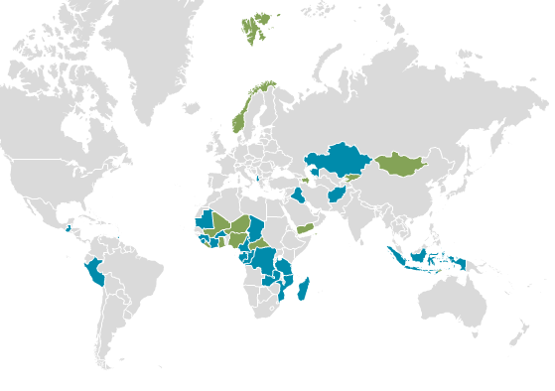
35 Implementing Countries, 12 of which are compliant
Plus Supporting Countries, including Australia, Canada, France, Germany, Japan, the Netherlands, Norway, the UK and the US.

Slide 5
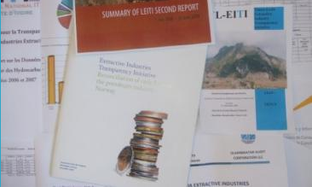
29 Countries now have Published EITI Reports
Almost a billion people with access to credible data on natural resource revenue – often for the first time.

Slide 6
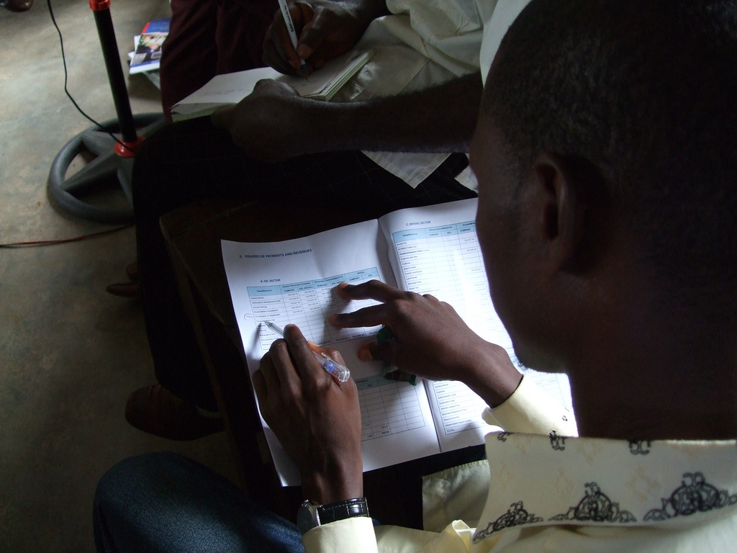
THE EITI:
BUILDS TRUST AND DIALOGUE;
EMPOWERES CIVIL SOCIETY AND COMMUNITIES;
BUILDS CAPACITY AND HELPS MANAGE RISK;
ENHANCES INTERNATIONAL AND DOMESTIC REPUTATION;
CREATES A MORE STABLE AND ATTRACTIVE INVESTMENT CLIMATE.
Notes:
The Liberia story

Slide 7
For Further Information
www.eiti.org

