Slide 1

FLEGT - REDD+ linkages: reflections from VPA negotiations
4 October 2011
Julia Falconer, European Commission, DEVCO C2

Slide 2
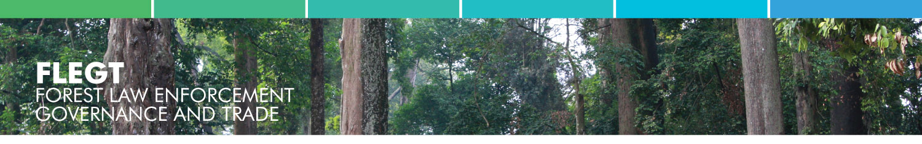
What is FLEGT ?
EU Forest Law Enforcement, Governance & Trade Action Plan
  EU response to tackle illegal logging
Includes action aimed at production and consumption:
  Public and business purchase policies to source legally verified timber
  Support for Producer Country governments and industry
  Trade agreements between producer countries and the EU – Voluntary Partnership Agreements (VPAs)
  Regulation to encourage EU businesses to know their supply chains
Notes:
2

Slide 3
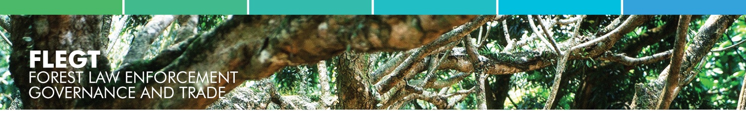
Voluntary Partnership Agreement
A legally-binding trade agreement :
  EU - Partner country
  Aim to work together to stop illegal logging
Objectives
  Control, track, verify & audit legal compliance of all timber production
  License assures markets of legal compliance
Contributes to :
  Good governance & transparency
  Policy and legal reform, incl. on land tenure, access rights
  Capacity building : govt services, operators, NGOs
  Better capture revenues and rents
  Measures to mitigate negative impacts on poor people
Notes:
3

Slide 4
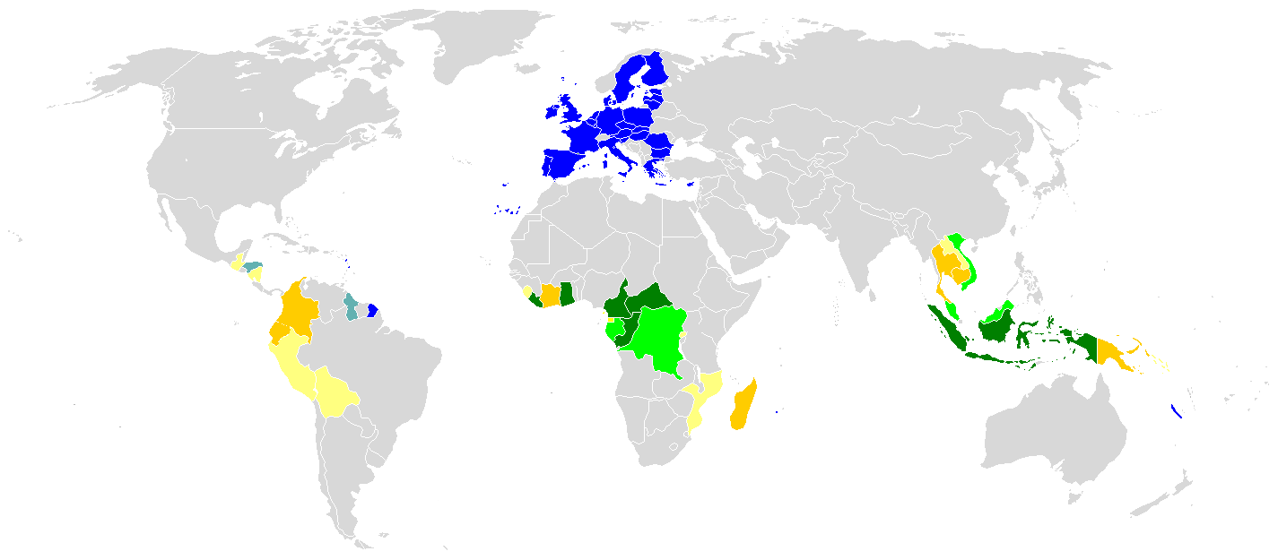










FLEGT licenses (not yet)
System development
Formal negotiations underway
Moving to negotiations
Preparation, in-country consensus building
Introduction to VPAs
FLEGT VPA partner countries
October 2011
Vietnam
Malaysia
Liberia
Indonesia
Ghana
Cameroon
Congo
C.A.R.
Gabon
DRC

Slide 5
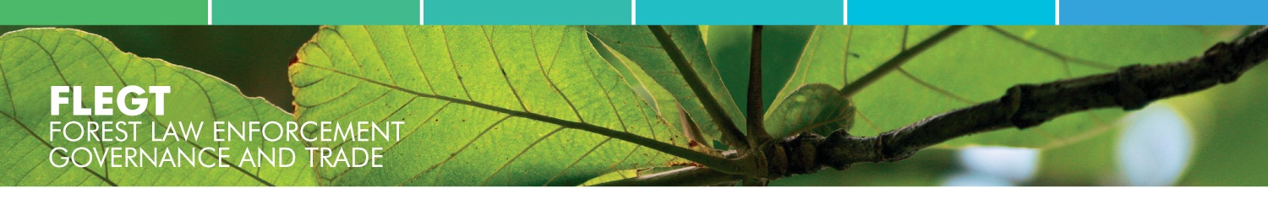
FLEGT & REDD: common challenges
Unclear legal frameworks: land use & forest access
Insufficient information systems & transparency mechanisms
Corruption, ineffective law enforcement and judicial systems
Rights/livelihood risks to local communities
Good governance is crucial to fight against illegal logging, maintaining existing forests and reducing forest degradation and loss
Markets can influence governance
Notes:
5

Slide 6
Weak governance risks for REDD
Effectiveness :
  Discourages investment (unsafe and unpredictable context)
Efficiency :
  Corruption/lack of transparency in payment mechanisms
  Uncontrolled implementation
  Difficult and complex monitoring
Equity :
  Risk of elite capture
  Poses human rights risks to local communities
Notes:
6

Slide 7
FLEGT & REDD common requirements
  Multi-stakeholder planning processes (trust and clarification)
  Credible Measurable Reportable Verifiable systems
  Establishing buyer confidence (carbon and timber)
  Control of international leakage and circumvention
  Mitigation of unintended negative consequences on local communities
Notes:
7

Slide 8
FLEGT & REDD: building synergies
Opportunities for
  Stronger political attention on forest issues
  Clarification of resource rights and tenure
  Strengthening of law enforcement and judicial systems
Potential areas of synergies:
  Addressing the drivers of forest loss
  Addressing challenges of governance and illegality
  Building effective forest governance and management
  Designing and implementing robust and effective mechanisms for MRV
  Promoting harmonised aid delivery
Notes:
8

Slide 9
Key lessons from FLEGT VPA processes
Inclusiveness:
  Local NGOs / International NGOs
  Private sector treated as a partner (focus on trade)
  In Liberia, communities were directly involved
National dialogue in parallel with int’l VPA negotiations:
  Pressure to maintain momentum because of the bilateral negotiations
  Time for government , civil society, private sector to form their opinion, engage in the process and build trust
Structured process and outputs
  Roadmap, Agreement content, Implementation structures
Implementation challenges
  Sustaining political momentum
  Financing: shared responsibility (govt, private sector, development partners)
Notes:
9

