Slide 1
REDD+ and NR governance
Ivar Jørgensen, Norad, Oslo, October 3-5, 2011

Slide 2
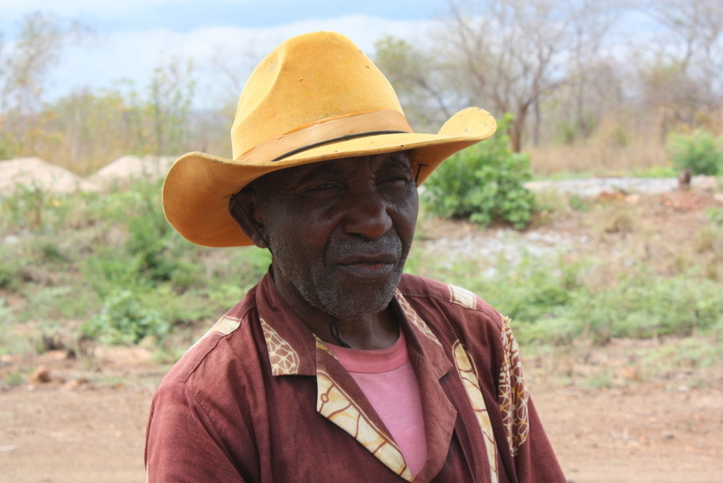
...Governance of natural resources can be understood as the interactions among structures, processes and traditions that determine how power and responsibilities are exercised, how decisions are taken, and how stakeholders have their say in the management of natural resources ...

Slide 3
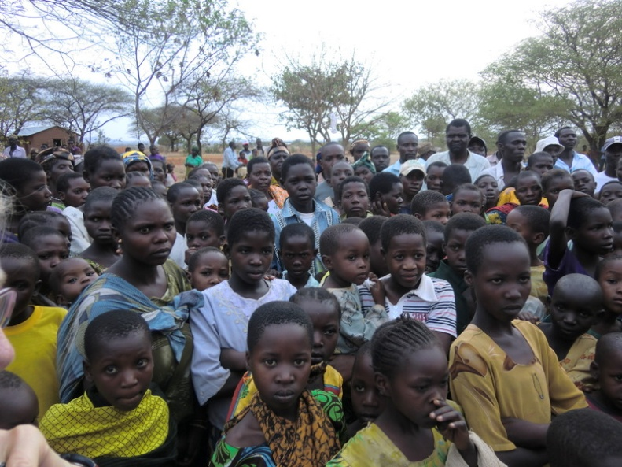
Importance of governance for Natural resources
Norway has grown rich on its natural resources – rules and systems for decision making and participation have been key to our progress
Common land management in Norway is a good case study
In many countries there are overlapping governance systems, and traditional users risk losing out
REDD+ is a good example of the need to link local governance with national and global systems

Slide 4
What is REDD+ ?
Reduced Emissions from Deforestaton and forest Degradation – a climate change mitigation effort
A fairly new concept that aims at organising payments to those who change the pattern of deforestation
It presents huge governance challenges – so plenty of work for the governance community!

Slide 5
Examples of support from Norway to NRM governance systems
NICFI: REDD+ support – building global, national and sub-national institutions for REDD+ - Real time evaluation of NICFI gave positive feedback
Forest and land administration including community forestry (e.g. Uganda, Zambia)
Oil for development – support to building institutions in a number of countries in Africa, Asia, Latin America
Governance of fisheries in e.g. Indonesia, Vietnam
Mining sector support (e.g. in Zambia)

Slide 6
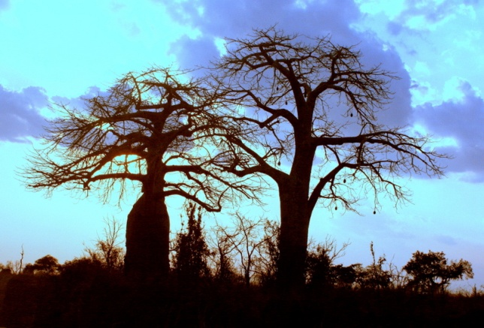
Norway supports and/or collaborates with many of the key players in development of governance structures for REDD+ and NRM
UN –REDD, FAO, UNDP, UNEP (including OGC)
U4, Intosai, Interpol, EITI
WB/FCPF, Profor, BioCF
Other bilateral agencies
FLEGT
Partner governments in Brazil, Indonesia, Guyana, Tanzania ++…
A host of NGOs and research organisations at global and local levels

Slide 7
Key priorities in NRM governance:
Accountability (including anti corruption, credible fund management systems)
Effectiveness (including co-benefits; land tenure ....)
Efficiency (including limiting the transaction costs; aggregation mechanisms )
Fairness /Equity (including gender; arbitration; benefit sharing arrangements)
Participation (including FPIC)
Transparency (including active information sharing)

Slide 8
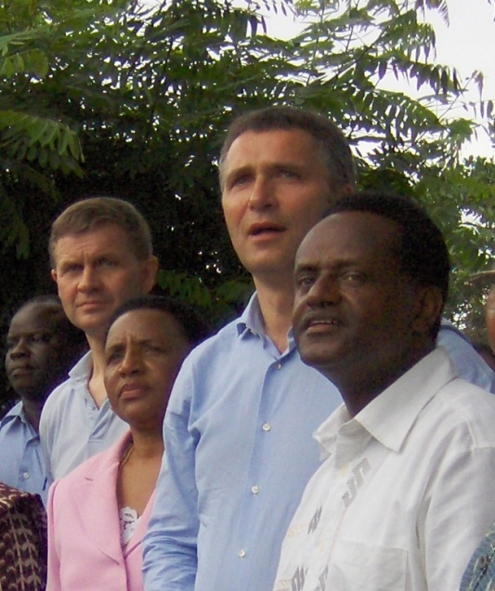
Some traits of NRM governance
Needs multiple levels of governance: Global –National – Local levels
No single recipe: each case will vary with local conditions
Importance of consultations at all levels, acceptance that developing good governance systems takes time
Special attention to indigenous peoples, forest dependent communities, gender

Slide 9
Why is gender important for
REDD+ governance?
Women have limited formal and informal power in forest governance
Women have limited access to justice, markets, capital, education ….
Women have limited roles in forest management decisions
Impacts from loss of forest goods and services are different between men and women
Gender is not yet well addressed in UNFCCC or in safeguard processes
Mismatch between official policies and realities regarding equal rights and equal participation
Benefits to women give different effects than benefits to men

Slide 10
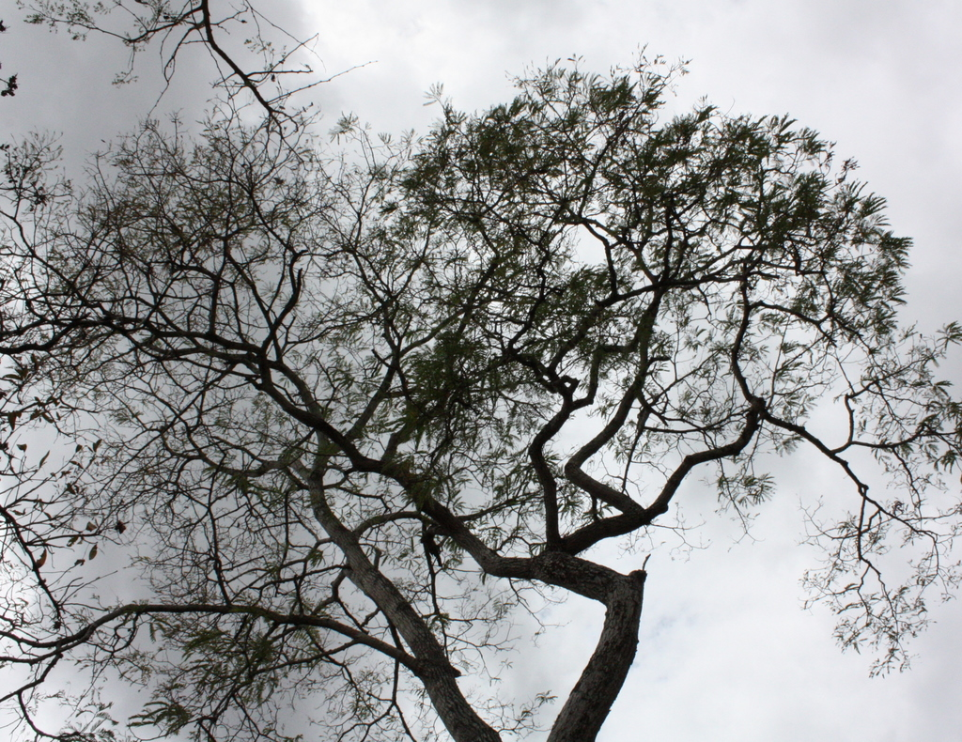
Challenges in building REDD+ architechture
REDD+ will not materialise unless there is an agreement at the global level , and it will not work unless it brings benefits to the local stakeholders
Only developing countries, many with weak governance systems, are eligible to REDD payments – risks of land grabbing, poor benefit sharing, corruption and fraud will be a challenge
It needs independent verification – both buyers and sellers of carbon have vested interests in boosting the numbers
Institutions to handle MRV ; leakage risks
The global community is in a hurry to make it work

Slide 11
Steps on the way to good governance for REDD+
Consultations and governance assessments
Policy development
Social and environmental safeguards
Tenure reform and land formalisation processes
MRV and reference levels
General anti-corruption efforts
Improved law enforcement
Transparent transfer and use of REDD+ funds
Education and capacity building , and repeat consultations......

Slide 12
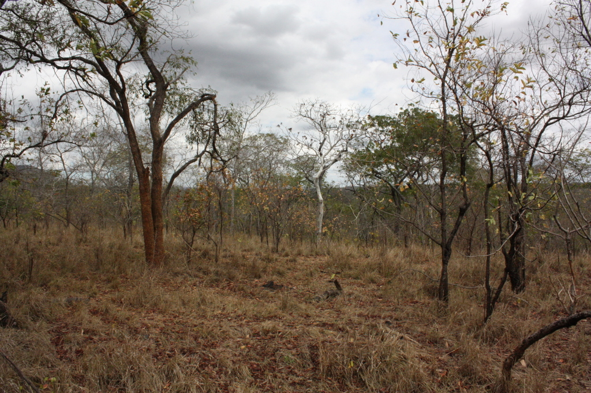
Characteristics of good vs bad governance in NR
Bad governance:
Competition and over-exploitation, degradation of the resource base
Insecure and biased property rights, elite capture, inequitable benefit sharing
Social and economic exclusion, conflict
Low livelihood outcomes, short term decisions
Good governance
Effective institutions govern the resource base
Equitable distribution, clear tenure rights
Access to knowledge and information
Good livelihood outcomes, room for long term planning

Slide 13
THANK YOU!

