Slide 1

FRAMEWORK FOR ASSESSING
AND MONITORING FOREST GOVERNANCE
Eva Müller
FAO

Slide 2

Outline
Background
Purpose of the framework
Intended users
Structure/Content
Plans for implementation
Transparency and accountability

Slide 3

Background
Internal and external pressures on countries to improve forest governance
Existing initiatives use different approaches for different objectives
    Agreement by countries and experts on need for common approach
Notes:
International requirements
Legality verification, REDD+, etc.
Domestic governance reform pressures
decentralization
land tenure
accountable and responsive government

Slide 4
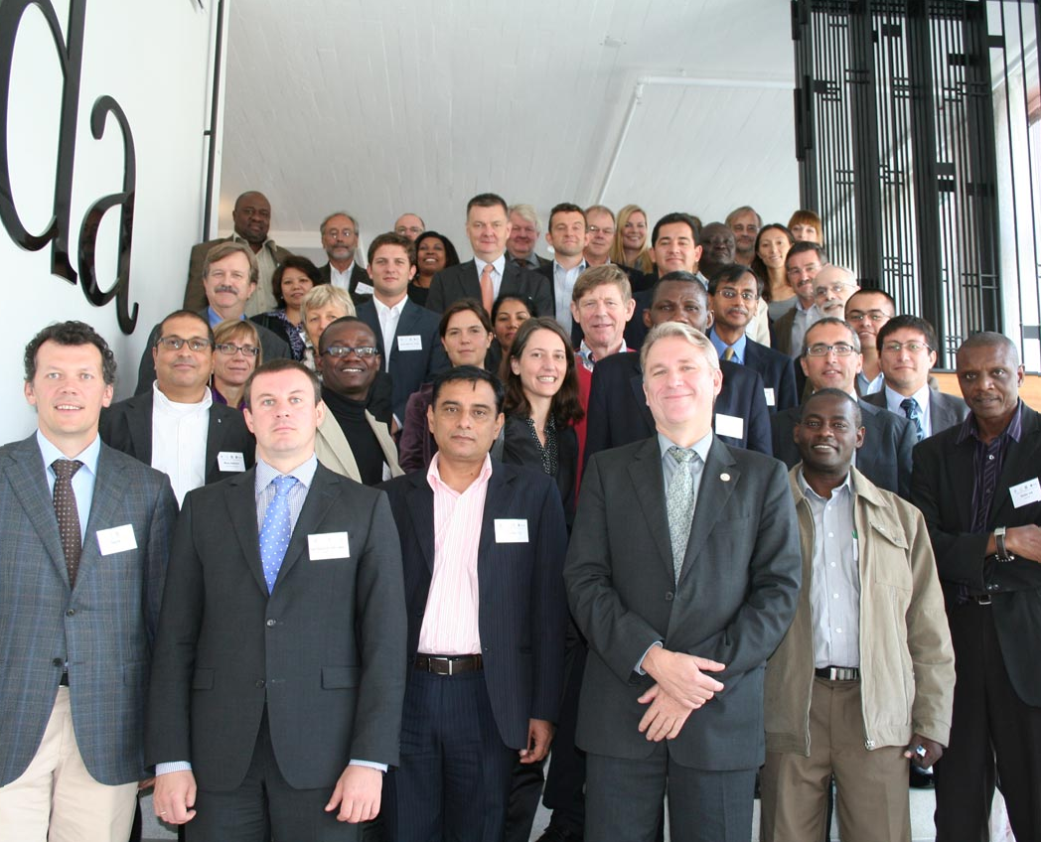
Stockholm Symposium 2010
Simple framework needed
Common terminology
Core set of parameters
Indicators to be defined by countries
Expert group to develop Framework
Notes:
International requirements
Legality verification, REDD+, etc.
Domestic governance reform pressures
decentralization
land tenure
accountable and responsive government

Slide 5
Objectives of Framework
Facilitate description, diagnosis, monitoring, assessment and reporting on the state of governance in a country’s forest sector
Enhance common understanding and communication about forest governance
Avoid duplication of forest governance monitoring and assessment efforts

Slide 6
Intended Users
Anyone involved in forest governance
National governments: for forest governance self-diagnosis, monitoring and assessment
Sub-national governments and NGOs: for specific forest governance processes, projects and initiatives
Advocates, investors, donors, researchers and generators of forest governance data: for organizing, analyzing and communicating forest governance information

Slide 7
Features
A tool, not a methodology
Builds on approaches and lessons from forest governance-related processes and similar initiatives using indicators
Includes core parameters already shared by many processes and initiatives
Based on common understanding of principles and attributes of governance
Provides menu of options
➔

Slide 8
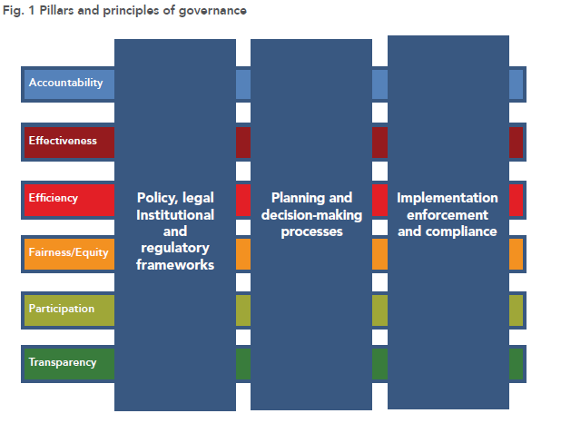

Slide 9
Elements of the Framework
Pillars (3) - fundamentals of forest governance
Component (13) - an essential element of a pillar
Subcomponent (78) - an identifiable element of a component, an important aspect of forest governance by which a component may be assessed
Indicator – a quantitative, qualitative or descriptive attribute that if measured or monitored periodically, indicate the direction of change in a subcomponent

Slide 10

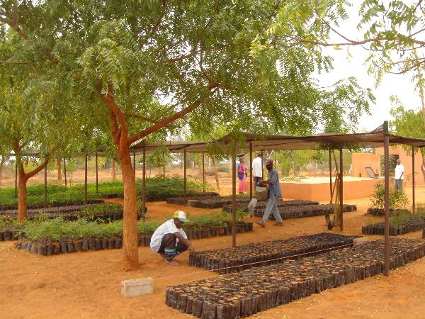
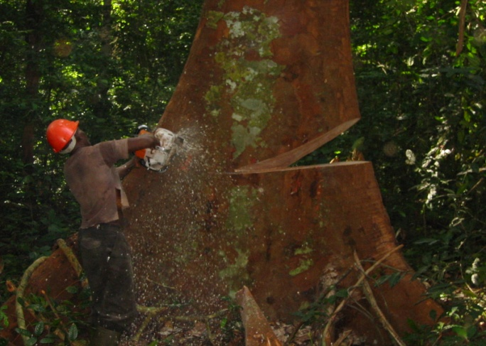
Using the Framework
➔The Framework can be customized for/by different users:
used in whole or in part depending on the purpose
simplified by focusing only on certain pillars and components
Expanded if aspects of interest to the user are not adequately covered

Slide 11
Implementation
To be tested in different contexts:
FLEGT: ACP-FLEGT Programme
REDD+: PGAs
WB Forest Investment Programme (FIP)
National Forest Monitoring and Assessment
Through multi-stakeholder processes and fora

Slide 12
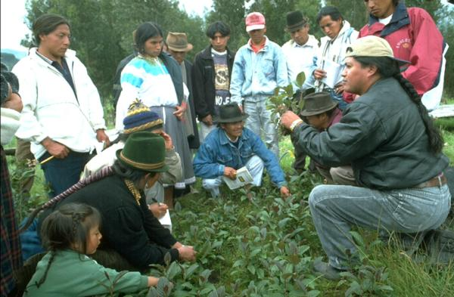
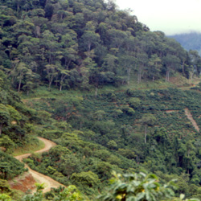
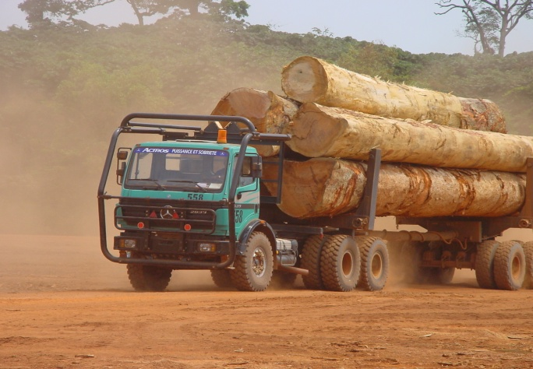
Transparency and accountability
Embedded in the components and subcomponents
Assessment and monitoring based on the framework can lead to improvements
.....if there is political will

Slide 13
Thank you
www.fao.org/forestry
www.profor.info

