Slide 1



Participatory Governance Assessment for REDD+: The pilot process in Nigeria
Oslo Governance Forum 3-5 October, 2011
By
Salisu Dahiru
National Coordinator REDD+
Federal Ministry of Environment, Nigeria
sdahiru85@yahoo.com

Slide 2
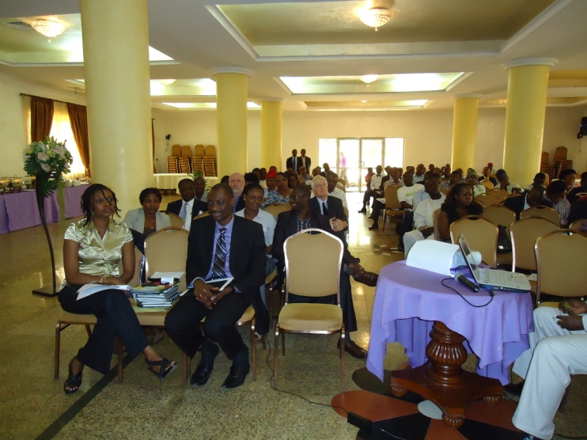
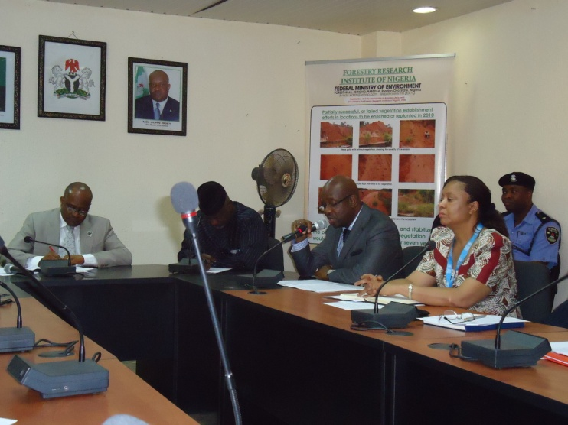
REDD+ Process in Nigeria
Context
2009: Federal Government of Nigeria engage in REDD+ and joins UNREDD
2010: With support from UN Agencies (UNEP/FAO/UNDP) undertook steps towards its national REDD+ readiness process
Nigerian stakeholders, with UN-REDD guidance, worked intensively to prepare, consult & validate a National REDD+ readiness Programme Document
2011: Nigeria submitted its Draft NPD to UNREDD at PB6
Will be considered for approval at PB7;

Slide 3
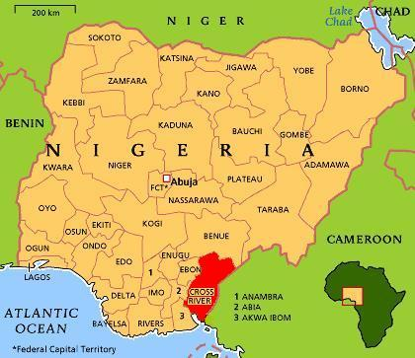
NIGERIA: a two-track approach to REDD+ readiness
Federal Level: Capacity-building & strategic framework for REDD+ [national level]
Cross River State: Intense REDD+ readiness & demonstration model for the country
  [sub-national level]

Slide 4
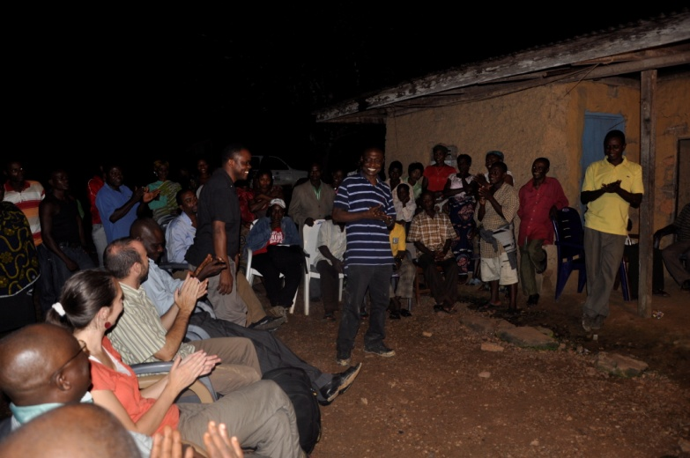
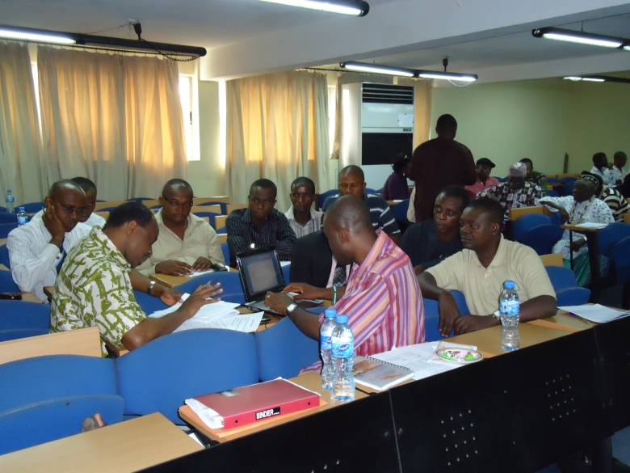
For Nigeria, a PGA/REDD+ is a key, early-action front
A sound governance system is central to REDD+ policies and finance success;
PGA process emphasizes the importance of participation of all stakeholders from the very beginning;
Promotes understanding of the diversity & divergence of REDD+ stakeholders;
Facilitates establishment of an information & monitoring system;

Slide 5
For Nigeria, a PGA/REDD+ is a key, early-action front (Contd.)
Ensures benefits of an inclusive and dynamic process;
Provides opportunity to design and deploy a country-led governance monitoring;
Enhance governance for REDD+ from the start and the inside;
Avoid the governance crisis in the oil sector – plus creating a best-practice model for governance in development mechanisms;
Stimulate transparency; legitimacy; accountability; stakeholder dialogue & monitoring as the bases for conserving forest resources;

Slide 6
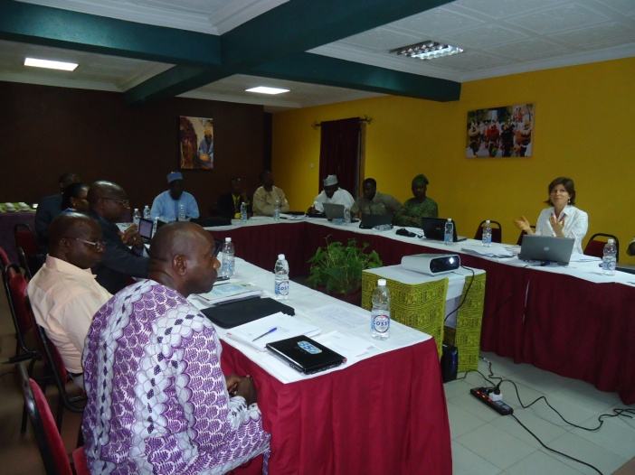
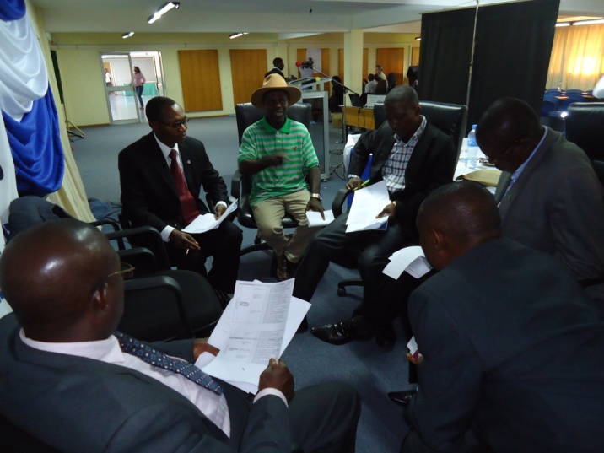
Start and status of Nigeria’s PGA process
Determined to monitor how governance and social safeguards for REDD+ are promoted, addressed and respected, Nigeria initiated steps towards its PGA process, comprising;
Consultation with key REDD+ stakeholders in Lagos (20 May 2011);
Consensus was reached on the key governance issues to be assessed;
PGA process envisage 2 phases:
Phase one: Preparatory; Development of PGA methodology (2011-12);
Phase two: Piloting the methodology in CRS & a 2nd State (2012-13)

Slide 7
Identification of stakeholders & participants
Federal level – A “Governance Working Group” will be created as part of the existing multi-stakeholder NTC on REDD+
Replicated in CRS; later scaled up to 4 other states
REDD+ Governance Research Team
Stakeholders & Participants for Nigeria’s PGA process will be drawn from: government officials, civil society actors (representatives of CSO platforms on REDD+), forest-dependent communities, national data and fiduciary control agencies, academia, and the media, among others

Slide 8
How PGA will enhance & enrich Nigeria’s REDD+ process
The 5 Priority areas to be addressed by the PGA/REDD+;
  Policy and legislation concerning REDD+ and democratic governance;
  Institutional capacity of government agencies at federal, state and local levels;
  Anti-corruption strategy for REDD+;
  Opportunities for civil society and forest-dependent communities to participate in decision-making processes related to REDD+;
  Benefit distribution system for REDD+;
Some 35 issues identified
Fewer indicators to be identified in order to make a governance monitoring system feasible
Outcomes will strengthen national capacity to assess REDD+ governance; and to use governance data to inform policies, to monitor REDD+ readiness and to hold various stakeholders to account

Slide 9
Progress & next steps in PGA/REDD+ in Nigeria
Key governance domains, issues & risks for REDD+ identified;
Technical consultation held to review Nigeria NPD in conjunction with the draft UN-REDD Social and Environmental Principles & Criteria, including Principle 1 on ‘’Democratic Governance’’;
Next Steps: Training workshop on governance assessment methodologies relevant to REDD+ ; to develop indicator set;
Stakeholders’ consultations at the state level (CRS) to seek feedback on the draft indicator set;
Development & Field testing of data collection instruments.

Slide 10
Concluding Remarks
Nigeria is committed to undergoing the PGA; as REDD+ readiness priority; and as a tool to provide potential donors and beneficiaries sufficient confidence in the Nigeria REDD+ mechanism to make it work;
PGA to assist the national REDD+ process in establishing an information-sharing & monitoring system on how governance-related safeguards are promoted, addressed and respected;
Nigeria appreciates support of the OGC; and in having selected Nigeria as one of the 2 pilots for PGA/REDD+;
Nigeria looks forward to further opportunities for collaboration & support in other areas

Slide 11
Thank You
for
Listening!
sdahiru85@yahoo.com
Tel: +2348030570625 (mobile)

