Slide 1
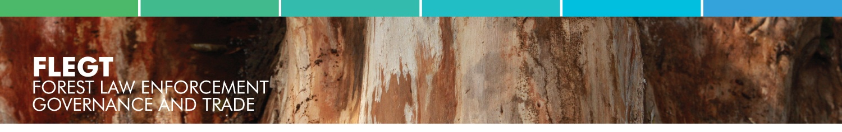
FLEGT : lessons for participatory processes
3 October 2011
Julia Falconer, European Commission, DEVCO C2

Slide 2
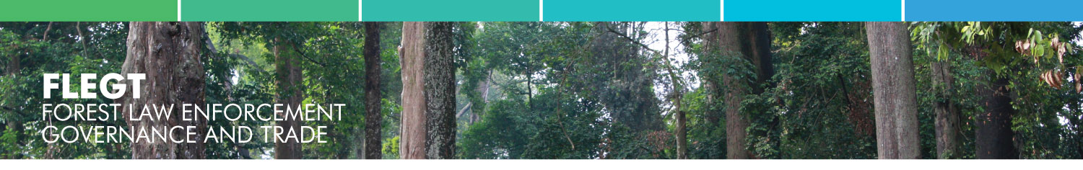
See briefing notes
What is FLEGT ?
The EU Forest Law Enforcement, Governance and Trade Action Plan (2003).
  EU response to tackle illegal logging
Includes action aimed at production and consumption:
  Public and business purchase policies to source legally verified timber
  Support for Producer Country governments and industry
  Trade agreements between producer countries and the EU –VPAs
  Regulation to encourage EU businesses to know their supply chains
Notes:
2

Slide 3

Voluntary Partnership Agreement
A legally-binding trade agreement :
  EU - Partner country
  Aim to work together to stop illegal logging
Objectives
  Control, track, verify & audit legal compliance all timber production
  License assures markets of legal compliance
Contributes to :
  Good governance & transparency
  Policy and legal reform, incl. on land tenure, access rights
  Capacity building : govt services, operators, NGOs
  Better capture revenues and rents
  Measures to mitigate negative impacts on poor people
Notes:
3

Slide 4
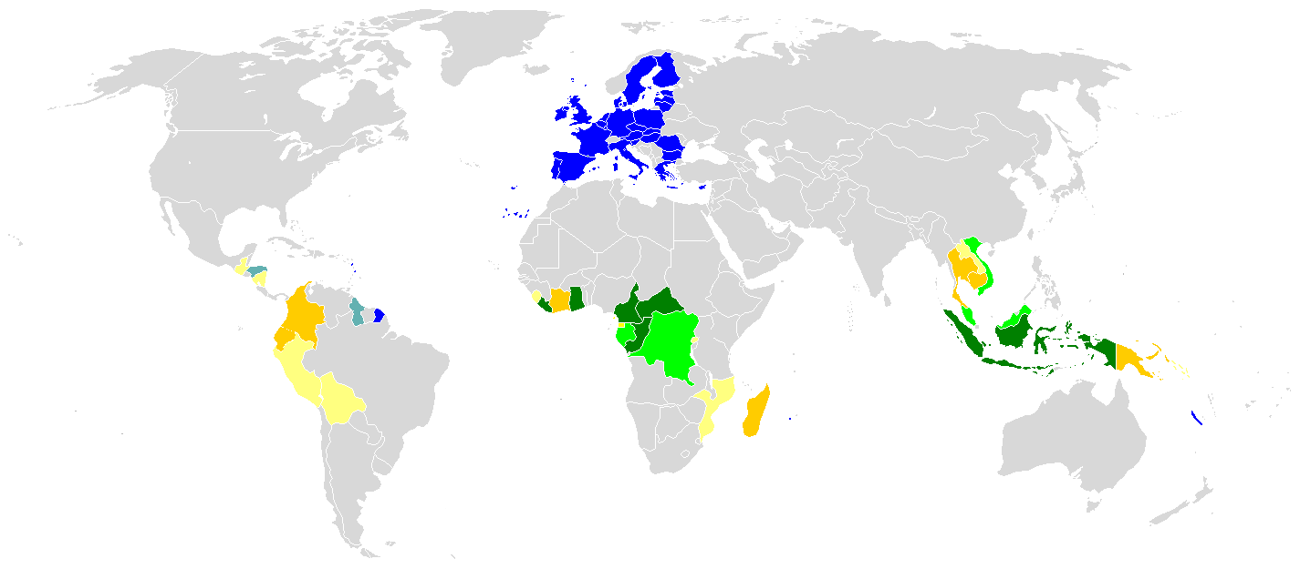










FLEGT licenses (not yet)
System development
Formal negotiations underway
Moving to negotiations
Preparation, in-country consensus building
Introduction to VPAs
FLEGT VPA partner countries
October 2011
Vietnam
Malaysia
Liberia
Indonesia
Ghana
Cameroon
Congo
C.A.R.
Gabon
DRC

Slide 5
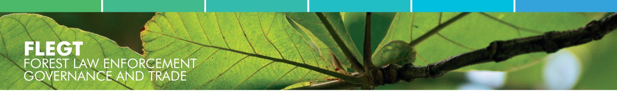
Key features of VPA
Legality Definition: clarity
Legality Assurance System to verify legal compliance
Licensing
Independent audit
Transparency measures
EU has reqts set out in briefing notes but no blueprint
  Legality ➔ based on countries’ legal framework
  LAS ➔ evaluated against established criteria
  Multi-stakeholder process: to ensure credibility both nationally and internationally
Notes:
5

Slide 6
Key governance challenges in VPAs
Unclear or conflicting law on forest rights, obligations, fees
Weaknesses in law enforcement and corruption
Unregulated domestic market & artisanal sector
Deficiencies in harvest control system : Logging outside allocated areas; not following management prescriptions; not respecting social obligations; not paying full fees; theft; etc
Limited accountability and limited information in public
Transparency in allocation & application forest mgt norms
Limited involvement of civil society in policy & monitoring
Limited rights (benefits) communities in management
Notes:
6

Slide 7
How NGOs see result of platform
 |  | 2007 | 2009
Civil society
 | NGO coordination | None | NGO Platform
 | NGO involvement in drafting laws | None / Very limited | Foreseen
Multi-stakeholder dialogue
 | Structured NGOs – Government- Industry dialogue | None / Very limited | Technical secretariat Nat. Consultative Group JIC
Policy reforms
 | Legislation to promote and protect the rights of indigenous peoples | Law drafted but pending | Linked to FLEGT license
 | Forest policy reform based on good governance principles | Not foreseen | Linked to FLEGT license
 | Civil society participation in concession allocation processes | Not foreseen | Linked to FLEGT license
 | Civil society and community involvement in the development of management plans and social agreements (cahier de charges) | Not foreseen | Linked to FLEGT license
 | Involvement of communities and civil society in the management of forest concessions | Not foreseen | Linked to FLEGT license
 | Community forestry | Not foreseen | Linked to FLEGT license
Transparency and information exchange
 | Availabilit of laws, social agreements, management documents, taxes, etc. | None / Very limited | Foreseen
Independent observer
 | Long-term commitment | 3-years project | Funding foreseen in VPA
 | Involvement of local civil society | Shadow team | Foreseen
Source: FERN, June 2009
Notes:
7

Slide 8
Features of VPA stakeholder process
The EU does not drive, instruct, or participate in stakeholder dialogue or internal country negotiations
But EU encourages serious stakeholder process– the quality & results are important
Iterative participation throughout a structured process: preparations, negotiations, development, implementation – not a one off consultation
Notes:
8

Slide 9
The process
In country consensus building
Information dissemination
Bilateral Negotiations
Negotiations with EC on VPA –road map
Negotiations AMONG stakeholder groups in VPA country
Agreement Ratification
VPA initialed
Negotiations WITHIN stakeholder groups
Stakeholders organize for discussion
Country debate and analysis on legality, governance challenges
VPA ratified in producer country and EU
System Development
Tracking & law compliance monitoring developed
Licensing system created
Independent auditor
Implementation
FLEGT Licenses issued
Indep Monitor functioning
Joint committee
timber controlled at EU borders
National stakeholder structures established
Guarantees stakeholders support and market confidence
Strengthens partner country’s ownership of results
Notes:
9
At the end, EU Customs will exclude timber with no FLEGT license from that country
will secure and improve EU market access
Characteristics : after the preparation phase, the formal negotiation uses a specific framework, a clear timeframe and offers a platform which is focused (not blabla ); this helps strengthening the partner country’s ownership of the results.

Slide 10
Informal stages: consensus building
Encourage development of dialogue and stakeholder platforms (with direct link EU & country stakeholder groups)
Stakeholder groups identify governance challenges, legality and regulatory problems
Stakeholder groups encouraged to establish representational mechanisms
Facilitated by Govt, by on-going projects, EU offices, external stakeholders.
Some countries have a “FLEGT envoy” to assist
Result: decision on whether or not to enter negotiations
Notes:
10

Slide 11
The negotiations
Negotiations between EU and partner
Each side constitutes a negotiating team
Agree a roadmap for the process
Negotiations between stakeholders in partner country
Self defining (NGOs: green, human rights, anti-corruption, Parliament, private sector: artisanal; industry)
Cross Govt: Finance, Justice, Trade, Forests, etc
Structures to support negotiations (eg. Steer committees, technical groups, consultative groups)
Facilitation: Secretariat/ Envoy/ Projects
Negotiation on content of VPA and reform agenda
Notes:
11
You understand that it is a team

Slide 12
Stakeholders in negotiations: eg Cameroon
GOVERNMENT
PRIVATE
NGO
Facilitator
President’s office
Prime Minister’s office
Parliament (2)
Commerce
External relations.
Justice
Home & land use
Finances
Forest and wildlife (3)
Local authorities
Forest owners & traders associations (syndicats)
SGS
ECFP (Platform of 30 NGOs dealing with environment, human rights, development)
IUCN
GTZ
Notes:
12

Slide 13
Time frame: eg Cameroon negotiations
6 formal sessions in Brussels and Yaoundé
16 technical meetings, either by videoconference, or face to face to prepare formal sessions
10 meetings in Cameroon on specific technical issues, framed around how to address governance or technical challenges
16 meetings for Cameroon stakeholders to prepare meetings with EU
Cameroon: 2 and a half years in negotiation
Congo less than 1 year
Malaysia still going after 5 years…..
Notes:
13

Slide 14
Challenges of stakeholder process
Mechanics:
  How selected?
  Representation of varied interests – constituency & legitimacy
  Numbers: practicality versus voice
  Organisational complexity: techn working groups/negot teams
Committees: balance of interests skilled negotiator/ facilitator
Representatives: capacity & interest to channel info& ideas to constituency
Time scales: Too fast? Too slow?
Stakeholder contributions (timing, quality) Walk outs
Role of EU and external stakeholder interests: increased suspicion? Or legitimacy and support?
Notes:
14

Slide 15
Lessons and results:
Negotiation Roadmap: sets ambition, steps & timeframe
Multi-stakeholder platform that delivers :
  Agreement on forest governance, clarity legal frame & technical systems;
  Time-bound and output-oriented stakeholder engagement
  In-country negotiation dynamic can build country ownership
Structure for stakeholders in implementation and oversight
  Important to maintain support and credibility
Joint monitoring &reporting builds accountability for results
Results framed in legally binding bilateral treaty
Notes:
15

