Slide 1
Monitoring and MRV context of the Country
National Forest Inventory (NFI): the previous NFI has not covered some forest type (the sampling strategy did not covered some forest types)
Forest Monitoring System (FMS): one national forest cover assessment was performed (coarse resolution), and several sub-national land cover assessment (not compatible between each other)
Green House Gas Inventory (GHG-I): mainly performed by contracting external resources

Slide 2
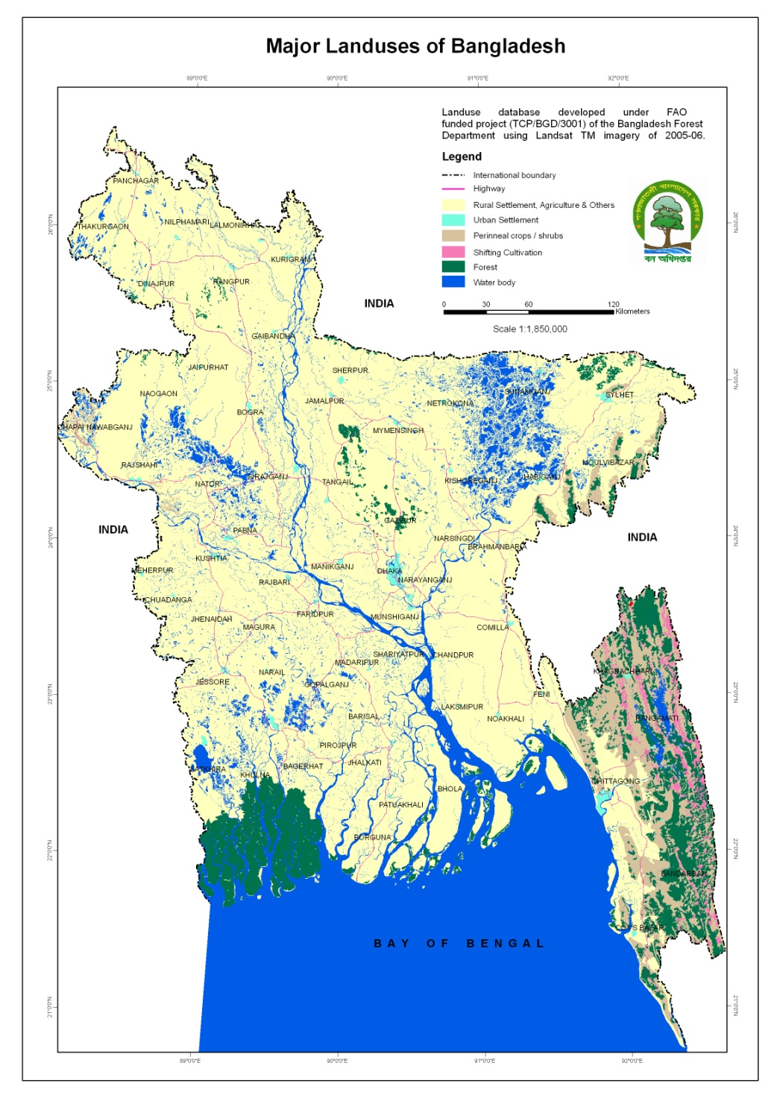
Experiences in inventorying National Forests
NFA (2005-2007)
    Sample intensity: 0.000054
    Number of sample: 296

Slide 3
Experiences in inventorying at National Forests
Inventory of the Hill Forests
Inventory of the Plain land Sal Forests
Inventory of the Sundarban Reserved Forests
Inventory of the Coastal Afforestation
Experiences in Carbon inventory at National Forests
Sundarban Reserved Forests
6 Protected areas of the Hill Forests

Slide 4
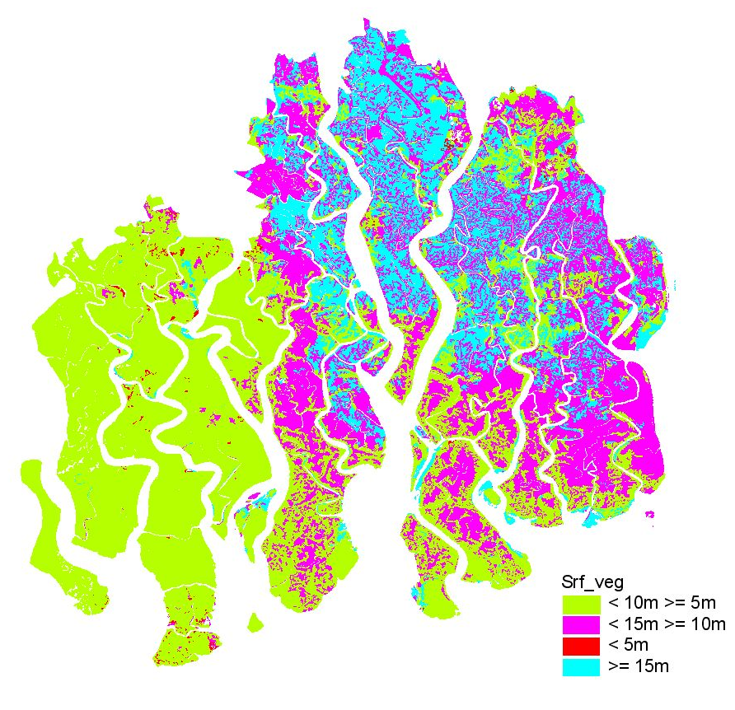
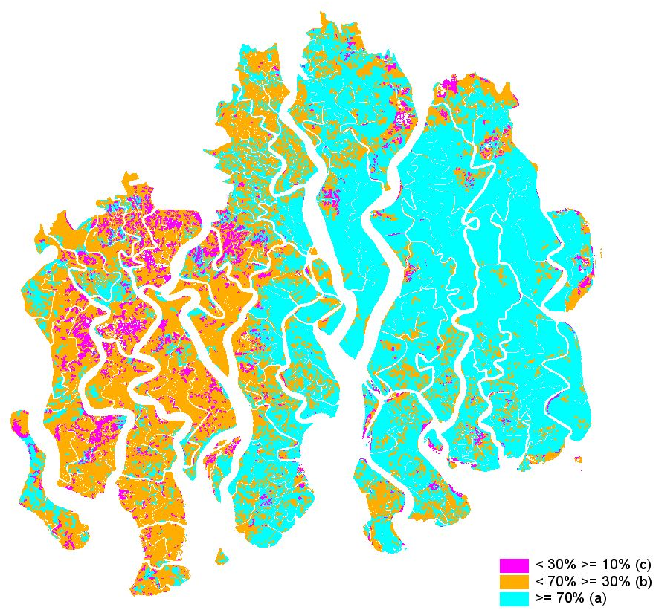
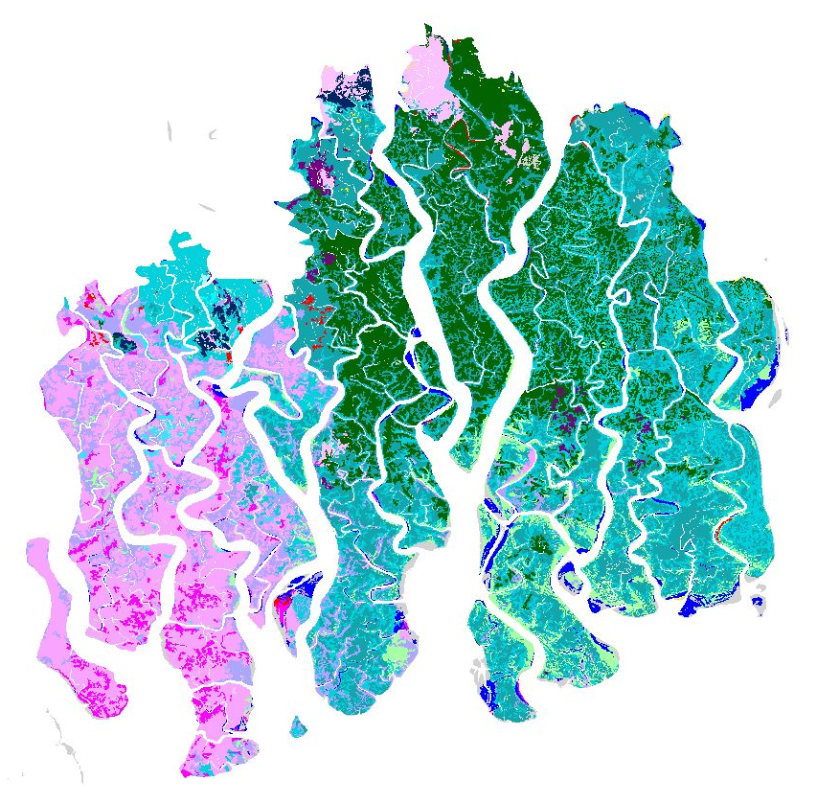
Experiences in assessing forest resources using
Remote Sensing
SRF assessment and mapping was done using aerial photo of 1958, 1981, 1995
Height classes
Forest types
Density classes

Slide 5
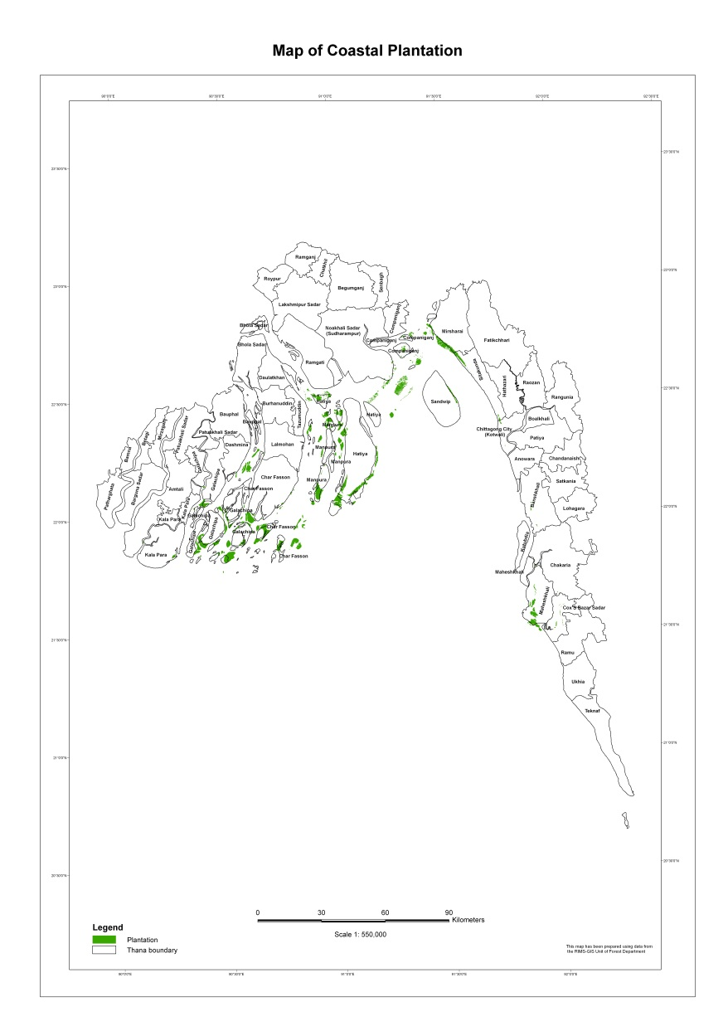
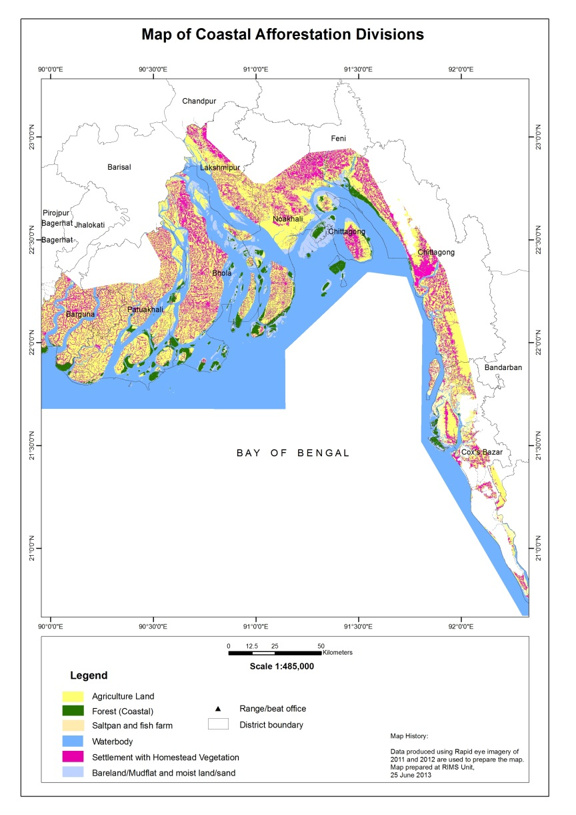
Experiences in assessing forest resources using
Remote Sensing
Coastal afforestation assessment and mapping was done using aerial photo of 1995 and Rapid Eye imagery of 2012

Slide 6
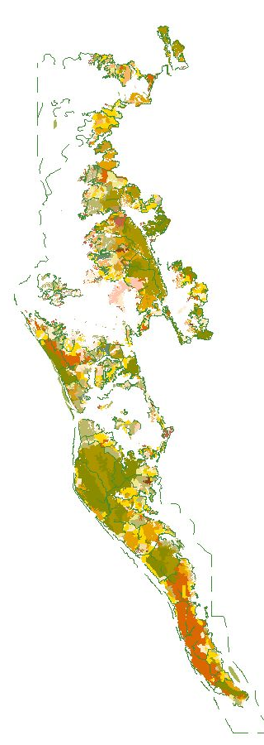
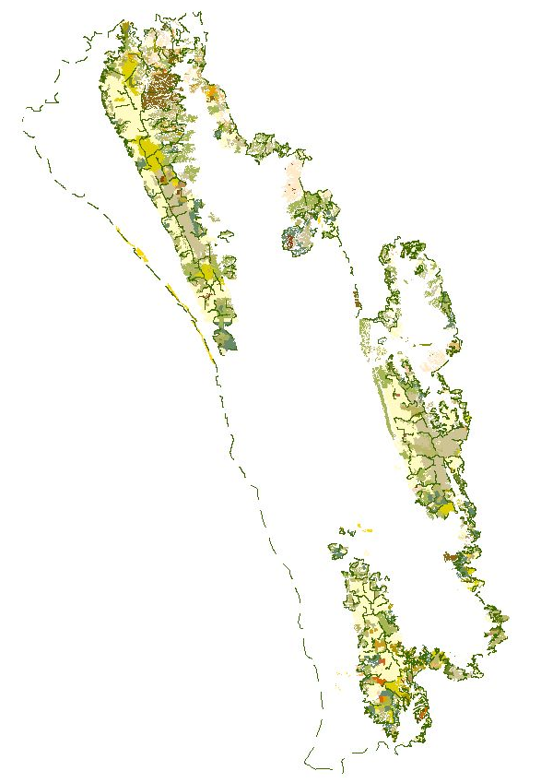
Experiences in assessing forest resources using
Remote Sensing
Hill forest assessment and mapping was done using aerial photo of 1995

Slide 7
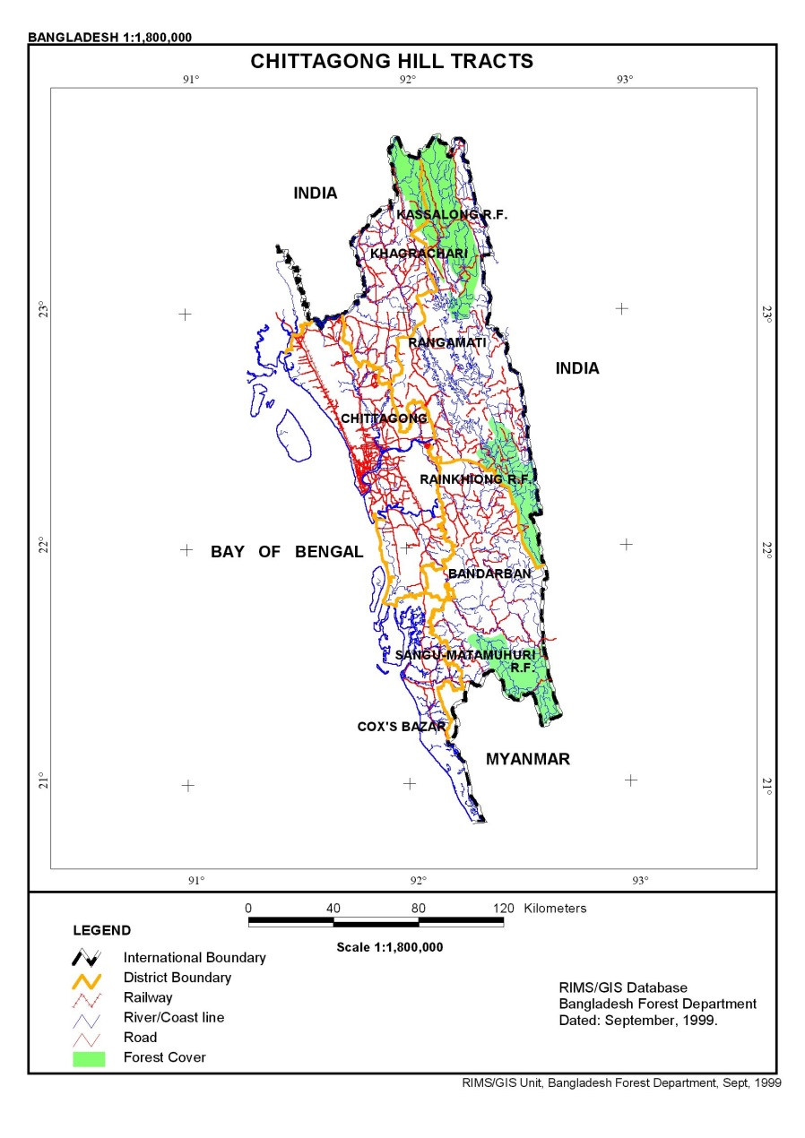
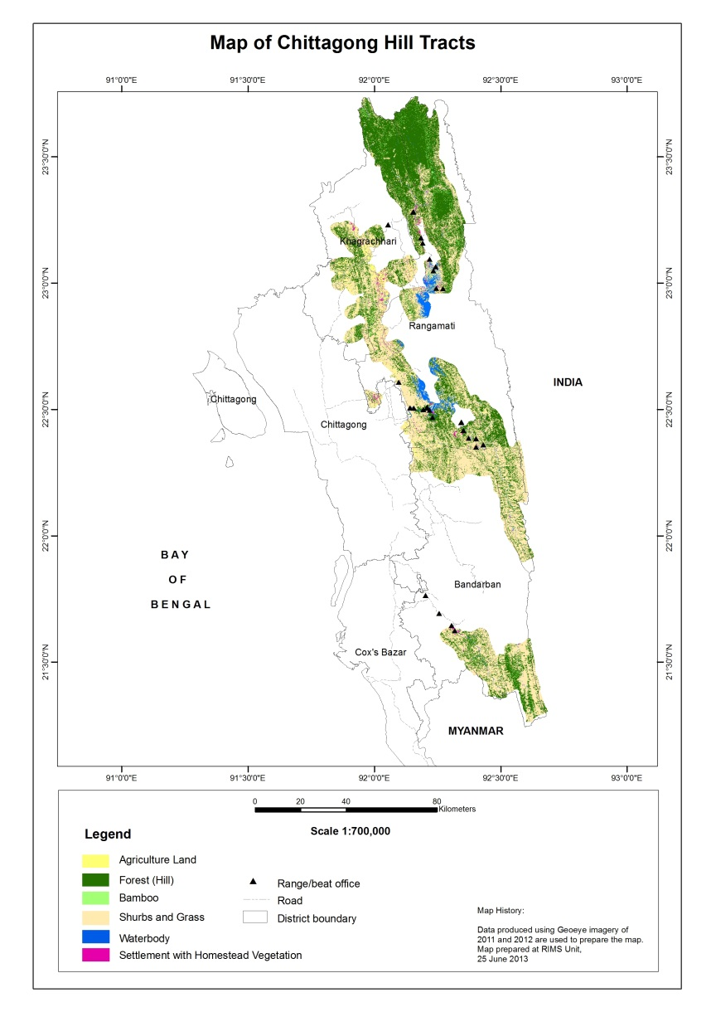
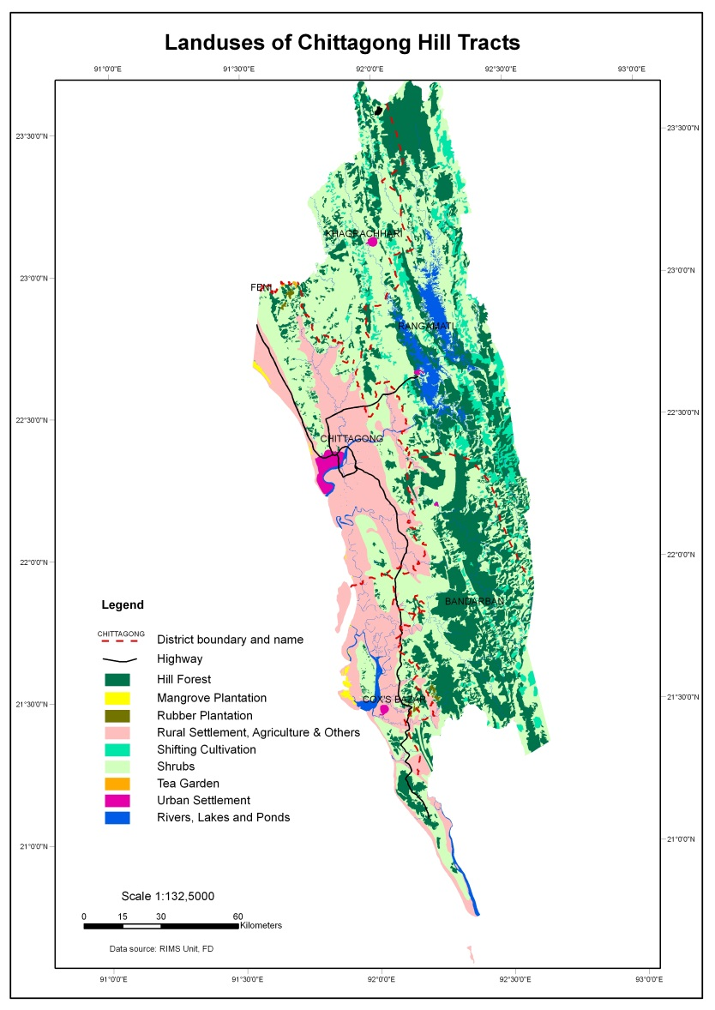
Experiences in assessing forest resources using
Remote Sensing
Hill forest assessment and mapping was done using aerial photo of 1961, survey, Landsat imagery of 2004-5 and Rapid Eye imagery of 2012

Slide 8
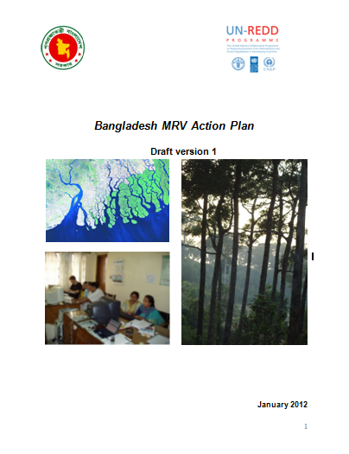


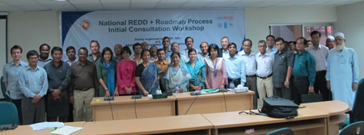
Process for the development of the Monitoring and MRV
Draft MRV Action Plan
MRV Action Plan
Implementation of REDD+ Readiness Phase
1st National Consultation
2nd National Consultation
…

Slide 9
Contribution to the REDD+ Readiness Roadmap preparation process
REDD+ Readiness Roadmap
REDD+ MRV Action plan
Intuitions involved in the MRV group
Forest Department
SPARRSO
Universities
Department of Environment and Forest
Bangladesh Water Development Board
IUCN
IPAC
UNDP & others
Regular group meeting

Slide 10
MRV Action Plan
Objectives of the MRV Action Plan:
To identify the existing capacity gaps in regards to develop Emission Factor, Activity Data and GHG inventory for LULUCF sector
To identify the REDD+ MRV activities to address the existing gaps for the REDD+ Readiness phase.

Slide 11
Gap analysis on M and MRV
Institutional arrangements
Human capacities
Technical capacities
  Financial sources
  Logistics, equipments and software

Slide 12
Capacity gaps | Institutional arrangements | Human capacities | Technical capacities | Financial sources | Logistics, equipments and software
National Forest Inventory | No NFI Unit at national level, 3 MPD is responsible to conduct inventory | Inadequate, Limited trained manpower | Inconsistent methodologies among the inventories, no emission factors, Limited number of allometric equation, Lack of proper archiving, No mechanism for QA/QC. | Limited financial support from revenue | Inadequate support
Forest Monitoring System | No specific monitoring system | Limited technical manpower | no proper definition of the classification systems, no consistent change assessment, not properly archived, No mechanism for QA/QC. | No revenue budget allocation | Lack of upgraded software and functional server.
GHG Inventory | No institutional arrangement | Lack of human resource, Inadequate Technical capacities | No accuracy checked, INC, SNC data archived , No mechanism for QA/QC. | No permanent source of funding | Lack of necessary software and technical equipments

Slide 13
Outcome of the Component 3 of R-PP
Develop a National Forest Reference Emission Level and/or a Forest Reference Level
i) Capacities for the development of Reference Emission Level strengthened. | Activity 3.1.1: Capacity need assessment
 | Activity 3.1.2: Building capacities in developing RELs/RLs
ii) National circumstances considered for REL/RL. | Activity 3.2.1: Assess Bangladesh’s National Circumstances
 | Activity 3.2.2: Historical assessment of drivers of deforestation and forest degradation
 | Activity 3.2.3: Data collection to support reference levels
iii) Output 3: Reference emission level(s) tested | Activity 3.3.1: Combine and harmonize historical forest area changes
 | Activity 3.3.2: Develop a methodology to assess past forest land area changes
 | Activity 3.3.3: Testing different RELs/RLs and possibilities of sub-national RELs/RLs

Slide 14
Outcome of the Component 4a of R-PP
Capacities to implement the GHG inventory for the forest sector strengthened; | Activity 4.1.1: Review and updating of MRV Action Plan
 | Activity 4.1.2: Organization of regular MRV meetings
 | Activity 4.1.3: Support to Institutional Arrangements for GHG National Inventory System for the LULUCF sector
 | Activity 4.1.4: Technical capacity building for the GHG inventory for the LULUCF sector
 | Activity 4.1.5: Support development of the catalogue of data to support the GHG inventory for the LULUCF sector and particularly for forestry

Slide 15
ii) National Forest Monitoring System established; | Activity 4.2.1: Development of land cover map index
 | Activity 4.2.2: Satellite image characterization for forest monitoring
 | Activity 4.2.3: Rationalization of land cover classification system
 | Activity 4.2.4: Development a forest monitoring system
 | Activity 4.2.5: Capacity building on geospatial data processing and database management
 | Activity 4.2.6: Forest boundary delineation
 | Activity 4.2.7: Development of a national land cover map and different legends using LCCS
 | Activity 4.2.8: Development of real-time forest fire detection and monitoring system

Slide 16
iii) National Forest Inventory Designed; | Activity 4.3.1: Harmonization of all existing inventory data and development of a robust database
 | Activity 4.3.2: Review of existing inventory designs and provide recommendations for NFI design
 | Activity 4.3.3: Validation of NFI design
 | Activity 4.3.4: Strengthening of forest inventory capability of stakeholders
 | Activity 4.3.5: Establish NFI
 | Activity 4.3.6: Development and upgrading of the existing NFA tree species database
 | Activity 4.3.7: Development of allometric equations for important species based on ecological regions

Slide 17
iv) Scientific research on key issues enhanced. | Activity 4.4.1: Enhance national capacities in volume, biomass and carbon stock calculation
 | Activity 4.4.2: Strengthen spatial modeling expertise
 | Activity 4.4.3: support to forestry research in the area of forest ecology and productivity

Slide 18
v) Integrated forest information system developed | Activity 4.5.1: Support integration of sub-national activities into the national system
 | Activity 4.5.2: Development of participatory tools for monitoring
 | Activity 4.5.3: Facilitate data sharing agreement between relevant institutions
 | Activity 4.5.4: Support to logistics, equipments and software needs for the information system
 | Activity 4.5.5: Documentation of methods and data collection for forest monitoring
 | Activity 4.5.6: information system supported by adequate data management system and calculation process
 | Activity 4.5.7: Development of a web based platform for data sharing between national stakeholders
 | Activity 4.5.8: Establishment of the Forest Management Information System

Slide 19
Information systems for measuring multiple-benefits and safeguards established | Develop a full list of the potential socio-economic, environmental, governance and other co-benefits and study the potential co-benefits. Assess and review of existing monitoring systems of multiple benefits In consultation with stakeholders, prioritize the co-benefits to be monitored Identify and assess related in-country national and international initiatives related to all REDD+ safeguards; Determine the framework of safeguards that are to be monitored Establish baselines and indicators for (i) all co-benefits to be monitored and (ii) all safeguards; Develop a system to monitor changes in the values for the selected indicators and to share this information – the Safeguard Information System (SIS); Integrate monitoring of safeguards and co-benefits into the integrated forest monitoring system (4a) Provide capacity development to organizations in order to collect and analyze relevant data and undertake monitoring of co-benefits and safeguards; Consult stakeholders to validate all above outputs and recommendations.

Slide 20
Mariam Akhter
mariam.akhter@fao.org
Thank You
Website: http://www.un-redd.org

