Slide 1

National Dialogue on Water Towers, Forests & Green Economy
5th Nov, 2012
Ecosystems Management for a Green Economy: Analytics and Evidences
Dr Pushpam Kumar, Chief, ESE Unit, DEPI, UNEP
(with inputs from Tim Christophersen, Forests and Climate Change
DEPI, UNEP)

Slide 2
Inclusive Green Economy
Inclusive Green Economy
Efficiency in Decision Making (Capture, demonstrate Ecosystem Services)
Sustainable Production
Job Creation
Sustainable Consumption

Slide 3
Multiple benefits from ecosystems: Acknowledge and Capture
Provisioning services
Food, fibre and fuel
Water provision
Genetic resources
Regulating Services
Climate /climate change regulation
Water and waste purification
Air purification
Erosion control
Natural hazards mitigation
Pollination
Biological control
Cultural Services
Aesthetics, Landscape value, recreation and tourism
Cultural values and inspirational services
Supporting Services
Soil formation
+ Resilience- eg to climate change
Important to appreciate the whole set of eco-system services & take into account in decisions
Not only after they have been lost and oft costly substitutes needed

Slide 4
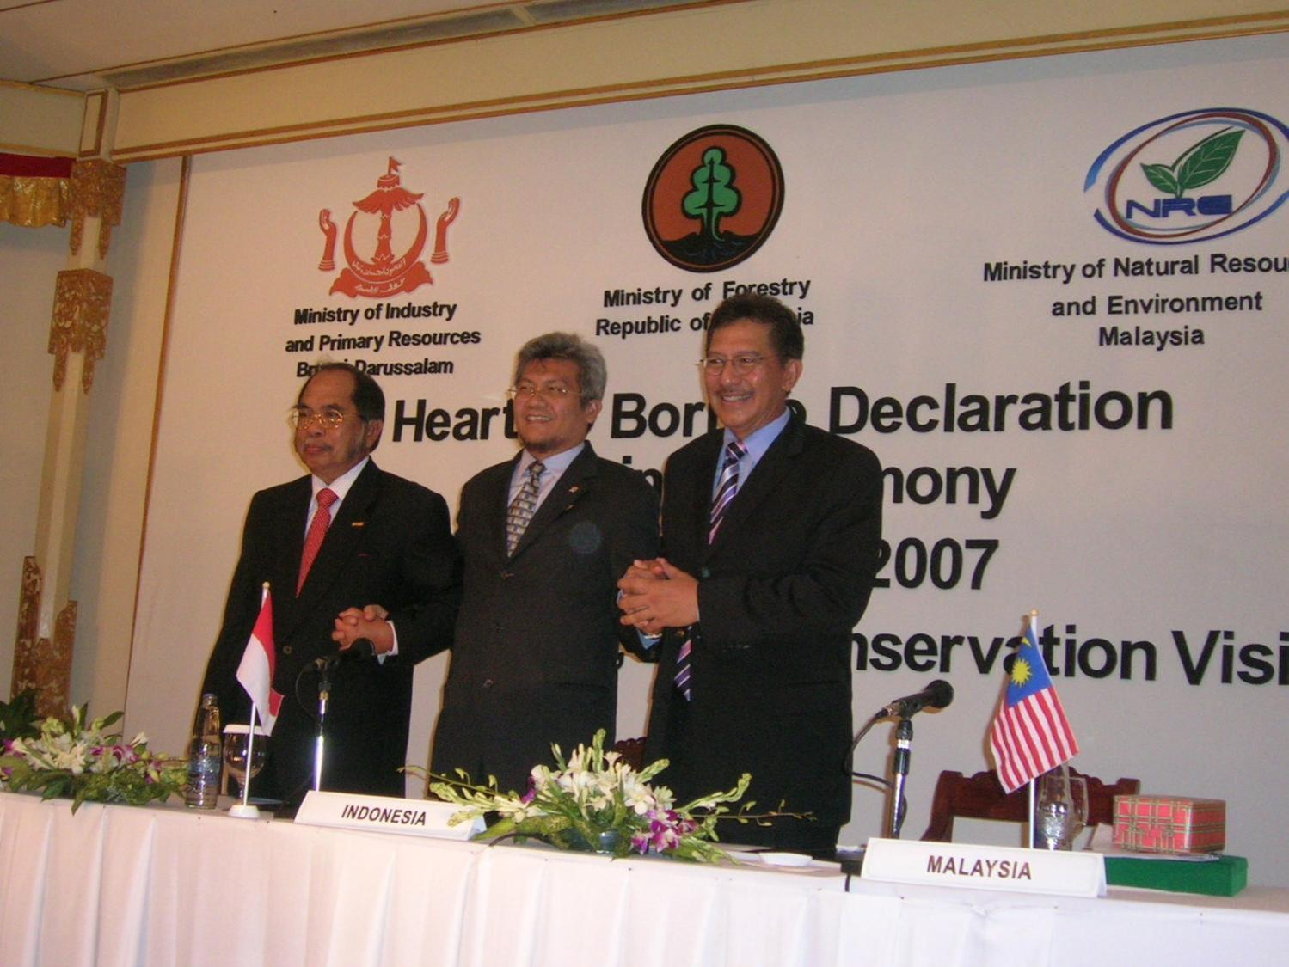
KALIMANTAN GREEN CORRIDOR PROJECT
REDD+ finance used to incentivize the transition to a Green Economy in Kalimantan, to support:
  7% GDP growth
  Food security
  Poverty alleviation
  Job creation
  41% carbon emission reduction
  by 2020 (of which 15%
  with international support),

Slide 5
Identify and Position the Beneficiaries and Policies
Beneficiaries:
Public sector (e.g. water – national & municipalities),
Public goods (e.g forests, biodiversity, climate),
Private sector (e.g. water, beer, energy, agriculture),
Citizens (e.g. water quantity, quality, price, security) and
Communities (e.g. payments, livelihoods/jobs, ecological assets & “GDP of the poor”)
Decisions: conservation / restoration investment, PES / public programmes
Policy synergies: Water – availability/quantity, quality,
Climate - mitigation (green carbon) and (ecosystem based) adaptation to CC
Job creation and livelihoods
Security - natural hazards (e.g. flooding), water, energy
Finances - public sector budget savings (Nat. gov’t, public services, municipalities)
Industrial policy – energy, water, forestry, agriculture...
Consumer affordability, Poverty

Slide 6
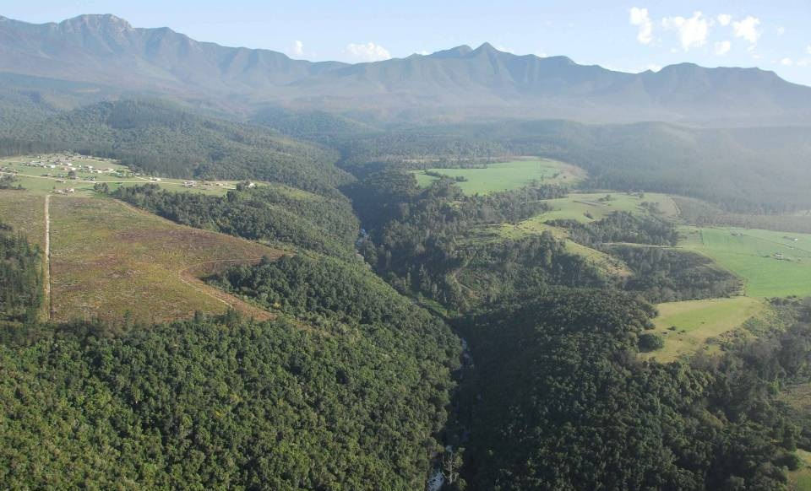
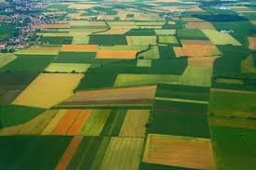
Services of Forest Ecosystems
climate resilience
water provision
erosion control
genetic resources
for agriculture
soil fertility
pollination
grazing
carbon storage
flow regulation
fish nursery

Slide 7
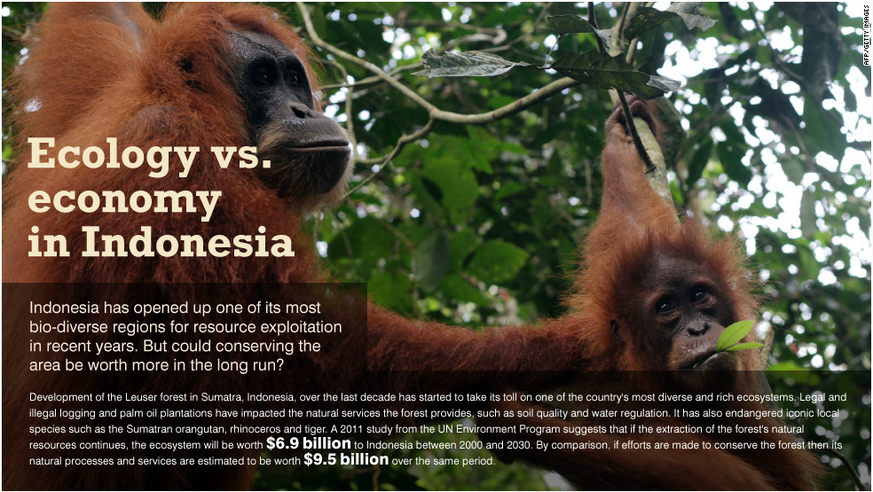
Indonesia’s Idiom
Extraction: 6.9Bn
Conservation: 9.5Bn

Slide 8
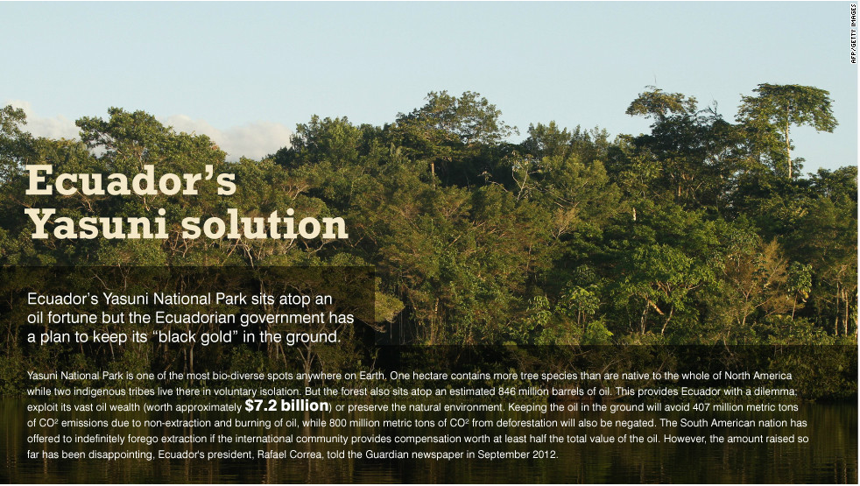
Ecuador’s Execution
Extraction of Oil Benefits: 7.2 Bn
No extraction (Forest Conservation): 13 Bn

Slide 9
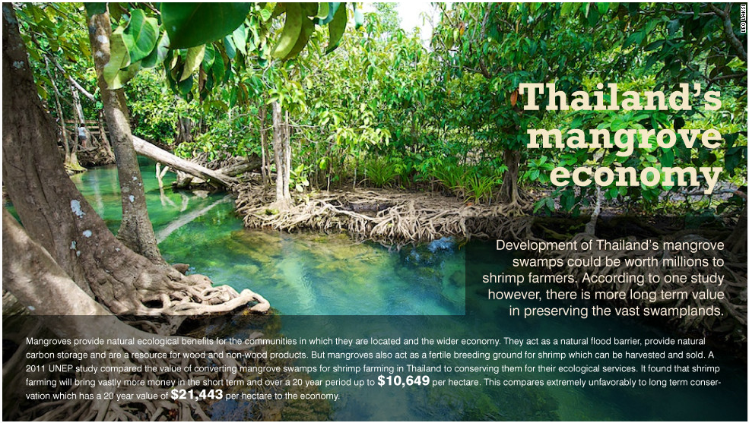
Thai Thinking
Conversion : 10649 Conservation : 21, 443p.ha

Slide 10
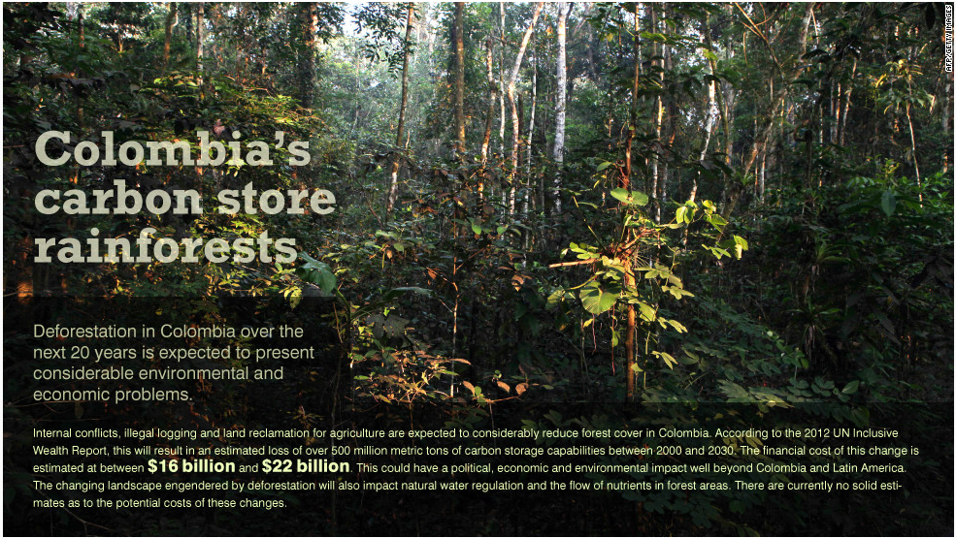
Colombian Crisis

Slide 11
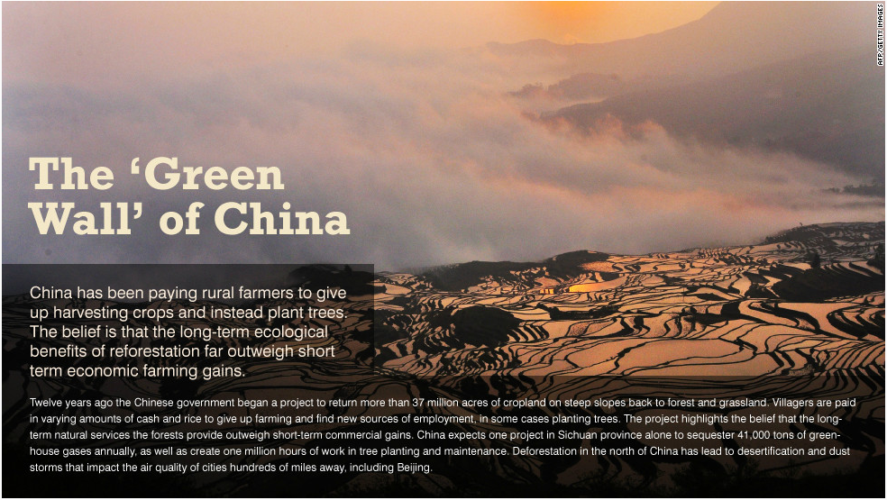
Chinese Choice of Tool

Slide 12
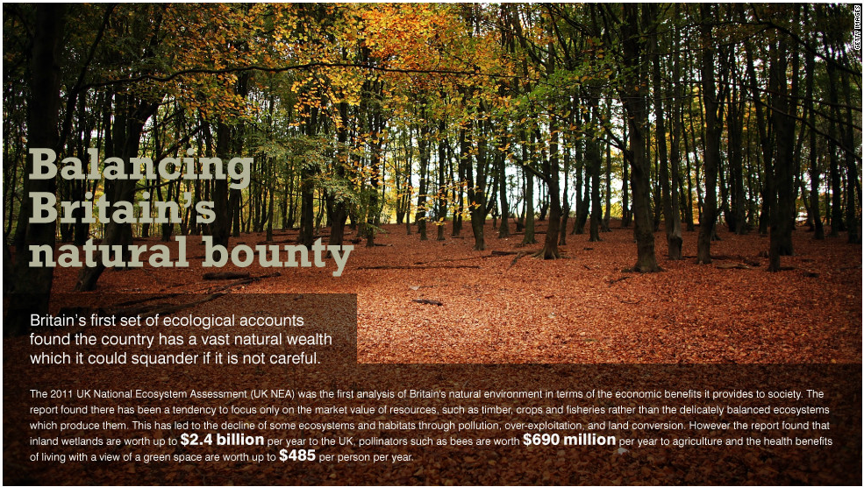
British Bounty

Slide 13
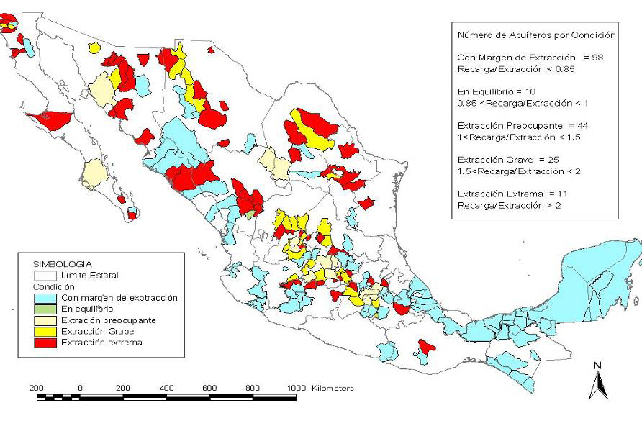
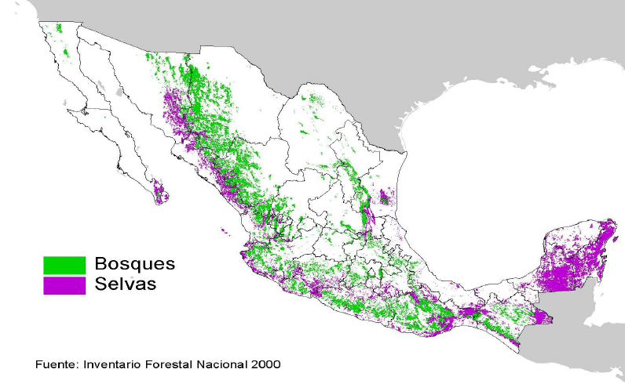
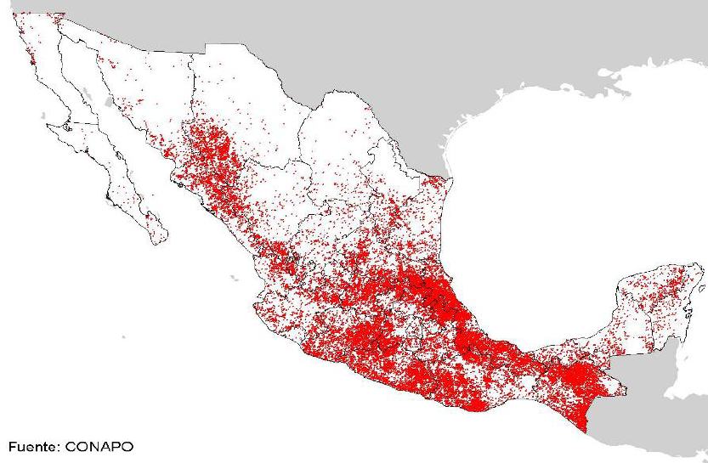
Use of Innovative Response Policy (PES)
Payments for Ecosystem Services (PES)
Hydrological services: Aquifer recharge;
Improved surface water quality, reduce frequency & damage from flooding`
Instrument: Mexico PSAH: PES to forest owners to preserve forest: manage & not convert forest
Result
Deforestation rate fell from 1.6 % to 0.6 %.
18.3 thousand hectares of avoided deforestation
Avoided GHG emissions ~ 3.2 million tCO2e
Reduce Deforestation
Address Poverty
Munoz 2010); Muñoz-Piña et al. 2008; Muñoz-Piña et al. 2007.

Slide 14
So, What can be done better?
One: Change fundamental compass of the economy
          1. IWR (UNEP-UNU)
        2. WAVES (WB-UNEP)
3. Natural Capital Committee
4. Role of Montane forests to Kenyan Economy (to be launched tomorrow)

Slide 15
Two: Investment in ecological infrastructure: Steps Towards Green Economy
Afforestation: carbon store+ reduced risk of soil erosion & landslides
Wetlands and forests and reduced risk of flooding impacts
Mangroves and coastal erosion and natural hazards
Restore Forests, lakes and wetlands to address water scarcity
PAs & connectivity to facilitate resilience of ecosystems and species
Notes:
15

Slide 16
3. Focus on Mainstreaming Ecosystem Services
The inclusion of relevant ecosystem services aspects into the decisions of institutions that drive development policy, rules, plans, investment.
By considering what ecosystem and biodiversity means for the economy
Evaluating current policies and identifying potential improvements

Slide 17
Focus on Mainstreaming of ES …..
Concept / Epistemology
Project / Strategy
Policies (Macro Policies)

Slide 18
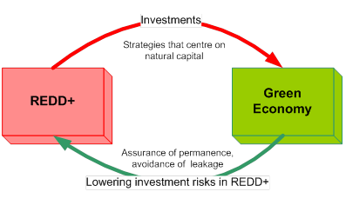
4. Green Investment-Green Economy Spiral
Source: DEPI, UNEP 2011

Slide 19
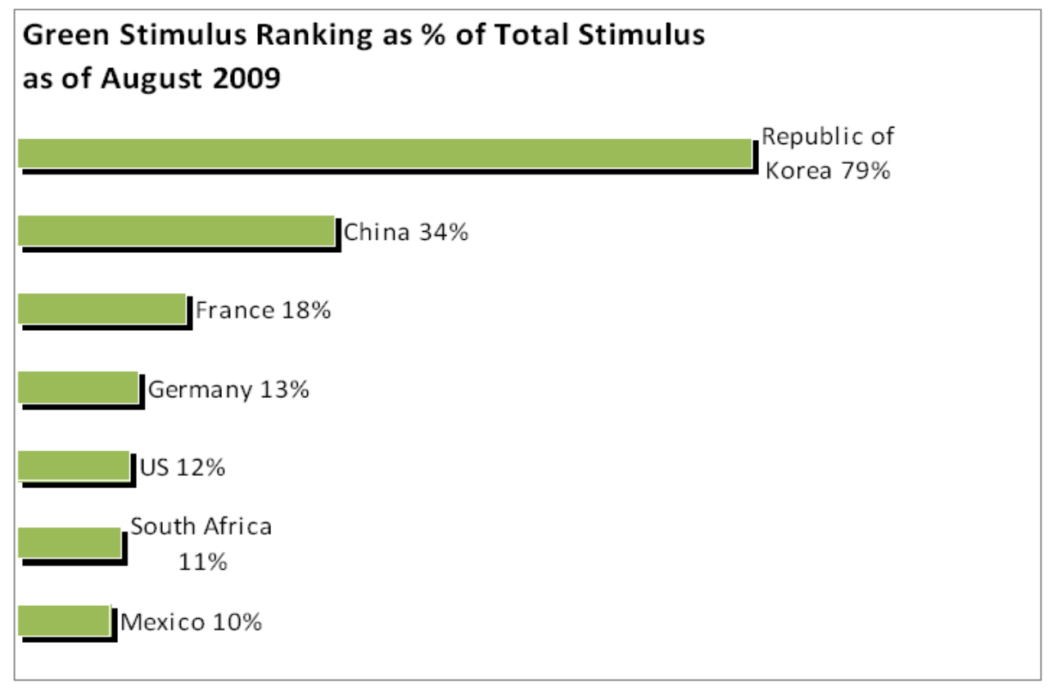
Green Growth – Investing in the Green Economy
Allocation of Stimulus Packages
Source: HSBC Global Research
Notes:
19

Slide 20
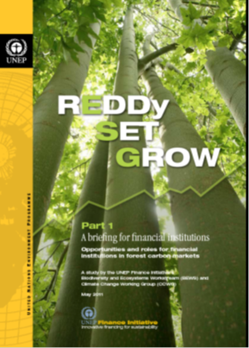

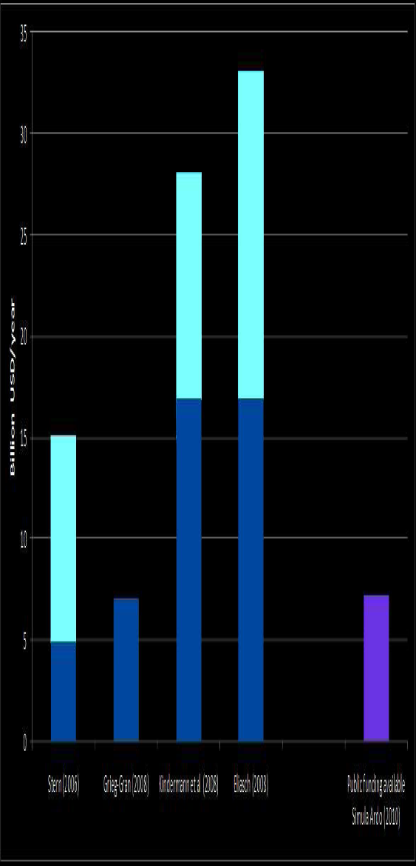
Private sector needs to be part of the solution …
Estimates of funding needed …

Slide 21
Finally, Questions needing attention
Has the role of ecosystem management in greening the Kenyan economy been recognized? If not, what can be done to increase such awareness?
How urgent is the need for restoring degraded ecosystems? What are effective means, markets, incentives, regulations, etc. for doing so?
In view of the failure of markets to reflect the correct value of ecosystem services, what kind of research and actions can be pursued to improve the current economic model for a Green Economy?

