Slide 1
Private Sector-Related Drivers of Deforestation in Cross River State, Nigeria
Richard Ingwe & Lillian Oyama
Workshop on Participatory Governance Assessment (PGA) for Nigeria REDD Programme in CRS, Nigeria.

Slide 2
Outline
Clarifying “private sector activities” that drive deforestation;
Identified “private sector activities”/drivers of deforestation:
Current situation
Private actors involved
Opportunities for reducing deforestation
Risks, challenges and road blocks that may hinder success
Stakeholders Engagement Matrix

Slide 3
Clarifying “private sector activities” that drive deforestation:
Economic activities and establishments that directly or indirectly degrade forest significantly
The private sector is a critical stakeholder to engage with for the REDD+ to succeed

Slide 4
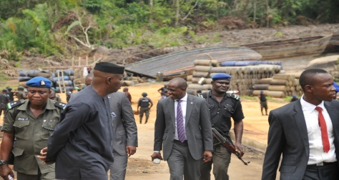
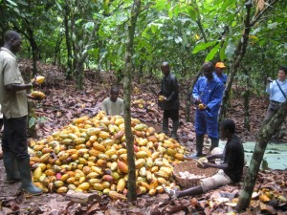
Identified “private sector activities”/drivers of deforestation
Commercial Extraction of Fuel-wood (including charcoal production);
Oil bunkering and associated oil spillage;
Timber/Logging;
Commercial Agriculture/Large Scale Farming

Slide 5
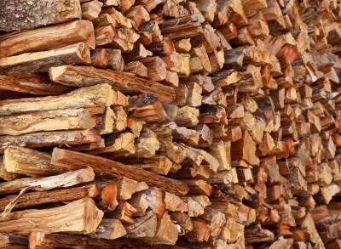
Commercial Extraction of Fuel-wood (1)
Current situation:
Wood is the main source of cooking fuel in rural areas;
High cost of substitutes eg.,cooking gas or kerosene stove cause increased exploitation;
Commercial fuel wood vendors extract wood in large quantities to meet high market demand

Slide 6
Commercial Extraction of Fuel-wood (2)
Private actors involved:
Fuel wood vendors
Charcoal producers; &
Fuel wood sellers

Slide 7
Commercial Extraction of Fuel-wood (3)
Opportunities for reducing deforestation:
NGOs working in the communities eg., Concern Universal (ongoing) and OneSky (previously) in Esuk-Mbah; CERCOPAN in Iko-Esai, by raising awareness; and
Promoting alternative livelihood options in the Communities.

Slide 8
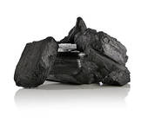
Commercial Extraction of Fuel-wood (4)
Risks, challenges and road blocks that may hinder success:
Accessibility, availability, and relatively low cost of “dirty fuel” (including unprocessed wood, charcoal crop residue from forests, among other processed biomass) remain the primary energy option for cooking for most Nigerians;
High demand of charcoal in the fashion and textile industry for finishing clothing;
Inadequate technological innovations to find local alternatives

Slide 9

Oil bunkering and associated oil spillage (1)
Current situation:
Extensive Oil Spillage as a result of illegal oil bunkering activities was observed in Esuk Mba community;
Ban on illegal bunkering by the CR State Governor HE, Sen. Lyel Imoke ;
The Governor personally led security operatives in a raid whereby 10 hand dug boats, two barges and thousands of containers of illegally bunkered oil containers were seized and burnt in Esuk-Mba

Slide 10
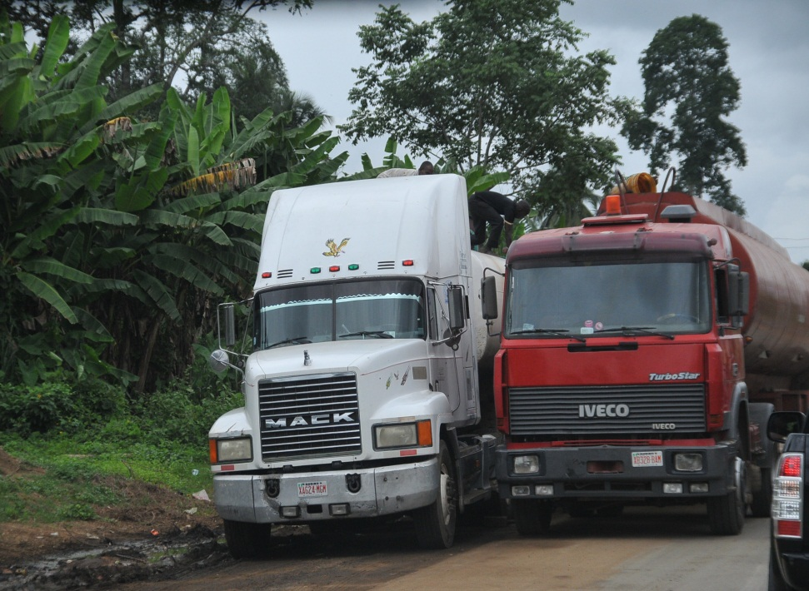
Oil bunkering and associated oil spillage (2)
Private actors involved:
Oil dealers

Slide 11
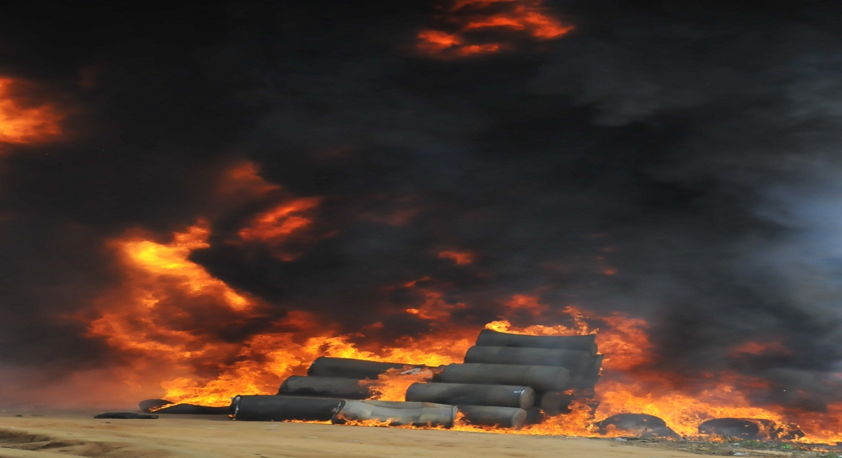
Oil bunkering and associated oil spillage (3)
Opportunities for reducing deforestation/forest degrading caused by drivers:
Ban on illegal oil bunkering activities

Slide 12
Oil bunkering and associated oil spillage (4)
Risks, challenges and road blocks that may hinder success:
Some Security operatives’ protection of oil dealers;
Oil bunkering is high income yielding business;
Bribery and corruption associated with bunkering;
Insubordination of some youth to authority as a result of financial independence/ personal gains from the bunkering business.

Slide 13
Timber/Logging (1)
Current situation:
High demand for forest resources from mangroves for building construction in Esuk-Mba and elsewhere in the state;
Existing wood processing factories/industries in the Calabar Free Trade Zone (CFTZ) and environs prior to the recent Government ban on logging still operational;
Moratorium on logging in force;
Ongoing enforcement of law banning logging makes it hard to know from respondents how much violation (illegal logging) is occurring underground

Slide 14
Timber/Logging (2)
Private actors involved:
Loggers (within and outside the community);
Building contractors;
Wood vendors

Slide 15
Timber/Logging (3)
Opportunities for reducing deforestation/forest degrading caused by drivers:
The role of Concern Universal and CRS Forestry Commission in creating awareness in the communities as well as enforcing regulations on the forest and the mangroves

Slide 16
Timber/Logging (4)
Risks, challenges and road blocks that may hinder success:
Loggers operate in a cartel;
High incentives are given to some influential members of the community to gain their support;
Limited non-forest based livelihood alternatives increase dependence on forest resources, including timber.

Slide 17
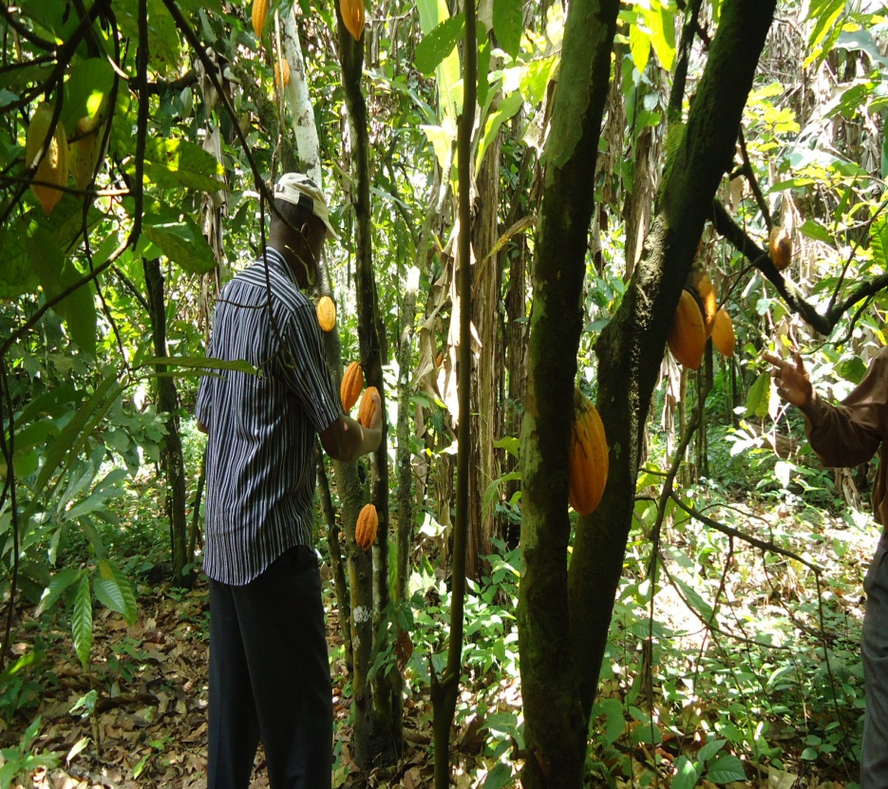
Commercial Agriculture/Large Scale Farming (1)
Current situation:
Burning of large forest areas deliberately by farmers in the bid to meet targets for subsistence and commerce;
Negative impact of chemicals used in cocoa farms to boost growth and increase harvest as well as control weed on the forest

Slide 18
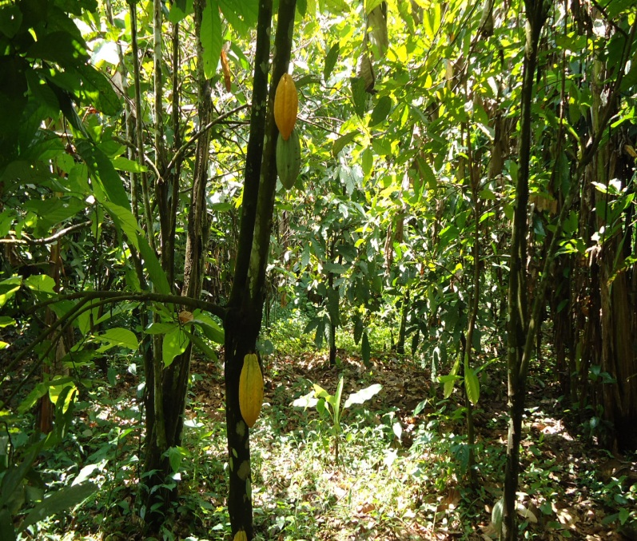
Commercial Agriculture/Large Scale Farming (2)
Private actors involved:
Small scale business owners profiting from the farms;
Plantation farmers and workers;
Farmers (men, women & youth) burn bushes as part of farming system practiced;
Community elders yet to fully appreciate damage potential of bush burning.

Slide 19
Commercial Agriculture/Large Scale Farming (3)
Opportunities for reducing:
deforestation/forest degrading caused by drivers:
UN-REDD+ programme implementation;
Community laws controlling unsustainable forest exploitation e.g. payment of fines and/or barring offenders from the community;
CRS Government laws banning logging;

Slide 20

Commercial Agriculture/Large Scale Farming (4)
Risks, challenges and road blocks that may hinder success:
Over-reliance on forestry as major source of livelihood with little or no livelihood alternatives;
Infrequent disregard for rules and regulations, especially by the youths and children;
Sole reliance on natural resources as major source of livelihood in the absence of alternatives.

Slide 21
Stakeholders Engagement Matrix
Private sector actor | Awareness-raising & advocacy on PGA & REDD+ | Governance Working Groups (at Federal AND State levels) | First workshop | Providing feedback on first draft of methodology | Data collection | Discussing PGA results & finding solutions
Fuel wood vendors | X |  | X |  | X
Charcoal producers and sellers | X |  | X |  | X | X
Oil dealers | X |  |  | X | X | X
Loggers/timber dealers | X | X |  | X | X | X
Plantation owners | X |  |  |  | X

Slide 22
So glad you listened!!!!

