Slide 1

Local Governance Anti-Corruption &
REDD in Latin America and the Caribbean

Slide 2
Objectives
How LAC countries tackle corruption at the sub-national level
Extract lessons learned from the case studies
How best practices can be applied in the REDD+ context

Slide 3
Corruption at the Sub-National Level
Vulnerability | Corrupt Practices
Dispersed control over finances | Fraud via embezzling or skimming
Freedom to hire and fire | Cronyism,clientelism or nepotism
Proximity with constituency | Bribery, fraud
Patronage Networks | State capture, bribery, fraud
Lack of capacity and oversight | Petty corruption

Slide 4
Structure
Corruption in the Forest Sector and REDD+
Lessons Learned from Case Studies:
Brazil & Bolivia
Recommendations

Slide 5
Corruption in the Forest Sector
Harvest/processing (e.g. illegal logging)
Transport (e.g. timber/wood products without permits)
Trade (e.g. avoidance of taxes/forest charges)

Slide 6
Corruption in the Forest Sector
Stage | Corrupt Practices
Regulatory Design | Undue influence on forest laws and regulations
Harvest/Processing | Bribery of local officials to harvest without permits, obtain logging permits, ignore over-harvesting
Transport | Bribery to allow transport of illegally logged timber
Trade | Bribery to export wood products without permits, avoid taxes, money laundry

Slide 7
Corruption & REDD
REDD+ design & implementation
Land administration
Carbon Rights & Measurement
Benefit & Distribution Systems

Slide 8
Corruption & REDD+
REDD+ Design
Land Administration | Bribery to ensure that land areas are allocated to or excluded from REDD+
 | Failure to recognize competing rights or customary land tenure
Carbon Rights & Measurement | Link carbon rights to State ownership of forests
 | Artificially inflate baselines
Benefit & Distribution Systems | State capture, nepotism& cronyism

Slide 9
Corruption & REDD+
REDD+ Implementation
Land Administration | Bribery to fraudulently create land titles
 | Bribery to include land areas in REDD+
Carbon Rights & Measurement | Bribery to register carbon rights over particular lands in the name of corrupt actors
 | Over-estimate the amount of emission reductions to inflate REDD+ revenues
Benefit & Distribution Systems | Sell the carbon rights without the consent of the indigenous people

Slide 10
Structure
Corruption in the Forest Sector and REDD+
Lessons Learned from Case Studies:
Brazil& Bolivia
Recommendations

Slide 11
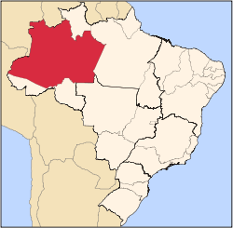
Brazil: State of Amazonas

Slide 12


BolsaFloresta

Slide 13




BolsaFloresta Partners

Slide 14
Anti-Corruption Measures
BolsaFloresta External Audits: PricewaterhouseCoopers
Portal daTransparência (Decree 3195/2011)

Slide 15
Structure
Corruption in the Forest Sector and REDD+
Lessons Learned from Case Studies:
Brazil &Bolivia
Recommendations

Slide 16
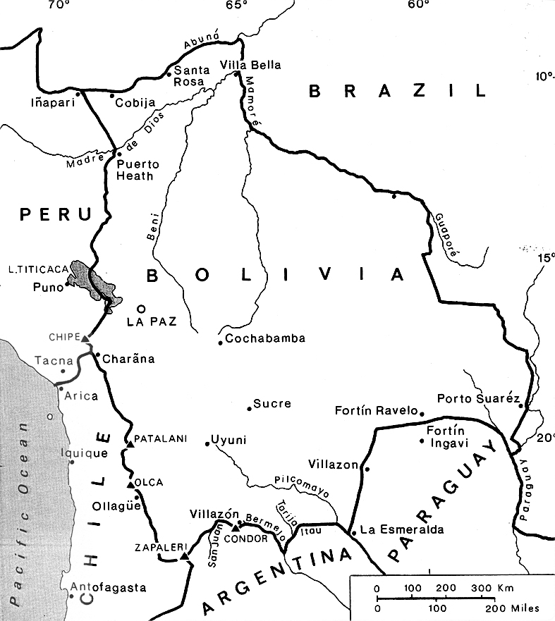
Bolivia

Slide 17
Decentralization
Popular Participation Law (1551/1994)
Administrative Decentralization Law (1654/1995)
Forest Law (1700/1996)

Slide 18
Anti-Corruption Measures
Single concession fee US$ 1 per hectare
Transparency & independence of ABT
Forest Monitoring

Slide 19
Anti-Corruption Laws
Anti-corruption Law 004/2007
Decree 28168/2005 access to information & transparency
Ministry against corruption

Slide 20
Lessons Learned
Good practices are instrumental in preventing corruption
Specific anti-corruption laws and bodies are less common at the sub-national level
Local bodies in charge of environmental control have a role in suppressing corruption
Local & indigenous communities participate more actively in forest administration

Slide 21
Structure
Corruption in the Forest Sector and REDD+
Lessons Learned from Case Studies:
Brazil & Bolivia
Recommendations

Slide 22
Key Recommendations
Sub-National Governance
Awareness & understanding about REDD+ and related corruption risks
Policy dialogue on financial resources for climate change, forest management and REDD+
Capacity building for local decision makers and civil society
Accountability and transparency in decision-making

Slide 23
Key Recommendations
REDD+ Design Phase
REDD-specific anti-corruption risks
Local governance institutions
REDD specific anti-corruption measures
Anti-corruption proposals in National Strategies

Slide 24
Key Recommendations
REDD Implementation
Local governance institutions to detect and suppress corruption
Local and indigenous communities and civil society
Transparency in decisions on resource use and distribution, as well as climate change, forest management and REDD+ policies
Use of UNCAC and IACAC as guide to develop anti-corruption frameworks

Slide 25
Anti-Corruption Checklist
1. Identify Corruption Risks
What are potential REDD-specific corruption risks?
What are the sectors involved?

Slide 26
Anti-Corruption Checklist
2. Design Anti-Corruption Measures
What measures are required?
Which institutions could carry out such measures?
What is the role/functions of those institutions?
What will be the relationship between national and local governance institutions?
How existing laws, policies and mechanisms could be used?
How could civil society, local and indigenous populations be involved?
Are the designed anti-corruption measures too complex or costly?
How to finance those measures?

Slide 27
Anti-Corruption Checklist
3. Implement Anti-Corruption Measures
How to ensure compliance with anti-corruption measures?
How to evaluate whether anti-corruption measures are effective?
Can the effectiveness of such measures be assessed through the IACAC Follow-up Mechanism?
How to report/inform the public about the measures taken?

Slide 28
Thank you
Contact Information
Beatriz Garcia, Ph.D.
REDD Forests
beatriz@reddforests.com
www.reddforests.com

