Slide 1
Developing capacities to mitigate corruption risks in REDD+
Estelle Fach, UNDP, UN-REDD Programme
Focus Group Workshop on Governance, Corruption and Benefit Sharing for REDD+ in Kenya
Nairobi, Kenya , 3-4 July 2013

Slide 2
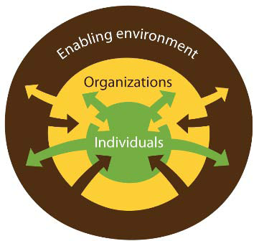
Capacities to manage corruption risks
Functional capacities | Technical capacities | Collaborative capacities
Management of capacities to identify, assess, respond to, and monitor corruption risks | Capacities required to apply specific corruption control or risk mitigating measure/tool in REDD+ processes | Integration of diverse insights, experience, and expertise from public, private and NGO stakeholders
Notes:
1. Individual dimension:
Knowledge incl. technical skills
Competencies (e.g. Rem. Sens skills)
Functional “people” skills - planning, HR etc
Attitudes and behaviours
Values
2 2. Organizational dimension: the functioning and performance of organizations, including :
Mandates (area of responsibilities)
Systems (e.g. a NFMS incl REDD+)
Internal processes
Organizational priorities
Collaboration and KS mechanisms
Resources, infrastructure, equipment
3. Enabling environment : the context in which individuals and organizations work:
country institutional arrangements
implicit and explicit rules (instituional context analysis)
power structures gov’t and CS
legal, policy and political environment ( refer to the legal preparedness study supported by FAO in Kenya)

Slide 3
Measures and tools
Tracking and monitoring tools | Preventive measures/tools | Investigation and enforcement
Early warning systems | Codes of conduct | Whistleblower / informants protection
Fraud detection systems | Declaration of conflict of interest | Locally accessible grievance/complaint systems
Social audits | Integrity awards – integrity as performance criteria | Strengthened law enforcement and judiciary
Public expenditure tracking surveys | Integrity pacts (companies, governments and communities ) | Clarity in what constitutes punishable corruption crime
Transparency portals | Stakeholder engagement
Community monitoring and score cards | FPIC
Hotlines | Transparent recruitment
Independent audits | … | …
Should build on what already exists and works in Kenya!

Slide 4
How fundamental is access to REDD+ information?
Notes:
Access to information (A2I) is a prerequisite for transparency, accountability and meaningful engagement of stakeholders, all underpinning the success of REDD+
It is part of human rights, anti-corruption and environmental international conventions and treaties to which the overwhelming majority of REDD+ countries have committed
Systems to provide information about safeguards are called for in the Cancun Agreements

Slide 5
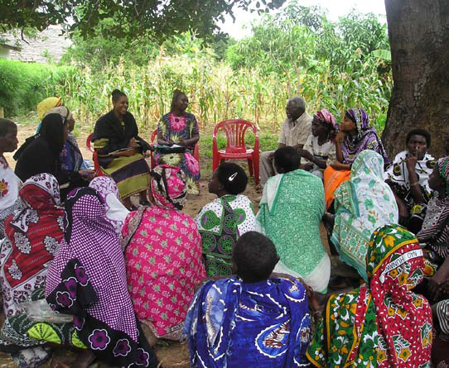
Access to Information about …what ?
  How REDD+ works and how it will affect local and indigenous communities
  What funding is received for REDD+ and how it is used
  Which government agencies, non-governmental organizations or representatives of the private sector are legitimate intermediaries or interlocutors
  How are decisions made, including on land tenure, benefit sharing and selection of projects/demonstration sites
  What are the (predicted or observed) environmental and social impacts of REDD+ activities

Slide 6
Access to Information about what ? (c’td)
  How the right to free, prior and informed consent is implemented
  How funds or benefits flow from the national to the local level – including the amounts, frequencies and beneficiaries
  What are the methods, data and assumptions that underlie results-based estimates (incl. Forest inventories)
  How safeguards are addressed and respected
  What are REDD+ related legal rights, such as carbon rights when/if they are developed, and what the modalities are for exercising them

Slide 7


How ? Good practices in REDD+ countries
  Make most of the information available proactively rather than by request
  Ensure the format and languages are adapted to different stakeholders : publishing online in national language(s) is rarely sufficient
  Have dedicated information officers accountable for information flows (both ways)
  Set clear time limits and low or no fees to access information
  Organize awareness campaigns to empower civil society on how to access and request information
  Check the effectiveness of information channels: monitor how information is used, when, and by who

Slide 8
What can Kenya do ?
Examine its obligations under the Draft Freedom of Information Bill and transparency requirements under Forest Law
Develop plans, with stakeholders, to define what information is needed when and in which format
Use best practices in the implementation of A2I laws to inform safeguard information systems
Establish transparency platforms that allow for feedback :
  REDD+ registry with clear (mandatory) guidelines, web-based, cell-phone based,
  Institutionalized dialogues
REDD+ information resides (or will) with various government, civil society and private sector stakeholders: coordinated efforts to avoid fragmentation of information are necessary
Notes:
Examine their obligations under national A2I laws for REDD+
Develop plans, with stakeholders, to define what information is needed when and in which format
Use best practices in the implementation of A2I laws to inform safeguard information systems
With clear roles and responsibilities and dedicated personnel
Learning from their own experience on how information reaches (or not) stakeholders
Establish transparency platforms that allow for feedback : web-based, cell-phone based, posters, institutionalized dialogues, regular town hall meetings etc
REDD+ information resides (or will) with various government, civil society and private sector stakeholders: coordinated efforts to avoid fragmentation of information are necessary

Slide 9
Key messages
Developing capacities to mitigate corruption risks in REDD+ is not only technical, but also about management and collaborations
A mix of measures that track and monitor, prevent and allow investigation/prosecution can be established based on existing strengths
Easy access to updated, understandable, relevant and usable information with clear requirements is a prerequisite

