Slide 1
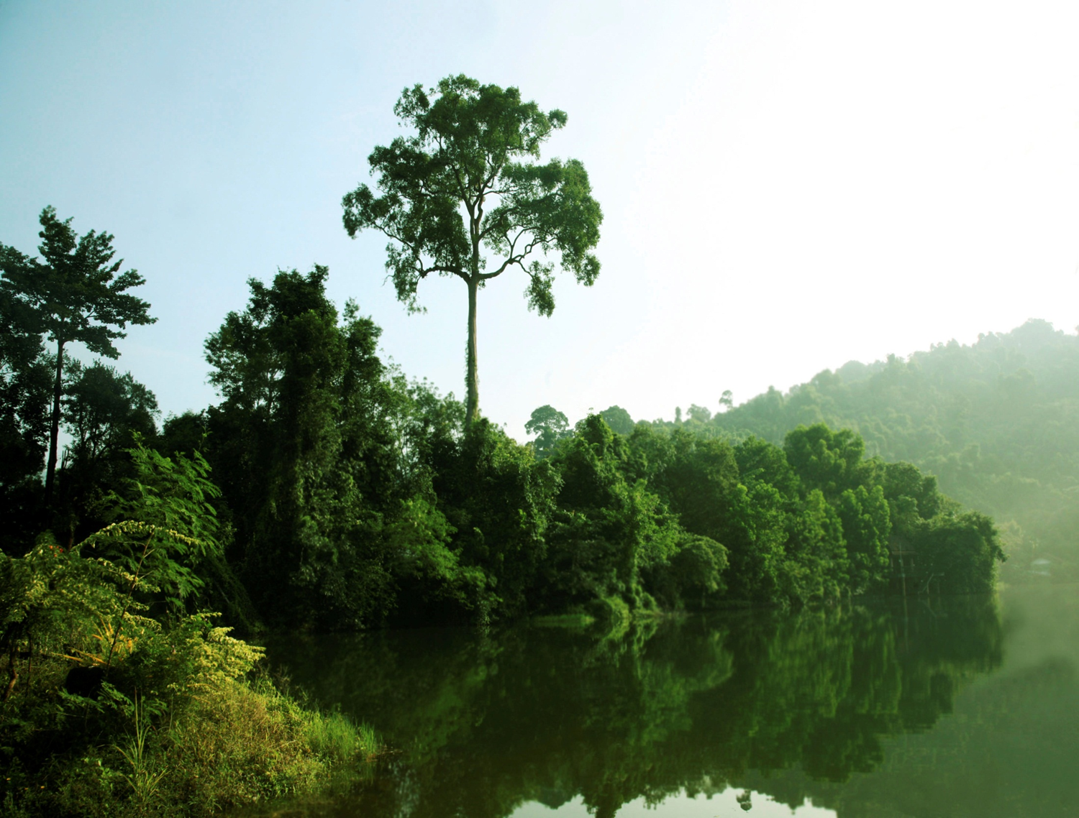
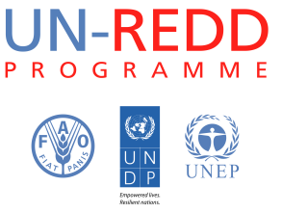
Anti-corruption for REDD+ : Key Messages
Why do corruption risks need to be addressed now?
What are corruption risks in REDD+?
What are risk mitigation actions? What are the tools?
Who can prevent corruption in REDD+?
On 10 and 11 October 2011 a group of anti-corruption experts and practitioners from 12 UN-REDD partner countries comprising civil society, anti-corruption governmental bodies and the UN met to discuss how potential corruption in REDD+ can be prevented, using new and tested approaches and building on the governance support that the UN-REDD Programme provides to partner countries.
Transparent, effective, and equitable REDD+ systems
There are challenges for anti- corruption actions for REDD+:
- There are inherent challenges in forest governance and upfront costs needed to address them
- REDD+ needs to happen within a broader enabling governance environment
- Collusion of political and business (e.g. logging, agri-business, mining) should not be underestimated
-Timing is tight and governance reform takes time, which means that innovative solutions are needed
- Capacity exists, but needs to be tapped into
Sustained political will and buy-in are necessary
.. Yet adressing corruption risks from the onset can help create and maintain trust and confidence among local actors and donors/investors
Corruption risks can be mitigated, learning from existing country experiences. For example :
For Phase 1 :
Corruption risk assessments
Political economy analyses for REDD+
- Participatory and transparent agenda-setting process
Documented decision- making based on publicly available data
Designing benefit distribution systems with few layers
Designing monitoring and grievance/recourse mechanisms
For Phase 2:
-Integrity assessment of national REDD+ frameworks
Establishing information management system
Establishing whistleblower protection mechanisms through internet, sms or other low tech means
For Phase 3:
Public expenditure tracking
Citizen budget monitoring
Transparency portals in ”citizen language” for social control over benefit distribution, such as the Brazilian example in Bolsa Familia
Addressing corruption risks in REDD+ issues requires collaborative actions. , for example :
Role of government anti-corruption practitioners in REDD+ countries:
- guarantee access to information on decisions and processes;
- openness to civil society engagement in the process;
- efforts to design time-bound policies;
- be committed to aid-effectiveness principles including an EITI-like process of transparent and accountable disbursement of funds
Role of CSOs
- be a watchdog & monitor financial flows and distribution of benefits, impacts on biodiversity, participation and institutional performance etc.
- support recourse mechanism, provide legal aid, and document & disseminate best practices.
The UN system can support
- developing the capacity of the actors above
- strengthening national integrity systems
- documenting and disseminating good practices and lesson learned
Corruption may occur in all phases of REDD+, but take different forms. For example:
During the design phase (Phase 1):
- undue influence by interest groups in the design of REDD+ policies
- bribery to local officials to include or exclude forest land from REDD+
- risk of undue influence in designing benefit distribution systems
- risk of influence in rezoning land
During implementation of policies (Phase 2):
- bribery to local level officials to fraudulently create land titles
- corrupt deals between villagers and companies related to selling licenses.
- loss of carbon rights for local communities
In the MRV/Performance payment (Phase 3):
- Fraud associated with technology-intense MRV systems, which could benefit the elite
- risk of embezzlement in benefit distribution systems
Large influxes of financial resources could increase fudiciary risks
Corruption could impede the positive development impacts sought by REDD+
Corruption could sideline forest-dependent communities from partaking and benefiting from REDD+

