Slide 1


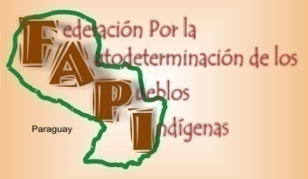



Safeguards of Paraguay for REDD+:
Environmental impact assessments will be carried out, in social areas, cultural and human rights, all strategically at the country level (as part of the preparation of the Action Plan REDD +) and at sub-national (for pilot projects), based on the Akwe:kon guidelines of the Convention on Biodiversity.
Protocol Proposal for Consultation and Consent for Indigenous Peoples of Paraguay, developed by FAPI in 2011 (Federación por la Autodeterminación de Pueblos Indígenas). Currently in revision process for final approval.
FAPI Guidelines for the implementation of the National Joint Plan in Indigenous Territories.

Slide 2
Construction of a national information system on safeguards in social areas, environmental and human rights will be designed and will be operating by the end of 2013 nationwide.
Effective implementation of the safeguards of Cancun, especially regarding indigenous peoples .Design and implementation of a system and mechanism for the monitoring of the guidelines of the UN-REDD and FAPI .

Slide 3
The UN-REDD process assists Paraguay in building the mechanism for the country to be ready for future REDD+ projects
Paraguay currently needs
Harmonization of the legal framework
Definition and clarification of the property rights of carbon stocks

