Slide 1
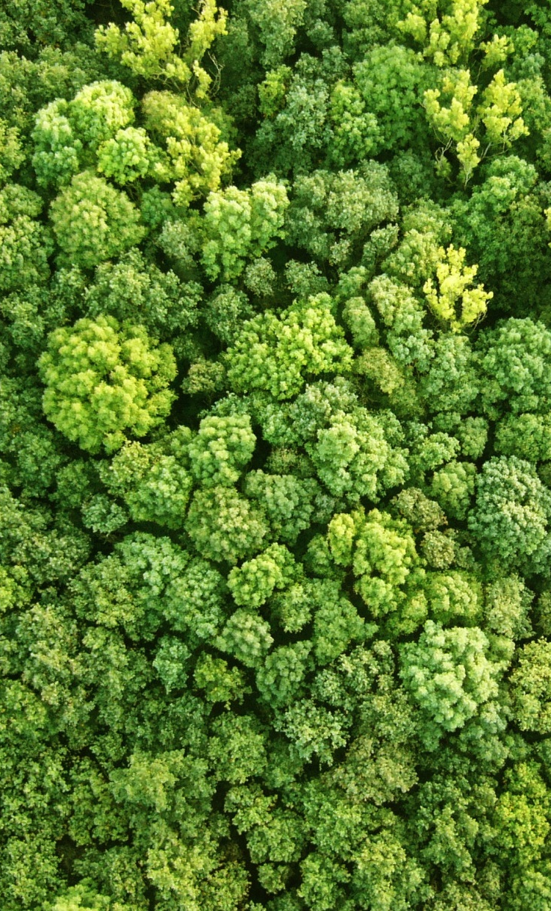
TITLE MYRIAD PRO
BOLD SIZE 32
Subtitle size 24
Presenter name
Date | Location
Notes:
Guidelines:
Limit text as much as possible, in favour of visuals, graphics (clean and simple), and photos that highlight your speaking points, rather than repeat them. If people are busy reading, they won’t be listening to your presentation!
Powerpoints should add value to your presentation. If information isn’t relevant or important, don’t include it.
Create your powerpoint with your live audience in mind, not as a publication for sharing afterwards. This will keep you from filling it up with too much information/text.
If you are going to insert charts, make sure they will be quickly and easily understood. Many times, complicated visuals are only meaningful to those who created them.
Avoid using animations or other outdated ‘special effects’. Keep your presentation clean and professional (i.e. no drop shadow lettering, 3D text, spinning transitions etc.)
Choose powerful images that illustrate your work. If you don’t have original photos, check out the UN-REDD Photo Bank on Flickr, or use creative commons photos (try pixabay.com for example).

Slide 2
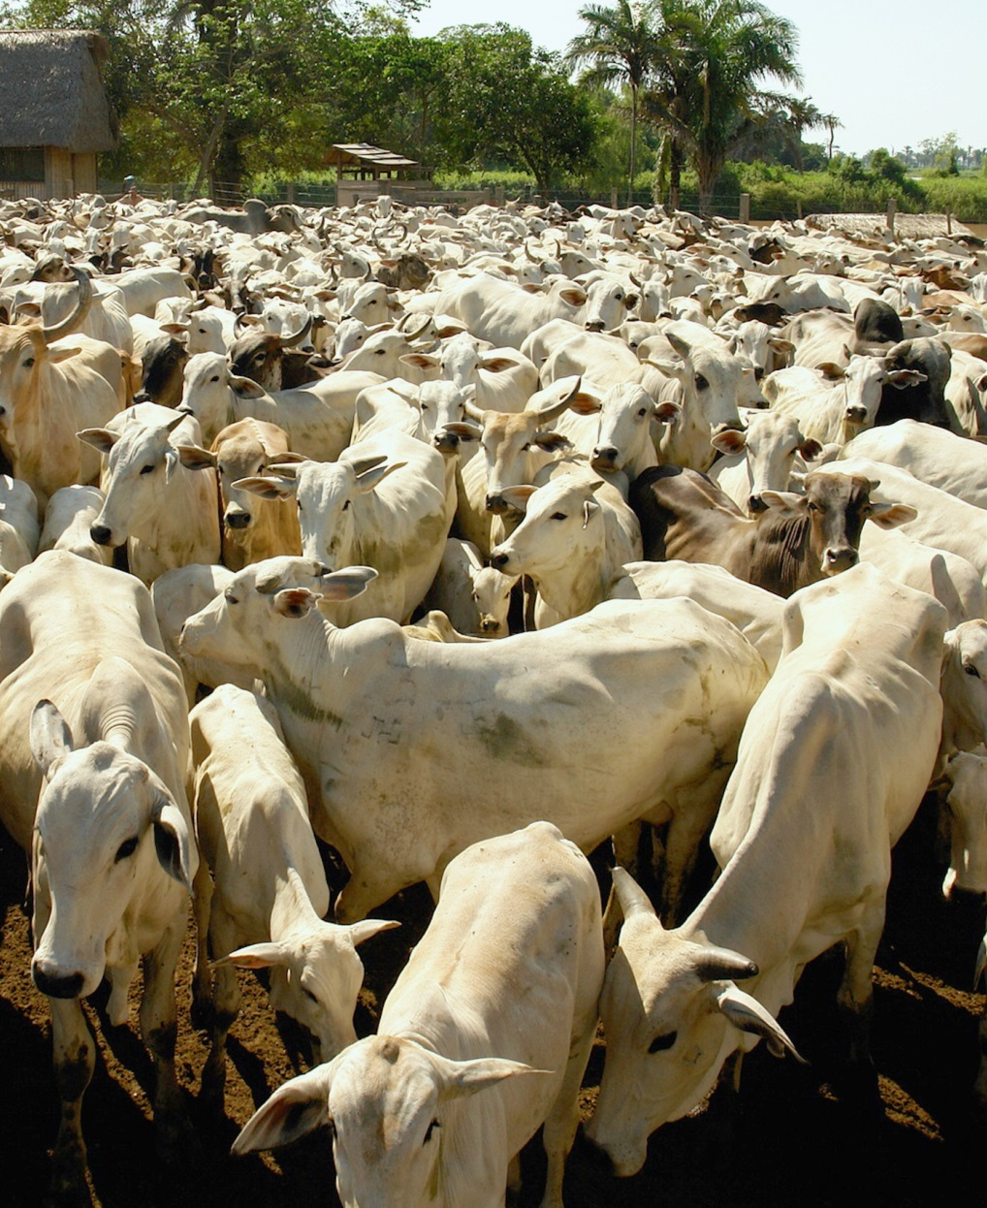
Outline
Context:
Problem/Issue:
Response:
Result:
Resources
Discussion

Slide 3
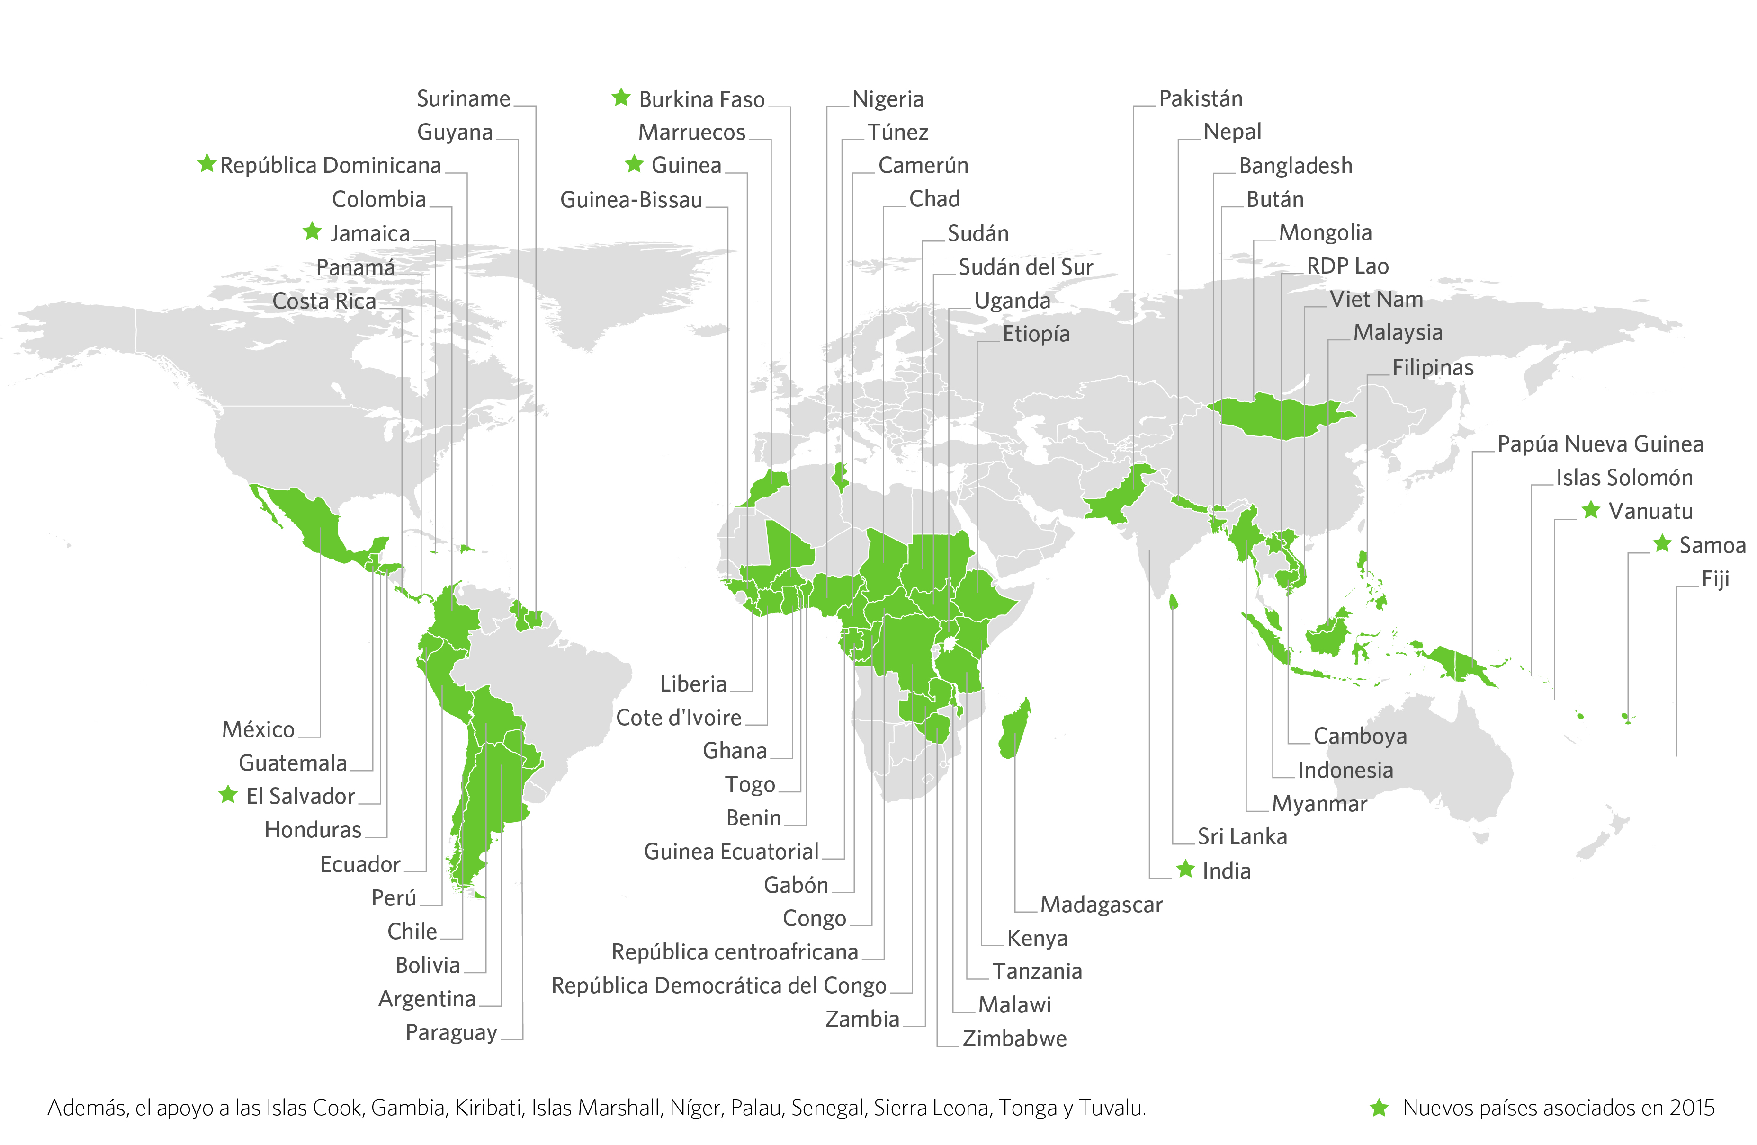
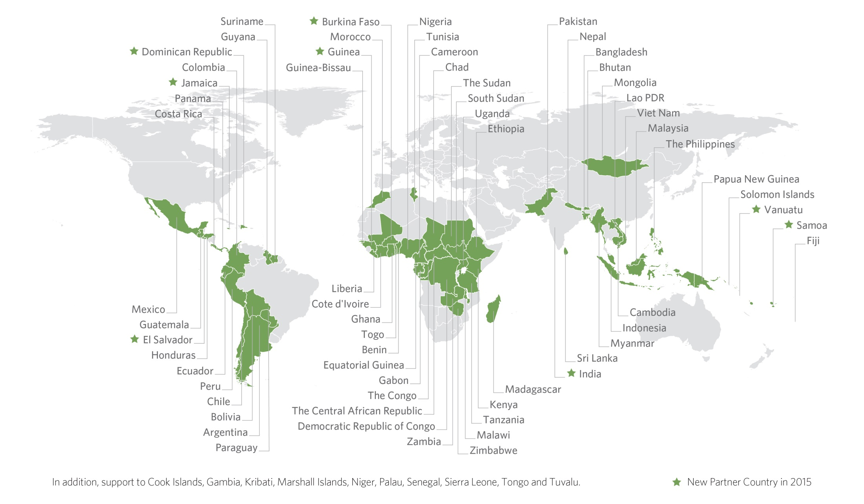

Slide 4
Text slide
“Quote example. Quote example. Quote
example. Quote example. Quote example.’”
The UN-REDD Programme Collaborative Online Workspace is an information and knowledge sharing platform for the UN-REDD Programme, its partner countries and the wider REDD+ community.
Please feel free to browse the knowledge and resource libraries, join in the discussions, connect with colleagues and share your experiences.

Slide 5
Table example
Heading 1 | Heading 2 | Heading 3
List 1
List 2 | List 3
 |  | List 4
Source:

Slide 6
Figure title
MINDMAP / CHART
EXAMPLE
MINDMAP / CHART
EXAMPLE
MINDMAP / CHART
EXAMPLE
MINDMAP / CHART EXAMPLE

Slide 7
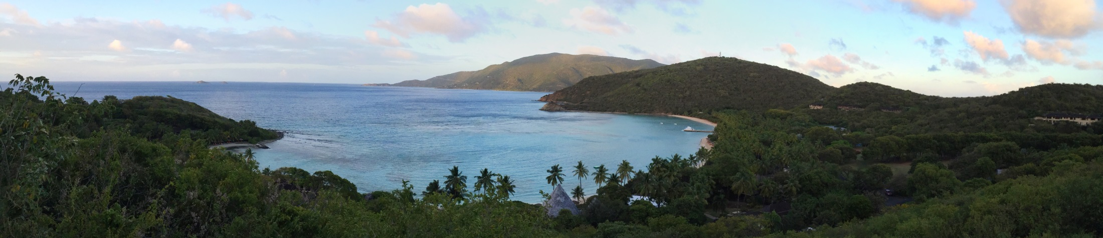
Thank you!
Presenter name | email@un-redd.org
Connect with us online:
www.un-redd.org
www.unredd.net

