Slide 1
PGA WORKSHOP ON PARTICIPATORY DATA COLLECTION METHODS
A PRESENTATION ON
PARTICIPATORY METHODOLOGIES: PRINCIPLES AND APPROACHES
BY
FRANCIS BISONG
6TH-9TH AUGUST, 2014
MAYOR HOTEL, AKPABUYO, CALABAR, CROSS RIVER STATE

Slide 2
PARTICIPATORY METHODOLOGIES
WHAT IS PARTICIPATORY RESEARCH (PR)?
A participatory research is both a mind set (attitude) and methodology
consisting of a range of approaches that enables local people to share, enhance and analyze their knowledge of life conditions
as well as share and enhance such for development planning purposes
The central goal is to involve people as active creators
Full engagement of people to raise their awareness and equip them with new skills

Slide 3
PR MIND SET
View research as a learning process
“Don’t know it all” approach
People know more about the environment in which they live for a long time than visitors
Researchers in new environment must be prepared to learn
Must distinguish what is:
Fact
An opinion
Hear say
Inference
An assumption

Slide 4
PR METHODOLOGY
Unit of appraisal is usually the community and its environs
It has been conducted in urban centres in many parts of the world
The village communities comprise of
groupings of people,
terrain,
water resources,
soil types,
crop types/farm systems,
trees,
animals,
flows of goods, labour and credit,
knowledge and experience etc.
PR has a range of tools and techniques for quick appraisal of community social and ecological contexts (i.e village social/resource maps, transect, flow diagrams, seasonality analysis etc.)

Slide 5
COMPONENTS OF PR
Participatory appraisal: Knowing what is there consisting of:
Participatory assessment- community problem analysis
Participatory baseline- collection of data to establish benchmark which change can be measured
Participatory monitoring- record & periodically analyse vital information
Participatory evaluation- evaluation of events to determine if project meets specified objectives
B. Participatory development: using existing knowledge to reduce discontinuities through development actions
C. Feedback: analysis of information and communication to all stakeholders

Slide 6
EVOLUTION OF PR
Participatory research evolved from a liberationist movement for paradigm shift from “engaging research for people” to “engaging people in research”
PR was developed as a response to the exploitative approach of conducting research on behalf of others to recovering “knowledge from below”
Initial application was in the field of Human Geography in Detroit at the end of 1960s and early 1970s
Participatory research gained prominence in the early 70s and 80s (Clifford et.al 2010) and widely used in the field of Social Anthropology.

Slide 7
RATIONALE
The emergence of PR based on:
Realization that only clear understanding and diagnosis of rural situation from insiders perspective can lead to solutions to rural problems
Failure of programmes and strategies derived from formal social science survey to transform rural landscape
Changing development paradigm, stressing the need/rights of beneficiaries of programmes to have an input into the design of programmes which affect their lives
Formal social science techniques based on the above are inadequate to tackle the urgent need for information about rural people and environment

Slide 8
KEY CONSIDERATIONS
The key considerations of PR are:
Strengthening Local Capacity: building local capacity to conduct problem analysis on its own and in the future
Policy Application of Findings: Using the research data appropriately especially for policy context
Short-cut Methods: better to use short-cuts method that yield reliable and valid data than having accurate information in “borrowed time”
Diversification of methods: using different perspective and methods for complete and reliable information
Validity of Indigenous Knowledge Systems (The expertise of the non-expert): respecting interest, abilities, preferences and knowledge of the local people

Slide 9
Indigenous Knowledge System (IKS)
IKS is used interchangeably with Local Knowledge (LK), Indigenous Technical Knowledge (ITK), and Traditional Knowledge (TK).
It is a local and community-based systems of knowledge unique to a given culture and developed over time as the community interact with their environment
it may be known by a community of people or by a specialized individual or a gender group

Slide 10
LEVELS OF INDIGENOUS KNOWLEDGE
Different levels/dimensions of indigenous knowledge: three levels of IK
Common Knowledge: The knowledge held by all members of the community e.g. all members of the community know the market days and festival periods
Shared Knowledge: Held by many but not all the members of the community e.g. Fishers will know common of fish species
Specialized Knowledge: Held by few people who may have had special training or apprenticeship e.g. very few will know the use of herbs in curing diseases
GROUP EXERCISE:
Give 5 examples each of the different levels of IK
Think about various differentiating factors of access to knowledge (e.g. gender)

Slide 11
Here are Some Examples :
Age
Occupation
Socio-economic status
Education
Division of Labour within household
Experience
History etc.
How does this compare with your list?
Pause a while to think about how differentiating factors of IK will affect methodologies for carrying out a PR?
How will it affect who you talk to regarding specific types of IK? Give examples

Slide 12
CHARACTERISTICS OF IKS
Based on experience
Dynamic and changing
Often tested over centuries of use
Locally generated by people who share common interest and experience
Typology of IK:
Practice,
Technologies,
Beliefs,
Tools,
Materials,
Experimentation,
environment,
human resources,
education,
communication

Slide 13
FORMAL RESEARCH VS PARTICIPATORY RESEARCH
S/ | FORMAL RESEARCH (CONVENTIONAL METHOD) | PARTICIPATORY METHOD
1 | Characterized by experts, external to the people (externally centralized) | Involve, empower and equip all stakeholders to contribute to problem solving
2 | Formal –teacher/student setting | Informal, discussion open and free
3 | Top-down approach | Bottom-up approach
4 | One way flow of information | Two way flow information
5 | Highly structured, focus on precision | Open-ended, visual interactive, Flexible, response to situations
6 | Pre determined , highly specified | evolving

Slide 14
FORMAL RESEARCH VS PARTICIPATORY RESEARCH
S/N | FORMAL RESEARCH TECHNIQUES | PARTICIPATORY METHODS
7 | Elaborate | Simple
8 | Focus on a narrow range of issues | Broad base information
9 | Issues are specific | Issues are co joined
10 | Expensive (time, materials and resources) | cost effective , saves time and easy to organize
11 | Collect data indirectly through enumerators | Data collection is direct
12 | Follow a long process of data analysis and report writing | Analysis is simple and straight forward
13 | Miss out context of respondents existence | Activities is interactive and iterative

Slide 15
CONTRAST BETWEEN CM AND PR IN COMMUNITY MAPPING
In conventional method mapping involved:
The use of satellite imagery
The use of aerial photograph
Land surveys using professionals
Map making conducted by field workers
In Contrast, mapping in PR involve:
Community members can draw the map of their community using papers and crayons.
Community members can be facilitated to make a model of their community using clay grass mud stones colours and sticks
Satellite imagery/base maps may be given to the community for identification and annotation
People become aware of their environment
Map important features

Slide 16
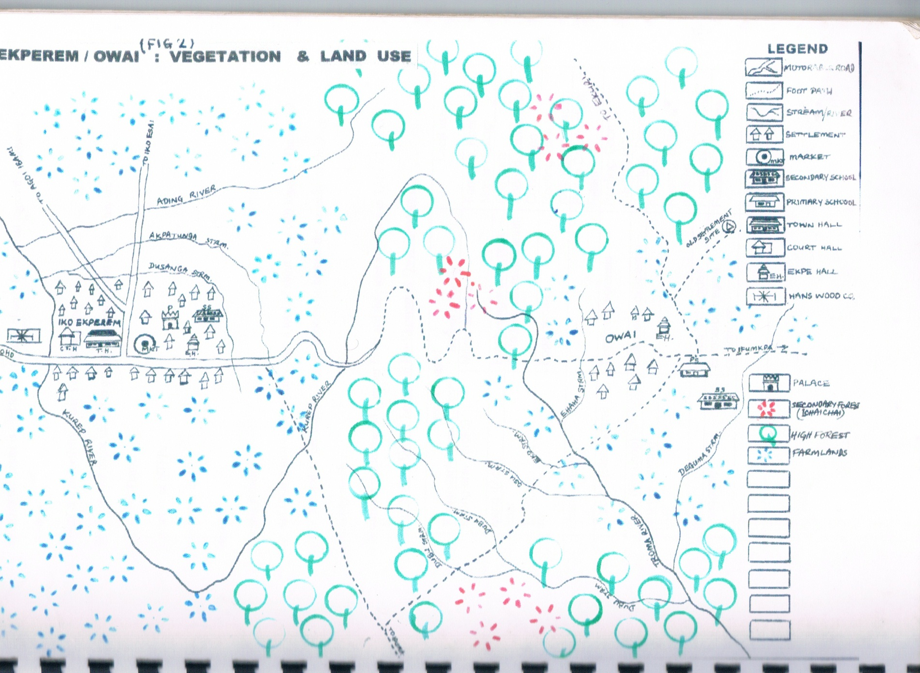
IKO EKPEREM LAND USE MAP FROM PR

Slide 17
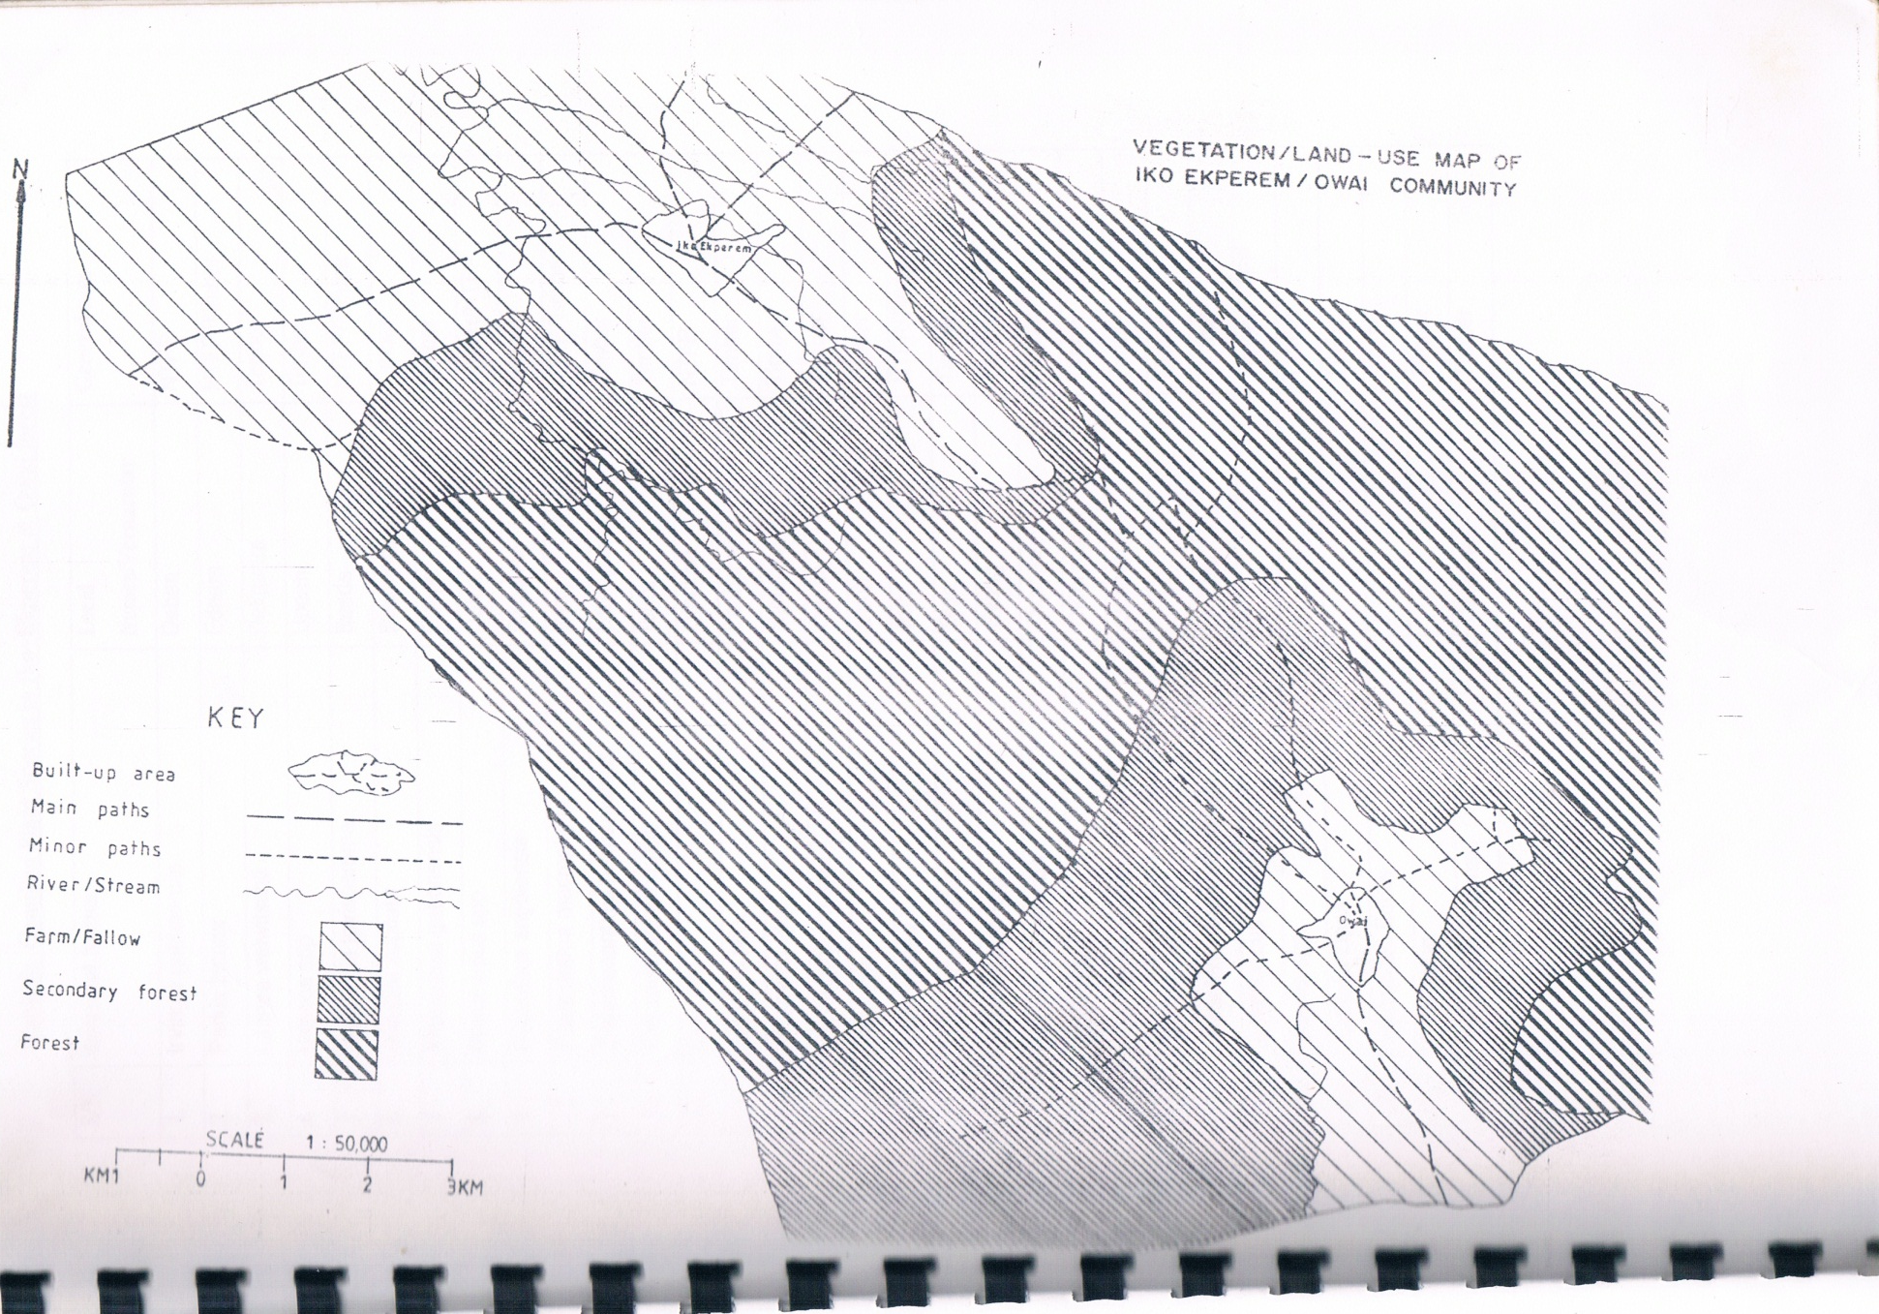
IKO EKPEREM LAND USE MAP FROM CONVENTIONAL METHOD

Slide 18
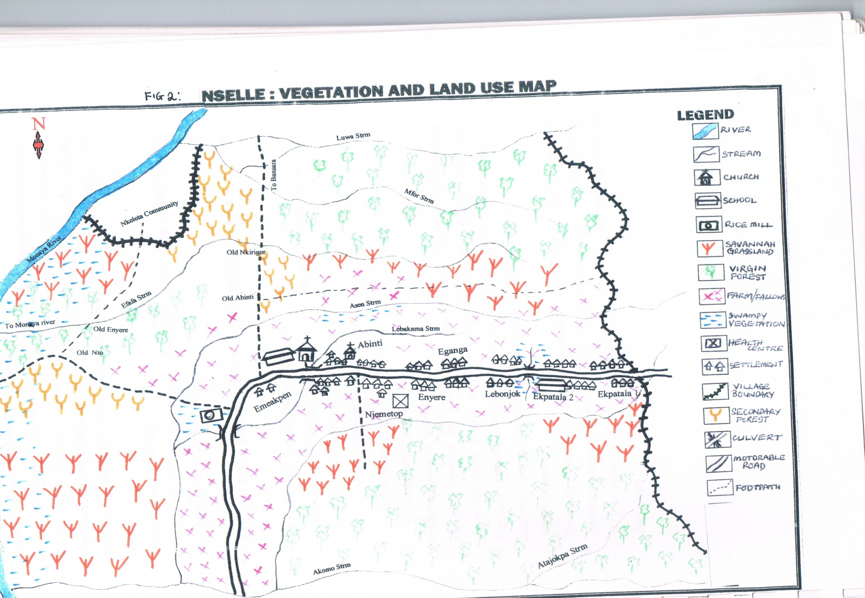
NSELLE VEGETATION/LAND USE MAP FROM PR

Slide 19
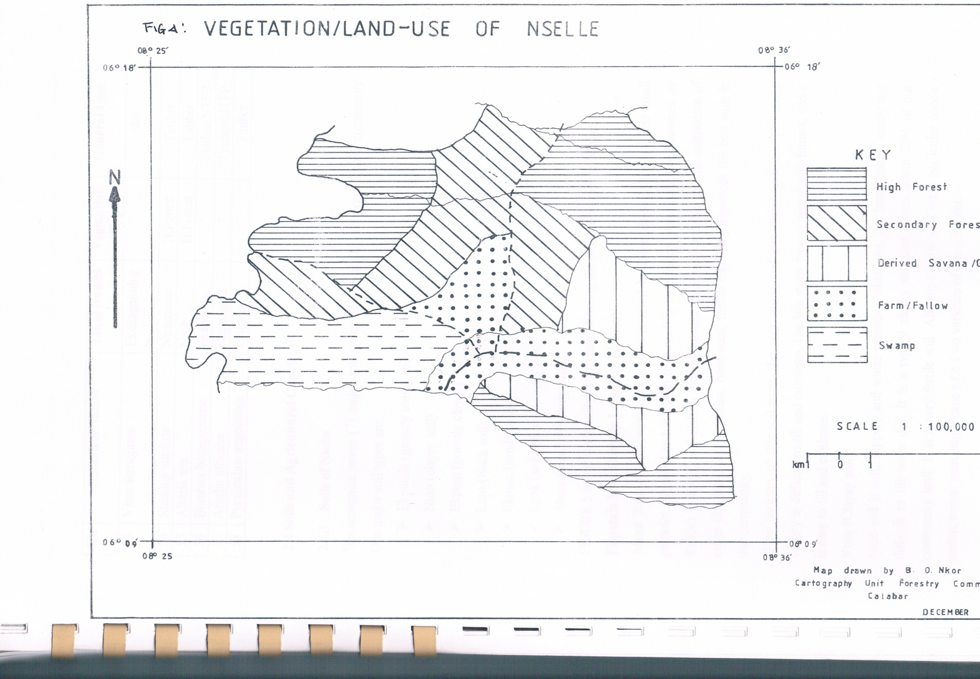
NSELLE VEGETATION/LAND USE MAP FROM CONVENTIONAL METHOD

Slide 20
CORE PRINCIPLES
PARTICIPATION: Both (Insiders and outsiders) Researchers and the community members are partners in data collection.
Ensure that all people play an active part in discussion and decision
Actively seeking the unheard voice
Be gender sensitive in a general meeting
Using a mixture of visual and verbal techniques
SUSTAINED DIALOGUE: Through dialogue between the external researchers (research team) and internal researchers (community members)
Encourage openness of dialogue and exchange in anon-judgmental atmosphere.

Slide 21
CORE PRINCIPLES CONT’D
POWER SHARING:
In PR, the researcher has to learn to engage internal actors as equals
Increase ownership and control – stimulating community to control the research process together with the external researchers can help give people a sense of ownership (“Hand over the stick”)
Bias Explicit/Critical self-awareness and responsibility: Every individual is shaped by his/her worldview, the researchers must avoid personal bias not dictate choices and opinions.

Slide 22
PRINCIPLES CONT’D
Rapid and progressive learning: Assume not to learn everything immediately.
Learn with conscious exploration,
use methods flexibly, and be prepared to adapt to the situation.
Have a plan, but allow for the unexpected.

Slide 23
CORE PRINCIPLES CONT’D
Flexibility and informality: the relationship between the research team and the community should:
Free for all to discuss.
Informal;
Based on equality
Unimposing instead of acting important
Not in a hurry
No standardized methodology, but based on purpose, time and resources
Triangulation:
Using multiple methods to investigate a subject
diversifying team members and data sources
Multiple sites
cross checking information and neutralize biases
capture a greater quantity of information.

Slide 24
CORE PRINCIPLES CONT’D
Optimal Ignorance: Optimal ignorance means getting only the information that is really needed and no more, avoiding collection of irrelevant data. (FAO, 2004)
Appropriate Imprecision: In conventional surveys, many of the data collected have a degree of precision that is really unnecessary. It is often more useful to obtain causes of problems, trends and directions of change, rather than accurate information on the absolute numbers affected by the problem (United Nations University, 2010)
Multiple Perspectives: Valuing all participant perspectives and exploring different views.

Slide 25
CORE PRINCIPLES CONT’D
Group Learning Process: Group learning and instruction will be iterative, changing as people’s perceptions evolve.
Ensure respect and safety for people at all stages of the process –ensure that people participate voluntarily, and that they understand that they can stop at any time.

Slide 26
CORE PRINCIPLES CONT’D
Leading to Change: The PR process should elicit learning and debate. The discussions should change individual and group perceptions as well as the population’s readiness for action.

Slide 27
CORE PRINCIPLES CONT’D
Sharing information: information and ideas are shared among rural people, and between them and the facilitators. Different organisations also share tips and practical experiences in the field.
Systematic learning process: the focus is on cumulative learning by all the participants and, given the nature of these approaches as systems of inquiry, their use has to be participative.

Slide 28
MAINTAINING RIGHT ATTITUDES AND BEHAVIOURS
The team facilitating PR must develop attitudes and behaviours to encourage participation. These include
Trust people so that they can analyse, plan, act, monitor, evaluate and reflect.
Don’t lecture or dominate people.
Listen to people.
Learn from people and share your own knowledge as appropriate.
Don’t judge people, but do challenge harmful ideas to help people see things in a new way.
Respect people and be friendly.
Be honest with people about intentions and expected outcomes.
Embrace error and learn from mistakes.
Have fun!
Don’t rush; let things evolve at their own pace.
Relax with people.
Don’t work for people; work with them. Better still be with them.

Slide 29
CONCLUSION
PR is democratic, engenders a sense of belonging and responsibility, create awareness, find multiple solutions to problems and is a mobilizing device for development, therefore ensure that:
Every idea counts/everybody’s view counts
Be Transparent:
Participatory decision-making requires readiness from all sides to reach a "win-win" compromise.
THIS WILL HELP TO BUILD MUTUAL TRUST.
THANKS! !! !!!

