Slide 1
PGA for REDD+ in NIGERIA: TRAINING ON GOVERNANCE INDICATORS AND DATA COLLECTION, Boje, 24-28 March 2014
PART II: INDICATOR CHARACTERISTICS:
HOW TO SELECT USEFUL GOVERNANCE INDICATORS?
25-26 March 2014

Slide 2
Exponential growth of governance indicators industry over the last 2 decades
World
Governance
Assessment
But what do they measure, for what purpose, with what effect?
Global
Accountability Report
Gender
Empowerment
Measure
Press
Freedom
GAPS in
Workers’ Rights
BEEPS
Global Integrity
Index
Index of
Bribe Payers Index
East Asia
Economic
Barometer
Freedom
Opacity
Commitment to
Index
CIRI
Development
Governance
Human Rights
Eurobarometer
Global
Matters
Database
Competitiveness
Afrobarometer
Polity
Index
CPIA
International Country
Corruption Perception
Bertelsmann
Freedom in the
(
WB
Transformation
World
)
Risk Guide
Index
Media
Index
Open
Journalists
Sustainability
Budget
killed
Index
Index
1974
76
78
80
82
84
86
88
90
92
94
96
98
00
02
04
06
Notes:
There has been a tremendous development in global indicators and indices on governance... But the important question to ask is “why” measure, “what for”, towards which purpose, and what?...
These global indices are used to rank and “name and shame” countries, and those rankings can sometimes help put certain issues on the global agenda, as they can have certain communication power and are often relayed by the media who like the “naming and shaming” game.
However, aside from ranking countries, those global indicators do not seem very useful in order to assess the actual state of governance (transparency, or other governance areas) inside one specific country, and almost never result in an improvement of governance in the concerned countries. Indeed, they look at the lowest common denominator between all countries in order to compare them, but do not help analyze specific country situation and identify precise governance problems in each country.
Too often, it is the indicator that determines what will be measured, while it should be the opposite – identify country priorities first, and then decide on what to measure based on the country’s needs and priorities, not based on a ready-made indicator to be used. The country context and country priorities should determine what will be measured, and the indicators should come at the service of the country’s issues, not the other way round.

Slide 3
 | Transparency International – Perception corruption index (2009) | Freedom House – Freedom in the world (2009) | World Bank – Corruption Control (2009) | Global Integrity (2009)
 | Burkina Faso 2. Malawi 3.Senegal 4.Gambia 5.Algeria 6.Mali (111e) 7.Mozambique (130e) | “free”: Mali “partly free”: 2. Senegal 3. Mozambique 4. Burkina Faso 5. Malawi 6. Gambia “not free”: 7. Algeria | 1. Mozambique (41%) 2. Burkina Faso 3. Algeria 4. Malawi 5. Senegal 6. Gambia 7. Mali (29%) | Moderate: Malawi Low: Senegal Very low: Algerie Mozambique
Notes:
These examples show the poor reliability and usefulness of global indices and rankings: different global indices on governance place countries in completely different orders… Where do these differences come from? (see next slide)

Slide 4
Where do these differences come from?
  1) What does each index measure?
    TI CPI → public sector
    WB corruption control index → private and public sector
    Global Integrity → anti-corruption mechanisms
  2) What types of indicators make up each index? (“apples and oranges”)
    State corruption vs. “petty corruption”
    Frequency of bribes vs. amount of bribes, etc…
  3) What sources of data are used?
    Non-representative of local populations
    Differences between expert perceptions and citizens perceptions (DIAL)
  4) Are the data sources the same every year?...
Notes:
To understand where differences in those rankings come from, it is necessary to look behind the index and the ranking numbers, and ask the following questions.

Slide 5
  3) What data sources are used?
Selected sources (out of 13 in 2009) | Subject asked (based on perceptions) | Respondents | Coverage
World Economic Forum (WEF) | Undocumented extra payments or bribes connected with various government functions | Senior business leaders; domestic and international companies | 131 countries
Bertelsmann Transformation Index (BTI) | The government’s capacity to punish and contain corruption | Network of local experts / local business people | 125 countries
Economist Intelligence Unit (EIU) | The misuse of public office for private (or political party) gain | International experts | 170 countries
Notes:
While it is well-known that “different indices measure different things”, it is also important to note that even one index is made up of individual indicators that measure very different things. For instance, “what exactly is measured by the CPI?” Difficult to answer with precision with so many second-hand sources!
There is also huge variety in the type of respondents consulted in each index (CPI sources). And in addition, there are differences in the country coverage for each survey. This means that some countries are not included in every survey, and that for these countries, there are fewer sources to make up their overall score. In practical terms, this means that country scores in fact are not all measuring the same things! Comparing apples and bananas!

Slide 6
TI Corruption Perception index (CPI)
2009 | 126th | Syria | 5 surveys
 | 176th | Iraq | 3 surveys
 | 179th | Afghanistan | 4 surveys
2008 | 147th | Syria | 5 surveys
 | 176th | Afghanistan | 4 surveys
 | 178th | Iraq | 4 surveys
2007 | 138th | Syria | 4 surveys
 | 172th | Afghanistan | 4 surveys
 | 178th | Iraq | 4 surveys
Notes:
In response to the 4th question (are data sources the same every year), this shows that the answer is no: the number of surveys done for the CPI is different from a country to another and a year to another for the same country (Iraq in the above example).

Slide 7
What are the objectives of governance assessments?
Examples:
External assessments: by development partners, independent research institutions, private sector companies,...
To make decisions on investment
To make decision on aid allocation, development support plans
strategic information for foreign affairs decisions;...
But limitations on ownership and national capacity development
Peer assessments: assessment of a state by other states (peers) on a voluntary basis e.g. African peer-review mechanism among AU members
National or local assessments:
To understand the causes of a problem and obstacles to reform (bottlenecks), or factors for success of policies
Evidence-based policy-making
Understand the impact of certain governance issues on a specific sector or population groups and design solutions
Notes:
The important question to ask is what are the objectives of the concerned governance assessments – what is their purpose, the agenda of those who conduct it, … to know why we are doing this!

Slide 8
Relevance of PGAs to REDD+
For government:
to highlight areas in need of urgent attention and prioritize action;
to provide relevant information on governance for policy-making and planning at national and sub-national level;
as a basis for political reform;
as governance data that can aliment the National Safeguards Information System, to be transmited to the UNFCCC;
to monitor progress and regression if regularly updated.
For civil society:
Consistent information on governance that can be used for advocacy and demanding accountability to decision makers
Data validated by the government, which avoids debates on the accuracy on the information and allows to move forward in the dialogue between civil society and government
To monitor progress or lack thereof

Slide 9
10 characteristics
Assessment is aligned to national political priorities, such as NDP
Assessment is country contextualized
Methodology is rigorous
Selection of indicators is transparent and participatory
Results are stored in a public national database
Indicators are pro-poor and gender-sensitive
Capacity of national stakeholders are developed
The assessment is cost-effective and timely
The results are widely communicated
The assessment is repeated
Notes:
10 central features of an effective democratic
governance assessment
1. The governance assessment system is anchored in the national
development plan
2. The assessment is country contextualized and focuses on
national governance priorities
3. A methodology is used that conforms to global standards in
terms of technical and scientifi c rigour
4. Indicators for the assessment are selected and generated
through a transparent, participatory and inclusive process
5. There is an institutionalized procedure to collect data from
a variety of sources and a public national database that stores
this information
6. The assessment is poverty and gender sensitive, and responsive
to other vulnerable groups in the country
7. There is a targeted approach to developing the capacity of
national stakeholders
8. The assessment is cost-effective and timely
9. The results of the governance assessment are widely
communicated and disseminated
10. The assessment is repeated to secure monitoring of
governance performance over time

Slide 10
WHAT IS AN INDICATOR?
An instrument that provides information, or an indication, gauge or measure on the condition, state or level of something
What is the difference between an index and an indicator?
An index is an aggregation of several indicators, which come together to provide one single, composite measure of something.
Examples of global indices:
HDI – Human Development Index is composed of different indicators on economic growth, education and health respectively.
CPI – Corruption Perception Index is composed of several indicators on corruption
Example of national indices:
IDI - Indonesia Democracy Index
PAPI – Vietnam’s Public Administration Performance Index
Mongolia’s MDG 9 on governance
Unlike an index, an indicator should be disaggregated to provide a measure of something specific, rather than an aggregation of different things.
Notes:
For the PGA, we are looking at developing disaggregated indicators, so as to have precise information on specific elements of governance.
It is possible to eventually put all indicators together towards an Index for the State or the country, like what Indonesia has done with the IDI, Vietnam with the PAPI or Mongolia with their “MDG 9” on governance (each of these comprise tens of indicators), to help set a national target on governance.
National indices, comparing provinces within a country, can be useful for national planning and policy-making purposes – unlike global indices that are usually not useful as policy-making instruments for a specific country.
But in any case we first need to have disaggregated indicators on the issues of concern (remember it is the issues that should determine the indicators and not the other way round.)

Slide 11
A GOOD INDICATOR
is…
Technical aspects
• Valid – measures what it is intended to measure
• Reliable – consistent and comparable over time
• Sensitive – able to detect extent and direction of change during the cycle
Practical aspects
• Specific – Identifies the nature of the expected change, the target groups, the target area, etc
• Measurable – reliable and clear measure of results
• Attainable – realistic given resources likely to be available
• Relevant – helps us to correct course during, and to learn after
• Time bound – data collection is feasible and not overly burdensome within timeframe
Notes:
Indicators need to be “SMART” and also technically valid, reliable and sensitive to change.

Slide 12
SMART INDICATORS: example from Indonesia
“Private sector perception on bribery practices for obtaining forest utilization permits application at district, province and central level in 2014”
Notes:
Is it Specific, Measurable, Achievable, Realistic and Time-bound? – Yes

Slide 13
DE JURE AND DE FACTO INDICATORS
De jure indicators measure a condition or a change in law, policies, measures, procedures or resources – are the legal and policy conditions in place for the desired change to happen?
E.g.: Is there a Law regulating the use of forest resources?
Is there an agency with a legal mandate to address corruption?
De facto indicators measure facts or changes in governance in practice – what are the effects of the laws, policies, measures or procedures in reality? Do citizens benefit from them in practice?
E.g.: In practice, is the Forest Law implemented?
In practice, is the anti-corruption agency effective?
Notes:
Both are necessary in order to assess one issue fully.
De jure indicators are usually “input” indicators.
De facto indicators are often “output” indicators, measuring the effect of a measure or “input”.

Slide 14
INPUT, PROCESS AND OUTCOME INDICATORS
Outcome indicators will tell us:
  What do we want to achieve?
  Have we achieved it?
Process indicators will tell us:
  How are inputs used to generate outcomes?
  What are the ‘best’ processes?
  When & how do processes need adjustment?
Input indicators will tell us:
  What is needed to create these processes?
  Whether it is available?
Note: there are overlaps between the two distinctions: de jure (in-law)/de facto (in-practice) indicators and input/process/outcome indicators.
Notes:
First, should be clear that indicators we want to identify through the PGA for REDD+ are indicators that measure progress towards broad governance objectives. We will not deal with the construction of activity indicators, such as measurement of training programmes.
Activity indicators are essential for front-line management, but they do not tell policymakers about progress towards their desired outcomes.
To identify an indicator, must know what is to be indicated or measured
Easiest to start with objective and then work down
Ensure there are clear and logical linkages between the levels
Outcome: achieve women’s equal participation in decision making, by ensuring that women are equally represented in parliament with men
2) Process (each one can be measured):
need women to stand for election
need women (and men) to vote for women
need women active in political parties
3) Inputs (each one can be measured)
Political parties willing to accept women as members and as candidates
Women willing and able to stand for election and, if they win, take office
Women may need training in campaigning
14

Slide 15
ACTIONABLE INDICATORS
Input / process indicators are more ‘actionable’ than outcome indicators
Outcome indicators are useful to assess progress towards the desired objectives of governance programmes (new laws or increased expenditures mean nothing in and of themselves)
But they lack ‘actionability’ (they don’t tell us what needs to be fixed / points of interventions)
Example: A government cannot ‘choose’ to lower a crime rate (an outcome indicator)
It can, however, choose to put more police on the streets (input), toughen penalties for offenders (prosecution process), or fund social programmes offering alternative activities to unemployed youth (input)
Notes:
An actionable indicator is one that provides insights into where reforms should be made - tell us what needs to be fixed / gives us something that can be “acted” upon.
Requires breaking down a concept in its component parts so that it eventually leads to points of interventions
Answers to these questions need to lead naturally to possible points of intervention.
% citizens who believe that legal protection is ensured equally to all citizens regardless of their material status, ethnic, religious affiliations, political/party affiliations
15

Slide 16
ACTIONABLE INDICATORS:
Example from Morocco
Outcome indicators (non-actionable) | Input / process indicators (actionable)
% citizens who believe there is a lack of transparency in the operations of local governments | Number of provinces which have a public forum for citizens to discuss with locally elected officials Number of provinces which formally publish contracts, tenders, local budget and local development plan
% citizens who do not believe that legal protection is ensured equally to all citizens regardless of their material status, ethnic, religious affiliations, political/party affiliations | Number of provinces where an awareness-raising programme on citizens’ rights to seek legal protection has been conducted % citizens who say they know where to / how to seek legal protection
Notes:
That provide insights into where reforms should be made - tell us what needs to be fixed.
Requires breaking down a concept in its component parts so that it eventually leads to points of interventions
Answers to these questions need to lead naturally to possible points of intervention.
16

Slide 17
Exercise: Which, if any, of these indicators are actionable?
1. How often do firms make extra payments to influence the content of new legislation?
2. How many judges and magistrates do you think are involved in corruption?
How would you make them more ‘actionable’?
Notes:
Module 1 - Introduction to the Programme
17
Which, if any, of these indicators are actionable? (drawn from CPI and WB’s Control of Corruption indicator)
17

Slide 18
Exercise: two examples
Non-actionable
1. How often do firms make extra payment to influence the content of new legislation?
2. How many judges and magistrates do you think are involved in corruption?
Actionable
In practice, are the regulations restricting post-government private sector employment for national legislators effective?
In practice, are the requirements for the independent auditing of the asset disclosure forms of members of the national legislature fulfilled?
In practice, when necessary, does the judicial disciplinary agency initiates investigations?
In practice, when necessary,
does the judicial disciplinary agency impose penalties on offenders?
Notes:
Module 1 - Introduction to the Programme
18
18

Slide 19
Actionable or ‘action-worthy’?
Simply because something can be measured and acted upon does not mean that it is an important constraint on good governance.
Actionable does not mean action-worthy
  e.g. Measuring whether a country has an independent anti-corruption commission when there is no guarantee it will reduce corruption
  e.g. Measuring the speed of judicial proceedings when not clear that increasing the speed will ensure that justice is done
There is a risk of measuring things because they are easily measurable, leading to “teaching to the test” and “reform illusion”
Notes:
Module 1 - Introduction to the Programme
19
What are the pitfalls of actionable indicators?
“Simply because something can be measured does not mean that it is an important constraint on good governance.”
Actionable does not mean action-worthy
E.g. Measuring whether a country has an independent anti-corruption commission when there is no guarantee it will reduce corruption
E.g. Measuring the speed of judicial proceedings when not clear that increasing the speed will ensure that justice is done
Risk of measuring things because they are easily measurable, leading to “teaching to the test” and “reform illusion”
Measuring whether a country has an independent anti-corruption commission when there is no guarantee it will reduce corruption (problem might lie in low wages of civil servants – what can independent anti-corruption agency do about that?!)
19

Slide 20
Determining what is an ‘action-worthy indicator’
Is it measuring interventions that are truly ‘beneficial’?
  Assessing performance of interventions only makes sense if these are first deemed appropriate for the particular country context
  Prior research can identify what reforms to prioritize, and ones that risk further entrenching corrupt systems e.g. political economy studies such as National Integrity Systems assessments by TI
Can the performance measured be attributed
to specific policy inputs? (‘actionable’ indicator)
Notes:
Module 1 - Introduction to the Programme
20
Measuring the ‘right’ interventions?
Note that it is of course impossible to be sure that an intervention will actually be beneficial before it is actually implemented...but the idea is to try to make sure the indicators measure relevant inputs, to the best of the knowledge that can be acquired from prior research, participatory discussion processes to determine the best indicators etc...
20

Slide 21
“Not everything that counts can be counted, and not everything that can be counted counts.”
The indicator should be adapted to the specific reality that we want to measure, and not the other way around!
Risk of measuring things because they are easily measurable, leading to ‘reform illusion’
Example: Measuring the number of corruption cases brought to trial (as an indicator of the efficiency of the judicial system in combating corruption):
  Does an increase in this indicator mean an increased level of confidence in the reporting mechanism, and in the courts?
  Or rather, does it indicate a higher incidence of corruption?
  Or both...?
In other words, are you really measuring what you intended to measure?
Are you sure it is the reality you want to measure that determines your indicator, or is it the indicator that determines the reality you are measuring instead?...
Notes:
What are the pitfalls of actionable indicators?
Another example: Measuring the speed of judicial proceedings when not clear that increasing the speed will ensure that justice is done...
Measuring women representation in parliament
21

Slide 22
QUANTITATIVE AND QUALITATIVE INDICATORS
Vote with your hands: qualitative or quantitative:
Number of people who have declared that they know the existence of a redress mechanism
Existence of a complaint mechanism
Existence of a complaint mechanism that is effective and timely
Quality of record keeping
Number of managers who believe that records are kept adequately
Number of staff trained on proper record keeping techniques
% of staff evaluations where proper record keeping appears as a performance criteria
Notes:
Note that indicators starting with “number” or “%” are not necessarily quantitative only: they can have qualitative elements

Slide 23
PERCEPTION-BASED, EXPERIENCE-BASED AND EVIDENCE-BASED INDICATORS
Perception-based: based on the opinion and perceptions of an element among stakeholders and experts
Experience-based: Polling stakeholders about their actual experience with something
Evidence-based: Harder facts

Slide 24
Perception based | Experience based | Evidence based
Based on the opinion and perceptions of an element among stakeholders and experts | Polling stakeholders about their actual experience with something | Harder facts
Example measuring accountability through the effectiveness of a complaint channel
% of polled local stakeholders who say they are «very comfortable» with the way their complaint has been handled | % of stakeholders for whom the resolution of a complaint has occurred without paying a bribe | Increase (or decrease) of the number of complaints between 2012 and 2013
Perception based | Experience based | Evidence based
Based on the opinion and perceptions of an element among stakeholders and experts | Polling stakeholders about their actual experience with something | Harder facts
Example measuring accountability through the effectiveness of a complaint channel
Perception based | Experience based | Evidence based
Based on the opinion and perceptions of an element among stakeholders and experts | Polling stakeholders about their actual experience with something | Harder facts
Example measuring accountability through the effectiveness of a complaint channel
% of polled local stakeholders who say they are «very comfortable» with the way their complaint has been handled | % of stakeholders for whom the resolution of a complaint has occurred without paying a bribe | Increase (or decrease) of the number of complaints between 2012 and 2013
Engages stakeholders in thinking about the issue --) create demand for accountability Opportunity to gather narrative elements Perception matters (Sarko) | same | Objective Actionable
Subjective Need high sampling size to be meaningful because respondents may be unwilling to discuss certain issues Less actionable | Not as subjective as perception based, but Still depending on a truthful answer | Takes data collectors to investigate official records if they can be accessed, Provide information on accessibility and on number of complaints at once, does not disaggregate between the two

Slide 25
Game with cards : evidence-based and perception-based
Question : please pick the card that goes with the indicator | Answer | Additional question : what question does this answer ? | How would you measure this ? | What is the problem with this indicator ?
% of polled local stakeholders who consider that access to REDD+ financial information (or similar existing system) is either adequate or very adequate | Perception-based
Time needed (days) between a request on flow of funds and the answer | Evidence-based
Question : please pick the card that goes with the indicator | Answer | Additional question : what question does this answer ? | How would you measure this ? | What is the problem with this indicator ?
% of polled local stakeholders who consider that access to REDD+ financial information (or similar existing system) is either adequate or very adequate | Perception-based | Perception of accessibility of financial information
Time needed (days) between a request on flow of funds and the answer | Evidence-based | Effectiveness of financial management, ease of use of fund tracking system
Question : please pick the card that goes with the indicator | Answer | Additional question : what question does this answer ? | How would you measure this ? | What is the problem with this indicator ?
% of polled local stakeholders who consider that access to REDD+ financial information (or similar existing system) is either adequate or very adequate | Perception-based | Perception of accessibility of financial information | Survey, questionnaire
Time needed (days) between a request on flow of funds and the answer | Evidence-based | Effectiveness of financial management, ease of use of fund tracking system | Interviews OR experience (test the system)
Question : please pick the card that goes with the indicator | Answer | Additional question : what question does this answer ? | How would you measure this ? | What is the problem with this indicator ?
% of polled local stakeholders who consider that access to REDD+ financial information (or similar existing system) is either adequate or very adequate | Perception-based | Perception of accessibility of financial information | Survey, questionnaire | Cannot yet be applied (in readiness phase) It does not measure something that exists Even people who do not know may feel they have to answer Identifying who to ask will be tricky : appropriate for local level ?
Time needed (days) between a request on flow of funds and the answer | Evidence-based | Effectiveness of financial management, ease of use of fund tracking system | Interviews OR experience (test the system) | Requires extensive research
Question : please pick the card that goes with the indicator | Answer | Additional question : what question does this answer ? | How would you measure this ? | What is the problem with this indicator ?
% of polled local stakeholders who consider that access to REDD+ financial information (or similar existing system) is either adequate or very adequate
Time needed (days) between a request on flow of funds and the answer

Slide 26
Complementarity in the use of indicators
De jure (input) indicator: In law, is there an agency with a legal mandate to address corruption? Does it receive regular funding, a professional & full-time staff?
  Measuring a change in law, in procedures, in resources
De facto (process / outcome) indicator: In practice, is the anti-corruption agency effective?
  Measuring improved governance in practice (how are citizens benefiting from this new institution?)
Notes:
Input
Existence and quality of formal rules found in documents, laws, regulations and the constitution (on paper)
Answer the question: “What has been done?”
Actionable
Say nothing about actual progress (implementation)
Outcome indicators
Assess deliverables to citizens
Answer the question: “Are citizens benefiting from specific institutions and policies?”
Lack actionability
Measure the improved governance in practice
Head of ACA protected from removal without relevant justification & through a formal process?
Difficulties accessing politically sensitive info necessary for carrying out investigation?
Subject to favourable or unfavourable criticism by govt?
Political appointments vs. based on professional criteria?
Conflicting family relationships / personal loyalties?
Threats / harassments?
26

Slide 27
COMPLEMENTARITY IN THE USE OF INDICATORS
Combine indicators to show discrepancies:
De jure indicator:
In law, is there an agency with a legal mandate to address corruption? (input)
De facto indicators:
In practice, is the anti-corruption agency effective? (outcome)
When necessary, is the ACA able to independently initiate investigations? (process)
Does the ACA make regular public reports (e.g. to the parliament)? (process)
Can citizens complain to the ACA without fear of recrimination? (e.g. whistle-blower mechanisms) (process)
Does the ACA act on citizen complaints within a reasonable time period? (process)
Notes:
Can use a ‘tree approach’
One question leading to another…
Does the ACA act on complaints within a reasonable time period? Could have 2 indicators, each important:
Avg time before complaint acknowledged – before complaint resolved
Can citizens complain to the ACA without fear of recrimination?
Effective Mechanisms in place to protect whistleblowers?
This would be a necessary condition for citizen being able to file a complaint without fear of recrimination (outcome indicator) – therefore an input indicator
27

Slide 28
Complementarity of indicators
Input indicators / ‘in law’ indicators | Impact indicators/ ‘in practice’ indicators
Measures the existence and quality of formal rules found in documents, laws, regulations and the constitution | Measures what has been delivered to citizens
Answers the question: “What has been done?” | Answers the question: “Are citizens benefiting from specific institutions and policies?”
Says nothing about actual progress | Measures actual improved governance
Example: In law, there is an anti-corruption agency mandated with the fight against corruption and protected from political interference. | Example: In practice, the public feels informed about the activities and services offered by the anti-corruption agency, and knows how to access these services.
Notes:
Balanced sets of indicators are needed: input-based indicators (e.g. focusing on the legal and institutional framework), and output-based indicators, (e.g. data on the experiences and opinions of those accessing the reporting mechanism).
Also: quantitative and qualitative, evidence and experience/perception, etc...

Slide 29

Balanced baskets of indicators
Do you have a balanced basket of indicators that measures progress towards a single aim?
Is the ambiguity inherent in each indicator reduced by the presence of the others?
Notes:
An indicator should rarely be used on its own. To interpret changes in ambiguous indicators, you should always use a group or ‘basket’ of indicators relating to the same policy objectives.
Baskets of indicators provide a more valid, reliable, and rounded view of policy progress.
At the same time, you must not allow the basket to get too big. A very large basket takes too much time to interpret. A Basket of 3 to 7 well-chosen indicators provides the degree of validity & the ease of interpretation required. The art lies in your ability to assemble small baskets of powerful indicators.

Slide 30
Balanced baskets of indicators
  What is the aim you want to achieve?
  What are the many reasons why your aim might NOT be achieved?
  For each “reason” → develop one indicator
Notes:
To measure “public safety”:
Number of crimes reported to the police
Increase → Higher real crime rate?
Higher level of confidence in police?
Both?

Slide 31
Balanced baskets of indicators?
Aim: “Equal access to justice”
Indicator 1:
Number of new courts opened in rural and urban areas
Indicator 2:
Number of courts per 100,000 residents
Indicator 3:
% citizens who say that they have access to court systems to resolve disputes
Indicator 4:
% accused not represented at trial
Notes:
An indicator should rarely be used on its own. To interpret changes in ambiguous indicators, you should always use a group or ‘basket’ of indicators relating to the same policy objectives.
Baskets of indicators provide a more valid, reliable, and rounded view of policy progress.
At the same time, you must not allow the basket to get too big. A very large basket takes too much time to interpret. A Basket of 3 to 7 well-chosen indicators provides the degree of validity & the ease of interpretation required. The art lies in your ability to assemble small baskets of powerful indicators.
Let’s use an example to show how a few indicators may be used together to provide insight into the same phenomenon.
As a group, these 4 indicators give a better indication of “equal access to justice” than anyone of them would alone.
But is the basket as a whole well balanced?
31

Slide 32
Indicator 1: Number of new courts opened in rural and urban areas Measures the activity of a court-building programme, but does not tell us the result of the programme: do people have their fair share of courts? | Indicator 3: % citizens who say that they have access to court systems to resolve disputes Tells us nothing about equality
Indicator 2: Number of courts per 100,000 residents Tells us nothing about the equality of the distribution of courts (serving mainly one group / one region?) | Indicator 4: % accused not represented at trial The basket as a whole is unbalanced: 3 indicators relate to the courts, and one to legal aid

Slide 33
Balanced baskets of indicators
Checklist for building a well-balanced
basket of indicators
Avoid narrow activity indicators
What is the strategic aim you want to achieve?
Draw one indicator from each institution/service that contributes to the overall aim
Or...
  What are the many reasons why your aim might NOT be achieved?
  For each “reason” → develop one indicator
Notes:
33

Slide 34
Balanced baskets of indicators
4 key services/institutions for achieving
“equal access to justice”
4 indicators:
1. Court system
2. Legal aid service
3. Police service
4. Prosecution service
Notes:
34

Slide 35
Indicator 1 – Court system % citizens who say that they have access to court systems, disaggregated by gender, ethnicity, region, etc. Adapted from version 1: Disaggregated to reveal issues of inequality | Indicator 3 – Police service % citizens who say that the police will respond to them without requiring a bribe if called to resolve a dispute, disaggregated by gender, ethnicity, region, etc. Adds balance: Will alert you to problems in police services that may block access to justice more for some groups than for other.
Indicator 2 – Legal aid service % accused persons legally represented at one or more court appearances, disaggregated by gender, ethnicity, region, etc. Adapted from version 1: Disaggregated to reveal issues of inequality | Indicator 4 – Prosecution service Ratio of prosecution caseloads in courts serving wealthier communities to those in courts serving marginalized communities Adds balance: Will alert you to problems in prosecution services that may block access to justice more for some groups than for other.
Notes:
Dropped indicator on court-building activity, and on no. of courts per 100,000 persons -- > 1 indicator on access, + added indicators on police & prosecution services
Also good illustrations of pro-poor & gender sensitive indicators

Slide 36



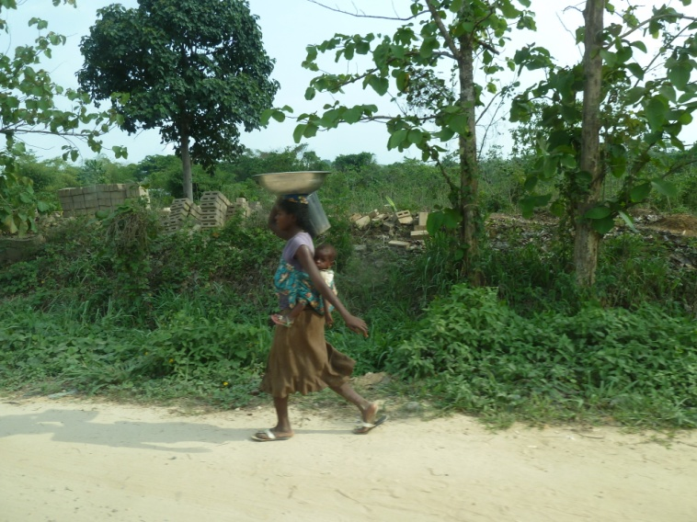


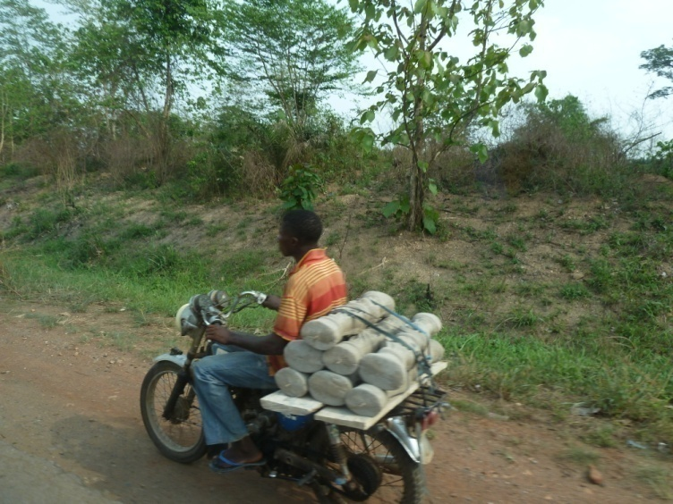

PRO-POOR AND GENDER-SENSITIVE INDICATORS
Notes:
Recognize anyone – or any place? ☺
Photos taken in Boki, and on the way from Calabar to Boje!

Slide 37
Poverty & gender sensitive indicators
Poor governance exacts a higher price on the poor: as an additional “obstacle”, and by lowering the quality of services
Gendered forms and dimensions of governance: men more often tend to be in positions of power, and therefore to be the beneficiaries of corruption, services, positions and other
Need for assessments to be sensitive to the impact of poor governance and service delivery on marginalised groups
Indicators in this area too often tend to be gender and poverty blind
Notes:
37

Slide 38
What makes indicators pro-poor or
gender sensitive?
4 ways to make indicators sensitive to vulnerable groups:
Disaggregating by poverty/gender
Specific to the poor/women
Implicitly poverty/gender sensitive
Chosen by the poor/women
Notes:
What other groups or attributes might be important to capture using these techniques?
Groups:
Marginalized ethnic groups and tribes, the disabled, HIV sufferers, children and youth, the unemployed, sex workers
Occupation based groups such as police officers, government officials, health workers, taxi drivers, teachers and principals, traditional authorities, small business owners
Geographically based:
Rural, urban, regional, national, provincial/district, municipalities, chiefdoms, communities
38

Slide 39
Pro-poor indicators
Disaggregating by poverty status:
  Percentage of legislators in local assemblies/councils from an underprivileged background e.g. coming from a poor household, minimal schooling, minority group
Specific to the poor:
  Evidence of local policies targeted at the poor, e.g. employment programmes, improved access to basic services
Implicitly pro-poor:
    Density and distances to rural health services
Chosen by the poor:
  The amount you need to pay to get medical assistance (Indicators derived from focus groups)
Notes:
Information is collected for the general population, then disaggragated by sex or income.
Value of indicator calculated separately for part of population characterised as poor, and for the non-poor. Allows comparison of these 2 values.
39

Slide 40
1. Disaggregating by poverty/gender
    → Information is collected for the general population, then disaggregated by sex or income
    % seats held by women in parliament
    Level of confidence among female citizens that the Parliament represents their interests
    % of Parliamentarians from poorer districts
that have functioning and accessible local
offices to meet with constituents
Notes:
Information is collected for the general population, then disaggragated by sex or income.
Value of indicator calculated separately for part of population characterised as poor, and for the non-poor, or for men & women.
Shows different effects of a policy or governance practice on women and men / on poor and non-poor.
Is % women in parliament a good indicator of gender equality or of women’s empowerment? What if the women elected are gender blind and do not support women’s issues? What if they are all middle class and not concerned with social issues or poverty?
40

Slide 41
2. Specific to the poor/women
    Measuring governance issues that are specific to the poor or to women
    Size of funds allocated to legal aid in provincial budgets (per capita)
    Number of attorneys as % of citizens in need of one
    % of local governments practicing gender-sensitive budgeting
Notes:
Information that directly relates to governance issues that are specific to the poor or to women.
governance practices targeted to females or males, such as fulfilment of quotas for women.
41

Slide 42
3. Implicitly poverty/gender sensitive
    Backlog of small cases of little financial value
    → Makes no explicit reference to poverty status or gender, but by its nature, clear that the indicator is of particular relevance to low-income groups / women
    The number of hours that polling booths are open during on election day
    Frequency of engagement of CSOs in consultations on the legislation-making process
Notes:
Indicator makes no explicit reference to poverty status, but by its nature, clear that indicator is of particular relevance to low-income groups.
longer hours allow more casual or shift workers to vote without loss of earnings
Small retail businesses may be an implicit measure of poverty, and PETS benefit the poor most,
Backlog…: could indicate that poor are disproportionately disadvantaged, since for them, even claims of small financial value means a significant opportunity loss in terms of both time & money.
42

Slide 43
4. Chosen by the poor/women
    → Identified & measured by using participatory techniques (surveys, focus groups, etc.)
    Acceptance of documentation other than birth certificates in the process of voter registration
    Women’s trust in the police and its ability to provide women with redress if they file a complaint
Notes:
Use of participatory techniques to provide opportunity for low-income groups to identify indicators considered to be of particular interest to the poor
P&G sensitivity of data → enhanced through research design
Involving marginalised groups in research objective, design (e.g. selection, scaling, weighting of indicators)
targeting these groups in research e.g. case studies
focusing on services and institutions used by these groups
involving in data collection
disaggregating survey data
43

Slide 44
Measuring legal protection & redress mechanisms with pro-poor indicators
Example of anti-corruption mechanisms | Pro-poor/gender sensitive indicators | Possible data sources
Availability of legal protection
Legal protection is ensured equally for all citizens regardless of their status / affiliations | Change in % of plaintiffs who have had no prior contact with the courts Change in the range of small claims filed by poor plaintiffs | Intake filing form, disaggregated by income, gender, ethnicity, religion
Efficiency and fairness of redress mechanisms
Local complaint mechanisms are efficiently providing redress against corruption | Change in time from filing to disposition in cases of small financial value Ratio of prosecution caseloads in courts serving “majority” communities vs. “minority” communities | Administrative data, disaggregated by income, gender, ethnicity, religion

Slide 45
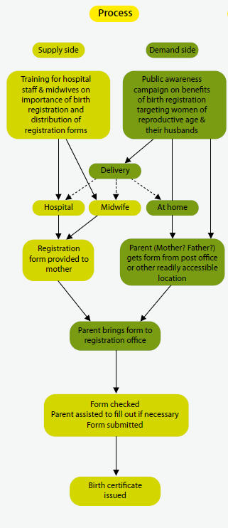
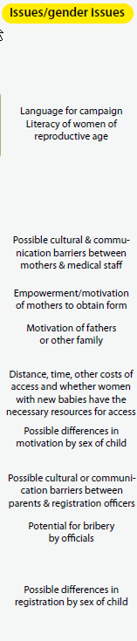
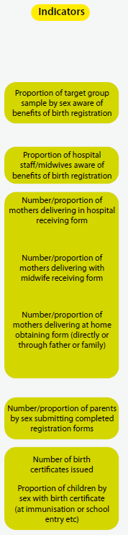
Notes:
Example of flowchart to outline a process: for each step of this process, gender-sensitive indicators can be developed.

Slide 46
Other dimensions of disaggregation
Democratic values require BROAD participation
  Ethnicity – female/male; poor/non-poor
  Location – rural / urban; female/male etc
  Disability – etc etc
A major challenge for monitoring & evaluating democratic governance
Notes:
Not all women are the same
Not all poor are the same
Democratic governance indicators in particular need to acknowledge and reflect the diversity of society

Slide 47
Assessing the ‘supply side’ of governance | Assessing the ‘demand side’ of governance
Number of criminal codes and criminal procedure codes harmonized with international Human Rights Law | % who say ordinary people can commit crimes without punishment % who say high level officials can commit crimes without punishment % who say people fear wrongful arrest

Slide 48
Complementarity of indicators
In-law (de jure) indicators and in practice (de facto) indicators
Input indicators, process indicators and outcome indicators
qualitative and quantitative indicators
disagregated indicators
gender-sensitive, poverty-sensitive, age-sensitive, community-sensitive indicators
Balanced baskets of indicators
- Do you have a balanced basket of indicators that measures progress towards a single aim?
- Is the ambiguity inherent in each indicator reduced by the presence of the others?
  What is the aim you want to achieve?
  What are the many reasons why your aim might NOT be achieved?
  For each “reason” → develop one indicator
Notes:
To summarize... Need complementary indicators, using every different types we have been talking about in this training, in a complementary and balanced manner... While at the same time taking into account the feasibility and being realistic about how many indicators we can afford to use, given the practical constraints we have – money, time, capacity etc.
It’s all about balance anyway!

Slide 49
Complementarity of data sources
Important to monitor both the ‘supply’ and ‘demand’ for good governance
Parallel with private sector:
  Assessment of the company’s charter, balance sheet, internal processes and assembly line
  OR / AND ?
  Assessment of whether consumers are actually buying their product, whether they were satisfied with it, and likely to keep on buying it
Notes:
Similarly to the indicators, the data sources need to be complementary as well.
The true state of political governance in a country cannot be assessed simply on the basis of an objective analysis
of the rules, resources and behavior of government institutions
Competent business people would never draw a final conclusion about the quality
of their company and product simply by investigating the company charter, its internal
processes or the assembly line. They would also need to know whether consumers were
actually buying their product and, more importantly, whether they were satisfied with it,
and likely to keep on buying it. In much the same way, the actual state of political governance
and, especially, democratic politics is at least partially in the eye of the beholder.

Slide 50
The double purpose of participatory governance assessments:
Strengthen the supply of governance (evidence-based policy-making)
PARTICIPATORY GOVERNANCE ASSESSMENT
Strengthen the demand for governance (accountability mechanism)
Notes:
Remember the PGA approach aims to strengthen both the supply and demand for governance…
…similarly it is important that the indicators address both “sides” – same thing with data sources…
…takes us to PART III on data sources and data collection methods.

