Slide 1




Status of PGA process in Nigeria
Workshop on Participatory Governance Assessment for REDD+ in Cross River State, Calabar, 16 -18 January 2013
Salisu Dahiru
National Coordinator REDD+
Federal Ministry of Environment, Nigeria
sdahiru85@yahoo.com

Slide 2

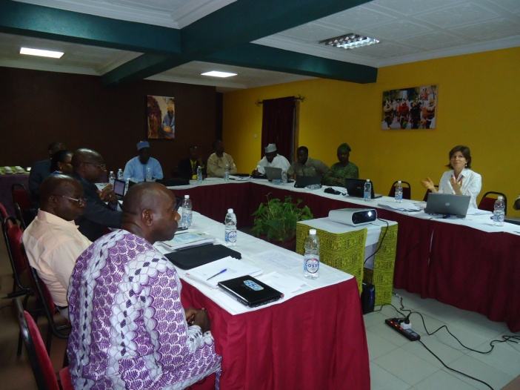
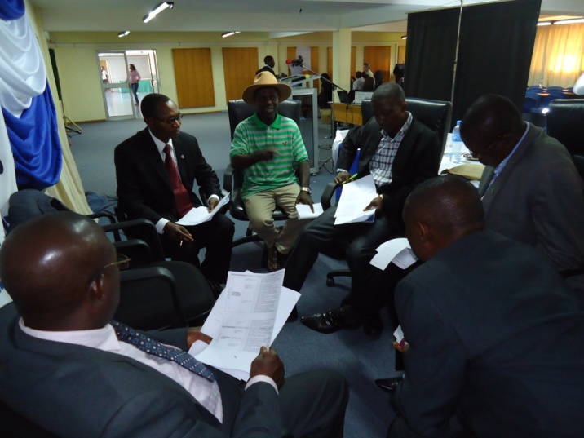
Start and status of Nigeria’s PGA process
Determined to monitor how governance and social safeguards for REDD+ are promoted, addressed and respected, Nigeria initiated steps towards PGA process, comprising;
Consultation with key REDD+ stakeholders in Lagos (20 May 2011);
Consensus was reached on the key governance issues to be assessed;
PGA process envisage 2 phases:
Phase one: Preparatory; Development of PGA methodology (2011-12);
Phase two: Piloting the methodology in CRS & a 2nd State (2012-13)

Slide 3
Identification of stakeholders & participants
Federal level – A “Governance Working Group” was created as part of the existing multi-stakeholder NTC on REDD+
Replicated in CRS; later scaled up to 4 other states
REDD+ Governance Research Team established in CRS
Stakeholders & Participants for Nigeria’s PGA process were drawn from: government officials, civil society actors (representatives of CSO platforms on REDD+), forest-dependent communities, national data and fiduciary control agencies, academia, and the media, among others;

Slide 4
Other activities undertaken
Oslo Governance Forum 3-5 October, 2011
Nigeria also participated in a Knowledge Exchange Meeting during April 2012 in Bogor Indonesia,

Slide 5
How PGA will enhance & enrich Nigeria’s REDD+ process
5 Priority areas to be addressed by the PGA/REDD+;
Policy and legislation concerning REDD+ and democratic governance;
Institutional capacity of government agencies at federal, state and local levels;
Anti-corruption strategy for REDD+;
Opportunities for civil society and forest-dependent communities to participate in decision-making processes related to REDD+;
Benefit distribution system for REDD+;
Some 35 issues identified
Fewer indicators to be identified in order to make a governance monitoring system feasible
Outcomes will strengthen national capacity to assess REDD+ governance; and to use governance data to inform policies, to monitor REDD+ readiness and to hold various stakeholders to account

Slide 6
Thank You
for
Listening!
sdahiru85@yahoo.com
Tel: +2348030570625 (mobile)

