Slide 1
Towards a comprehensive regional work plan for the strengthening of national forest monitoring systems in the Mesoamerican Region

Slide 2
Context
The regional assessment needs is framed in the work that is being undertaken in the context of the Mesoamerican Integration and Development Project (PM) .- Mesoamerican Strategy for Environmental Sustainability (EMSA).
Strong synergies between the Mexico-Norway Project for REDD+ readiness and the EMSA: development of a joint cooperation strategy for the development and implementation of forest monitoring systems in the region.
The south-south cooperation strategy was designed in order to create synergies between the initiatives working in REDD+, to make the most of the technical and financial resources present in the region. This strategy was developed in collaboration with all the countries participating in order to truly identify needs for cooperation, strengths and specific opportunities for each country.

Slide 3
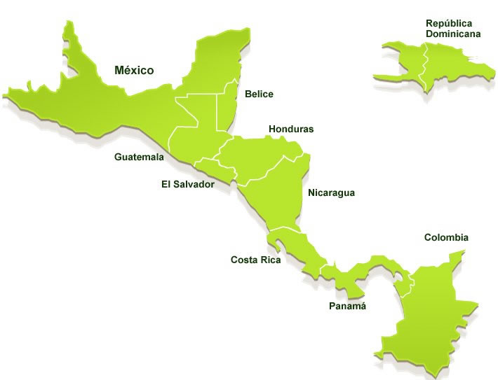
Mesoamerican Integration and Development Project, an example of south-south cooperation
Regional mechanism for dialogue and coordination.
Seeks to articulate cooperation, development and integration efforts amongst the Mesoamerican region in order to improve the quality of life of its citizens.
Technical resources + local know how = regional agenda based on cooperation and co-responsibility to address common problems.
Promotes the generation of regional public goods.
WHY ?
Integrated by: It represents:
224 million people*
A territory of 3.65 million km2
An estimated regional GDP:
$ 1,723 trillion USD* (march 2014)
*Source: AMEXCID

Slide 4
May 2013
Second meeting of the Ministers Council of EMSA (may 2013), cooperation activities in monitoring systems and climate change analysis
July 2013
Workshop “International cooperation opportunities to strengthen monitoring systems in Mesoamerica and REDD+ Readiness”
Nov 2013
Draft “State of implementation of National Monitoring Systems in Mesoamerica”
Warsaw meeting: Agreement to develop a Work Plan proposal to strengthen national forest monitoring systems.
Feb 2014
Identify needs and priorities on forest monitoring in order to identify collaboration priorities in the Mesoamerican Region.
Draft for final feedback from countries. Proposal for three main activities: i) south-south cooperation early actions; ii) sources of finance for the activities, iii) Master plan for building capacities and institutionalizing monitoring systems.
Feb – Nov 2014
Early cooperation actions: Strengthening of technical capacities through six workshops (2014), with technical and financial support of the main initiatives working on monitoring systems for REDD+ in the region.
Approval of regional needs assessment: financial and technical support by the UN-REDD programme to consolidate the Detailed Plan for Forest Monitoring within the EMSA
Oct 2014
Notes:
A finales de este mes habrá una reunión de ministros emsa. En esta se le informará al consjo de ministros de la EMSA sobre la cooperación ONUREDD.

Slide 5
1. Early South-south cooperation actions
Systematize and share lessons learned (workshop topics)
Identify existing platforms and data bases
2. Financing of south-south cooperation
Build an expert network
Strengthen capacities
Identify possible internal and external sources of finance
3. Master Plan for the strengthening of capacities and institutionalization in EMSA countries
Regional Needs Assessment
Built from inputs of previous activities
Establish objectives, activities, roles and responsibilities of actors involved
Costs and sources of finance

Slide 6


