Slide 1
Session 2c
2014 Semi-annual Progress Update
of the
UN-REDD Programme
13th Policy Board meeting
Arusha, Tanzania
6-7 November 2014

Slide 2
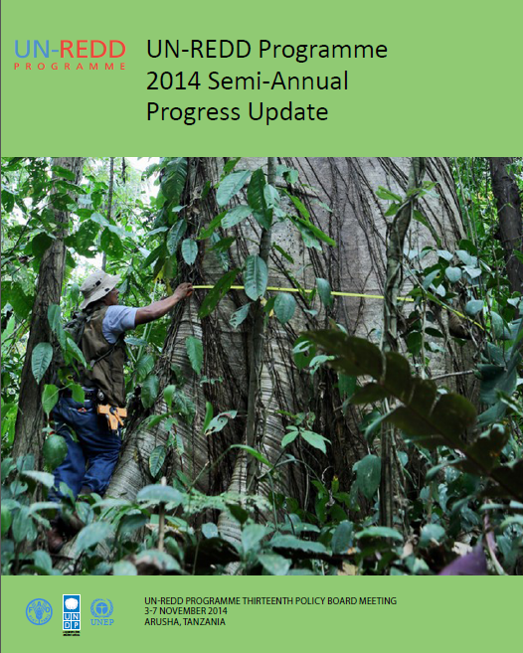
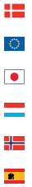
Denmark
European Union
Japan
Luxemburg
Norway
Spain
‘The Secretariat shall provide the Policy Board updates on the implementation progress of Joint Programmes (both Global and National) every 6 months, based on information received by the Participating UN Organizations.’
Rules of Procedure and
Operational Guidance
(revised May 2014)

Slide 3
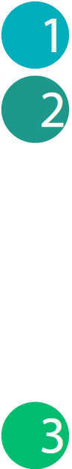
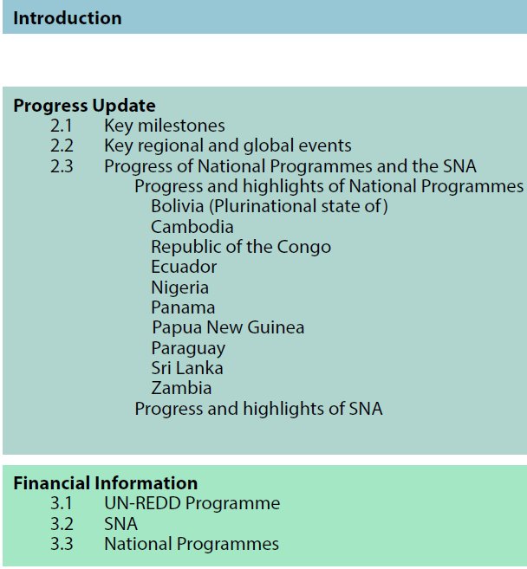
CONTENT
ANNEXES
Annex 1. SNA Progress Update
National Programme semi-annual progress reports:
Annex 2. Bolivia
Annex 3. Cambodia
Annex 4. Republic of the Congo
Annex 5. Ecuador
Annex 6. Nigeria
Annex 7. Panama
Annex 8. Papua New Guinea
Annex 9. Paraguay
Annex 10. Sri Lanka
Annex 11. Zambia

Slide 4
MAIN FEATURES
Covers period 1 January 2014 – 30 June 2014.
Light in format and shorter summarised content.
Focuses on key progress and achievements against targets
Highlights key events related to regional and global level knowledge sharing and cooperation.
Interim financial information
Provides a more consolidated view of support through the Programme's modalities and mechanisms
Flags main delays and adjustments of the National Programmes
Lessons learned (more elaborated in annual reports)
Serves as stock-taking in preparation for the 2014 Annual Report.
Annexes provide detailed information on progress under the SNA Outcomes and the individual National Programmes.

Slide 5
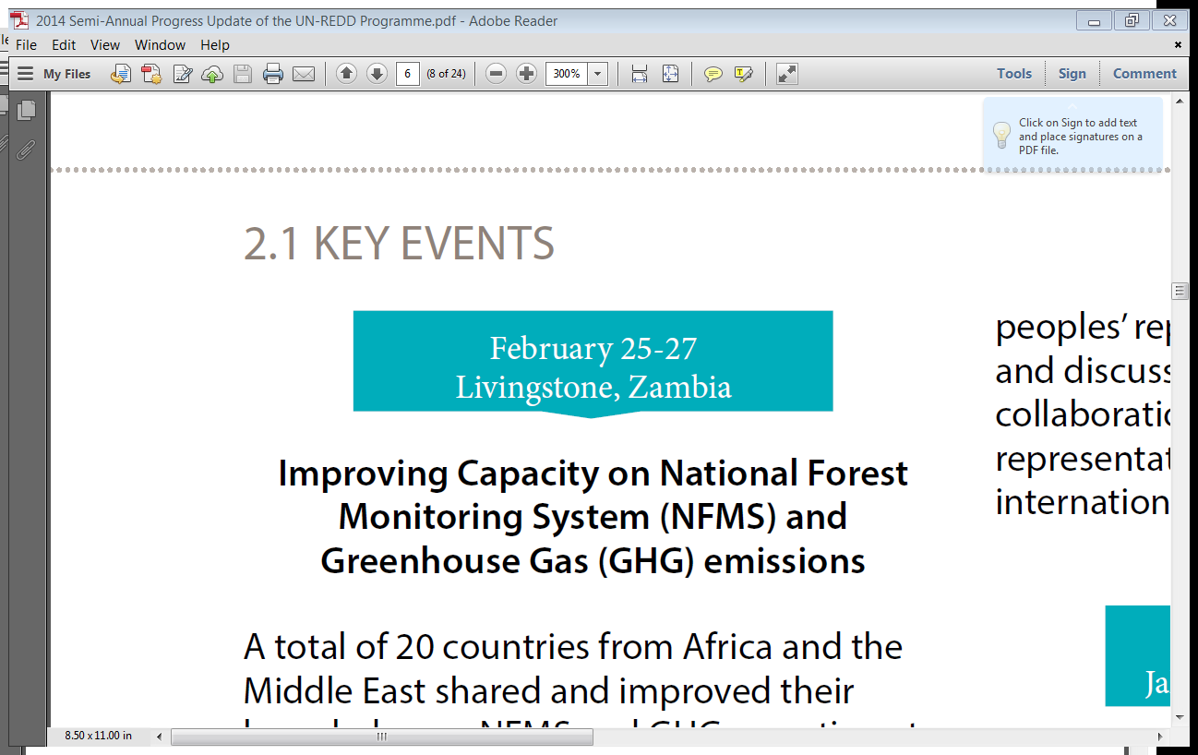
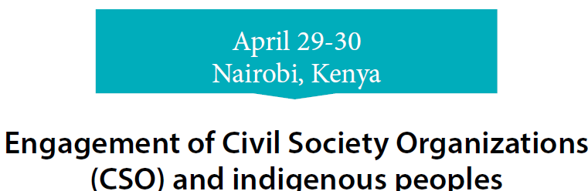
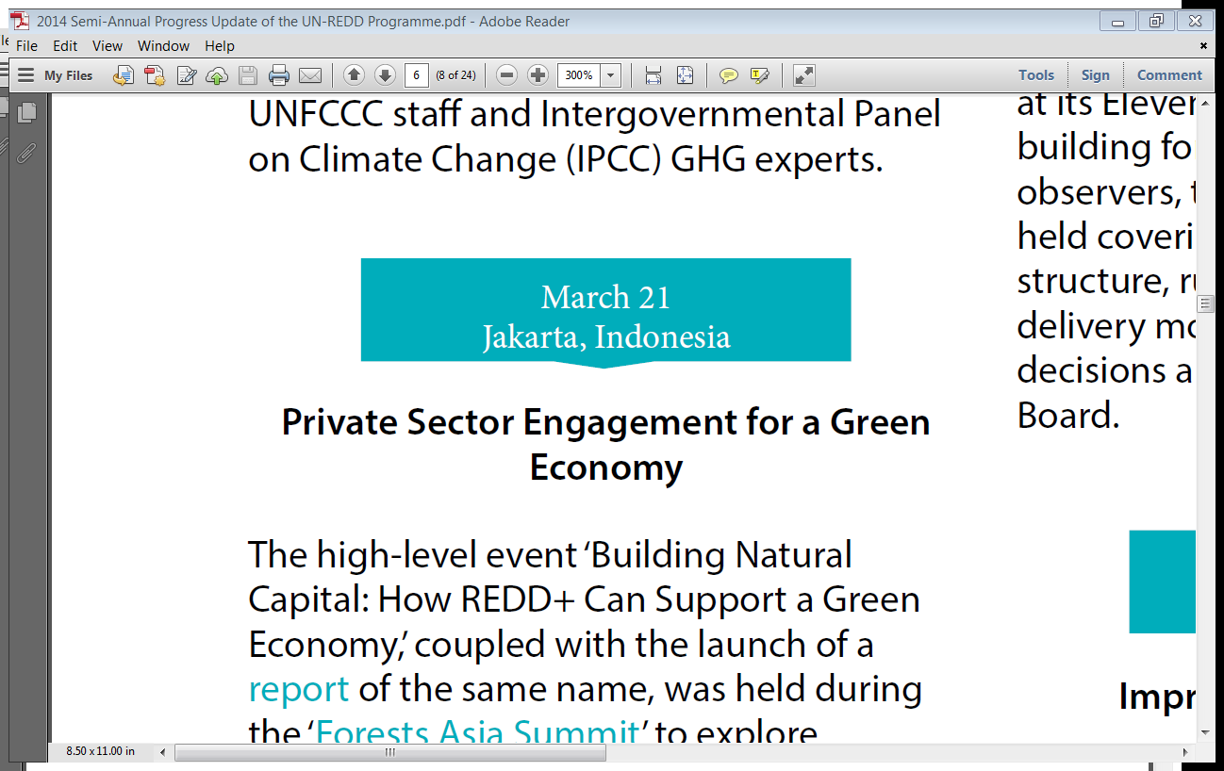
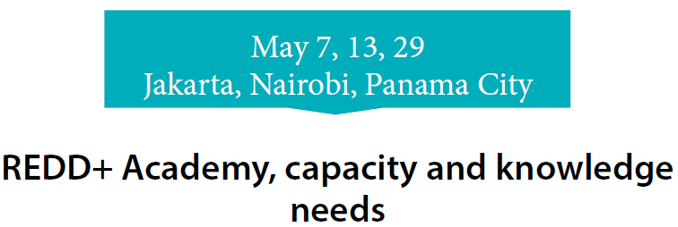
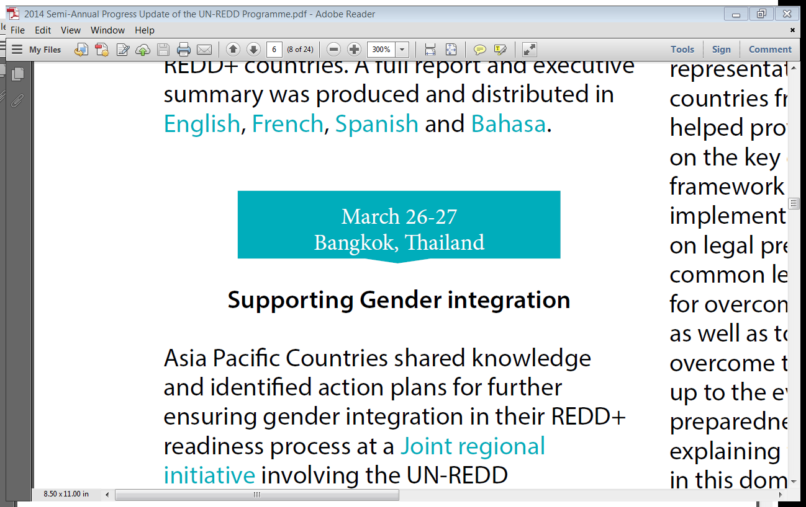
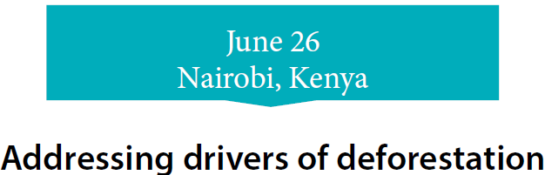
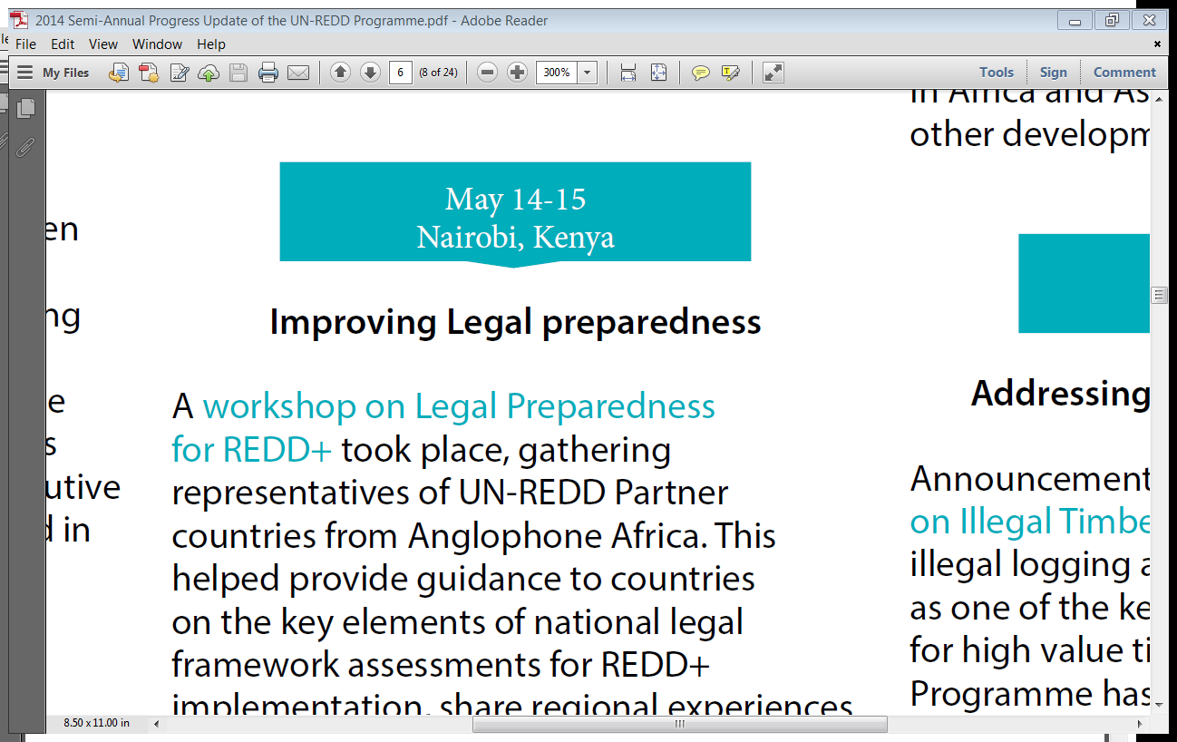
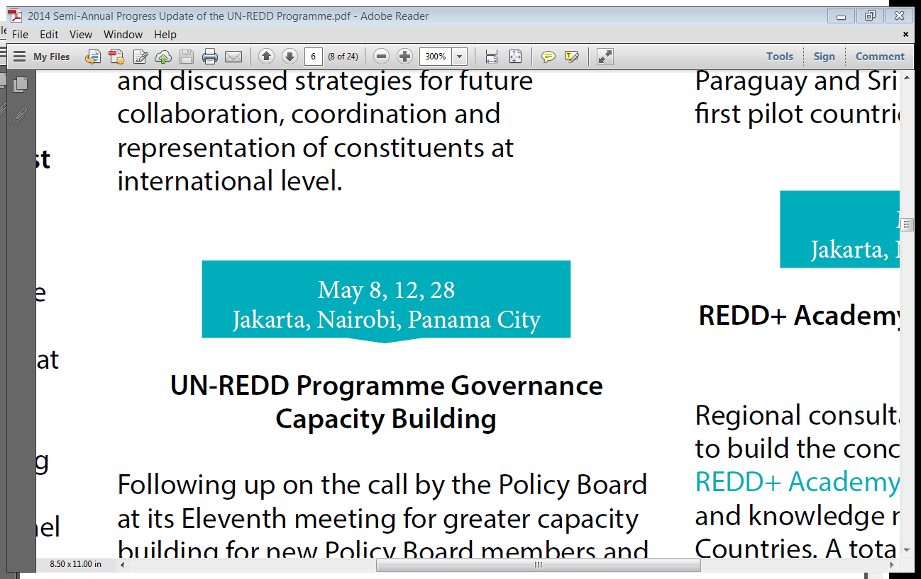
Key Global and Regional Events
Notes:
Examples of key events

Slide 6
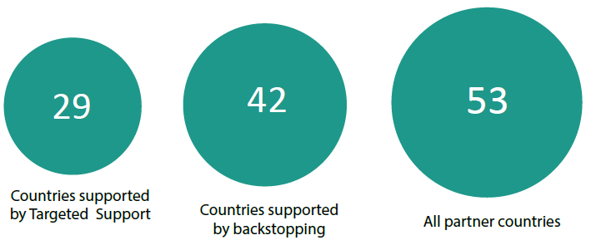

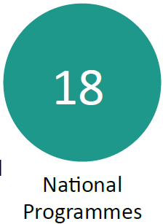
OVERVIEW
Favourable funding situation for 2014 allowed for:
Additional countries to:
request (Argentina, Côte d'Ivoire and Mongolia), and
develop (Honduras and Uganda) National Programmes.
Expansion of and increased support through SNA
Targeted support - within 6 months US$ 4.8 m approved, 57% of total amount approved for targeted support from 2012 until June 2014.
First regional targeted support approved (Pacific Islands).
Launched new avenues of work (CBR+, REDD+ Academy and CNA).

Slide 7
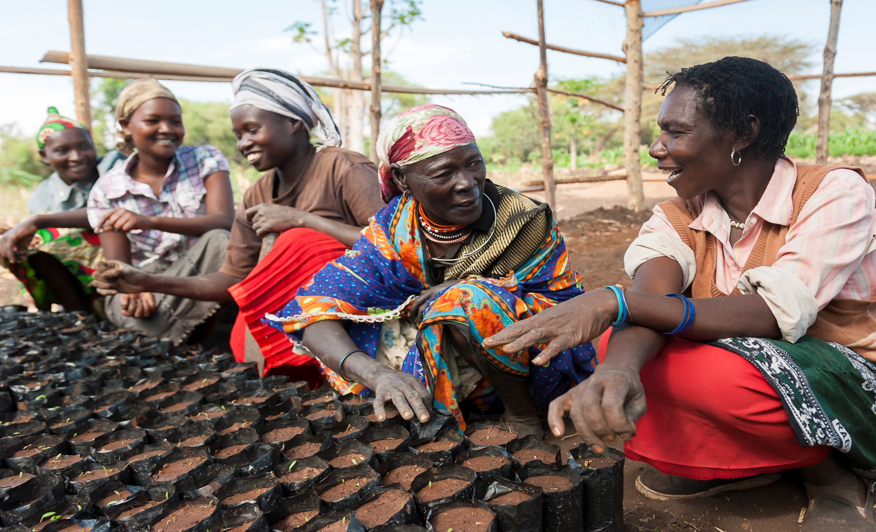
HIGHLIGHTS

Slide 8
HIGHLIGHTS
National Programmes
SNA
NFMS and MRV
Cambodia is generating data to asses historic RELs.
The Congo is designing NFMS, MRV and the RLs.
Nigeria have increased capacity on NFMS and MRV through targeted support.
Panama developed a forest cover and land use map from 2012.
PNG completed a remote-sensing based pre-assessment of NFI and yielded LULUC data from 2001-2010.
Sri Lanka is advancing on the implementation of MRV Action Plan and signed a data sharing agreement with FAO.
Zambia improved capacity on REL/RL and is working to consolidate the national approach to REL/RL.
OUTCOME 1. MRV and Monitoring
Launched ‘NFMS for REDD’ or nfms4redd.org web portal in English and Spanish, providing:
Technical documentation.
Publications of KM materials and tools.
Improved capacity on MRV and NFMS through backstopping, targeted support and coordination with other initiatives (JICA, SilvaCarbon, GIZ etc):
Asia Pacific: Bangladesh, Mongolia, Nepal, Pakistan, Salomon Islands, Sri Lanka and Viet Nam.
Africa: DRC, Ghana, Ethiopia, Côte d'Ivoire, Kenya, Nigeria, Sudan, Togo, Uganda and Zambia.
LAC: Argentina, Bolivia, Colombia, Costa Rica, Ecuador, Mexico and Paraguay.
Notes:
Outcome 1:
A fully upgraded ‘National Forest Monitoring System (NFMS) for REDD’ or
nfms4redd.org web portal has been launched in English and Spanish, providing
technical documentation and statistics from the countries’ NFMS and Measurement,
Reporting and Verification (MRV) systems - including publication of knowledge
materials, tools and documents on various aspects of NFMS and MRV.
Government staff are better able to work on MRV and NFMS in Asia Pacific
countries (Bangladesh, Mongolia, Nepal, Pakistan, Salomon Islands, Sri Lanka and
Viet Nam), in Africa (DRC, Ghana, Ethiopia, Ivory Coast, Kenya, Nigeria, Sudan,
Togo, Uganda and Zambia) and in Latin America (Argentina, Bolivia, Colombia,
Costa Rica, Ecuador, Mexico and Paraguay) thanks to technical backstopping,
targeted support and enhanced coordination with other initiatives, namely JICA,
SilvaCarbon and the German Society for International Cooperation (GIZ), who
work in this field in the countries.

Slide 9
HIGHLIGHTS
National Programmes
SNA
National REDD+ Strategies
Cambodia is carrying out a technical review of its National REDD+ Strategy.
The Congo has prepared a roadmap for strategy development.
Panama is working to complete a draft strategy by December 2014 and gathering technical inputs for the implementation of the strategy.
Paraguay is advancing on the strategy design and completed background studies.
OUTCOME 2.
Governance and National REDD+ Strategy
Practical Guide to PGA launched in Oslo based on lessons learned from Indonesia, Nigeria & Viet Nam.
Argentina, Bangladesh, Côte d’Ivoire, Mongolia, Panama and PNG planned activities and allocated budget in their key REDD+ documents for gender and/or women engagement issues.
Launched “Assessing Forest Governance: A Practical Guide to Data Collection, Analysis and Use”.
Launch of the Sustainable Forest Management tool box at COFO22.
Notes:
During this reporting period:
Most countries with NP have focused on generating and analysing data and information for developing the strategy.
Outcome 2:
Several countries planned activities and allocated budget in their key REDD+
documents for gender and/or women engagement issue: Bangladesh, Côte d’Ivoire
and Panama in their Readiness Preparation Proposal (R-PP) documents; Argentina in
its revised R-PP and UN-REDD National Programme planned activities; Mongolia in its
National REDD+ Readiness Roadmap that was validated at national level in May and
subsequently endorsed by the Minister of Environment and Green Development; and
Papua New Guinea (PNG) into its draft Guidelines on Free, prior and informed
consent (FPIC) on REDD+, which are now currently going through a validation
process.
Launched “Assessing Forest Governance: A Practical Guide to Data Collection,
Analysis and Use” providing guidance for planning a forest governance assessment,
designing data collection methods and tools, collecting and analyzing data and
sharing results to decision makers and other stakeholders.
Launched the Sustainable Forest Management tool box at COFO22, Committee on
Forestry, 22-27 June, Rome.

Slide 10
HIGHLIGHTS
National Programmes
SNA
OUTCOME 4. Stakeholder Engagement
Indigenous peoples and CSOs strengthened their capacity of engaging in REDD+ :
Argentina, Cambodia, Côte d’Ivoire and PNG.
Mesoamerican Alliance for People and Forest Congress meeting.
Launch of report on regional FPIC workshops, incl. FPIC status in 8 LAC countries and guidance on use and implementation of the ILO Convention 169.
Launched a report “Building Natural Capital: How REDD+ Can Support a Green Economy” at Forest Asia Summit
Cambodia finalized its REDD+ Communication Strategy and established a ‘gender team’.
Panama:
completed active listening process in three target sectors (a) public, private, social and academic institutions, (b) Afro-descendant communities, and (c) peasant communities.
Supported COONAPIP’s resource management, reporting and technical recruitment capacities.
Sri Lanka’s CSO Convening Committee developed a work plan for enhancing its engagement in the National Programme.
Notes:
Outcome 4:
A report was launched on the regional FPIC workshops, including information on the
current status of FPIC in eight Latin America and the Caribbean (LAC) countries,
lessons learned, interviews with key stakeholder representatives and guidance on the
use and implementation of the International Labor Organization Convention 169 on
Indigenous and Tribal Peoples Convention and the United Nations Declaration on the
Rights of Indigenous Peoples.
Increased understanding on how REDD+ can be embedded in a country’s broader
Green Economy transformation and the role that the private sector plays in this was
achieved thanks to a report launched during the Forest Asia Summit in Jakarta on 6
May, titled “Building Natural Capital: How REDD+ Can Support a Green Economy”.
The report featured in private sector blogs, while the policy brief The Role of the
Private Sector in REDD+: the Case for Engagement and Options for Intervention was
downloaded 393 times during the reporting period following the event.

Slide 11
HIGHLIGHTS
National Programmes
SNA
Safeguard Information System
The Congo is building a decentralised civil society capacity for enhanced stakeholder engagement.
PNG finalized National Guidelines on FPIC and rolled out REDD+ Awareness and Training session on social and environmental safeguards.
Cambodia undertook a review of safeguards for REDD+ in Cambodia drawing from experience from global and national level, Indonesia and Vietnam.
OUTCOME 5.
Safeguards & Multiple Benefits
Viet Nam and DRC using multiple benefits tools and data for spatial analyses.
9 countries advanced in identifying core elements of the national approach to safeguards;
Costa Rica, the Republic of Congo, Cambodia, DRC, Ecuador, Indonesia, Nigeria, PNG and Viet Nam
4 countries improved the SIS design;
Costa Roca, Ecuador, Peru and Zambia
Country Approach to Safeguards Tool (CAST) finalized and launched in Eng and Spa.
Benefits and Risks Tool (BeRT) v.2 developed in an interactive format and being tested in countries.
Notes:
Outcome 5:
Four countries have identified and elaborated elements contributing to the overall
design for a SIS: Costa Rica undertook stakeholder consultations and interviews with
strategic partners, and conducted a review of the methodological framework in
relation to the design of the SIS. Costa Rica has also furthermore undertaken a first
evaluation of available information systems in the country and is advancing on identifying information sources or systems that can contribute to its SIS. Ecuador held
an expert workshop on the design of the SIS. Peru is preparing a plan to develop
institutional arrangements for the SIS.
The Country Approach to Safeguards Tool (CAST) has been finalised and launched in
two languages (English and Spanish). A French version is being produced. Tools for
improving women’s participation were integrated into the CAST, as were resources
and tools on safeguards and related work areas - particularly stakeholder
engagement and governance The Benefits and Risks Tool (BeRT) v.2 has been
developed in an interactive format and will be launched in October 2014. The new
version will be tested during a safeguards workshop in Bhutan in late 2014 and
evaluated with safeguards experts in the Republic of the Congo in September.
Results will be presented at an Africa regional workshop on legal preparedness for
implementing REDD+.

Slide 12
HIGHLIGHTS
National Programmes
SNA
OUTCOME 6. Green Economy
Launched a global report ‘Strategies for Integrated Landscape Investments’.
Indonesia, Ghana and Peru engaged with the private sector in agricultural commodity supply chains (Green Commodities Programme and UNEP-FI).
Paraguay produced its first map of deforestation risks along with the estimation of opportunity cost of REDD+.
Indonesia further developed the Indonesia Green Economy Model (I-GEM).
Cambodia, Ecuador, Nigeria, Sri Lanka and Zambia have paid more attention to drivers of deforestation analyses and to creation of robust baseline for forest cover.
Sri Lanka is hiring a private sector engagement consultant to boost the work in this area.
Stakeholder consultations include a broader set of stakeholders that go beyond CSO and indigenous peoples.
Notes:
Outcome 6:
A global report entitled “Financing Strategies for Integrated Landscape Investments”
was produced by EcoAgriculture Partners and launched in May 2014 in Washington
DC. This paper discusses needs, reviews barriers and provides recommendations for
the financing of integrated land management. Findings are based on a review of
roughly 250 financial institutions and mechanisms that support multi-objective
investments within a landscape context, as well as 29 integrated landscape
institutions.
Indonesia further developed work on the Indonesia Green Economy Model (I-GEM):
- An operational model is now made available which is currently being tested by
the Indonesian plan agency (BAPPENAS)
- The Central Kalimantan model is the first provincial based model that is made
accessible to planners at district level.
- A national level demonstration model has been developed, while the LECB-
Indonesia Project is progressing and planning to launch an e-learning website
that provides planners, scientists and NGO activists all over Indonesia with access
to Green Economy information and System Dynamics Modelling.
- The United Nations Office for REDD+ Coordination in Indonesia, with support from
the UN-REDD Programme, is developing an I-GEM based model to assess the
value of forest ecosystem services in Indonesia.

Slide 13
HIGHLIGHTS
National Programmes
SNA
Increased recognition of National REDD+ Strategies as the tool for moving towards RBA.
Supported the design of new NPs in a way responsive to the REDD+ Rulebook.
Future reports will reflect the relationship between the National Programmes and the REDD+ Rulebook
UN-REDD and FCPF synchronized reporting cycle:
Annual report: March 15
Semi-annual progress report: August 15
OUTCOME 7. KM and Communication
Strengthened KM and Communication:
Communication through social networks and other channels re-activated or reinforced.
Numerous KM products and events delivered
Significant increase in stakeholder engagement with the KM information sharing tools.
Workspace upgrade is near completion.
Notes:
Examples of KM products and events include:
- 4 regional KM workshops
- development and promotion of Country Approach to Safeguards Tool (CAST)

Slide 14
HIGHLIGHTS
National Programmes
SNA
National Programmes status:
12 active
6 completed
2 pending signature
5 in pipeline
Colombia requested an extension for signing of its National Programme.
Ecuador's National Programme was extended by 14 months.
OUTCOME 8. Secretariat
External UN-REDD Programme Evaluation completed.
Roadmap for development post-2015 strategy of the Programme developed.
6 New Policy Board members - Argentina, Bangladesh, Republic of Congo, Côte d’Ivoire, Honduras and Sri Lanka.
UN-REDD Programme governance capacity building workshop took place in 3 regions.
Notes:
Examples of KM products and events include:
- 4 regional KM workshops
- development and promotion of Country Approach to Safeguards Tool (CAST)

Slide 15
FINANCIAL
Financial Information:
Interim, un-certified financial information.
Comprise both disbursements and commitments.
Official year-end expenditures are available by April 2015 and reported in Annual Reports.
UN-REDD Programme
73% delivery = US$ 115,151,862
SNA
75% delivery
(US$ 73,516,262)
National Programmes
69% delivery
(US$ 41,635,600)
Notes:
SNA: Cumulative expenditure is since Nov 2011 against approved budget until Dec 2014

Slide 16
FINANCIAL
TARGETED SUPPORT & BACKSTOPPING
1 January – 30 June 2014
Targeted support
Amount approved: US$ 4.8 m (represents 57% of total approved amount)
Number of countries supported: 8 country requests and 1 regional request
Backstopping
Total amount in backstopping costs: US$ 4.6 m
Number of countries supported: 42 countries, including 1 region (Pacific Islands)
Notes:
Of the eights country request, six referred to top-up amounts, i.e. countries had requests previously approved
Work areas that most requests referred to. Often a targeted support request refers to more than one work area.
57% of total approved amount since 2012 reflects the strategy of using targeted support for more robust support to countries which are gearing up for REDD+, such as Myanmar (US$ 1,115,000), as well as for strengthening technical capacity regionally - such as the support provided to the Pacific Islands (US$ 1,415,000).

Slide 17
FINANCIAL: SNA
Per SNA Outcome –
Total expenditure and delivery as of 30 June 2014 against
budget approved until 31 December 2014 (US$)
US$
Notes:
Note:
Budget and expenditures exclude Indirect Support Costs.

Slide 18
National Programme Delivery AFRICA
31 Dec 13
28 Feb 15
30 Oct 15
30 Jun13
31 Dec 14
Closed
Closed
Submitted to PB
In the Pipeline
Uganda

Slide 19
National Programme Delivery
ASIA-PACIFIC
31 Dec 14
31 Oct 12
31 Dec15
31 Mar 14
30 Jan 16
30 Apr 13
30 Jun 12
Closed
Closed
Submitted to PB
Pending Signature
Closed
Closed

Slide 20
National Programme Delivery
LAC
31 Dec 15
31 Dec 17
31 Dec 14
30 Jun 15
31 Jan 16
Submitted to PB
0%
In the Pipeline
Honduras

Slide 21
Your contributions, comments and suggestions are of highest value
for the continuous improvement of the UN-REDD Programme reporting.
The Feedback Form of this meeting includes a section on reporting.
Thank You
Thais Linhares-Juvenal
Thais.Juvenal@un-redd.org
Website: http://www.un-redd.org

