Slide 1
Financial Status of the UN-REDD Programme Fund
Arusha, Tanzania
6 November 2014
Notes:
This presentation is based on the Funding Framework as of 10th October 2014
I am not going to present directly the table but three different charts generated from them

Slide 2
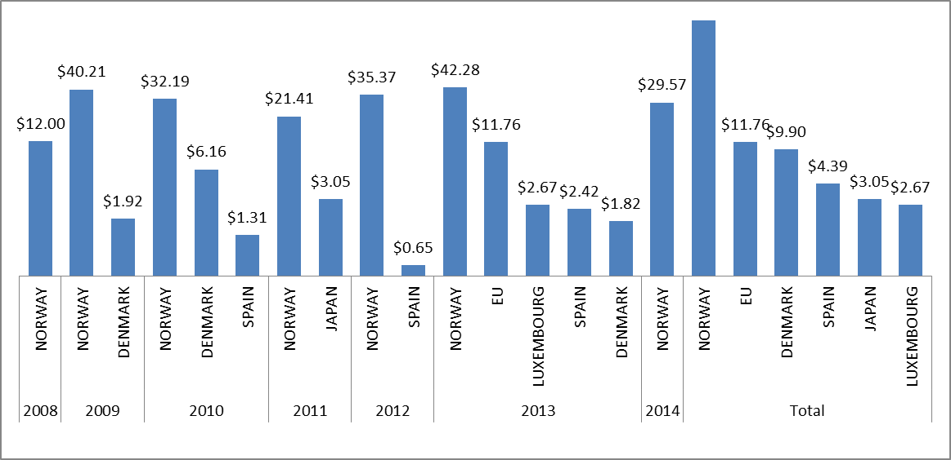
Contributions
Total deposit 244.8 Millions
Interest 2.4 Millions
Commitment 1.3 Millions (EU)
$213
Notes:
This first chart capture the contribution made by donors by years and cumulatively.
As we can see here Donors have been regular in their contributions, with from 2009 to 2013 several donors contributing each years. The 2014 do not include the pledge made earlier today by Spain and Norway.
Norway has been the biggest contributor follow by the EU, Denmark, Spain, Japan and Luxembourg. Total deposit to date is 244.8 Millions with a really low pending disbursement in commitment from the EU of 1,3 M

Slide 3
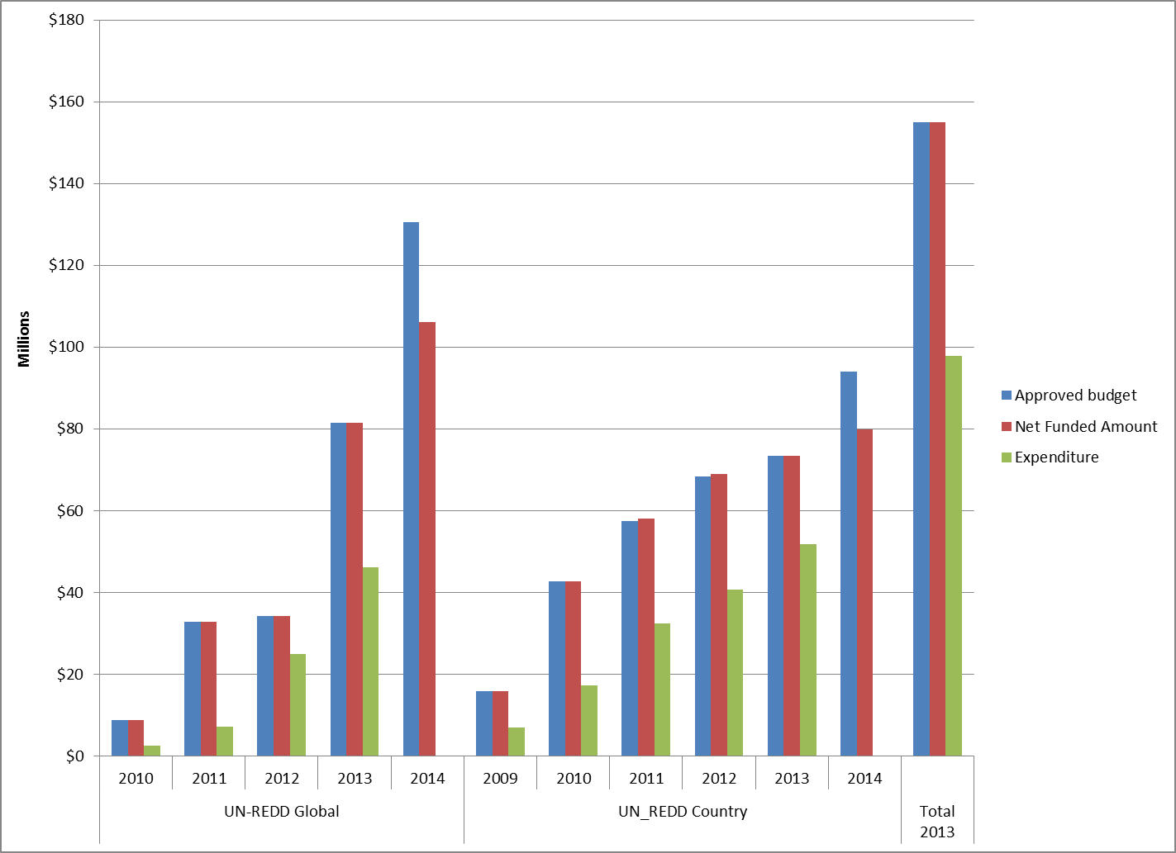
Allocation vs Expenditure
Overall 60% delivery in Dec. 2013
Notes:
This second graph is presenting the allocation made (using approved and net funded amount) against expenditure reported each year by participating organization both for the UN REDD Global program and National Programs
As we can see the trend line here is very linear with a total average of expenditure of 60 % by the end of 2013.
Please note they are presented here as cumulative numbers !
As you can see there is no major concern here and we can expect that the majority of the current project funded prior to 2014 will reach 100 % delivery in the next year or two if the trend remain the same or even accelerated as delivering capacities are progressively increasing.
With the phase out of the Fund starting next year project delivery rate will be watch closely.
As I said we are presenting here consolidated data, it is also interesting to look at the specific delivery rate by countries and this is something the UN REDD secretariat has been doing as you can see in the next slide

Slide 4
Detailed delivery analysis UN REDD Country
Notes:
This table is rating the delivery of National Program by comparing their individual delivery to the average delivery rate. The performance is rated using a scale of four, for example exceptional when the delivery rate is above 20% of the average.
I will not enter into the details of each national program performance, but I would like to point out that this could be a good step through assessing the value for money of UN REDD program investments by comparing them with the performance of the result indicators of the Fund.

Slide 5
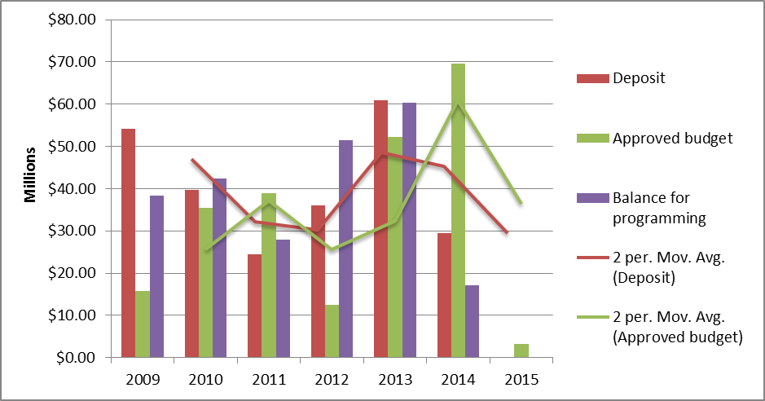
Balance for programming as of today
12,085,671 USD
Notes:
This last graph is showing the Balance for programming by comparing the Deposit versus the approved budget by year. The figures you have here are not cumulative.
As you can see there is no linear trend. Since the contributions are usually being made the year prior to actual allocation, this graph is showing as well the trendline for the deposit and allocation using 2 years Average. This is the two lines you see in colors.
It is interesting to note here that the trend between the two lines is quite similar meaning that there is a similarity between contributions and programming cycle. It shows that contributors were able to follow the capacity of the Board to allocate, but also that the Board was able to use the opportunity of the contributions by making allocation on time.
You will also note that we will have in 2014 the lowest balance for programming since the beginning of the Fund.
“Since the 2015 is the last year for programming under the current UN REDD Program, it is a good sign that the program is anticipating the phase out by allocating in 2014 most of the available resources.”
Today, US$12 m are available for programming without the request from Honduras and Uganda for approx. US$ 5m.

Slide 6
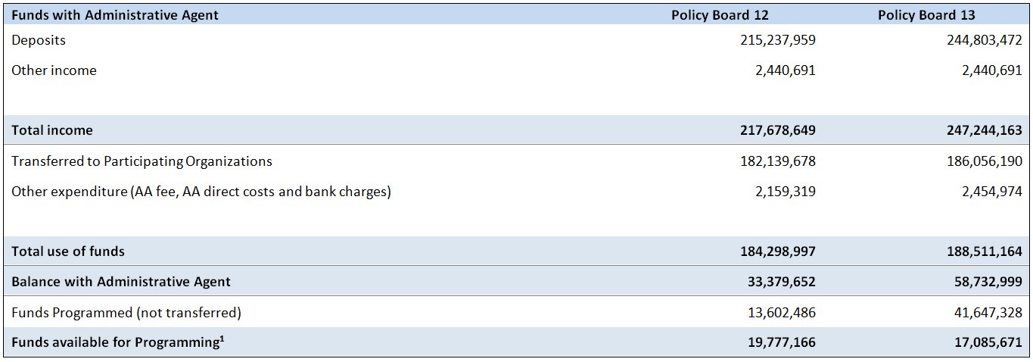
Changes in fund availability since the last Policy Board
All data are available on the GATEWAY page of the Fund
http://mptf.undp.org/factsheet/fund/CCF00
Notes:
1. The Policy Board noted requests from Honduras and Uganda for approx. US$ 5m, leaving US$12 m available for programming.

