Slide 1
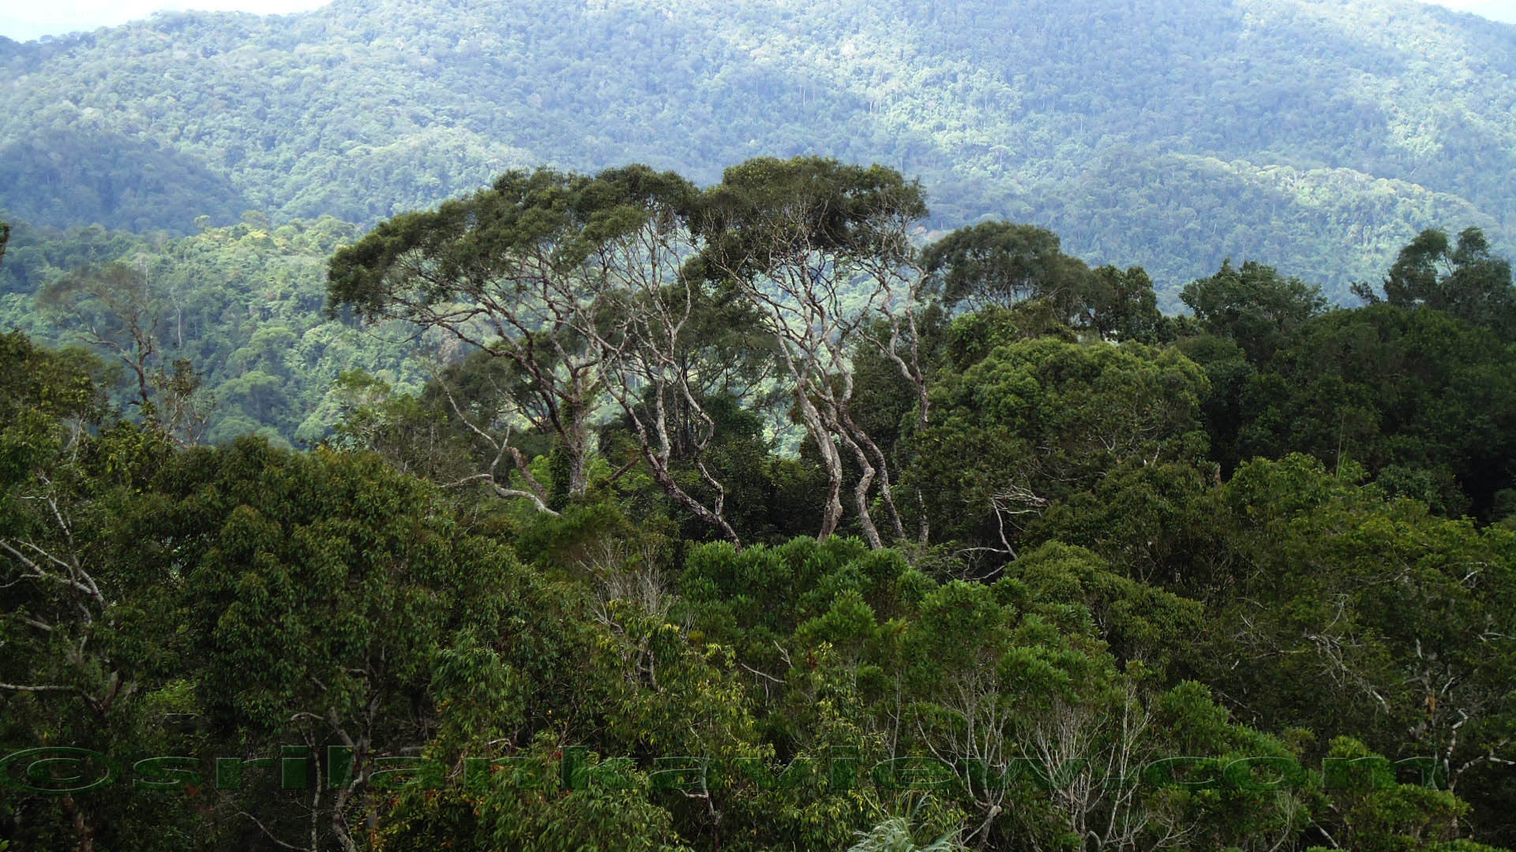
Sri Lanka UN-REDD Programme

Slide 2
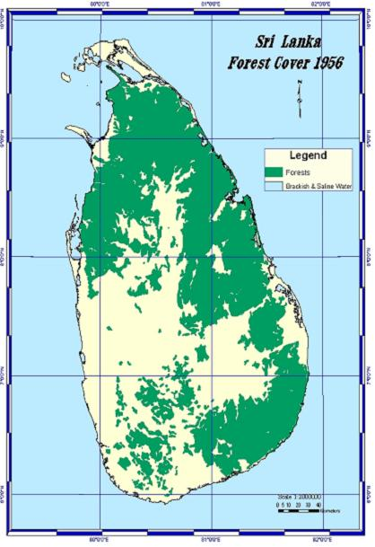
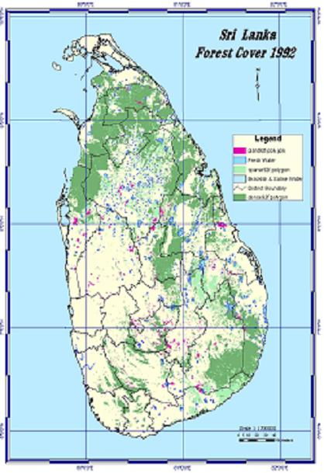
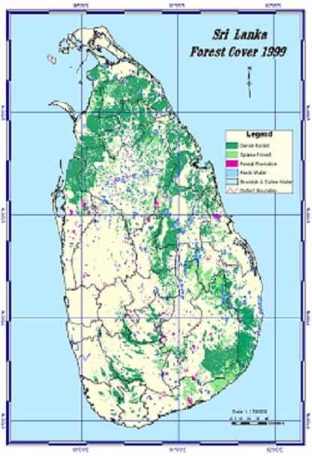
1956
1992
1999

Slide 3
Development of REDD + Strategy:
Studies/Assessments
Assessment of drivers of land-cover changes in Sri Lanka (Drivers of deforestation and forest degradation)
2. Analysis of national legal, institutional and procedural arrangements

Slide 4
Assessing Drivers of Land-Cover Change in Sri Lanka
Notes:
This presentation shows the approach in Sri Lanka towards the drivers study. This will try to highlight the critical role that the drivers study plays for identifying PAMs. With this, the drivers study is a cornerstone for developing the REDD+ strategy.

Slide 5
Objective of assessing drivers
Political economy of land-cover change
Identify policies and measures
Prioritise policies and measures
Assess drivers of land-cover change
Plan, manage funds,
implement
Land-cover change matrix
Assess national circum-stances
Build reference levels
Notes:
Slide shows at a glance the objectives of assessing drivers and how this assessment fits into the larger context of capacity development for REDD+.
Connection to other slides: this is the general overview of the presentation.
The assessment of drivers is a key stone of developing REDD+ in any given country – for obvious reasons: this is about the ‘why’ of land-use change. More specifically, it is a key input both for work towards building a mitigation strategy and planning PAMs and for building RLs.
The following slides basically provide further explanation to several of these boxes: LUC matrix, assessment of drivers, assessment of national circumstances, prioritisation of PAMs.
Relation to UN-REDD: in SL’s UN-REDD the blue bubbles are part of the MRV outcome 5 and the blue bubbles of the mitigation strategy outcome 4.

Slide 6
Land-use change matrix
 | Forest land | Cropland | Grassland | Wetlands | Settlements | Other land
Forest land | Forests remaining forests | Reforestation
Cropland | Deforestation | Other land-use changes
Grasslands
Wetlands
Settlements
Other land
Notes:
Slide shows the concept of the land-use change matrix.
Connection to other slides: important piece of input to the drivers assessment, next to a socio-economic analysis.
In the rows we have the later time point and in the columns we have the earlier time point. The diagonal are un-changed area. In the cells of the matrix, there are areas corresponding to land-use change.
The green cells correspond to reforestation because this is conversion from other lands to forests. the red cells are deforestation because this corresponds to conversion from forests to other lands.
Relation to UN-REDD: building the land-cover change matrix is part of outcome 5.

Slide 7
Assess drivers of land-cover change
Inhibitors
Underlying drivers
Proximate drivers
Land-cover change
Catalysts
Notes:
Slide shows the approach taken in Sri Lanka to identifying drivers of land-cover change. This was developed by a team from the university of Colombo.
Connection to other slides: point of departure for most of the work on drivers is a thorough assessment.
Proximate and underlying drivers are the socio-economic processes that drive land-cover change. For instance, the construction of a new road is a proximate driver that leads to deforestation and forest degradation change along the fringes of the road as the road opens up access. The underlying driver of such a process could then be, for instance, a trend of increasing urbanization and wealth and therefore increasing availability of funds for infrastructure improvements.
Inhibitors and catalysts are related dynamics, mostly within the government itself that either spur or curb the drivers. For instance, well-directed land-use planning can inhibit deforestation / degradation despite road construction. For instance, rent-seeking behaviour among local elites can exacerbate deforestation / degradation along the new road in undermining land-use planning.
Relation to UN-REDD: the assessment of drivers is out output 4.1 and thus part of our outcome 4 that leads up to the development of the mitigation strategy.

Slide 8
Prioritise policies and measures
Criteria for prioritising
Carbon benefits
Cost profile
Non-carbon benefits
Political barriers
Coherence with development agenda
Notes:
Slide shows possible criteria that could be used for prioritising PAMs. This is tentative and a decision has not yet been taken on the criteria.
Connection to other slides: identifying PAMs is an important use of the drivers study. While the drivers study will deliver many different PAMs, prioritisation is important.
For instance, a proposed PAM may be to invest into land-use planning along new road-development projects in order to reduce ensuing deforestation / degradation. Such a proposed PAM would need to be assessed against the 5 criteria above. It would probably deliver significant carbon benefits and also non-carbon benefits, would be relatively expensive, fully coherent with other development goals under Sri Lanka’s national planning, but also face significant political barriers as local elites can have vested interests.
Similar-style assessment would be carried for a list of PAMs that come out of the drivers study.
Relation to UN-REDD: In SL’s UN-REDD the prioritisation of PAMs is covered as a piece of outcome 4.

Slide 9
Analyse national circumstances: is plausible reference available?
1983-2009
Since 2009
Deforestation and forest degradation accelerate?
Slow economic growth?
2017+
Conflict in the north-eastern region
Economic acceleration?
Economic growth?
Reduced forest degradation? Forest area expansion?
Slower rates of forest loss ?
Peace in Sri Lanka
Continued peace
Results-based REDD+ commences
Notes:
Slide shows how Sri Lanka’s national circumstances are quite particular and how this will make building reference levels quite difficult. This is a conventional understanding of historical trends in SL that will need to be tested in the analysis of national circumstances.
Connection to other slides: assessment of national circumstances is based on the drivers study and is an important input to building reference levels.
Sri Lanka’s development took a turn in 2009 when the armed conflict ended that had been raging for 25 years. The conflict had subdued economic development for 25 years and it had also lead to an increased tree cover in the north eastern region of the country. Since it ended, deforestation and forest degradation increase, along with an economic boom that the country benefits from.
In terms of the drivers study this means that drivers before 2009 are quite different from drivers after 2009. This also means that trends of land-cover change from before 2009 to after 2009 is inappropriate. Sri Lanka does not currently have a reliable reference period available to use a basis for calculating a RL.
Relation to UN-REDD: in SL’s UN-REDD programme, the assessment of national circumstances is included as an initial output of our MRV outcome 5.

Slide 10
Where assessing drivers fits into the big picture of REDD+
Develop implementation strategy
Prioritise policies and measures
Access international funds
Implementation
Mitigation Strategy
Funds management
Identify policies and measures
Develop proposals for REDD+ actions
Make available national funds
Planning processes
Assess drivers of land cover change
Coordinate among sectors and approve
Introduce REDD+ actions into capital budget
Measurement, reporting, verification
Start
Assess national circumstances
Build reference levels
Track with national forest monitoring system
Notes:
Slide shows the big picture of work packages that the government needs to engage in towards REDD+, and it shows how the drivers study is a point of departure.
Connection to other slides: this is the grand overview and also the last slides. It links back to the very first slide and showing the complete overview.
Assessing drivers of land-cover change is a key input for both work on the mitigation strategy (in blue) and work on MRV (in red). Both of these, in turn, lead up to integrating PAMs into national development planning processes (green) and also funds management (orange).
Conceptually, the drivers study is a first initial step towards REDD+ and the implementation of mitigation actions.
Relation to UN-REDD: Capacity-development support covers all of these aspects. In Sri Lanka the mitigation strategy, the planning process and the funds management are covered under our outcome 4 and MRV under our outcome 5.

Slide 11
Anura Sathurusinghe
Npd.redd@gmail.com
Anura.sathurusinghe@gmail.com
Thank You
Website: http://www.un-redd.org

