Slide 1
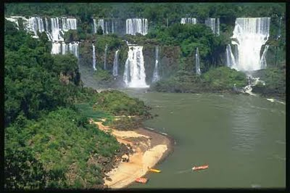
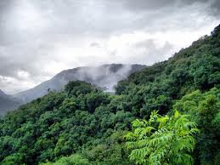
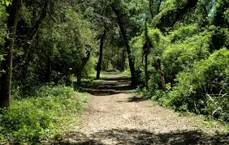
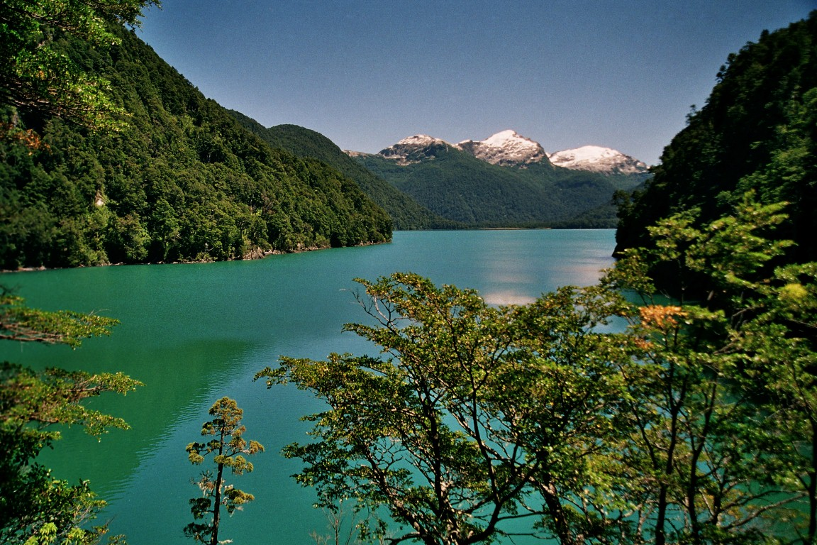
Selva Misionera
Yungas
REDD+
ARGENTINA
Bosque Chaqueño
Bosque Patagónico
Bosque Patagónico

Slide 2
Background on forests in Argentina
R-PP process and status
UN-REDD National Programme
National REDD+ management structure
Bosque Patagónico

Slide 3
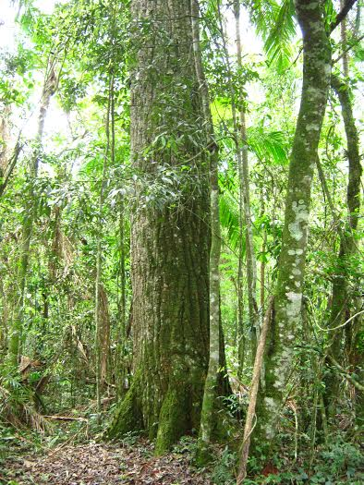
Main Land Area
278 million hectares
Native Forests
30 million hectares
Forest cover
9,75%
Deforestation Rate
1,2%
Deforestation
250 mil ha/year

Slide 4
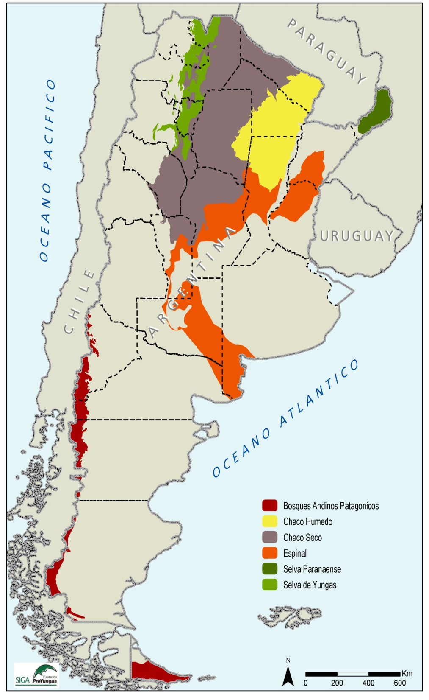
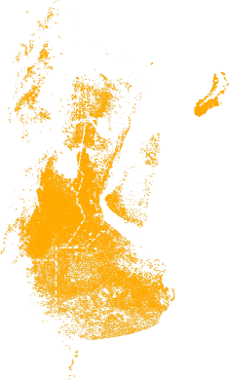
LAND USE CHANGES
HISTORICAL
Agricultural production in new territories (mostly forest lands)
PRESENT
National Agricultural Plan 2020: more production based on yield increments, soil management and land planning.
Native Forest Protection Act
Notes:
Incremento de la producción global de alimentos en base al incremento de la productividad y uso sostenible del suelo con aptitud agrícola en rotación .
110 millones a 154 millones de toneladas.
Tendencia 2000-2010 de 25% aumento de la productividad en 10 años

Slide 5
Land Use Assessment and REDD+ Preparation Strategy
- Agricultural expansion
- Forest Fires
- Catle Ranching
- Infrastructure Development
- Non-sustainable Logging
- Policies and regulations law enforcement
Strenghtening Monitoring
Land Tenure Assessment
Studies for especific ecological regions
Land Use Change Models Risk Assessments
Opportunity Cost
Forest Sector Assessment

Slide 6

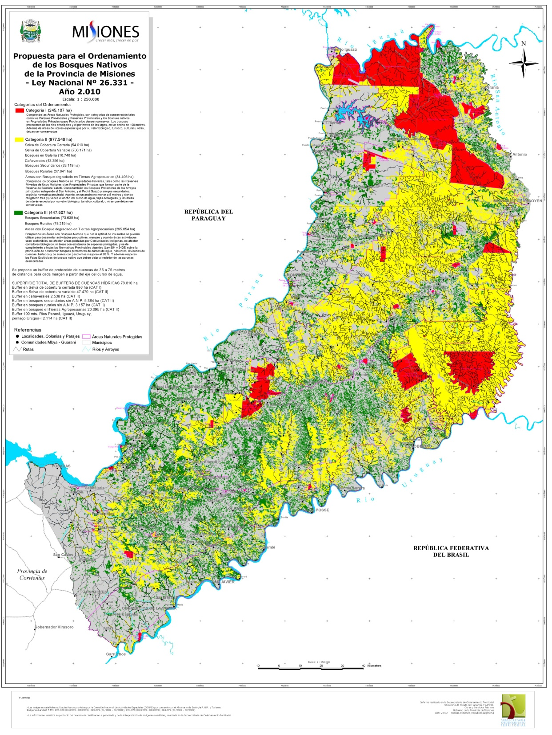
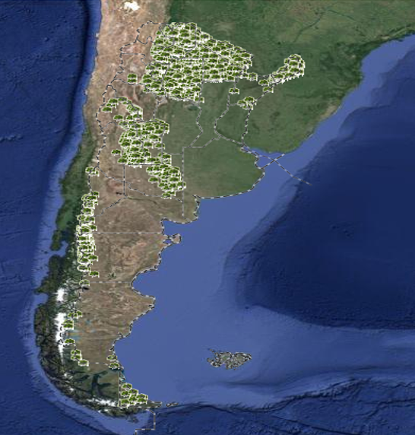
Native Forest Protection Act
(National Act 26.331)
5 millions hectares covered
2,500 Conservation & Sustainable Management Plans
Investments for 327 millions dolar (2010-2014)
19 Provinces with Native Forest Land Planning
Land Planning: Misiones Province

Slide 7
Other Related Ongoing Efforts
Integrated Initiatives:
  REDD+ National Program / R-PP / Native Forest Protection Act.
Complementary initiatives:
  National Biodiversity Observatory (GEF)
  Ecosystems Services Payments Project (GEF)
  Native Forests and Communities (WB loan)
  Biodiversity Sustainable Use (GEF)
  Gran Chaco Regional Project (GEF)
  Social Program on Forest (PROSOBO)

Slide 8
Selva Misionera
Yungas
R-PP
Argentina
Bosque Chaqueño
Bosque Patagónico
Bosque Patagónico

Slide 9
R-PP history
2009: joins UN-REDD
2010: Argentina presents its R-PP to the FCPF and it is endorsed by the PC
2013: Argentina is invited to present a National Program to UN-REDD
2013: Argentina implements a consultation process on REDD+ with a focus on safeguards
2013/14: First steps towards developing the web dissemination platform of the NFMS.
2013/14 Development of the National Programme including socialization meeting

Slide 10
Participation and Consultation
Participation
39 Workshops
945 People
Institutions
100 Civil Society Organizations
All country regions
Results
Indigenuos People Consultations Protocol - Operation Rules for REDD+ Advisory Committe
Identification of key actores and stakeholders
Transparency and accountability
Conflict Resolution Mechanism
Tailored Consultation Strategy for Indigenuos People
Vision

Slide 11
Main R-PP Components
1a. National Readiness Management
1b. Initial exchange of information and dialogue with key stakeholder groups
1c. Consultation and participation
2a. Evaluación sobre el uso de la tierra, los causantes de los cambios en el uso de la tierra, la ley forestal, la política y la gestión
2b. REDD+ Strategy Options
2c. Implementation Framework de REDD+
2d. Social and environmental impacts during the preparation and implementation of REDD+
3. Reference Level Development
4. National Forest Monitoring System
4b. Designing an information system for multiple benefits, other impacts, management and safeguards

Slide 12
R-PP review and comments
Gender and forests: being addressed through PROSOBO (Social Program On Forest)
National and sub-national levels: development of strategies at different levels (e.g. Misiones)
REDD+ strategy & drivers of deforestations: e.g. how to tackle mechanized agriculture and its impact on forest
Institutional framework for REDD+: REDD+ aims at being anchored to the forestry law and agro-food plan 2020.

Slide 13
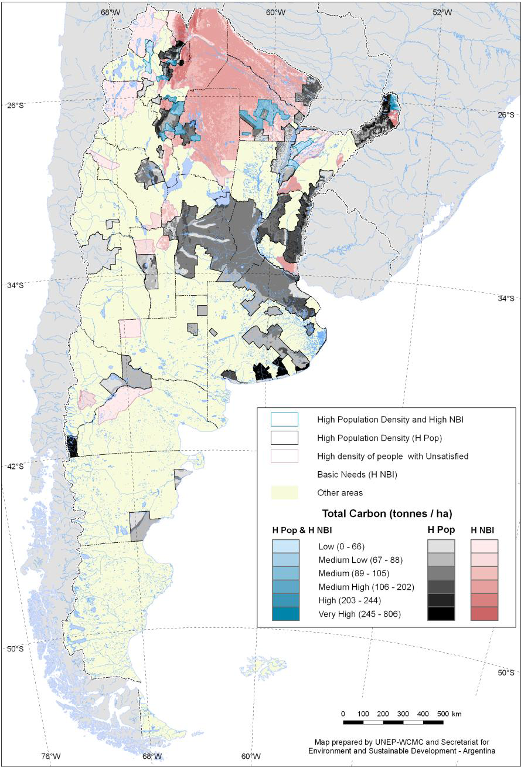
Social Approach In the National REDD+ Strategy
The highest levels of poverty are in forest communities in high carbon areas
In this context, the government set a social forestry program that aims at improving the social well being of forest communities, including gender issues.

Slide 14
Setting targets to reduce deforestation by provinces or ecoregions
Integration of objectives, goals &options of REDD+ strategy in the forestry law and the Agric-food 2020 Plan
Data gathering - analysis
Development of ecoregional and provincial strategies and options
Develop reference levels (step wise and ecoregional approach)
APPROACH

Slide 15
Selva Misionera
Yungas
UN-REDD National Programme
Bosque Chaqueño
Bosque Patagónico
Bosque Patagónico

Slide 16
R-PP Component | UN- REDD National Program
1a. National Readiness Management | National Strategy REDD+ Development
1b. Initial exchange of information and dialogue with key stakeholder groups
1c. Consultation and participation
2a. Evaluación sobre el uso de la tierra, los causantes de los cambios en el uso de la tierra, la ley forestal, la política y la gestión
2b. REDD+ Strategy Options
2c. Implementation Framework de REDD+
2d. Social and environmental impacts during the preparation and implementation of REDD + | Safeguards Information System
3. Reference Level Development | Development of Reference Levels
4. National Forest Monitoring System | National Forest Monitoring System
4b. Designing an information system for multiple benefits, other impacts, management and safeguards | Safeguards Information System

Slide 17
ARGENTINA NATIONAL REDD+ PROGRAM RESULTS
Stakeholders engagement and communication developed and implemented.
IPs consultation mechanism developed
Decision makers have information on drivers of deforestation and degradation
Decision makers have information on opportunity costs by ecoregion
Decision makers have information on future scenarios of deforestation
Decision makers have information on multiple benefits of REDD+
Decision makers have information regarding the feasibility of national investment in REDD + and fundraising
Decision makers define strategic options for REDD +.
Decision makers count with a financial architecture design and benefit sharing mechanism validated
Decision makers count with proposed regulations and institutional arrangements for the implementation of REDD +
Decision makers have a proposal for registry as part of the web dissemination platform of the National Forest Monitoring System

Slide 18
ARGENTINA NATIONAL REDD+ PROGRAM RESULTS
Protocols for defining national reference levels.
National and ecoregional reference levels defined.
National Forest Monitoring System aligned with REDD+ requirements.
Strengthened capacity for incorporation of information on REDD into the web dissemination platform of the NFMS
Strengthened capacity to monitor deforestation and degradation aligned with the requirements of the UNFCCC
The National Forest Directorate have a revised NFI methodological design, tailored to the needs of REDD + and piloted
Strenghtened capacities in the Environment Secretariat, other relevant bodies (including provincial environmental authorities) to report on GHG in the AFOLU sector, articulated with the NFMS
Analysis of legal framework related to REDD+ safeguards, and compliance status and challenges in the country developed.
Analysis of institutional framework related to REDD+ safeguards.
Identified key environmental and social risks for eco-region and potential social and environmental safeguards are suggested
The advisory committee of civil society (CAR) is operational and participating in the development of strategy

Slide 19
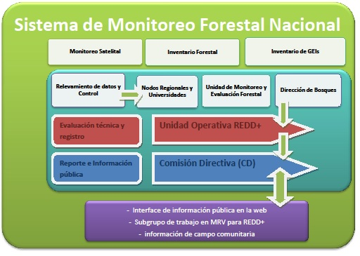

Slide 20
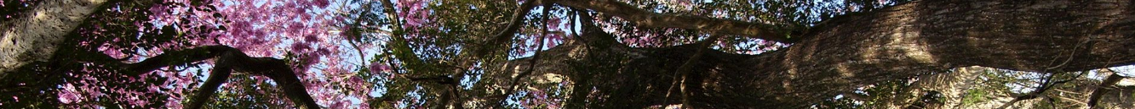





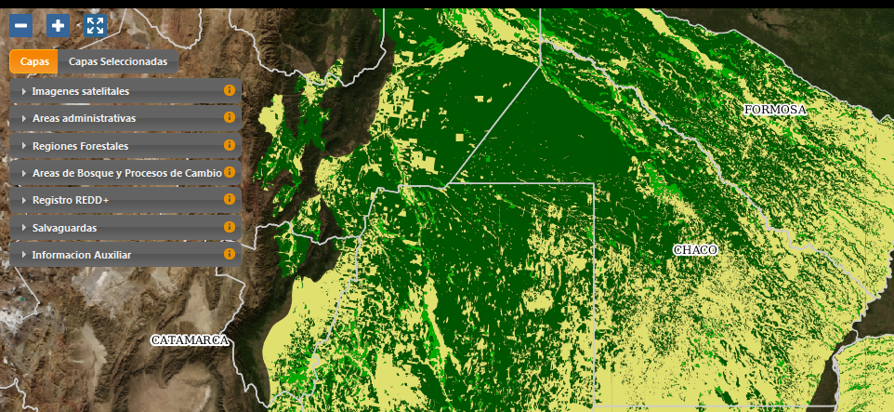
ARGENTINA NATIONAL FOREST MONITORING SYSTEM
GIS-Web Platform
S o m o s
Ambiente

Slide 21
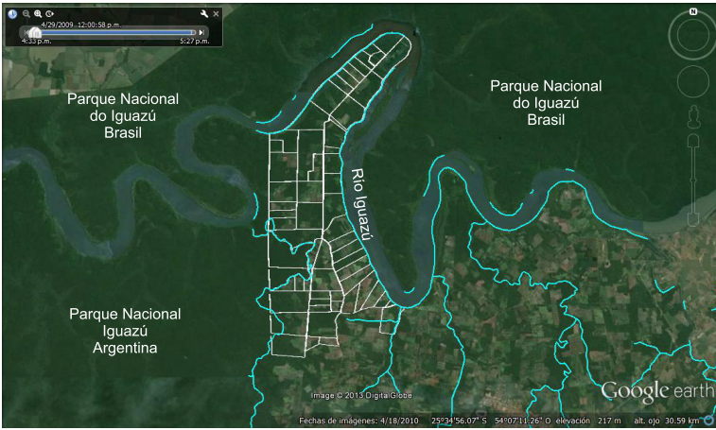
REDD+ registry piloting in the SIG-Web information platform

Slide 22
Argentina National Strategy REDD+ Budget
Componente | Agencia | USD
National REDD+ Strategy | FAO | 160,000
 | PNUD | 808,200
 | PNUMA | 530,000
 | Subtotal | 1,498,200
2. Development of Emissions Reference Levels | FAO | 433,000
 | Subtotal | 433,000
3. Strengthening National Forest Monitoring System | FAO | 1,165,000
 | Subtotal | 1,165,000
4. Development of Safeguards Information System (SIS) | FAO | 10,000
 | PNUD | 50,000
 | PNUMA | 70,000
 | Subtotal | 228,000
5. Operating Unit and Program monitoring and evaluation | Shared Cost by UN Agencies | 364,800
 | SUB-TOTAL | 3,591,000
 | Costos indirectos | 251,370
 | TOTAL | 3,842,370
TOTAL FCPF | 3,800,000
National Government | 2,582,000

Slide 23
National REDD+ Managment
Steering Committee
Government Committee on CC
REDD+ Operational Unit
Environment Federal Council COFEMA
Environment Secretariat
REDD Advisory Committee
Indigenuos People
OSC
Civil Society
Academic Representatives
Private Sector
Social Coordination
Infrastructure Coordination
Agro Coordination
Biodiversity Commission
Agriculture, Foreign Affairs, Energy Ministries

Slide 24

Thank you
Vamos Argentina

