Slide 1
Twelfth Policy Board meeting
Lima, Peru
8-9 July 2014
Update on the REDD+ Academy

Slide 2
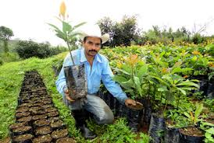
Overview
The REDD+ Academy is proposed as a 2 week face-to-face course for selected decision makers to share experiences and increase their knowledge of the wide range of topics needed to implement REDD+ in their countries
It aims to facilitate South-South Cooperation and build a network of Alumni
Three regional design workshops were held for Asia and Pacific (7 May), Africa (13 May), and Latin America and the Caribbean (29 May)
During the workshops the REDD+ Academy concept was presented and capacity needs in the regions discussed with 80 participants (total) from 35 UN-REDD partner countries, and representatives of IPs and CSOs, Norway, and UNDP, UNEP and FAO
This presentation highlights the feedback from the 3 design workshops, the key topics identified, and the progress made thereafter

Slide 3
Feedback from Regional Design Workshops
Countries want:
  A different approach to capacity building than other CB initiatives: should be systematic, adaptive and iterative
  Highly focused learning experience providing a full overview of all relevant REDD+ aspects. A quality assurance mechanism will monitor and adapt the curriculum and its delivery
  Region-specific learning incorporating national REDD+ experiences, existing structures, institutions, and link to other capacity building initiatives
  Target ‘amplifiers’ of knowledge/new national “champions” for REDD+ (in Govt, CSOs and private sector) who can drive REDD+ forward, including in key policy/economic sectors
  Participant selection will be on merit, based on criteria to be developed jointly with national UN-REDD Focal Points

Slide 4


Feedback from Regional Design Workshops (contd.)
Countries want:
  Face to face learning with preparation and follow-on resources available online to further support graduates
  Involve experienced national REDD+ practitioners to facilitate some sessions
  Support alumni of REDD+ Academy to foster south-south cooperation
  Shared hosting: Annual rotation of the Academy from country to country (Indonesia and Nigeria offered to host 1st regional sessions)
  (proposed) Possibility to have national versions of the REDD+ Academy

Slide 5
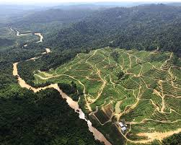
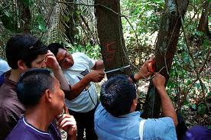
Structure of the REDD+ Academy
The Policy Board provides overall direction and guidance on the REDD+ Academy, and decides on budget allocation.
An Advisory Committee (approx. 20 members) will provide overall guidance on the curriculum, quality of content, and its operations.
UNEP, UNDP and FAO will collaborate on operational issues. Coordination of the REDD+ Academy will be led by UNEP.
Regional face to face sessions of the Academy will be held at least once every year (if budget available). Hosts will be UN-REDD partner countries.
Further learning resources will be made available on line, including a MOOC (Massive Open Online Course) for broader outreach.

Slide 6
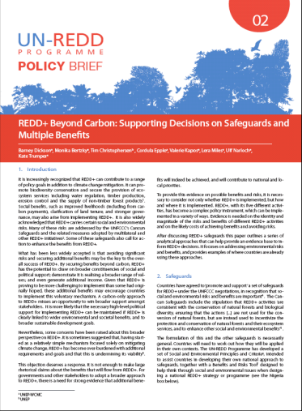


Tentative List of Learning Modules
Introduction to REDD+
Forests, Carbon Sequestration & Climate Change
Institutional Frameworks and Methodologies for Achieving REDD+ Readiness
Analyzing and Addressing Drivers of Deforestation and Forest Degradation
National REDD+ Strategies and Governance
MRV, NFMS and REL/RL
Spatial Planning and Tenure for REDD+
Public Awareness & Stakeholder Engagement
REDD+ Finance and Private Sector Engagement
Safeguards and Multiple Benefits
Benefit-Sharing, Sustainable Development and the Transition to a Green Economy

Slide 7

Progress after Design Workshops
UNEP has entered into an agreement with Yale University to develop modules
An inventory of key knowledge products is ongoing
Discussions with UNITAR and other potential partners are ongoing to identify synergies and collaboration
Indonesia has offered to host 1st regional session of the Academy (by October 2014)
Nigeria has offered to host Africa session (early 2015)
A Massive Open Online Course (MOOC) on REDD+ and Land-use Planning will also be developed as a complementary source of knowledge for broader outreach (to be launched in 2015)

Slide 8

Establishment of Advisory Committee
Terms of Reference of the Advisory Group are attached to the report on REDD+ Academy
Input requested mostly by email (no in-person meetings foreseen)
Invited partner organizations, based on expressed interest and on ongoing REDD+ capacity building work:
CIFOR; Climate and Development Knowledge Network; Conservation International; Forest Carbon, Markets and Communities (FCMC) Program; Global Canopy Program; IUFRO; UNITAR; UNORCID; World Bank/FCPF; World Wildlife Fund (WWF); University of California; Australia National University
The immediate task ahead of the Advisory Committee is to provide inputs, review and approve the course content for each of the modules developed by Yale University.

Slide 9
Participation of Policy Board members in the Advisory Committee
Members of the PB are invited to join the Advisory Committee of the REDD+ Academy
Please inform UN-REDD Secretariat if you would like to join, call will be made after PB 12 (via email)
Suggested to have the following as the minimum composition from PB members
  one country per region
  one donor
  one CSO, and
  one IP rep

Slide 10
Tim Christophersen, UNEP
Tim.Christophersen@unep.org
Thank You
Website: http://www.un-redd.org

