Slide 1
Country Specific Support
Support to National REDD+ Action
Twelfth Policy Board meeting
Lima, Peru
8-9 July 2014

Slide 2
OUTLINE OF SESSION
Presentation by the UN-REDD Programme Secretariat
  Categories of support of the Support to National REDD+ Action 2011-2015 (SNA).
  Situation update of country specific support
  Country needs assessment
Presentation by Costa Rica on its targeted support
Q&A

Slide 3
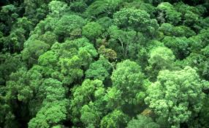
UN-REDD PROGRAMME DELIVERY MODALITIES
SNA
NP (18 countries)
International Support Functions | Country Specific Support | Secretariat
Support to enhanced REDD+ knowledge.
Enabling countries to contribute to development of technical guidelines, tools, methodologies promoting increased expertise on REDD+, incl.
South to south.
Targeted support requested as per procedures in place
Demand-driven, specific, support under one or more of UN-REDD work areas, complements REDD+ efforts.
Backstopping:
Support to countries from UN-REDD staff in both HQs and regional offices.
Remote technical support, travel for scoping missions and missions directly related to supporting country activities.
UN-REDD Programme services, secretariat s and logistic support.
Support to coordination
Facilitation of knowledge sharing among participating countries, stakeholders and staff
Results-based management
Country Specific Support
55% of SNA expenditures
in 2012 & 2013
48% budgeted in proposed Work Plan & Budget 2015
Notes:
The SNA is delivered according to three categories of support, namely, international support functions, country specific support and secretariat. These categories of support, allow the UN-REDD Programme to contribute for the development of methodologies, approaches and guidance on how to address the elements of REDD+ as defined by the UNFCCC, as well as provide for direct support to countries for implementing their readiness efforts by using the UN-REDD approach, while also catering for knowledge management, south-south cooperation and secretariat services
Hereafter we refer targeted support to support for which a country has requested assistance (following procedures in place..
Examples, if questions arise
ISF:
Development of guidance on identifying and prioritizing corruption risks in national contexts or encouragement of engagement with private sector for mobilizing private REDD+ investment.
Country Specific support: Missions to provide technical support on issues related to MRV and the national forest inventor or assist with a country needs assessment
Secret: Organization of Policy Board meetings and support to interagency coordination.

Slide 4
SNA COUNTRY SPECIFIC SUPPORT -
TARGETED SUPPORT
How to request targeted support?
Procedures & Voluntary Form for requesting targeted support:
UN-REDD Workspace ˃ Global Programme ˃ Targeted support
Requests to be sent to the UN-REDD Programme Secretariat.
Support following a request by country. (Procedures for Accessing UN-REDD Programme Targeted Support, PB8, 2012).
Partner countries with or without a National Programme.
Technical or advisory support by the three UN agencies on a critical REDD+ readiness aspect.
Serving as a bridge between NP and the SNA.
Not covered through other multilateral or bilateral initiatives or by its NP.
Country has developed, or being in the process of developing, a National REDD+ strategy / integrated in the overall REDD+ efforts.

Slide 5
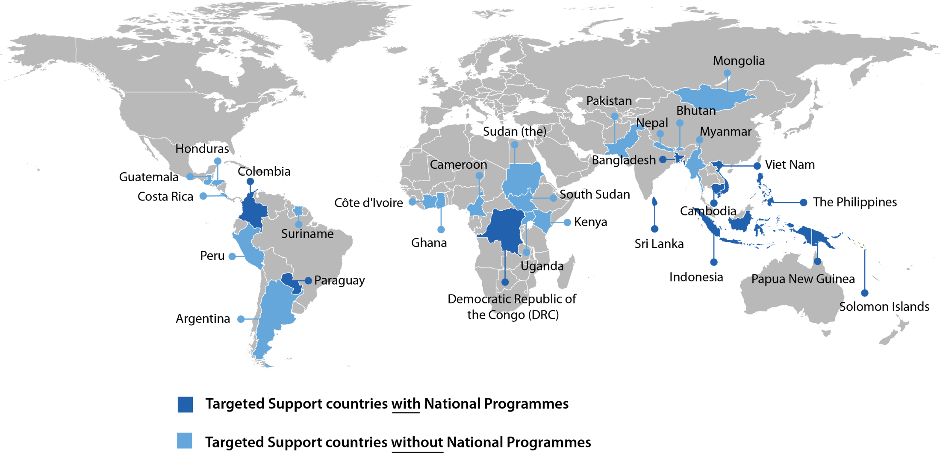
COUNTRY SPECIFIC SUPPORT -
TARGETED SUPPORT
Proven to provide flexible support for immediate and specific needs
- A growing number of countries requesting support.
+ support to the Pacific Islands through regional support
Notes:
All figures presented are from 27 June
29 countries have targeted support. The map shows in light blue colour the UNREDD partner countries with targeted support. Dark blue marks the countries that have NPs but also targeted supprot complementing the NP activities.
Highest number of countries requesting support as well as largest amount of support approved in total; Asia and the Pacific
8 countries from Africa requested support and approved amount equals 19% of total approved amount
8 countries from Latin America and the Caribbean requested support and approved amount equals 12% of total approved amount
13 countries from Asia and Pacific requested support and approved amount equals 69 % of total approved amount
(The exact numbers of countries assisted in the Pacific through regional support requested by PNG and Solomon islands is not yet known)

Slide 6
TARGETED SUPPORT – AMOUNT APPROVED, 1 JULY
Total amount: US$ 8.4 million
Amount to single countries: US$ 7.0 million
to countries without NP: US$ 5.2 million
to countries with NP: US$ 1.8 million
Amount to regional request: US$ 1.4 million
Span of support to single countries:
US$ 13,900 - US$ 1,179,200
(Average: US$ 241,500)
Notes:
The total amount approved per June is about 8.4 million with the largest amount approved to countries without NP (5.2 million).
The requests from countries without NP are 18, meaning 74 per cent of all requests.
The smallest single country request was for and the largest to Myanmar. The average excluding the regional support to Pacific islands is about USD 240, 000. The number of countries (or requests) per range of approved support is seen in this lower graph.
First approval in 2013, 100, 000 USD in total, 25,000 to PNG, 75,000 in Solomon
Second approval in 2014, 1,415,000 USD in total, of which
75,000 USD for specific activities in Solomon
About 150,000 USD to PNG
About 298,000 USD to Solomon
About 890,000 USD to other pacific islands

Slide 7
TARGETED SUPPORT – BY WORK AREA
Top work areas (SNA outcomes) supported:
Governance
MRV & Monitoring
Safeguards & Multiple Benefits
Joint UN-REDD-FCPF country needs assessment in 2012
Overall, results similar to the CNA in 2012 that showed high rates among all countries for:
Governance, MRV & Monitoring and REDD+ Strategy Development, Safeguards, and MRV and Reference Levels.
Notes:
These graphs show the number of countries whose requests included needs under one or several of the work areas, which are being supported within these areas. Governance, MRV & Monitoring and Safeguards & Multiple Benefits are the top three areas or SNA outcomes).
Regionally, we see the support across the work areas in the lower graph. A large proportion of Africa countries requests support under MRV and Mon. as well as governance issues. The Asia and the Pacific

Slide 8
TARGETED SUPPORT – NUMBER OF COUNTRIES SUPPORTED
BY WORK AREA AND REGION
Notes:
(A request can address one or several work areas)

Slide 9
TARGETED SUPPORT –
APPROVED AMOUNT PER COUNTRY
Notes:
All figures by 27 June 2014
The large amount to Myanmar’s work on its National Strategy development incl. stakeholders engagement , REDD+ awareness; participatory governance arrangements, REDD+ safeguards and NFMS; National forest monitoring system etc and to Indonesia to support its PGA work also after its NP was finalised as well as regional support to the pacific islands explain the large proportion of approved supprot to Asia and the Pacific while less to Africa and LAC.
Apart from support to separate countries, targeted support can also contribute to build REDD+ capacity at regional level, Papua New Guinea (PNG) and Solomon Islands (US$ 100,000) submitted a joint request in 2012, for example. The targeted support was allocated to support the consultations and development of a proposal for a regional support structure for forest monitoring and measurement for the Pacific. Based on the achievements further support was requested for the establishment of forest monitoring and forest inventory support facilities for the Pacific, including training of Pacific Island Countries government counterparts, technical guidance and provision of necessary equipment. This brings the total value requested by PNG and Solomon to about US$ 1.5 million.
First approval in 2013, 100, 000 USD in total, 25,000 to PNG, 75,000 in Solomon
Second approval in 2014, 1,415,000 USD in total, of which
75,000 USD for specific activities in Solomon
About 150,000 USD to PNG
About 298,000 USD to Solomon
About 890,000 USD to other pacific islands

Slide 10
Targeted support in comparison to other support modalities or mechanisms
Flexible
Tailoring of support to specifc needs /national circumstances
Well complement the National Programme and support from other initiatives
Across all stages of REDD+
Relative fast response on requests
Need to increase information and understanding of possibilities offered by TS
Sometimes too specific or scattered requests

Slide 11
SNA COUNTRY SPECIFIC SUPPORT -
BACKSTOPPING
Support to countries with view of develop or implement NPs or Targeted Support.
Requests can be done directly to the leading agency on the particular area of work.
Support from agencies’ HQs, regional or country office teams through support missions or remote support.
Scoping missions for assessing needs and help finding the most suitable support modality/ies.
Support common for preparation of NPs.

Slide 12
SNA COUNTRY SPECIFIC SUPPORT -
BACKSTOPPING
In 2013, backstopping expenses: almost US$ 6 million
Number of countries supported in 2013: 37 countries
Africa: 11
Asia and Pacific: 15
LAC: 11
Notes:
Highest number of countries supported by backstopping in 2013 was in Asia & the Pacific (15 countries) followed with the countries in Africa and LAC (both had 11 countries supported)
Largest amount of expenses for backstopping refers to Asia and Pacific, which is the same as the overall situation of approved targeted support upon request as earlier described.

Slide 13
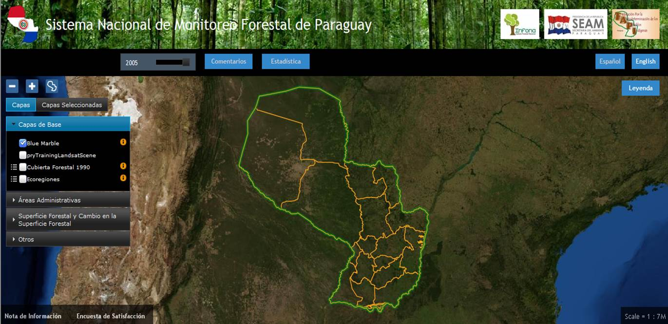
COUNTY RESULTS & PROGRESS
See Annual Report 2013
KENYA (Non NP)
Completed a legal analysis of REDD+ issues drawing
from relevant environmental and land legislation and policies.
EXAMPLES FROM REGIONS (TS & BACKSTOPPING)
PARAGUAY (NP)
Advanced processing of satellite imagery for forest monitoring using free and open-source tools.(GIS-web portal)
INDONESIA PGA work at advanced level; Knowledge enhanced on REDD+ as a catalyst of green economy through technical support and targeted training.
BANGLADESH (scoping of NP)
Completed REDD+ Integrity
study informing analyses of drivers of deforestation and forest degradation
planned under its NP (part of its roadmap to REDD+ readiness and scoping its NP, approved at PB11)
Notes:
The annual report provides the achievements per country page and in a separate section for the supported countries without
All these examples (Kenya, Indonesia, Bangladesh and Parag) have been supported with both backstopping and targeted support. As a complement to NP, note Parag and Indonesia (even when NP ended) and for scoping Bangladesh’s NP.

Slide 14
COUNTRY NEEDS ASSESSMENT
As of 1 July
2 requests received by the Secretariat
Additional notification of interest:
10 country requests &
1 regional request (West Africa)
Support possible through SNA Budget 2014 Revision approved at PB11, Dec 2013.
Assessments will enhance:
- understanding of national and/or regional REDD+ capacities and needs;
- capacity to assess, coordinate and integrate their readiness activities and support requirements;
country ownership of and capacities to implement national REDD+ strategies;
further accuracy of matching of support to needs;
- opportunities to complete readiness as well as on enhancing coordination of support from different sources.
Available to UN-REDD Programme partner countries
Further REDD+ engagement through targeted support, backstopping, NP, Tier 2 or other initiatives or national platforms.
See Outline in Call for Proposals. (Deadline extended to 25 July)
Tentative results to be presented at the next Policy Board Meeting.
Notes:
Primarily intended to be undertaken by the UN-REDD Programme partner countries that are willing to engage further on REDD+ either through targeted support or National Programmes.

Slide 15
Targeted Support Experiences
Costa Rica

Slide 16
COSTA RICA – TARGETED SUPPORT
Objective
To generate field experience and systematize lessons learned on the implementation of the UN-REDD Social and Environmental Principles and Criteria, harmonize them with SESA, SES and the World Bank
To develop a safeguards information system

Slide 17
COSTA RICA – TARGETED SUPPORT
Specific Goals
Identify indicators, variables and information sources framework for social and environmental principles and criteria – preferably using existing information
Develop a methodological framework for developing a sole information system bringing together the interests of UN-REDD, SESA, REDD-SES and the World Bank
Validate the above-mentioned methodological framework through the application of the information system along the national REDD+ process

Slide 18
Specific Goals, cont.
Design a technical, scientific, social and economic road map for the information system
Systematize the process
Develop an assessment system for the information system

Slide 19
Costa Rica – from identification of needs to approval of targeted support
Identification by Costa Rica of priority needs
Preparation of request
Submission of request to UN-REDD Secretariat
13 September 2012
Review of request by the participating UN agencies
Approval of support
Response from UN-REDD Secretariat
UN-REDD Partner Country
Support from UN-REDD regional teams and remote technical support from agencies
US$ 225,000, incl.
a later top up (financial support from all 3 agencies)
Safeguards Coordination Group
Work area referring to all 3 agencies - Review and recommendations on technical content of request
17 Oct.
2012
Notes:
x –x, 2012

Slide 20


Proyecto Diseño de un Sistema de Información
sobre Salvaguardas de REDD (CMNUCC, COP. 16)
Mayo 2013 - Diciembre 2014
Fondo Nacional de Financiamiento Forestal – FONAFIFO
MINAE
Alexandra Sáenz

Slide 21
Resumen de Proyecto financiado con Targeted Support de Programa ONU-REDD y por Fonafifo
Título del Proyecto: Diseño de un Sistema de Información sobre el abordaje y cumplimiento de las Salvaguardas de REDD de la Convención Marco de las Naciones Unidas de Cambio Climático (decisión 1/CP.16), durante la aplicación en Costa Rica de las medidas REDD descritas en el párrafo 70 de la CP. 16
Atlas Award ID: 70672
Project ID: 84526
Fecha inicio: 1-05- 2013
Fecha de finalización: 31-12-2014
Presupuesto (cash): US$ 225,000
Consultores: 2
Fonafifo (contraparte y responsable de ejecución):
  Asignación de Director de Proyecto. Carmen Roldán Chacón.
  Recurso humano de apoyo para ejecución de reuniones y talleres.
  Materiales, recursos económicos y humanos, para realización de actividades.
  Espacio físico, comunicaciones, impresiones.

Slide 22

Proyecto Diseño de Sistema de Información sobre Salvaguardas de REDD (CP. 16)
PROCESO
Interpretación de Componentes e las Salvaguardas
Propuesta Base de Indicadores validada
Diagnóstico situacional
Metodología
Propuesta de Sistema de Información legitimada

Slide 23
Componentes
de las salvaguardas
Análisis de componentes y sub-componentes de las salvaguardas de REDD (CP. 16)
Diagnóstico
Resultados
Contexto nacional e internacional sobre el tema de salvaguardas de REDD (CP. 16) y sistema de Información.
Existencia de indicadores y plataformas de información : competencias institucionales, operación institucional (fortalezas, limitantes, requerimientos) etc.
Una metodología para construcción de indicadores. 2013.
Una metodología para mejora continua del Sistema. 2014.
Un Propuesta de Sistema que cumpla con los requisitos indicados por la COP, LEGITIMADA por los usuarios. 2014 Setiembre.
Definición e interpretación con Actores Relevantes.
Un primer grupo de indicadores (VIABLES), VALIDADO con proveedores de información y con destinatarios de la información. 2014 Setiembre.
Identificación de vacíos de PLR
Análisis de Políticas, Leyes y Regulaciones (PLR) que responden a las salvaguardas de REDD (CP. 16)
Una hoja metodológica para los indicadores que permita la comparabilidad. 2014.

Slide 24

Criterios utilizados para la selección de indicadores:
RELEVANTE: Se encuentra en el ámbito oficial de información.
PERTINENTE: Se ajusta a los objetivos del Sistema y a las disposiciones de la Convención. Define prioridad.
RESPONSABLE: Existe una dependencia que genera el indicador.
DISPONIBILIDAD DE INFORMACION BASE: Las dependencias identificadas como fuente de las variables para los indicadores generan en forma regular la información base.
REQUERIMIENTOS DE LA PERIODICIDAD DE LA INFORMACION BASE: Con base en el período que se determine para la generación de los indicadores a raíz de los requerimientos de la demanda.
FACILIDAD DE MANEJO E INTERPRETACIÓN: Comprensible por parte de los usuarios y/o beneficiarios del Sistema.
BENEFICIO: Para la toma de decisiones sobre las acciones de REDD y para el reporte público ante la Convención.
CONFIABILIDAD.
COSTO.
INDICADOR VIABLE: Indicador que cumple con todos los requisitos anteriores.

Slide 25

Formato base de Hoja Metodológica para los indicadores de CR
Hola Metodológica del Indicador
Identificación del Indicador
Cód. identific. indicador:
Nombre indicador: | Nombre preciso y claro del indicador
Unidad de medida: | Unidad de medición en la cual se presenta el dato del indicador
Periodicidad de recopilación: | Período en que se recopilan los datos básicos (mensual, semestral, anual)
Cobertura geográfica: | Nacional, provincial, cantonal, distrital
Disponibilidad: | Desde |  | Desde que momento está disponible la información para el indicador descrito (mensual, semestral, anual) |  |  |  |  |  |  | Hasta |  | Hasta que momento está disponible la información para el indicador descrito (mensual, semestral, anual)

Slide 26
Descripción general del indicador
Definición: | Definición completa del indicador
Definición de las variables del indicador: | En caso que corresponda, definición de cada variable que conforma el indicador
Interpretación: | Descripción técnica para entender el indicador
Metodología para el levantamiento del indicador: | Forma en que el indicador es recolectado, medido, construido, validado, buscando siempre su calidad, veracidad, replicabilidad.
Método de medición : | Si aplica. Descripción detallada
Fuentes de los datos: | Instancia que genera: |  | Nombre de las dependencias o instituciones que suministran los datos de las variables del indicador
 | Dirección: |  | Dirección en sitio WEB de las fuentes primarias
Responsables: | Nombre y ubicación de la persona (teléfono, fax, e-mail) encargada de administrar la información que se utiliza para generar el indicador
Frecuencia de actualización: | Período en el cual la fuente actualiza la información para reporte (mensual, semestral, anual)
Mecanismo empleado para recopilar la información: | Censo |  | Encuesta |  | Registro administr.
 | Estac. Monitoreo |  | Estimación directa |  | Otros
Limitaciones : | Todas aquellas restricciones o limitaciones (recursos, cálculo, proceso, medición) que posea el indicador,
Finalidad: | Fin y utilidad que posee el indicador para la instancia que lo genera
Tema : | Tema primario con que se relaciona el indicador
Subtema: | Tema secundar. con que se relaciona el indicador
Iniciativa con que se relaciona el indicador: | Convenios, acuerdos, leyes, programas, instituciones relacionados con el indicador

Slide 27
Comentarios generales del indicador
Elaborado por: | Nombre: |  |  | Nombre de la persona que elabora la hoja metodológica
 | Cargo: |  |  | Cargo que ocupa en la institución
 | Teléfono: |  |  | Número teléf. |  |  |  | E-mail: |  |  | Correo electrónico
Fecha última actualización hoja: | Mes: |  |  | Mes de la modificación |  |  |  | Año: |  |  | Año de la modificación
NOTAS
La hoja metodológica corresponde a la descripción detallada de un indicador o estadística.
Cada hoja metodológica debe ser trabajada y llenada debidamente por un grupo de personas ligadas a la temática del indicador. Idealmente deben participar los involucrados tanto en la generación de la información, como en su procesamiento, en su análisis y también en su adecuada difusión.
La hoja metodológica cumple dos funciones, por un lado es la definición de las reglas que permiten contar con el indicador, y en segundo lugar, son el referente para conocer con detalle las características específicas de ese indicador.

Slide 28
Proceso de Validación Técnica
Con especialistas o con responsables de la información para revisión de hojas metodológicas, completarlas, identificar vacíos, identificar necesidades institucionales
En el diseño incluir los costos asociados al desarrollo de indicadores específicos y para atender necesidades institucionales
Proceso de Revisión con Usuarios
Con diferentes Usuarios del Sistema, para intercambiar conocimiento, analizar la comprensión de los indicadores, su utilidad, incluir indicadores que se consideren necesarios en caso que sean viables
En el diseño del Sistema, incluir necesidades de desarrollo de capacidades y los costos asociados, y establecer los mecanismos de coordinación y comunicación requeridos.
LEGITIMACION
Propuesta de Sistema de Información sobre las Salvaguardas de la Cancún, incluye la propuesta metodológica , instrumentos y mecanismos para el desarrollo del Sistema Nacional de Información (2014)
SISTEMA DISEÑADO

Slide 29
Instrumento para la preparación de Comunicaciones Nacionales a la CMNUCC
Instrumento para Instituciones, Organizaciones, Individuos, interesados UCC en la aplicación de las medidas de REDD de la CMNUCC en Costa Rica
Sistema de Información sobre las salvaguardas de la CMNUCC
(párrafo 70, CP 16)
Instrumento para Sistemas de Monitoreo de Instituciones que aplican las medidas de REDD de la CMNUCC en Costa Rica
Instrumento para la toma de decisiones de Gobierno para el desarrollo e implementación de Políticas, Programas o Proyectos en Costa Rica

Slide 30
Alexandra Sáenz
ASaenz@fonafifo.go.cr
and
Thais Linhares-Juvenal
Thais.Juvenal@un-redd.org
Website: http://www.un-redd.org
Thank You!

