Slide 1
Twelfth Policy Board meeting
Lima, Peru
8-9 July 2014

Slide 2
Portfolio level analysis: National Programme Progress
An introduction to the National Programme information management tool: RADAR
Mirey Atallah
Senior Officer – National Programmes
Notes:
4b. Introduction to the performance dashboard for National Programmes
Key points :
Overview of criteria and analytical sources
Presentation of sample country progress and information
Aggregate analysis and quantitative information
Qualification of analysis and caveats
Bottlenecks and strategic issues portfolio level information
Potentially a 15 mn additional presentation from Ecuador on the FPIC Ministerial decree to highlight complexity of REDD+ / TBC by Mirey

Slide 3
Outline
Background
RADAR
The dashboard
Criteria & analytical sources
Sample country
DRC
Future work
Proposed approaches, improvements & additions

Slide 4
Background
RADAR
The dashboard
Criteria & analytical sources
Sample country
DRC
Future work
Proposed approaches, improvements & additions

Slide 5
The ‘information management’ concept
Visual progress report
Information management system
Graphical representation of data
Easy-to-read
General
RADAR
Overview
Interface
Tracking tool
Reporting
Data input → visual output
UN-REDD

Slide 6
RADAR
R
A
D
A
R
REDD
Analysis
of
Data
Assessment
Reporting
,
&
Notes:
REDD Analysis of Data, Assessment & Reporting

Slide 7
Background
RADAR
The dashboard
Criteria & analytical sources
Sample country
DRC
Future work
Proposed approaches, improvements & additions

Slide 8
Analytical sources
Tracking tool
Annual reports
Financial data analysis

Slide 9
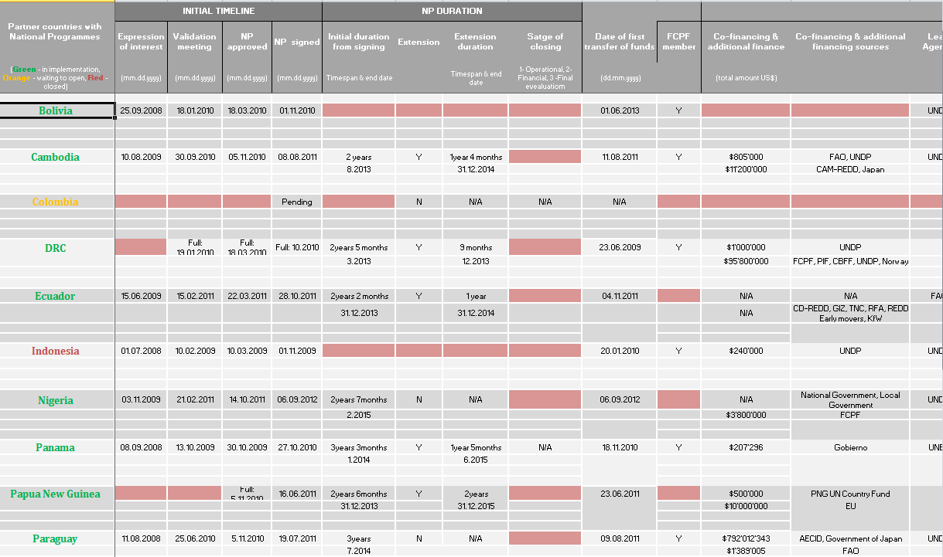
Analytical sources

Slide 10
Analytical sources
Tracking tool
Annual reports
Financial data analysis

Slide 11

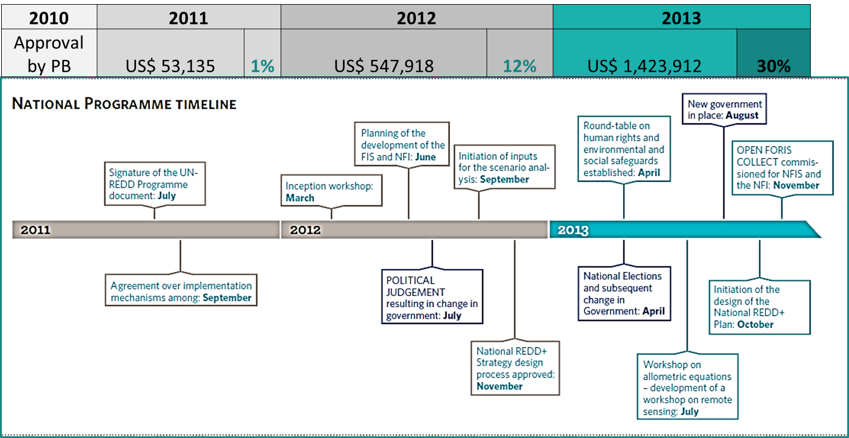

Analytical sources

Slide 12
Analytical sources
Tracking tool
Annual reports
Financial data analysis

Slide 13
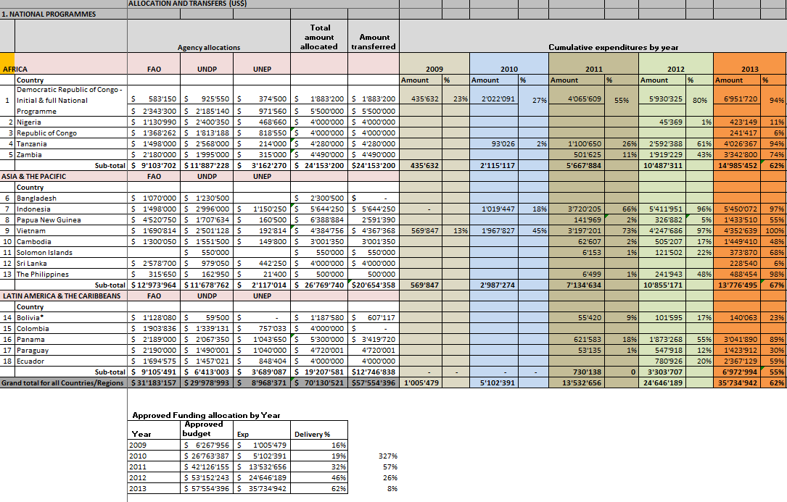
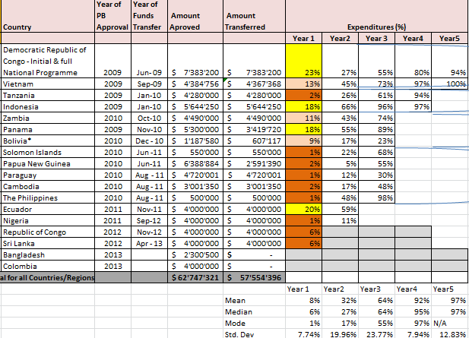
Analytical sources

Slide 14
Criteria
Overview
Status
  Year X out of Y
  Stage of closing
Duration
  Initial
  Extension
FCPF member
Timeline of key events & dates
Examples include
Expression of interest
Approval
Signing
Validation
Extension
Financial Analysis
Expenditure
Available funds
Funding allocation by agency
Regional analysis

Slide 15
Background
RADAR
The dashboard
Criteria & analytical sources
Sample country
DRC
Future work
Proposed approaches, improvements & additions

Slide 16
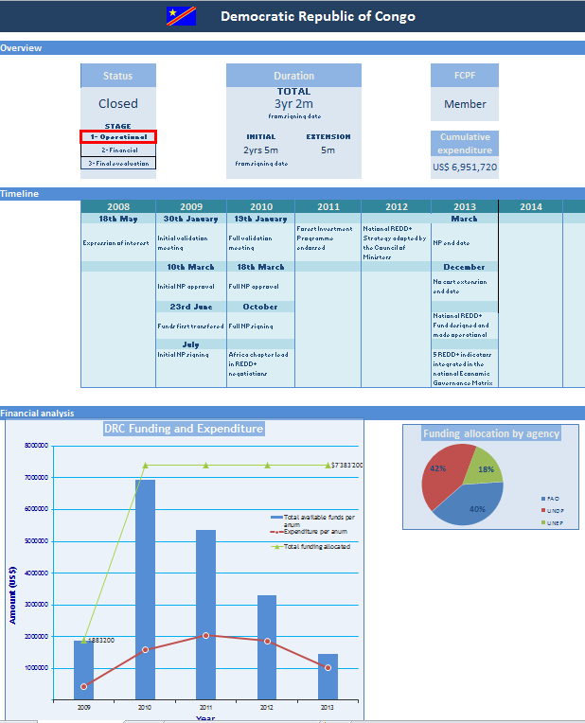
Country tab: DRC

Slide 17
Regional analysis

Slide 18
Background
RADAR
The dashboard
Criteria & analytical sources
Sample country
DRC
Future work
Proposed approaches, improvements & additions

Slide 19
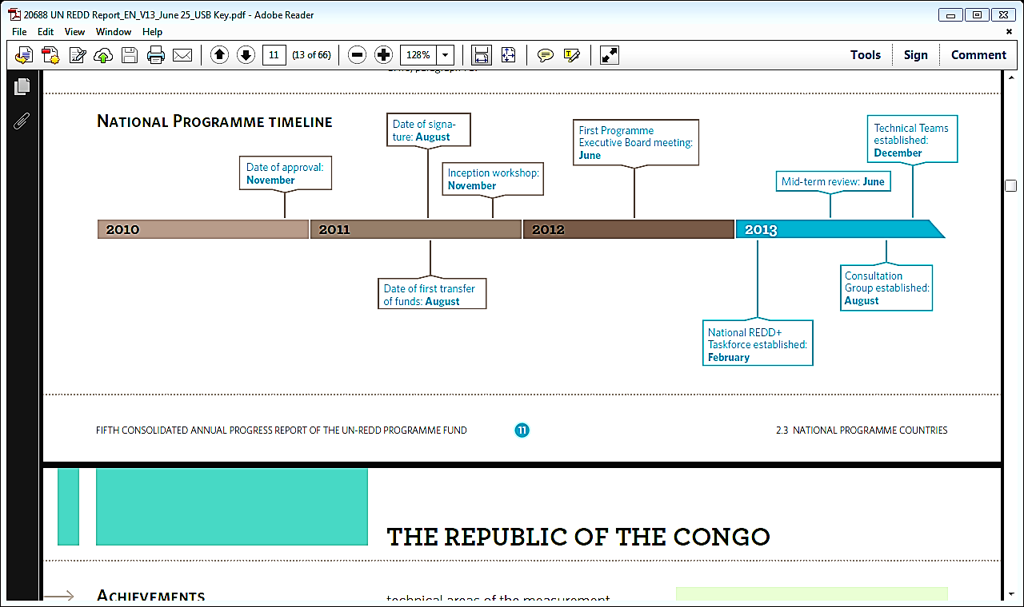
National Programme
Analysis of Implementation
Example: Cambodia NP Financial Delivery and Timeline
2010 | 2011 |  | 2012 |  | 2013
Approval by PB | 62'607 | 2% | 505'207 | 17% | 1'449'410 | 48%

Slide 20
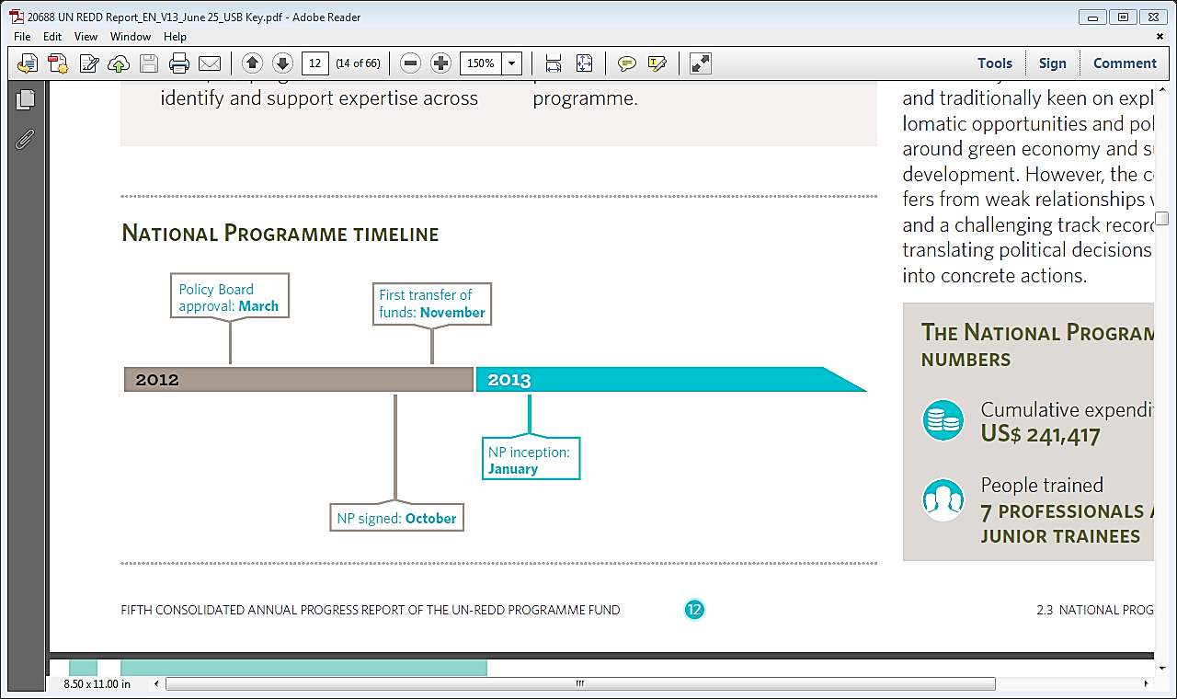
National Programme
Analysis of Implementation
Example: Republic of the Congo NP Financial Delivery and Timeline
2012 | 2012 |  | 2013
Approval by PB | - | 0% | 241'417 | 6%

Slide 21
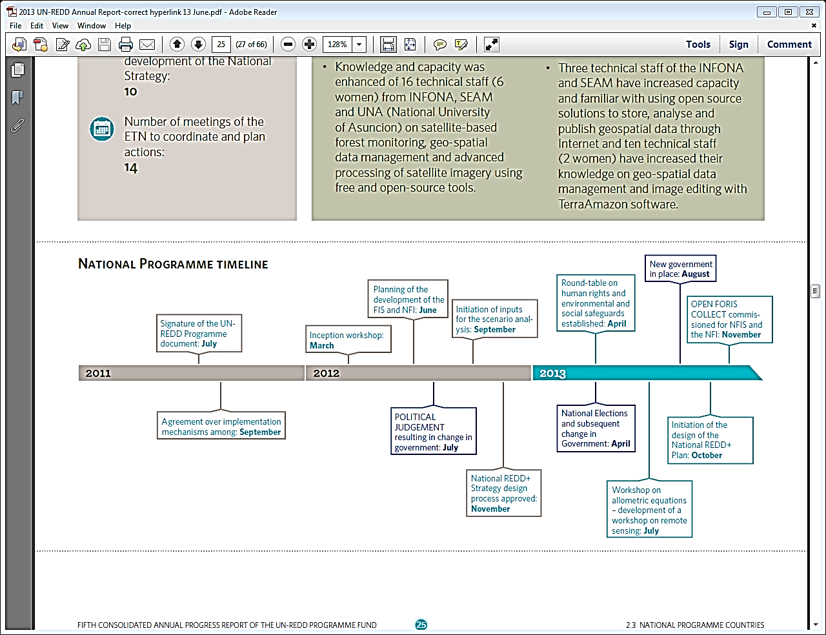
National Programme
Analysis of Implementation
Example: Paraguay NP Financial Delivery and Timeline
2010 | 2011 |  | 2012 |  | 2013
Approval by PB | US$ 53,135 | 1% | US$ 547,918 | 12% | US$ 1,423,912 | 30%

Slide 22
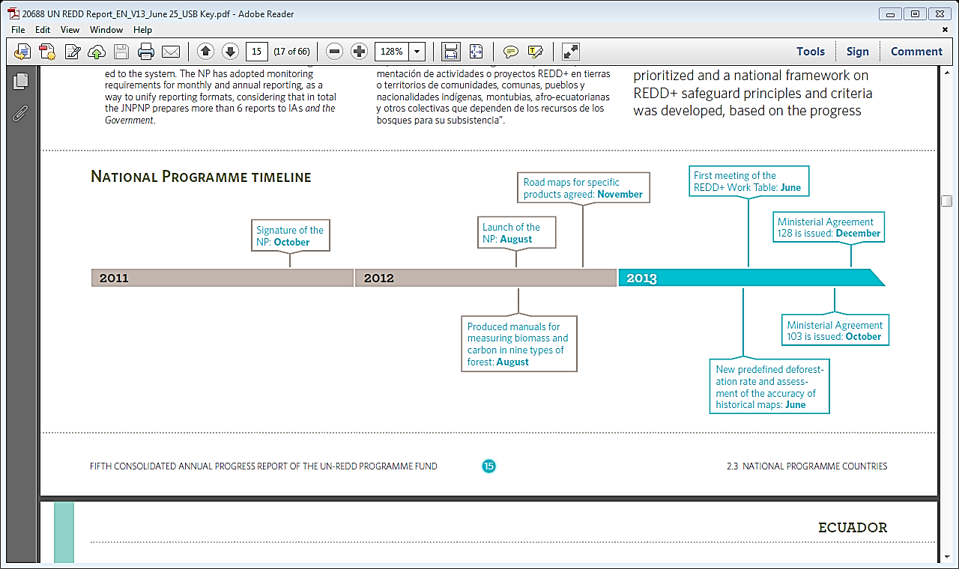
National Programme
Analysis of Implementation
Example: Ecuador NP Financial Delivery and Timeline
2011 | 2011 |  | 2012 |  | 2013
Approval by PB | - | 0% | 780'926 | 20% | 2'367'129 | 59%

Slide 23
8-12 months: from approval by the BP or signature of NP document until first output (e.g. Inception workshop, PEB meeting, coordination units operational)
National Programme
Analysis of Implementation
NP structure is set up
Stakeholder consultations take place
Initial activities start
Std deviation of 19%
Financial delivery
Results delivery timeline
8%
Most of the planned activities are implemented and start delivering results in year 3
Std deviation of 23%
11 no-cost extensions / 61% of NPs
Yr 1
Up to 32%
Yr 2
23% - 98%
Yr 3
4

Slide 24
Proposed approaches, improvements & additions
Integration of qualitative and quantitative data
Interactive maps
Move towards a web-based real-time RADAR fed in directly by countries and quality assured by Secretariat

Slide 25
National Programme
Analysis of Implementation
Example: Ecuador NP Financial Delivery and Timeline
2011 | 2011 |  | 2012 |  | 2013
Approval by PB | - | 0% | 780'926 | 20% | 2'367'129 | 59%

Slide 26
Mirey Atallah
Mirey.Atallah@un-redd.org
Thank You
Website: http://www.un-redd.org

