Slide 1
Twelfth Policy Board meeting
Lima, Peru
8-9 July 2014

Slide 2
The UN-REDD NP Pipeline
Past, present and prospective
Mirey Atallah
Senior Officer – National Programmes

Slide 3
Outline
Past
Legal anchor
Rules of procedure
PB decisions
Present
Current pipeline
Analysis
Changes in REDD+ landscape
Future
Proposed approaches
Criteria &WG

Slide 4
Past
Legal anchor
Rules of procedure
PB decisions
Present
Current pipeline
Analysis
Changes in REDD+ landscape
Future
Proposed approaches
Criteria &WG

Slide 5
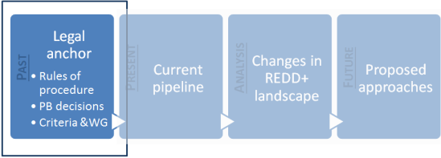
Rules of procedure
‘Quick Start’ phase, aiming to support pilot countries make progress towards National Readiness Plans, actions should be defined and detailed according to country needs
In-country → Secretariat→ PB
  Formulation of draft documents is country-led
  In-country validation
  Secretariat review based on criteria:
    Ownership of the NJP by government and non government stakeholders
    Level of consultation, participation and engagement
    Programme effectiveness, coherence with country strategies and other relevant initiatives, and cost efficiency
    Management of risks and likelihood of success
    Consistency with the UN REDD Programme Framework Document
    Compliance with UN REDD operational guidance and the UN Joint Programme format (incl., cover page, results framework, budget, etc.).
  PB to provide comments on final NJP documents
    Approve the entire programme budget
    Approve a portion of the programme budget
    Approve an initial programme budget tranche
    Reject the NJP and request re submission
Approval through signing by: National Government authorized representative(s), UN Resident Coordinator and representatives from 3 agencies

Slide 6
Policy Board decisions on country invitations
PB1: Future NJP sub-forms should provide specific info on proportion of NJP interventions supporting in-country capacity development
PB4: Secretariat requested to recommend what needed to be addressed prior to
PB6: Agreed that working group apply revised criteria to prioritize countries for new NPs, based on available funds; revised criteria and proposed priority countries will be circulated inter-sessionally for approval in May 2011
Dec 18: Updated document on ‘Criteria to Prioritize Countries for New National Programmes’ approved
PB5: Established the Working Group (WG), facilitated by the Secretariat, to propose selection criteria for prioritization of funding allocations
PB4: Secretariat requested to review submission form template

Slide 7
Past
Legal anchor
Rules of procedure
PB decisions
Present
Current pipeline
Analysis
Changes in REDD+ landscape
Future
Proposed approaches
Criteria &WG

Slide 8
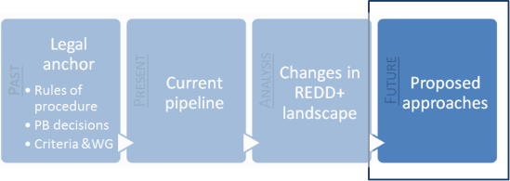

Current approach
Business as usual
Re-establish working group
Existing criteria
Re-rank countries
New pipeline
Add new countries
AFCG UT’Z CHE’
CAOI
Denmark
Zambia
UNDP
Policy board decision
Contingent on fund availability
Invite countries
Notes:
Issues: would all countries need to be ranked again or only new ones to be added
Working group members: Denmark, the Zambia, CSO (LAC), UNDP – to reconfirm availability or be replaced
Process to be undertaken intersessionally to allow pipeline by 2015

Slide 9
Criteria and Working Group
Working group tasked to:
  define criteria to prioritize countries for new NPs
  rank the countries according to the criteria and propose them to be invited
Contribution of UN-REDD to the national REDD+ readiness process
Effective engagement of UN agencies at a country level
REDD+ Potential
Annual change rate 2005-2010 %
Poverty (Population below $2.00 a day)
Pipeline
Forest % of land area
Rated based on self-assessment by UN agencies
33%
33%
33%
Rated using data reported in the REDD+ Partnership Database
'3'= USD 0-10 million;
'2'= USD 10-20;
'1'= USD >20 million.

Slide 10
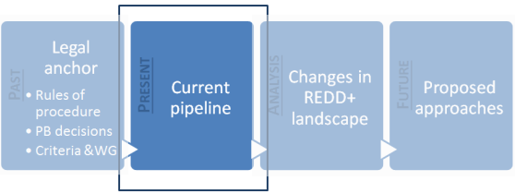
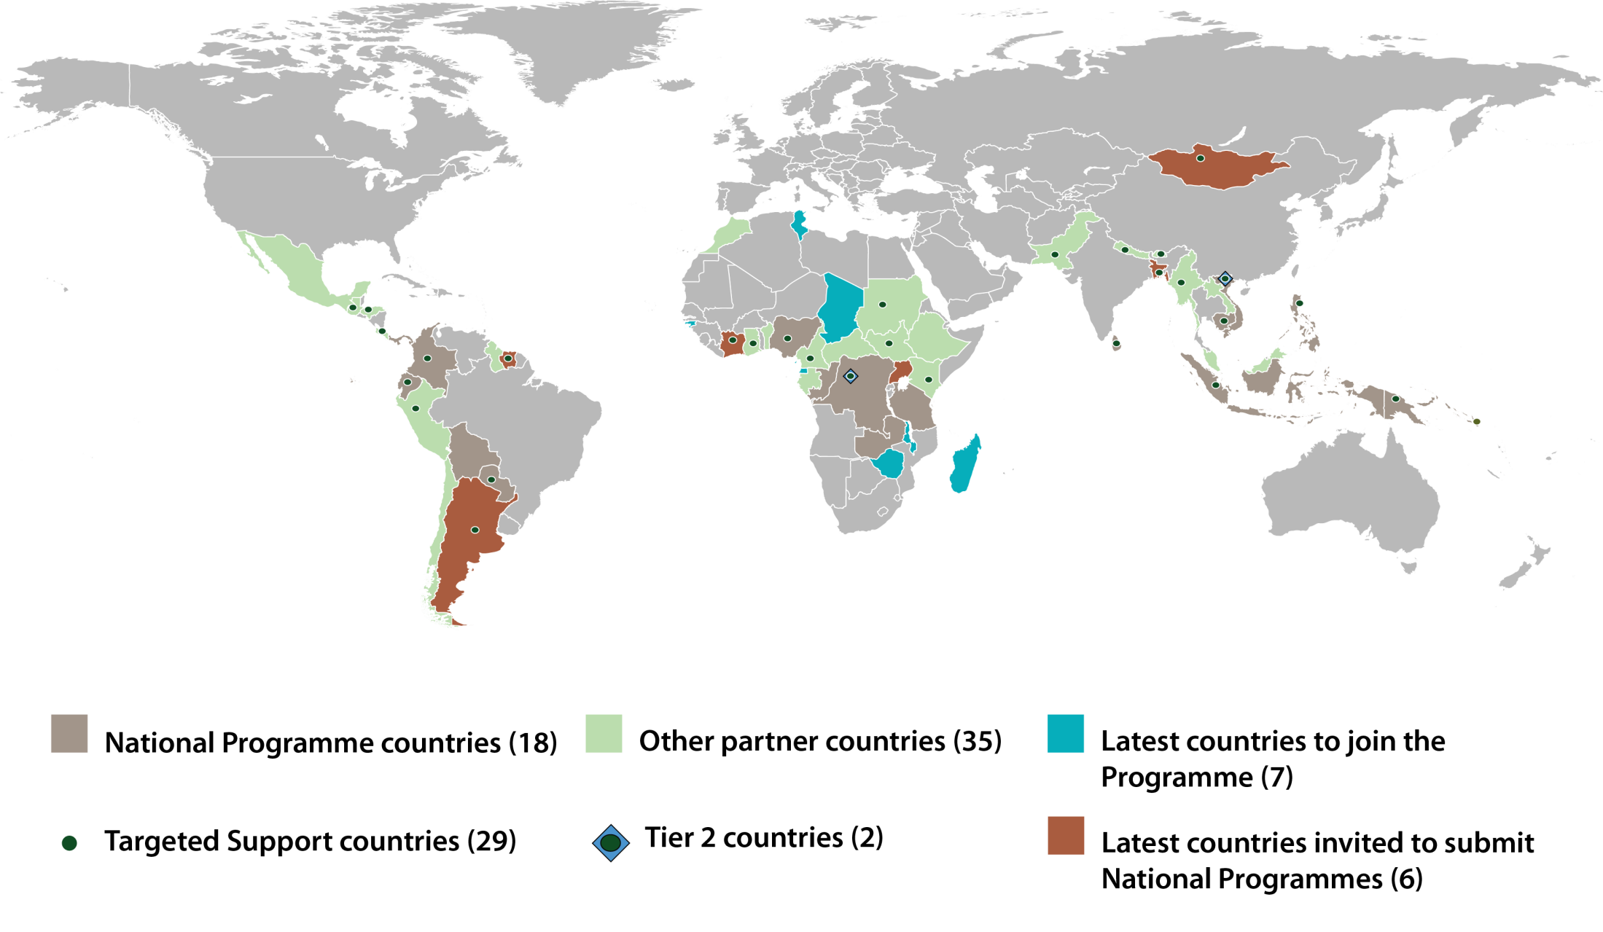
Current pipeline

Slide 11
Past
Legal anchor
Rules of procedure
PB decisions
Present
Current pipeline
Analysis
Changes in REDD+ landscape
Future
Proposed approaches
Criteria &WG

Slide 12
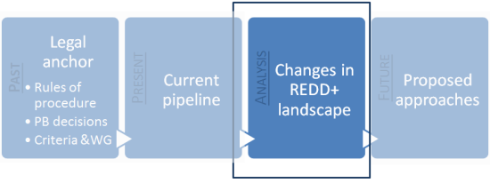
Change in circumstances
Existing approach does not fully promote ownership: invitation to countries rather than request by countries, no co-financing, pipeline silent on political positioning of REDD+ in development process
Compared to start of programme, multiplication of actors in the REDD+ arena at national level necessitates coordination and niche approach
Evaluations indicate comprehensive NPs over-ambitious, require more analysis, capacity gaps are critical
Warsaw framework approved leading to more clarity on requirements
Recognition of non-linear transition from readiness to implementation
8 additional countries since the last ranking in May 2013.

Slide 13
Issues to consider
PB 12
Intersessional
Preparation of R-PPs
PB 13
New pipeline
Preparation of R-PPs
PB 14
Last intersessional
PB 15
3 months
  Steady flow of new countries joining
  Potentially 7 new NPs
  Regional balance

Slide 14
Past
Legal anchor
Rules of procedure
PB decisions
Present
Current pipeline
Analysis
Changes in REDD+ landscape
Future
Proposed approaches
Criteria &WG

Slide 15
Proposed approach
Country driven
Fund availability
PB agreement on process
Expressions of Interest
Assessment process
New Pipeline
Vision
Current support
Niche for UN-REDD programme
Absorption capacity
Funding needs
Estimated timeline

Slide 16
Request to Policy Board
Approve the proposed approach for pipelining as indicated in the session document
Reactivate working group, invite PB members to volunteer and mandate to review EOIs.

Slide 17
Mirey Atallah
Mirey.Atallah@un-redd.org
Thank You
Website: http://www.un-redd.org

