Slide 1
UN-REDD PROGRAMME 12th
POLICY BOARD MEETING
UGANDA’S INITIAL IDEAS AND ROAD MAP
FOR THE
DEVELOPMENT OF A NATIONAL PROGRAMME IN SUPPORT TO UGANDA’S NATIONAL REDD+ PROGRAMME
The National REDD+ Secretariat: Lima (Peru) on 8 July 2014

Slide 2

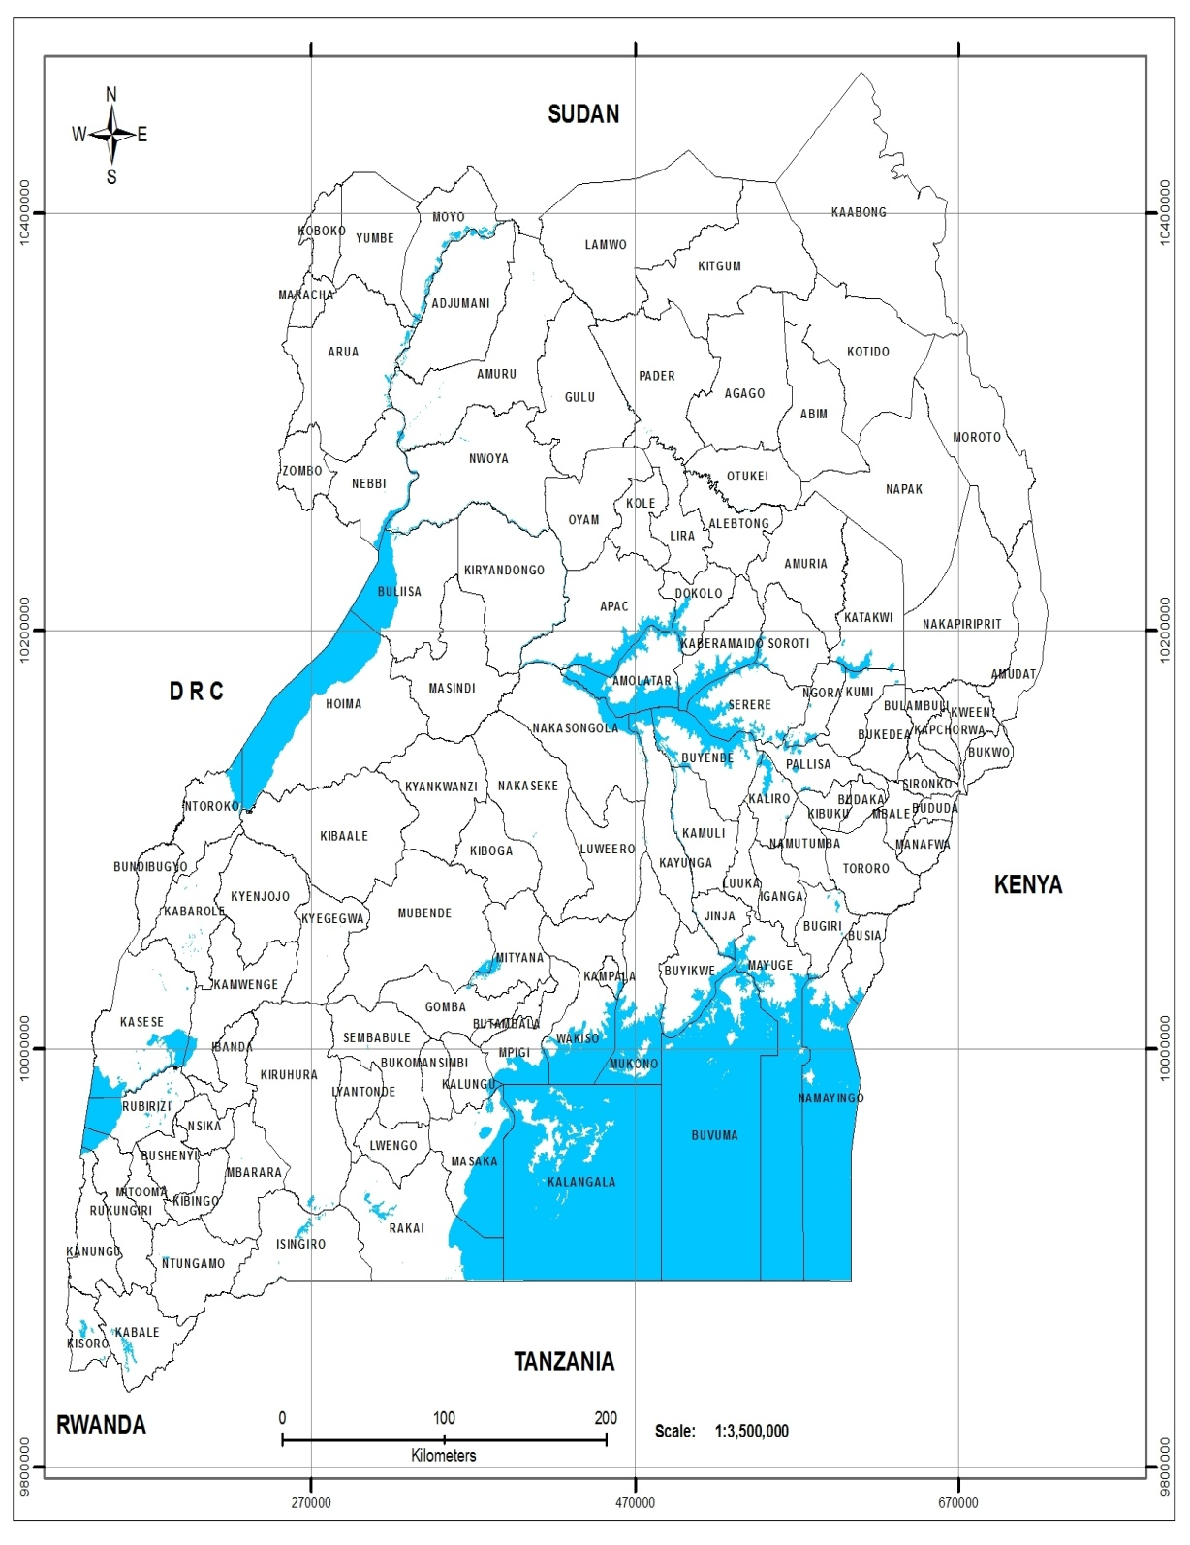
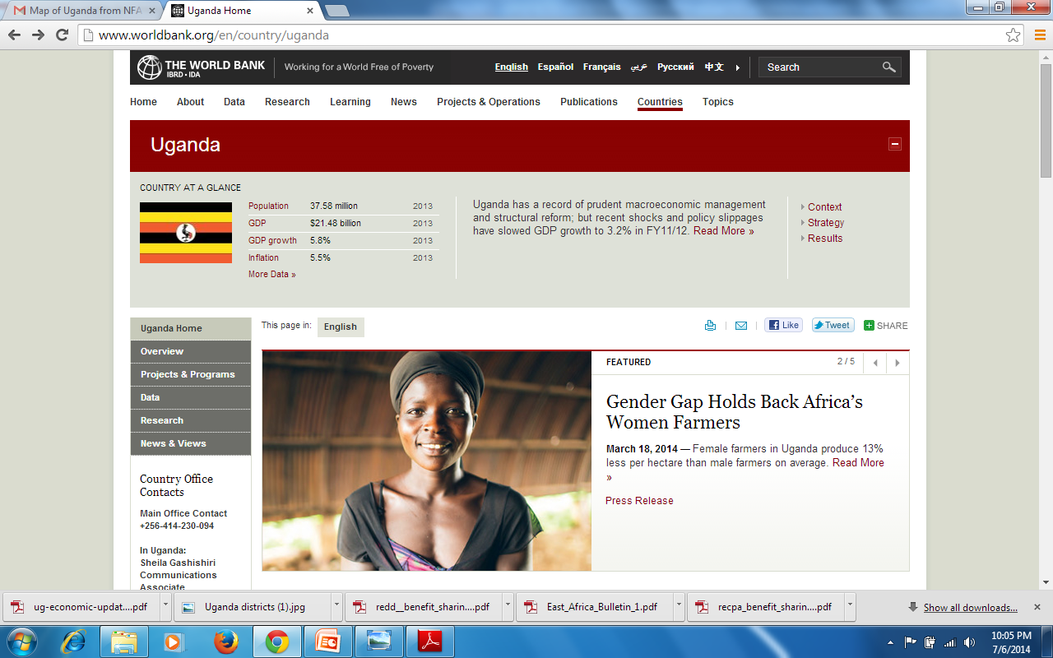

Slide 3

Uganda’s VISION for REDD+
The Goal of the R-PP is to ensure that “Uganda is Ready for REDD+”:
  Development & elaboration of Options for DD & practices needed for SMF/SFM & for Conservation;
  Ensuring stakeholder engagement;
  Development of Tools and Methodologies & Systems (NFMS + SIS)
  Strengthening of National and institutional capacities
Sector Vision: REDD+’s catalytic role for restoring the forests and the value of the forestry sector as an integral part of Uganda’s green economic growth is recognised and actively promoted

Slide 4

Uganda’s VISION for REDD+
Institutional vision:
  capacity to deliver & coordinate with other sectors;
  Institutions linked to drivers of REDD+ cooperate & Act to address them;
Biophysical Vision: Deforestation (circa: 90,000+ Ha per year) reduced to 1990 baseline by 2040.
Sustainability vision: REDD+ is expected to catalyze the forestry sector to:
  meet its environment services + continue providing livelihood & economic roles; + to continue meeting society (cultural) and
  provide these services in perpetuity i.e. Sustainably

Slide 5
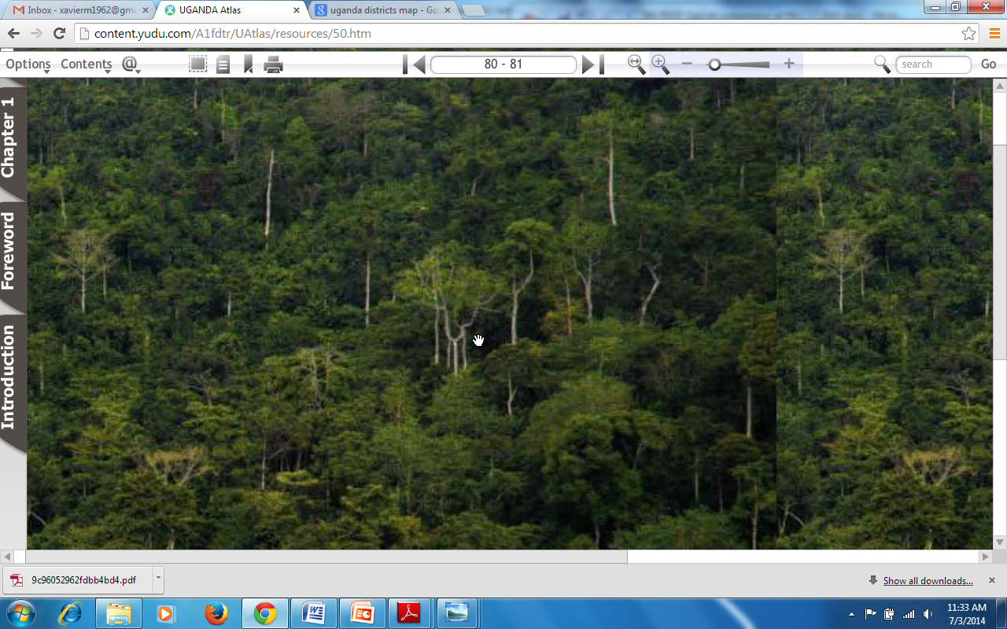
Part of Mabira Forest (a PA in Central Uganda)
Notes:
Author: Uganda Atlas

Slide 6
WHAT IS ALREADY UNDERWAY:
National REDD+ Management Arrangements
Planned
REDD+ is Embedded in the Climate Change Policy (CCP);
A Climate Change Policy Committee (CCPC) incorporates the Steering Committee
A national REDD+ Technical Committee (NTC) replaces the RWG
Taskforces :
  The SESA / Consultation and Participation Task Force
  Policy,
  Reference Level
Status to date
The Policy was approved by a pre-Cabinet Committee on Environment
An inaugural Meeting with the New Climate Change Policy Committee (CCPC) held on June 25, 2014
Notes:
Photo by Dr Sara

Slide 7
WHAT IS ALREADY UNDERWAY:
On Multiple Components
Current Support Portfolio:
World Bank’s FCPF
Austrian Development Cooperation (ADC)
UN-REDD Targeted Support;
Government of Uganda;
Norway /Norad/Norhed
DANIDA/IUCN/
Unknown to CSOs & Universities
Status to date
Management coordination in progress
Staff Recruitments (Technical & Communication) underway
Consultancies & M.o.Us: ToRs for about 10 contracts under preparation;
Mid-Term Report for FCPF due in March 2015
Initiatives on sub-national REDD+
Notes:
Photo by Dr Sara

Slide 8
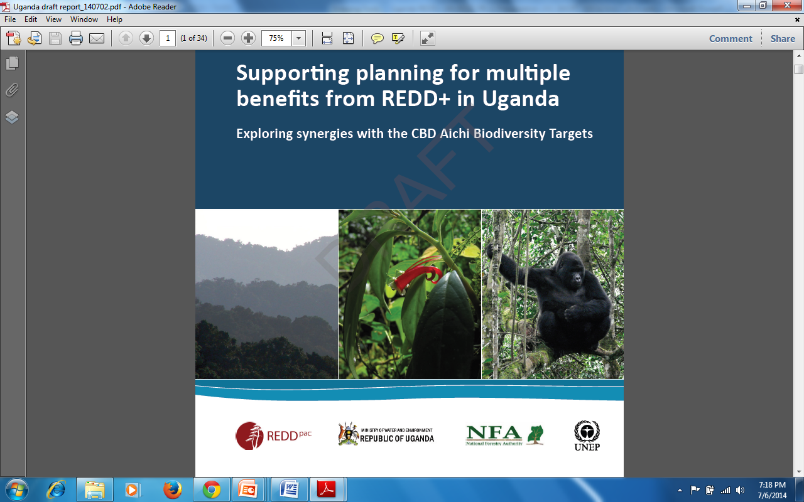
PART 2: WHAT IS ALREADY UNDERWAY: Draft Report on Multiple B of REDD+ Part of UN-REDD Targeted Support

Slide 9
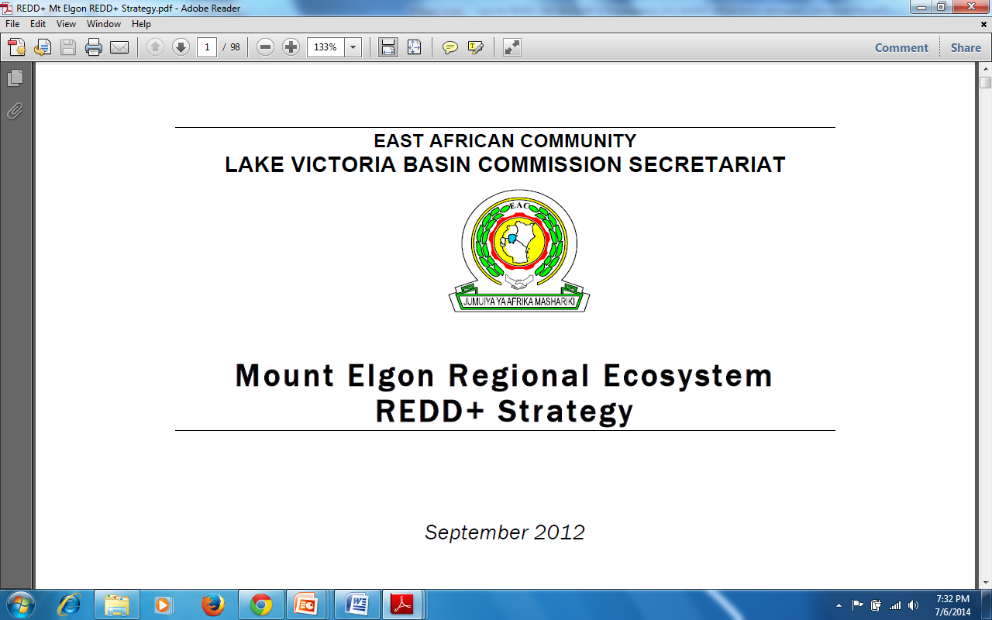
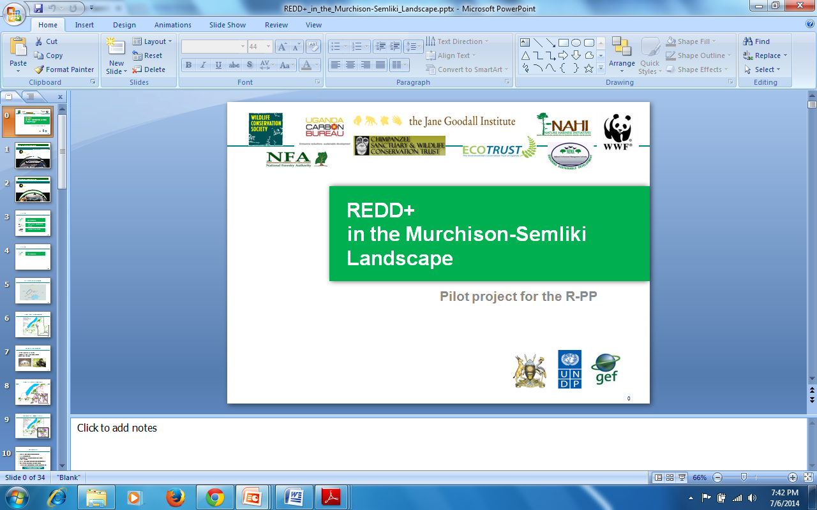
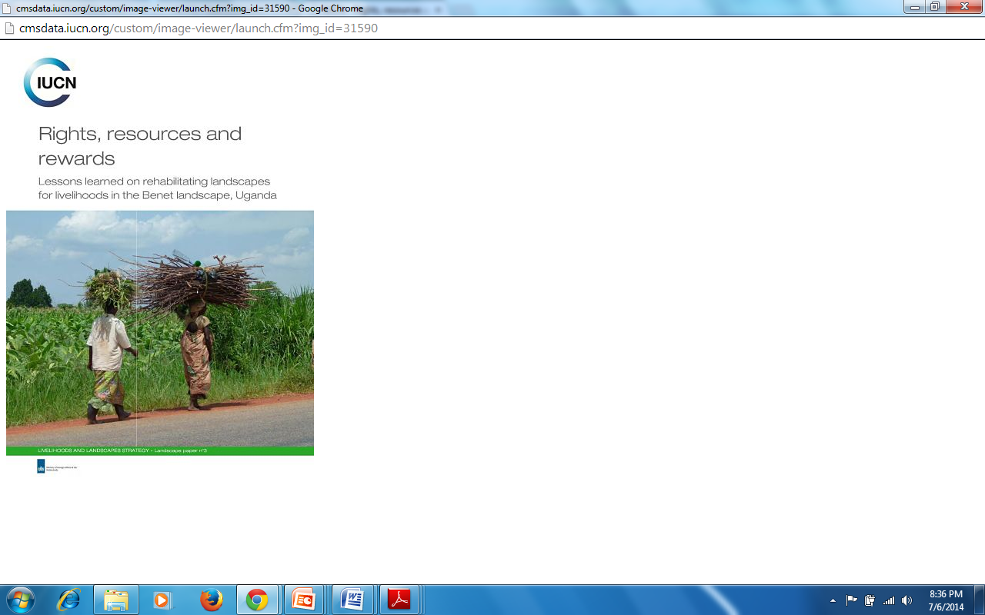
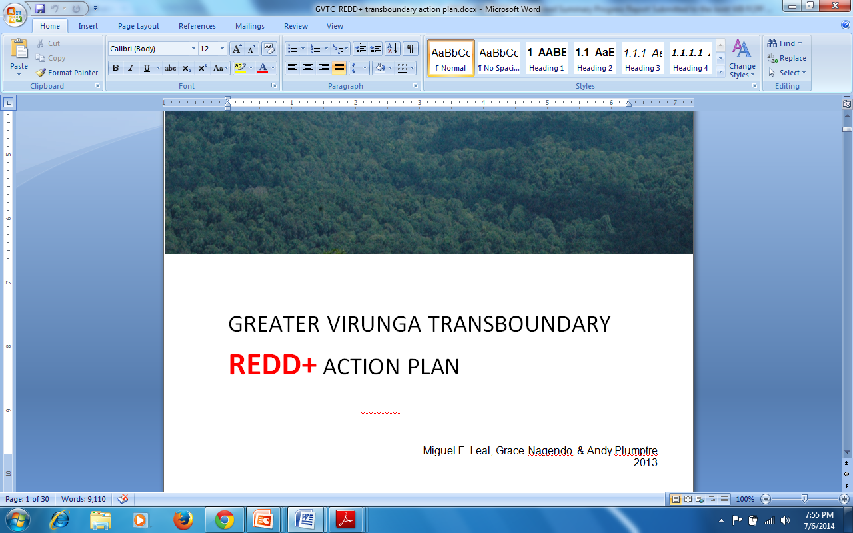
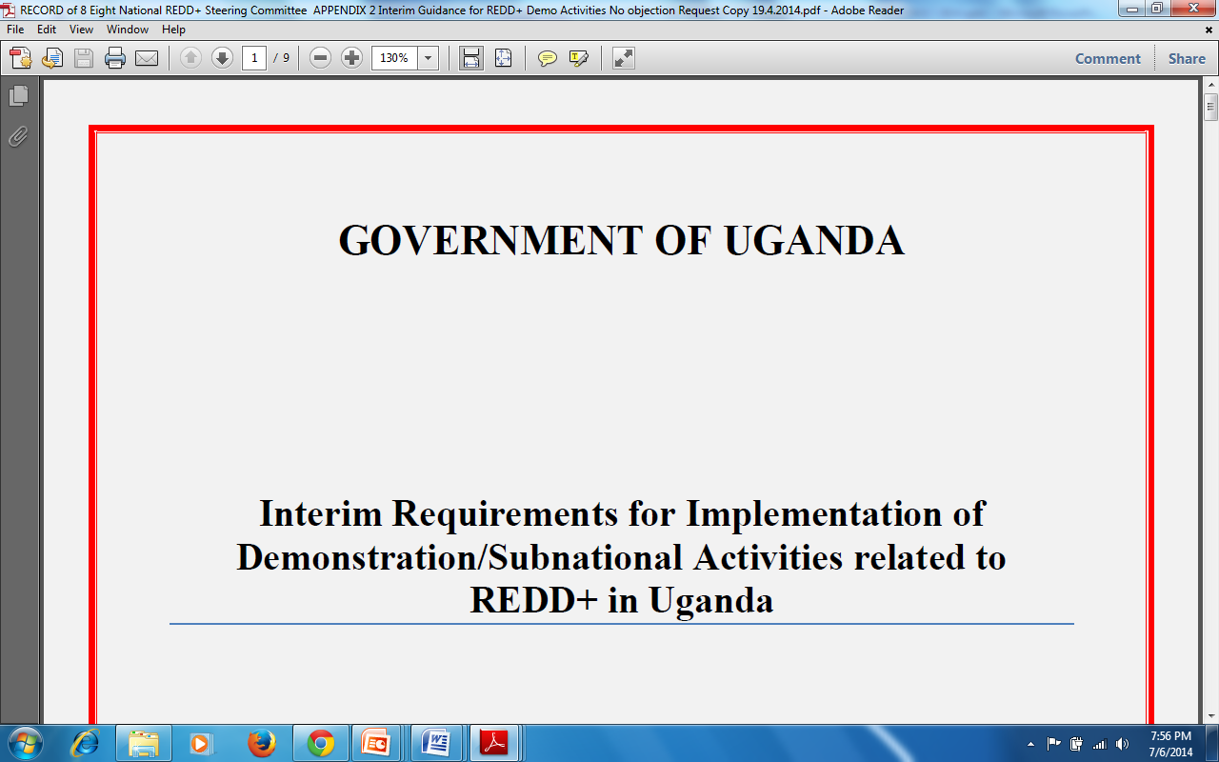

Slide 10
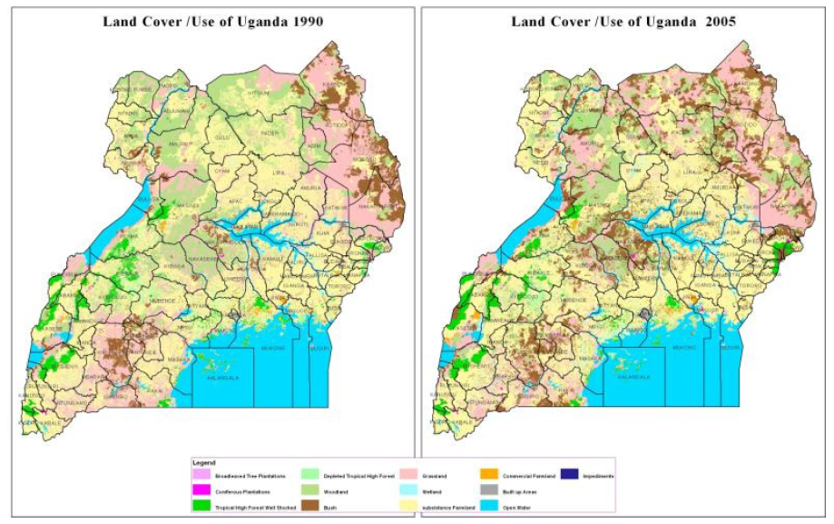
Status of Forest Resources: 15% Cover Vs 24% (1990); annual forest loss between 88,000 -92,000 Ha (ca.2005/2010)

Slide 11
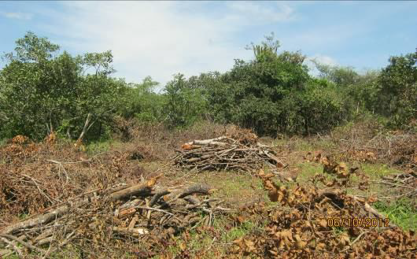
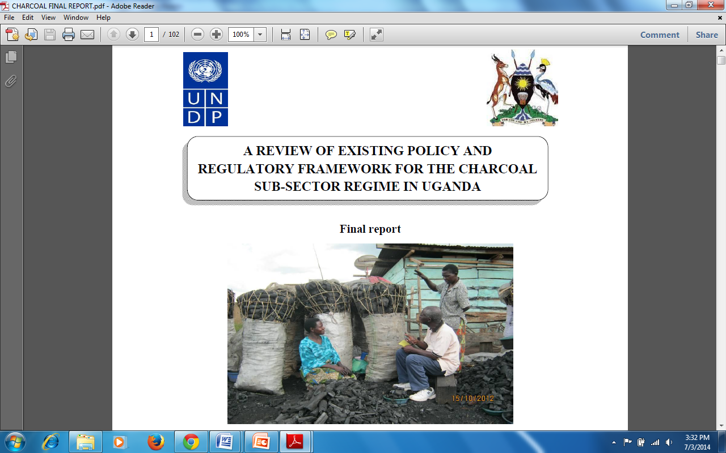
Uganda’s R-PP identified: drivers of deforestation and forest degradation
Agricultural Encroachment
Charcoal Production
Firewood harvesting
Timber harvesting
Livestock Grazing
Addressing needs of Forest Dependent People
Policy, legal, institutional framework
Notes:
Photo by Kazoora (UNDP Report 2012)

Slide 12
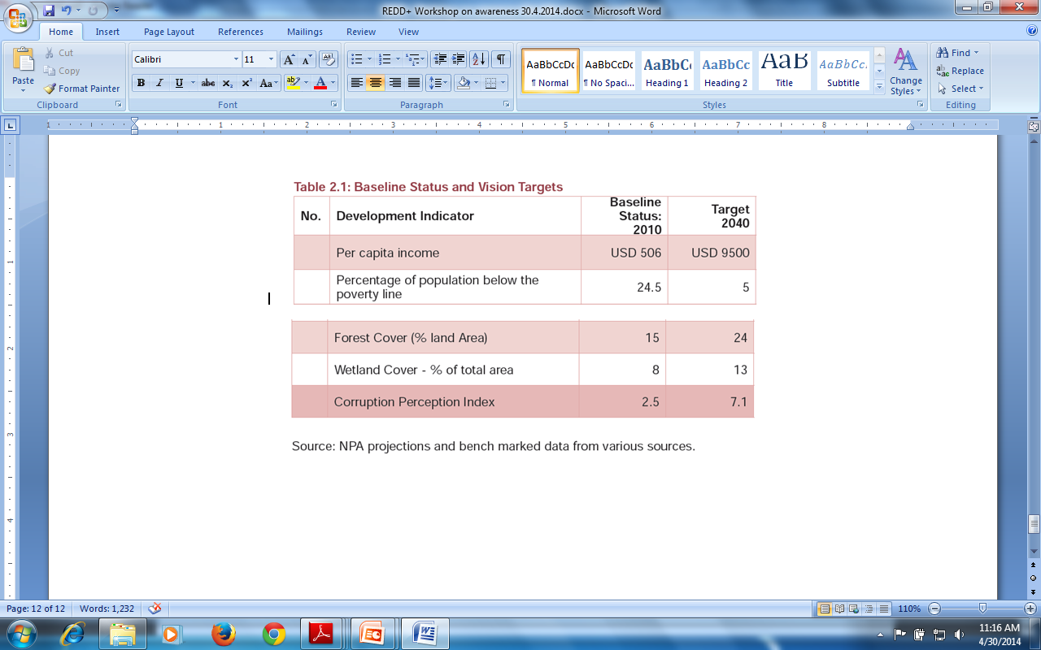
National Development Goals: Forestry in Uganda’s “Vision 2040” Targets

Slide 13
GAP ANALYSIS AND POTENTIAL AREAS OF SUPPORT BY UN-REDD PROGRAMME
A joint FCPF & UN-REDD mission in June served to assess status of planning and finance for REDD+ readiness, which identified 4 major lines of UN-REDD support:
  policy dimensions of REDD+ Strategy work (2b);
  NFMS & MRV (4a);
  demonstration of REDD+ (anticipating implementation); and
  enhanced coordination and technical advisory support (1a).

Slide 14
PART 3a. GAP ANALYSIS Support from FCPF & ADC as % of R-PP Budgeted Requirement (The financial Gap still above 50%)
Components | Sub-components | Support Status
1. Readiness Organization and Consultation | 1a. National REDD+ Management Arrangements | 16.30 % (FCPF)
 | 1b. Consultation, Participation, and Outreach
2. REDD+ Strategy Preparation | 2a. Assessment of Land Use, Land Use Change Drivers, Forest Law, Policy and Governance | 40.66 % (FCPF)
 | 2b. REDD+ Strategy Options
 | 2c. Implementation Framework
 | 2d. Social and Environmental Impacts
3. Reference Emissions Level/Reference Levels |  | 156.39 % (FCPF)
4. Monitoring Systems for Forests and Safeguards | 4a. National Forest Monitoring System | 83. 69 % (Austria) + UN-REDD (Targeted)
 | 4b. Information System for Multiple Benefits, Other Impacts, Governance, and Safeguards

Slide 15
GAP ANALYSIS AND POTENTIAL AREAS OF SUPPORT BY UN-REDD PROGRAMME
R-PP Components that offer highest potential of complementarity;
R-PP components that the UN-REDD has greatest comparative advantage
New areas that would catalyse in-country efforts, and remove barriers to meeting national forestry Goals

Slide 16
GAP ANALYSIS AND POTENTIAL AREAS OF SUPPORT BY UN-REDD PROGRAMME :
Policy measures & multi-sectoral dialogue:
  UN-REDD can support Uganda with the analysis of policy options and measures for REDD+,
  facilitating a robust cross-sectoral policy level engagement for the REDD+ strategy.
  This would nicely complement the technical design of the REDD+ strategy under World Bank support (which employs the SESA approach), adding the required policy and political dimensions, so that the national REDD+ strategy is robust, transformational and anchored in national development policy.
  UNDP, which is already supporting green development policy work in Uganda, has within UN-REDD the expertise to support this stream of work, together with FAO and UNEP expertise.

Slide 17
GAP ANALYSIS AND POTENTIAL AREAS OF SUPPORT BY UN-REDD PROGRAMME
NFMS with MRV functions [plus design of a SIS].
  The most distinctive gap R-PP Readiness is the design of a National Forest Monitoring System (NFMS) with Measuring, Reporting and Verification (MRV) functions.
  A NFMS with MRV functions is a crucial requisite for REDD+.
  UN-REDD can support this design work.
  This is a very technical task for which FAO has a global expertise and readily available tools and approaches.
  In addition, UN-REDD could support the design of a Safeguards Information System (SIS), building on the work under SESA, the ESMF, multiple-benefits assessments and demonstration activities. The SIS will be linked to the NFMS and the latter to the FREL/FRLs

Slide 18
GAP ANALYSIS AND POTENTIAL AREAS OF SUPPORT BY UN-REDD PROGRAMME
Demonstrating REDD+ at sub-national level through landscape approaches:
  In order to support national REDD+ strategic planning and better inform future implementation, the integrated landscape management will be promoted in one or two sites.
  This will be carried out through comprehensive analytical work, followed by engagement and capacity-building of relevant stakeholders (notably local communities, private land-owners and local governments, among others), together with early action.
  "Integrated landscape management" is understood as mutually agreed land-management schemes, entailing REDD+ objectives, established by concerned stakeholders.
  These schemes address ecological, social and economic interactions while encompassing diverse multiple benefits from the landscape at different scales.
  This stream of work will generate practical lessons for the REDD+ strategy, particularly with regards to policy options, private sector engagement, typology of field investments, and integration of multiple benefits
  UNEP is just launching a new initiative/partnership on landscapes approaches for REDD+, which could be pioneered in Uganda.

Slide 19
GAP ANALYSIS AND POTENTIAL AREAS OF SUPPORT BY UN-REDD PROGRAMME
Capacity-building support to manage REDD+ readiness:
  This is a transversal stream of work that aims at enhancing national capacities to manage
    a high-quality and timely-delivered REDD+ process,
    mobilising and engaging the required institutions and stakeholders,
    exploiting synergies between work streams as well as with initiatives beyond the REDD+ arena,
    sustaining the policy work, and building the national case for REDD+ in order to
    foster international dialogue and resource mobilisation for REDD+ implementation.
  It will comprise the deployment of international and national expertise to plan, coordinate, sequence, facilitate, monitor and connect the different work streams and actors in REDD+.

Slide 20
Scope of NP and UN-REDD support approach
In view of the existing support by FCPF and the Austrian Development Cooperation agency to Uganda on REDD+ (estimated around USD 5 millions), the UN-REDD support is expected to be focused on the streams indicated before, and hence the National Programme (NP) to be submitted for the forthcoming UN-REDD Policy Board will be of medium size (estimated: USD 1.2 to 1.6 millions).
At the same time, Uganda requires some targeted support (TS) from UN-REDD in 2014 and in early 2015, to enhance national capacities for managing REDD+ readiness and prepare the grounds for a smooth formulation, appraisal and launching of the NP.
This proposed arrangement (a medium-sized NP with short-term TS) will suit finely the current and foreseen needs of Uganda REDD+ readiness, while enabling UN-REDD to be a catalyst.

Slide 21
Indicative Schedule
Description of planned Steps for Uganda UN-REDD NJP work and activities | May 2014 | Jun 2014 | Jul 2014 | Aug 2014 | Sep 2014 | Oct 2014 | Nov 2014 | Dec 2014 | Jan 2015 | Feb 2015 | Mar 2015 | Apr 2015
Step 1: Post-Nairobi Thoughts [May 2014] | √
Step 2: Secretariat to advise on depth of NJP document Content & Process [May 2014] |  | √
Step 3: Uganda REDD+ team to Seek UNDP and FAO Support in Uganda [May/June 2014] |  | √
Step 4: Scoping mission (Joint FCPF, UN-REDD & Uganda mission) [mid-June 2014] |  | √
Step 5: PB informal presentation by Uganda (roadmap & key areas for UN-REDD support) [early July 2014] |  | √
Step 6: Task Force prepares NJP document, with UN-REDD support missions, and stakeholders consultations [July-September, 2014]
Step 7: UN-REDD appraisal mission [September 2014]
Step 8: Validation by stakeholders [September 2014]
Step 9: Submission to UN-REDD Secretariat [September 2014]
Step 10: International technical review [October 2014]
Step 11: PB 13 Presentation & discussion [November 2014]
Step 12: Due diligence, finalization [December to February 2015]
Step 13: Signature [March 2015]
Step 14: Inception phase [From April 2015]

Slide 22
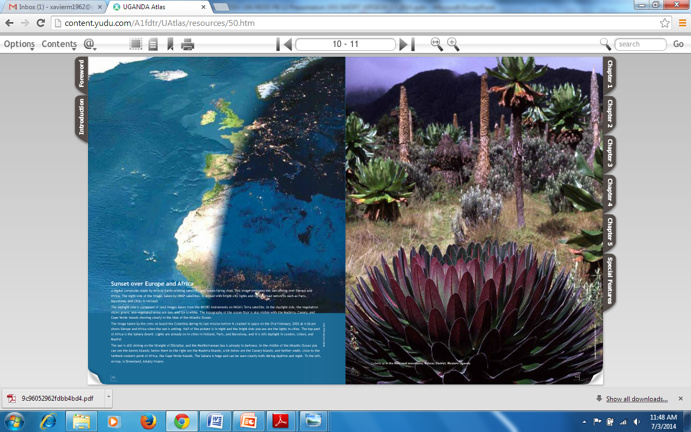
Uganda’s Mt. Rwenzori National Park (Alpine Zone: Photo Source: Atlas at http://content.yudu.com/UNEP
Notes:
Photo Attribute: Uganda Atlas at http://content.yudu.com/

