Slide 1


MINISTRY OF ENERGY, NATURAL RESOURCES, THE ENVIRONMENT AND MINES (SERNAM)
The UN-REDD Programme
July 2014
1

Slide 2
Content
1. Context of Honduras
2. The REDD+ Process in Honduras
3. Potential Support from UN-REDD

Slide 3
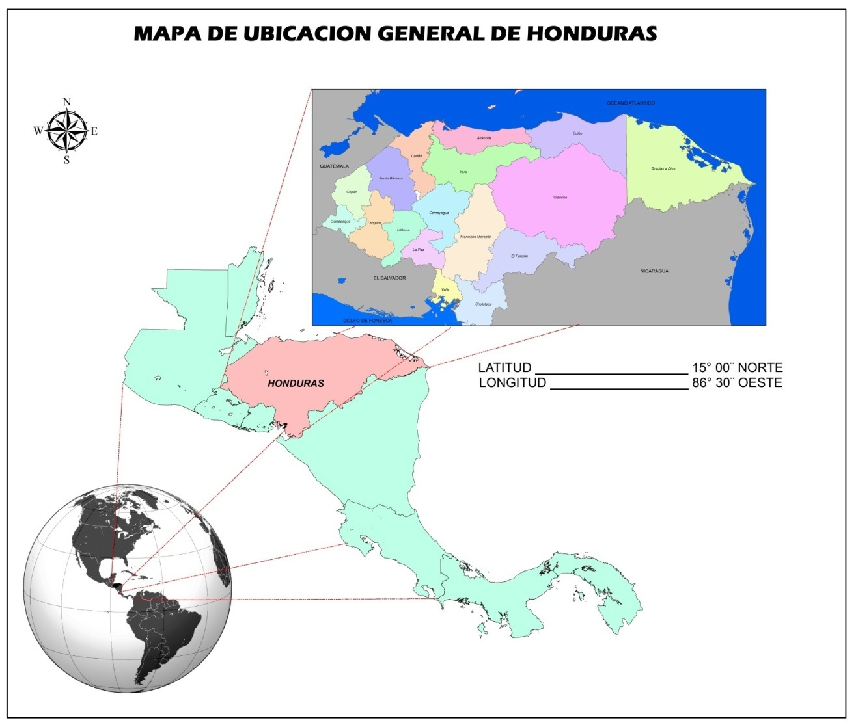
1. Context
Country Context
Total area: 112,492 km²
Population: 8.72 million
Pop. density: 77.56 per km²
50% rural population
10% indigenous and Afro-
Honduran population
59% forest coverage
Deforestation:
Aprox. 39,000 ha/year
2

Slide 4
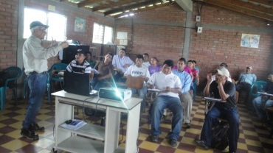
1. Context
The country’s political mandate
Administrative management to ensure improved institutional effectiveness, efficiency and transparency;
The new administration should simplify services and bring them closer to the citizens, increase transparency and improve Government-civil society relations;
Results-based institutional management (National System for Results-Based Management);
Results should “Create Public Value”, guaranteeing rights, meeting needs, providing quality services, opening new opportunities, building community, citizenship and democracy;
The State’s reform process is based on operational decentralisation.
3

Slide 5
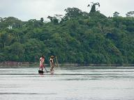
1. Context
SERNAM’s Vision and Mission
Vision: Honduras has successfully consolidated a model of sustainable development through bridging economic development and social inclusion and respecting the environment, the harmonious relationship with nature and cultural diversity.
Mission: To ensure the protection, conservation, and use of the country’s strategic national resources through sustainable and holistic environmental policies and natural resources management, aiming to consolidate a model of sustainable economic and social development which is equitable and inclusive and contributes to improving the Honduran people’s quality of life.
4

Slide 6
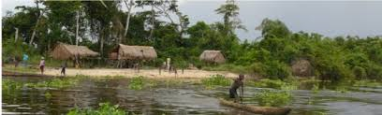
2. The REDD+ Process: Progress
What does Honduras want to achieve through the
REDD+ Mechanism?
“Improve the quality of life of women and men through
conservation, sustainable forest management and the
restoration of degraded forest areas”.
5

Slide 7
2. The REDD+ Process: Progress
Strategic Objectives for Adaptation and Mitigation in the National Strategy on
Climate Change (ENCC) that correspond to the Forest and Biodiversity sectors
SECTOR
MEASURE
STRATEGIC OBJECTIVE
I. In the long term, preserve the function, structure and composition of the ecosystems in order to improve their adaptation capacity with regard to climate change.
II. Prevent the loss of tropical broadleaf and coniferous forests due to fires and forest plagues under climate change conditions.
Adaptation
III. Implement adequate forest management for protection and production, in the context of the alteration of natural wealth, functionality and symbiotic relationships caused by climate change.
Forest and Biodiversity sectors
I. Reduce and limit greenhouse gas emissions in order to contribute voluntarily to climate change mitigation and strengthen collateral processes of socio-economic and environmental sustainability.
Mitigation
II. Strengthen synergies between the measures of adaptation and mitigation in order to better adjust socio-natural environments to the manifestations and impacts of climate change and prevent the adverse effects of the response.
6

Slide 8
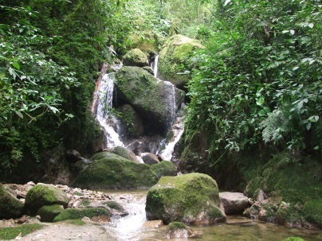
2. The REDD+ Process: Progress
An enabling legal and political framework in REDD+?
Country Vision and Mission
Environmental and Forest Law
SERNAM’s modernisation based on results
Climate Change Law
National Strategy on Climate Change
The National Office on Climate Change
7

Slide 9
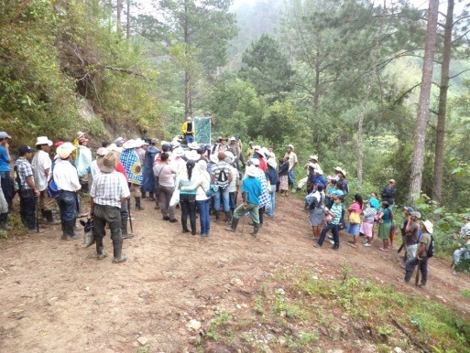
2. The REDD+ Process: Progress
Current Development Partners in REDD+?
R-PP Preparation Proposal:
USD 8.6 million
REDD+ Preparation/Implementation Proposal:
USD 3.8 million (FCPF)
Deforestation baseline and carbon estimates in three types of forests:
USD ??? (REDD-FCPF project/CCAD-GIZ)
Two subnational pilot projects to understand the local context in forest governance:
USD ??? (USAID/GIZ)
8

Slide 10
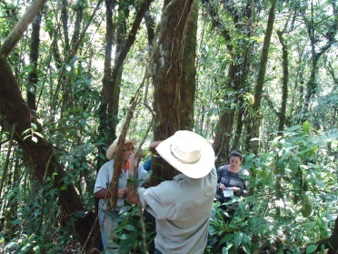
2. The REDD+ Process: Progress
REDD+ Project, 2014-2017 (FCPF-UNDP, USD 3.8 million)
Structure for Coordination and Participation (REDD+ Sub-Committee)
A platform to distribute information about the national process (SERNAM)
Establish a robust Complaints and regress mechanism
Develop participation and consultation mechanisms (CONPAH)
Identify strategic options for REDD+
Elaborate SESA through participatory processes
Support the design of Reference Levels
Support the development of a national monitoring system
Support building an Information System for Safeguards
9

Slide 11
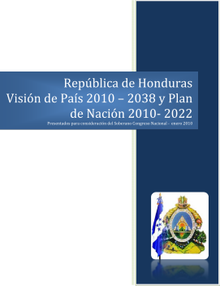
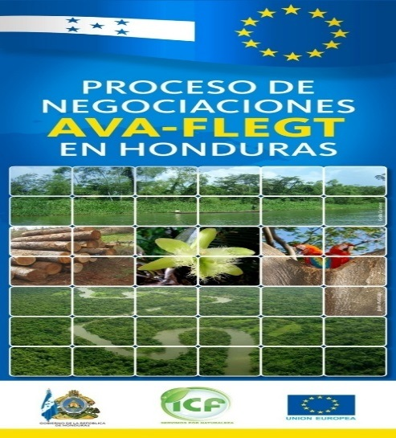
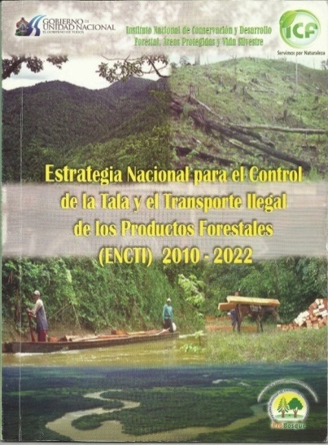

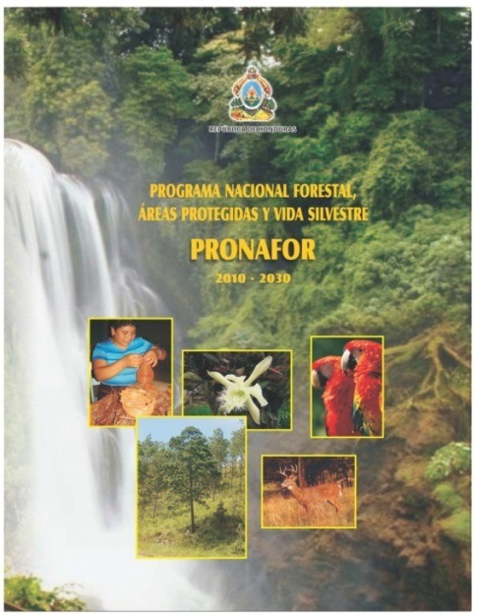
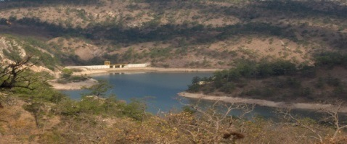
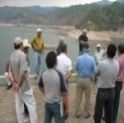
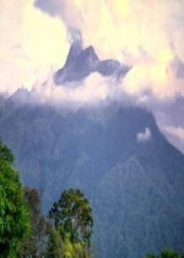

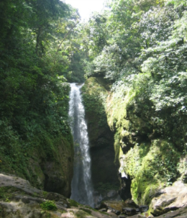
2. The REDD+ Process: Progress
Strategic Planning Instruments for Honduras’ Forest Sector (EU)
REPUBLICA DE HONDURAS
LEY FORESTAL, AREAS PROTEGIDAS Y
VIDA SILVESTRE
POLÍTICA FORESTAL, AREAS PROTEGIDAS Y VIDA SILVESTRE
HONDURAS
DECRETO No. 98 - 2007
FORCUENCAS
Un proyecto financiado por la Unión Europea y el Gobierno de Honduras con resultados importantes para la conservación del medio ambiente en Honduras.
10

Slide 12
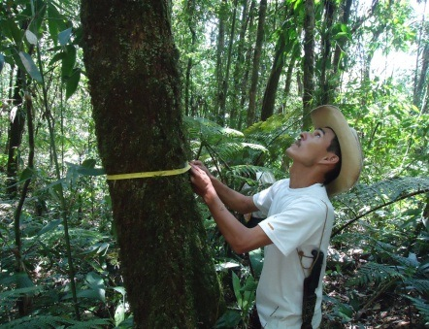
3. Potential Support from UN-REDD
Contribute and support current efforts in Honduras for:
Result 1:
The National Strategy for Reducing Deforestation and Forest Degradation, in the context of REDD+, has been implemented in a sustainable manner.
Result 2:
The enabling framework for implementing the National Strategy for Reducing Deforestation, in the context of REDD+, created under relevant international guidance, has been implemented.
Result 3:
The scientific and technical bases for managing the degradation of the forests in Honduras have been established and strengthened through the framework of a Forest Observatory.
Potential Support from UN-REDD:
USD 3.4 million
11

Slide 13
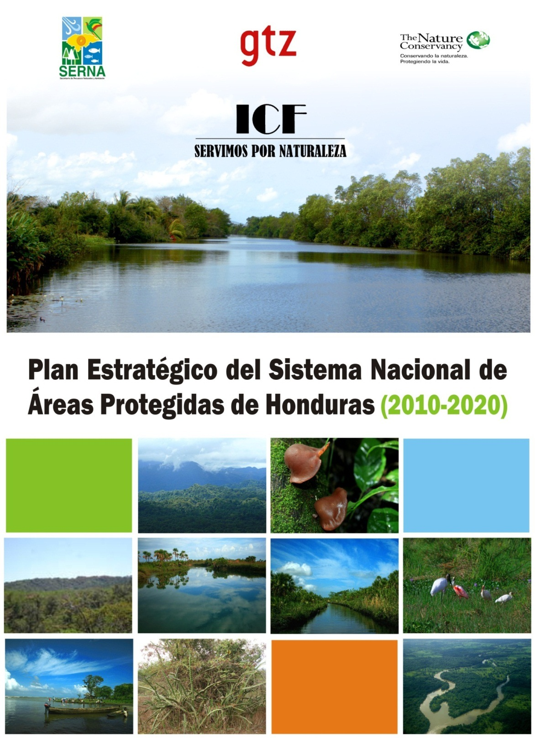
Thank you!
12

