Slide 1
Twelfth Policy Board meeting
2013 Annual Report of the
UN-REDD Programme
Lima, Peru
8-9 July 2014

Slide 2
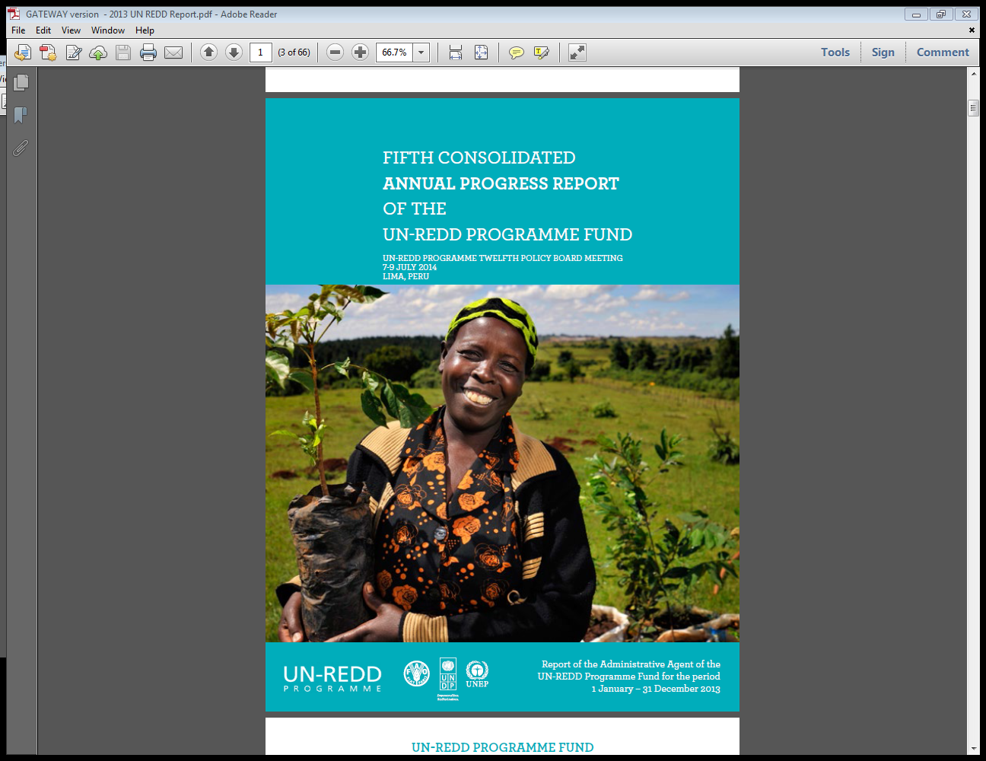
2013
Annual Progress Report
of the
UN-REDD Programme FUND

Slide 3
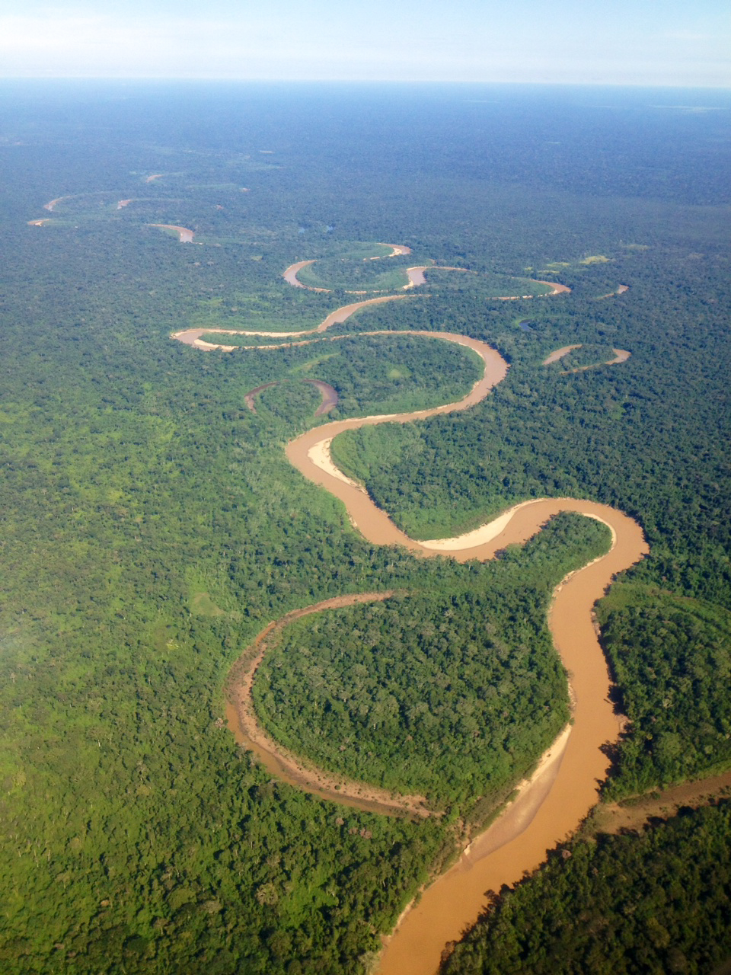
2013 Annual report
Focus and New Features

Slide 4
FOCUS: Results-based Management
Guided by the UNDG Results-Based Management principles
Reported against the UN-REDD Programme Strategy 2011-2015, National Programmes Planning, Monitoring and Reporting Frameworks and SNA Results and Monitoring Framework 2011-2015
Comprising consolidated narrative and financial reports
Emphasis on results, lessons learned and analyses
Country pages emphasize on REDD+ readiness support and results at country level
Notes:
Country pages: provide highlights of results drawing on the full annual reports and cannot be considered as providing the full picture of achievement and progress through NPs.

Slide 5
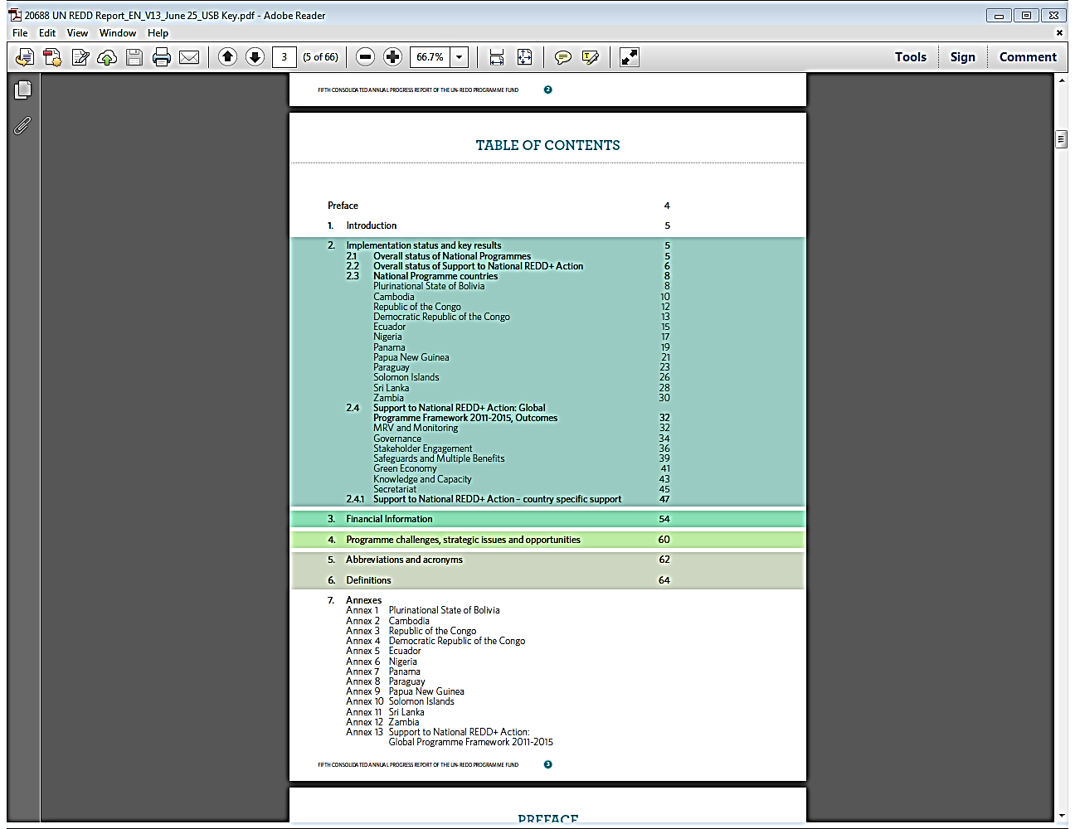
Structure of the Report
Structured in a manner similar to the 2013 semi-annual update (test run)
Implementation status and key results:
Provides integrated understanding of the Programme
Highlights individual aspects as well as linkages of delivery modalities (see next slide)
Draws attention to Programme work areas (SNA Outcomes)
Financial information
Challenges, strategic issues and opportunities

Slide 6
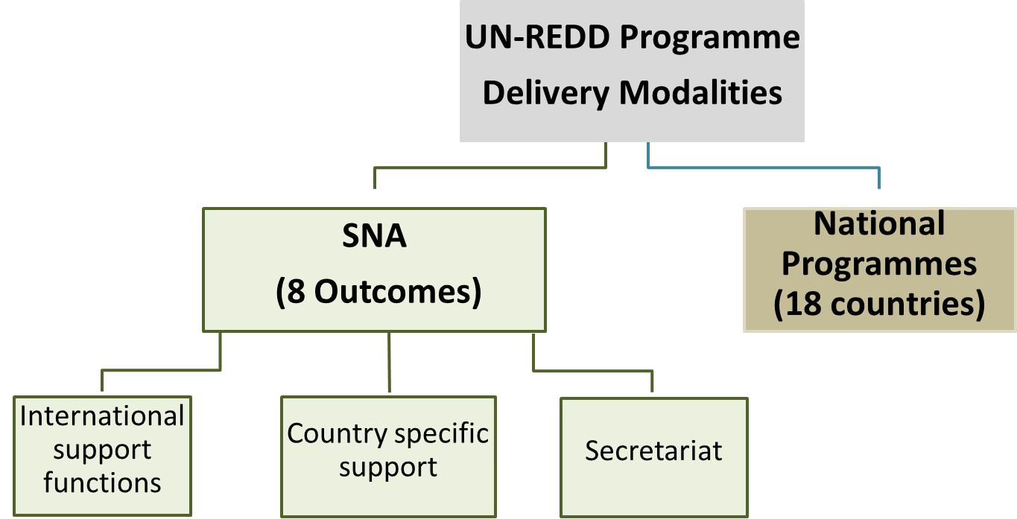
UN-REDD Programme Delivery Modalities

Slide 7
Structure of the Report: ANNEXES
12 Annexes for countries with National Programme
1 Annex for SNA achievements and progress
Provides detailed information per delivery modality in accordance with :
National Programme Planning, Monitoring and Reporting Framework
SNA (2011-2015) incl. Results and Monitoring Framework (Outcomes and Outputs)
List of activities of SNA available on Workspace

Slide 8
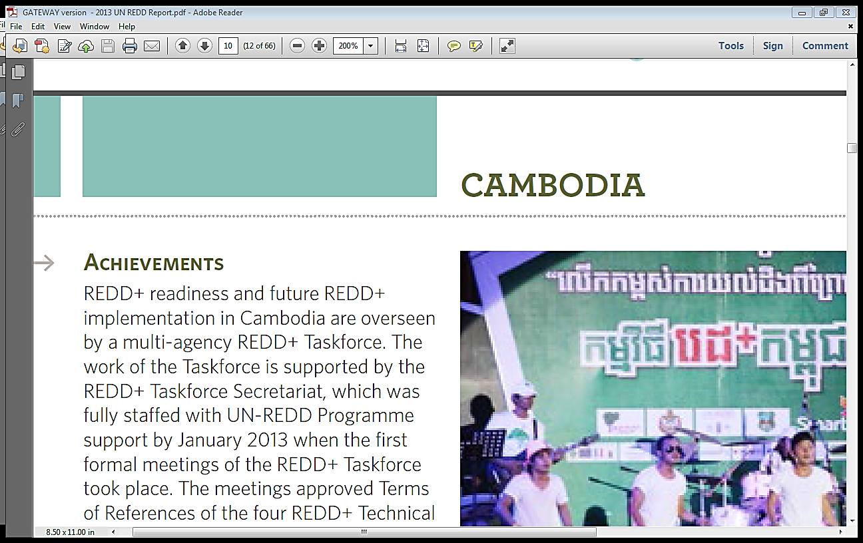
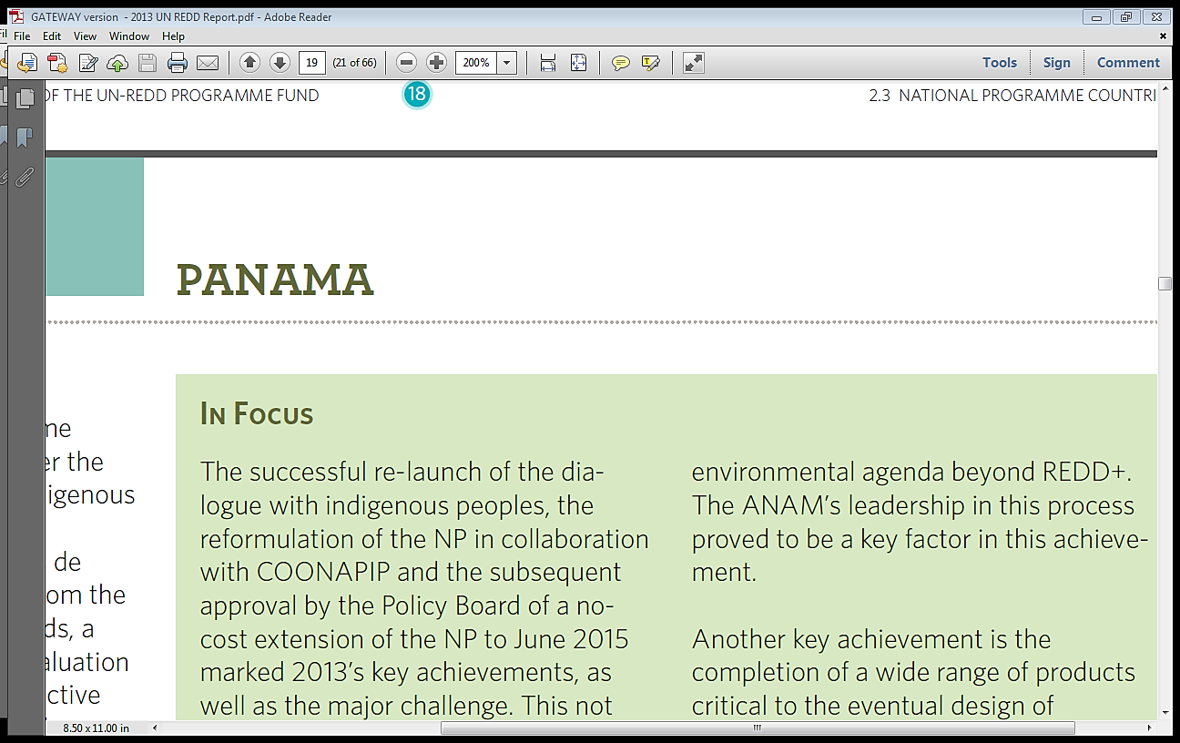
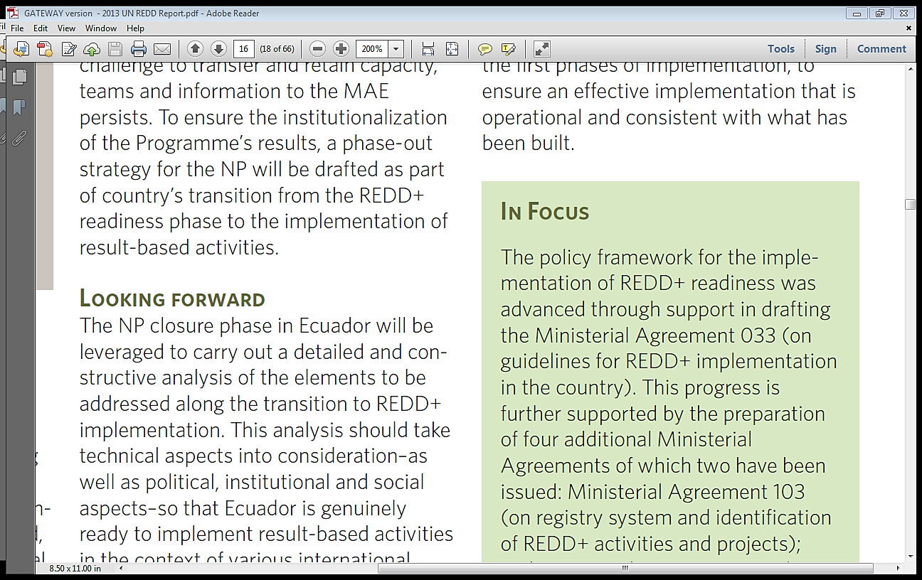
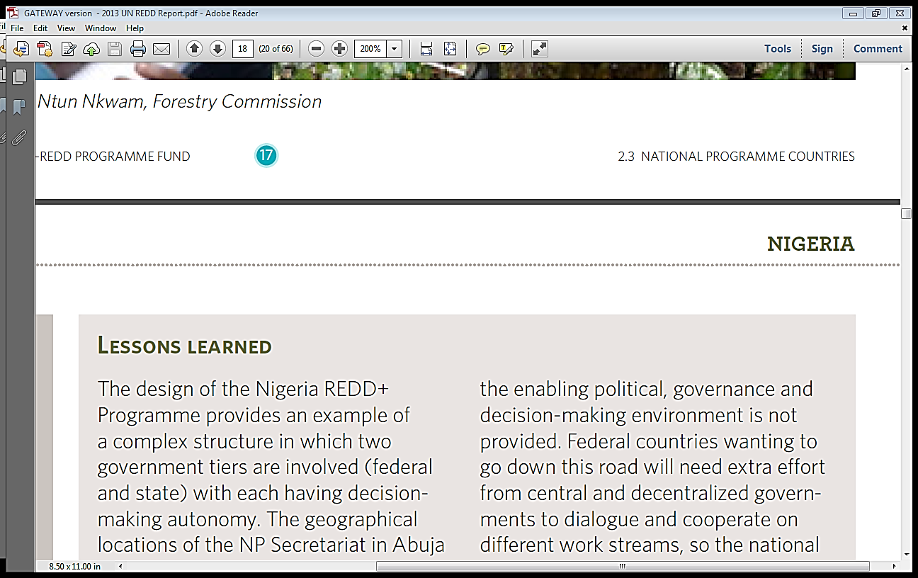
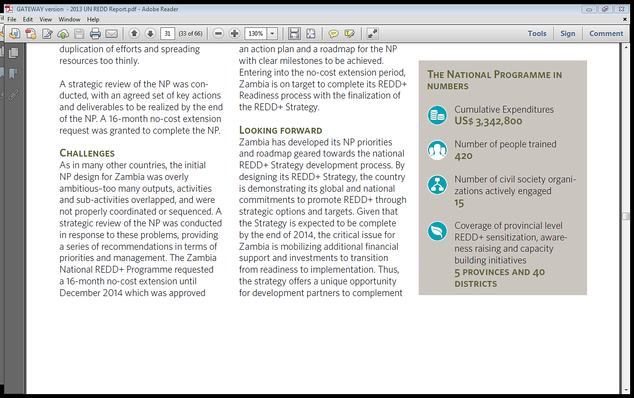
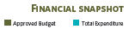
Content Structure
Improved design
Narrative, numeric and graphic presentation of information
Harmonized and coherent format across delivery modalities
Each country page and SNA Outcome page has same content structure:
Ensure consistency
Easy to find information
Allow to compare and draw analyses
Covers retrospective, current and future issues
Notes:
Country Pages and SNA Outcomes pages each has the following same content (the following two example slides on SNA Outcome 5 and Cambodia page shows the harmonized content structure):
Achievements
In Focus
Looking Forward
Lessons Learned
Challenges
Financial Delivery

Slide 9
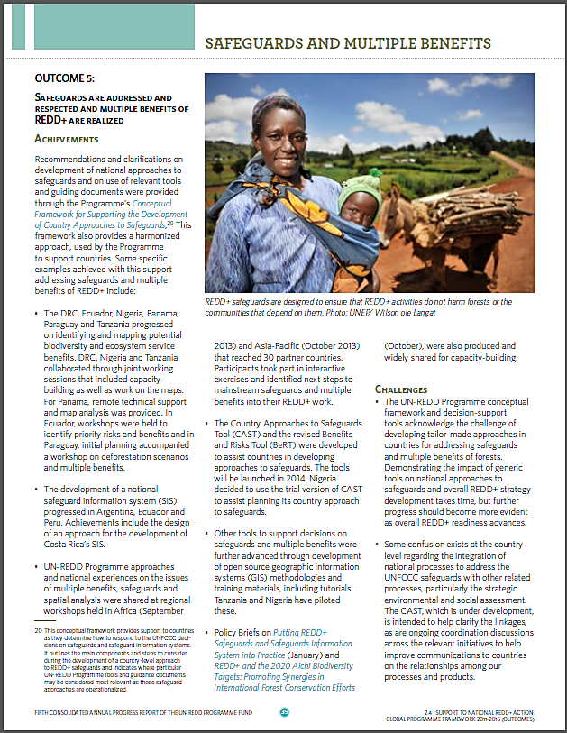
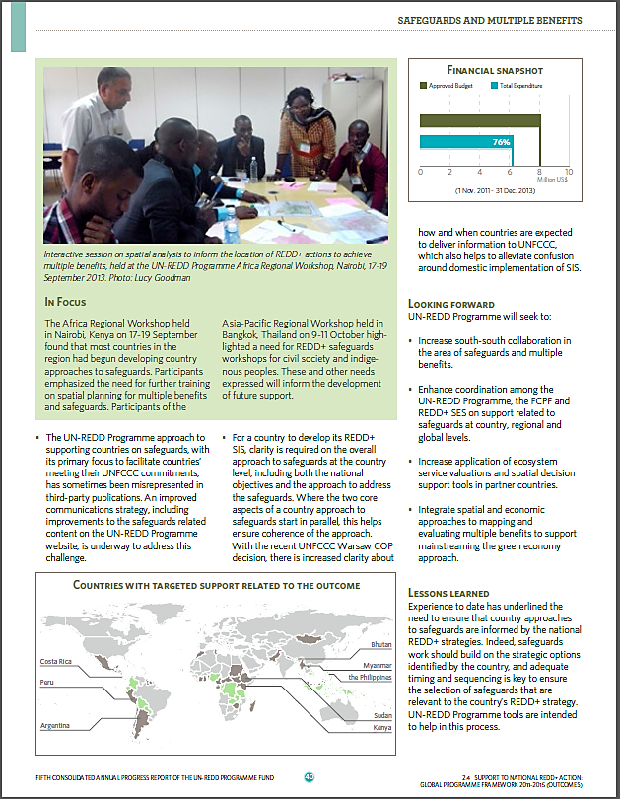
Example: SNA Outcome 5 Page
Notes:
This page shows an

Slide 10
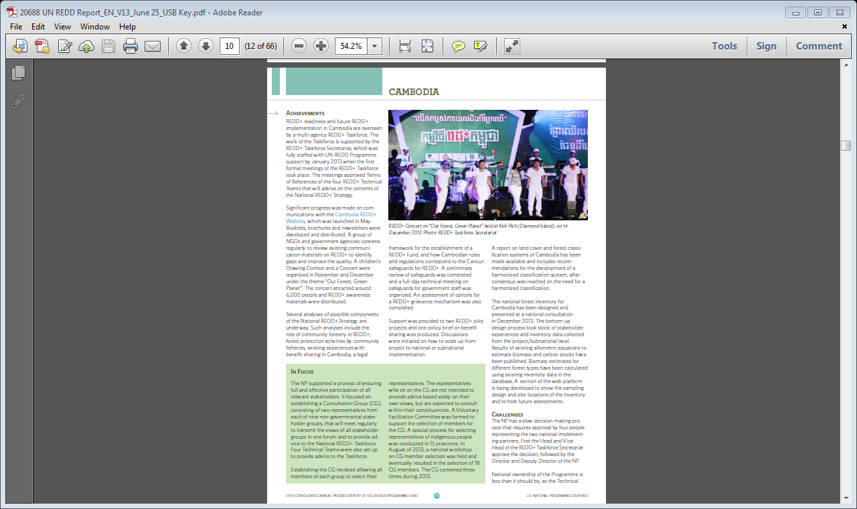
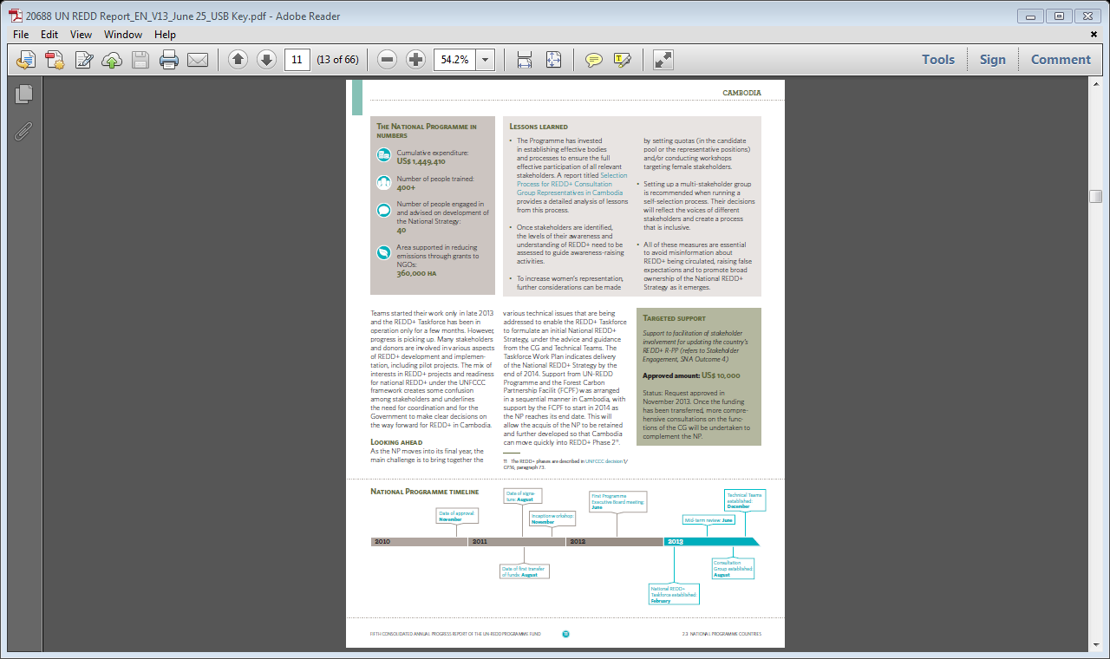
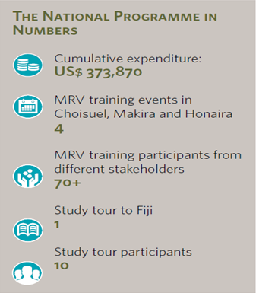
Example: Cambodia Country Page
Improved design
Narrative, numeric and graphic presentation of information
Condensed and concise information
Country pages have:
National Programme timeline to analyze progress and bottlenecks
Deliverables in numbers (expenditure, training, number of people involved, etc)
Notes:
These new features are being tested this year. E.g. categories for NP in Numbers include both harmonized categories (for comparabilty) and additional elements unique to each NP (richness in diversity). Seek PB feedback on this and whether we continue with the feature.
Entries for the timeline have been restricted to 4 per year of implementation of the NP, some e.g. Nigeria include milestones prior to NP initiation because of significance in relation to REDD+ (deforestation ban in cross river state), others include external factors (such as Paraguay that shows how changes in government influence NP implementation). The purpose of the timeline is to (i) identify incompressible processes and allow better planning for new NPs; (ii) demonstrate how progress evolves.
The timeline is shown in two colors, in blue the active year, in grey the previous years. Will be adjusted to show extensions. PB feedback on usefulness of this visual support is welcome.
Example of Solomon Islands: the National Programme in Numbers
Paraguay National Programme Timeline (example)

Slide 11
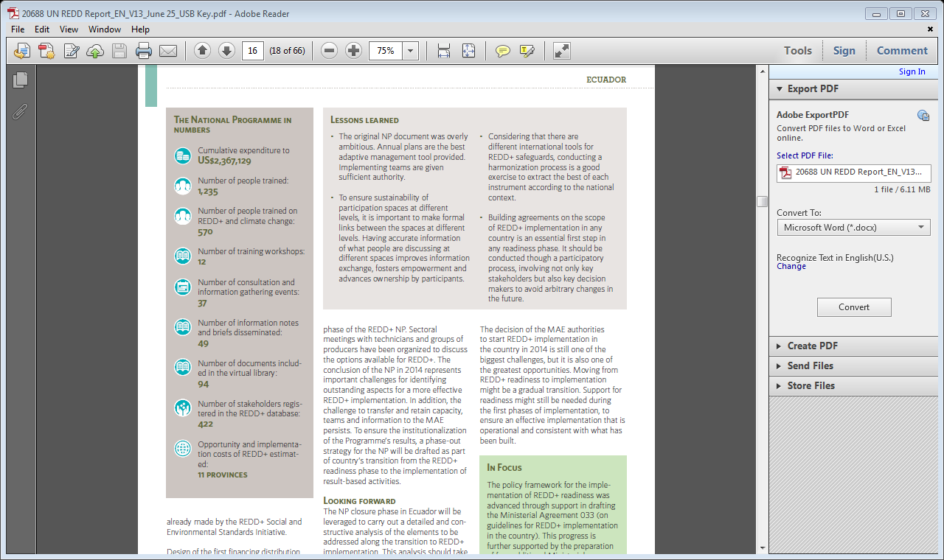
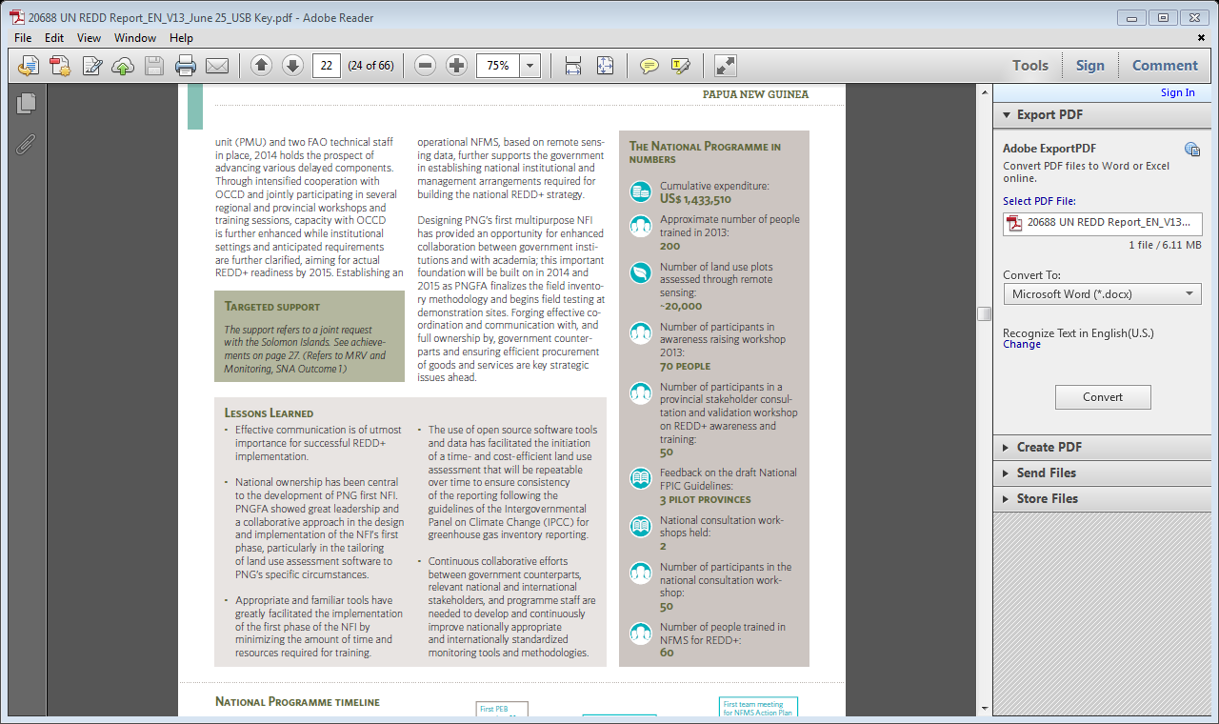
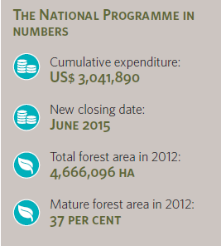
New Features: Country Pages
Country pages have:
National Programme in Numbers to allow to see impact and to make comparison.
Notes:
This slide shows how countries reported in the test round. Very different: Some one many items (Ecuador) and some only on 1-3 items (Bolivia only on expenditure).
This year, for the first time, as a test run, the countries are requested to provide deliverables of NPs in numbers. Each country page has a section on ‘The National Programme in Numbers’. Almost all countries reported on:
financial deliver in numbers,
number of training and
number of people trained.
Otherwise, in this test round, there is not harmonized reporting on deliverables in numbers.
Countries represented in boxes (from left to right) are: Panama (smallest one), Ecuador and PNG

Slide 12
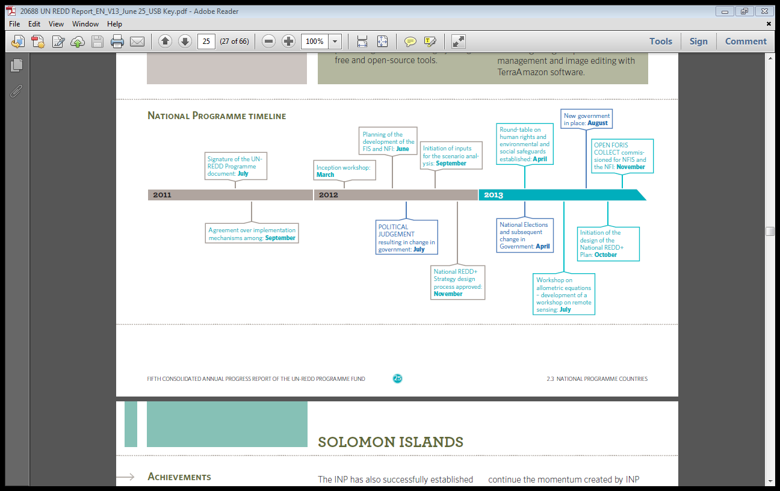
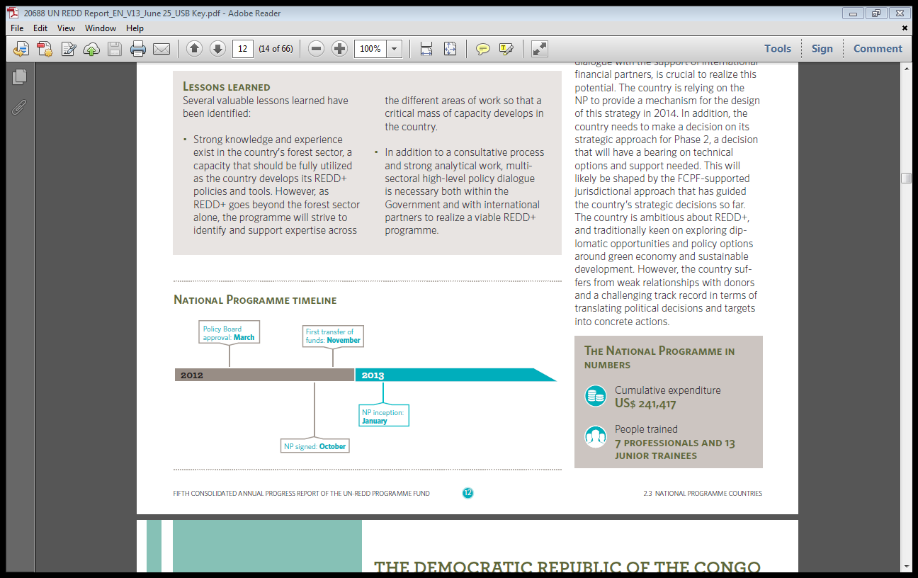
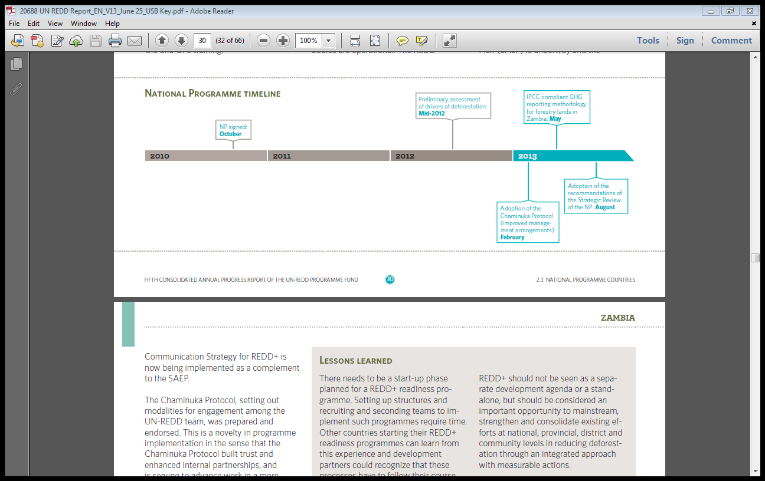
New Features: Country Pages
Country pages have:
National Programme Timeline to analyse progress and bottlenecks
Notes:
This slide also shows how countries reported differently in this test round.
Timelines selected as examples are (in order):
Paraguay
Republic of Congo
Zambia

Slide 13
2013 Annual Report
Highlights

Slide 14
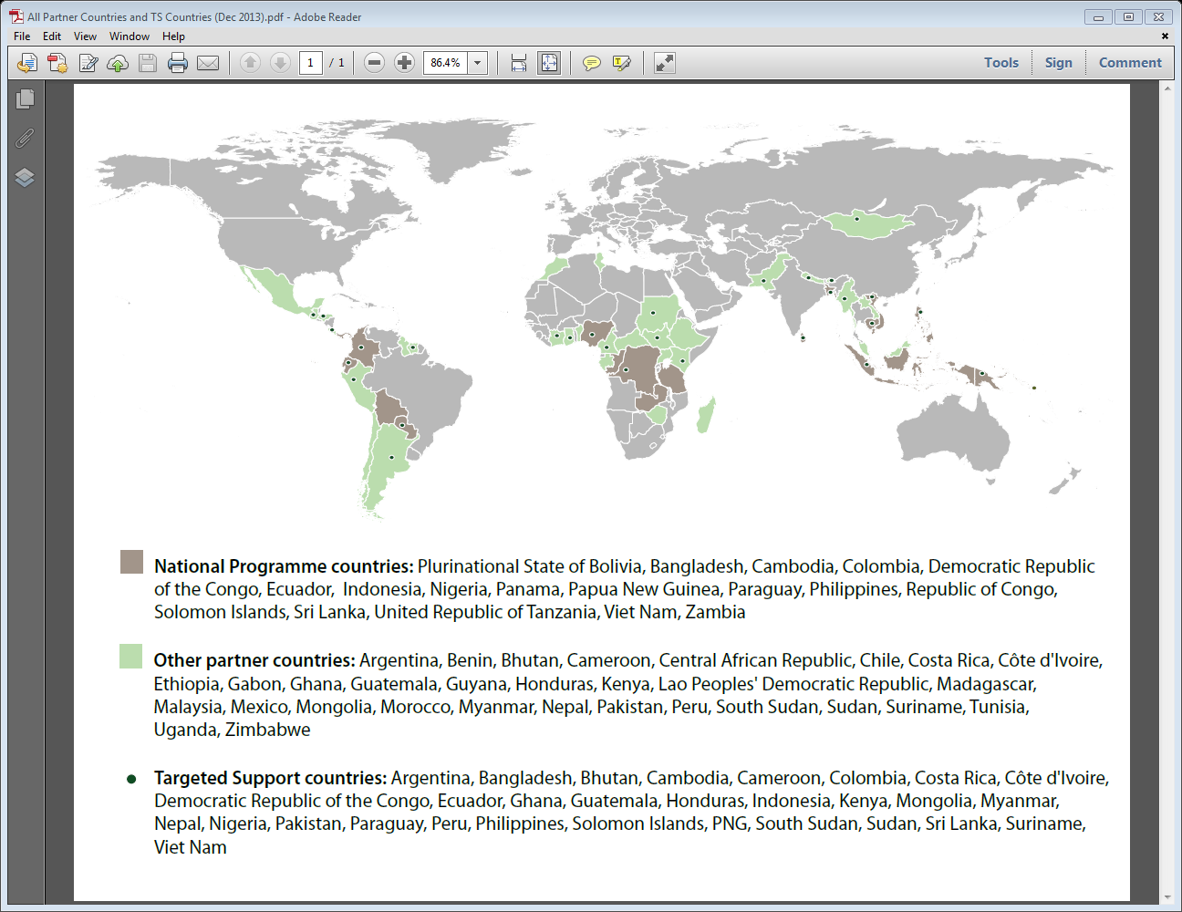
UN-REDD Programme Highlights
49 Partner Countries
3 new Partner Countries (Madagascar, Tunisia and Zimbabwe)
18 Countries with National Programme Other Partner countries
28 Countries with Targeted Support
37 Countries received backstopping
Notes:
New Partner countries as of December 2013. More have been added since.
18 countries with NP at all stages of implementation

Slide 15
Programme Highlights
5 year anniversary:
5 year stock-taking
Looking ahead post 2015
Expanded country focus:
Delivery modalities are more integrated and mutually complementary
Increased number of countries identifying needs and requesting support in their REDD+ efforts
US$ 60.9 million additional funding in 2013:
Denmark | EU | Luxembourg | Norway | Spain
US$ 1.8 m | US$ 11.7 m | US$ 2.6 m | US$ 42.2 m | US$ 2.4 m

Slide 16
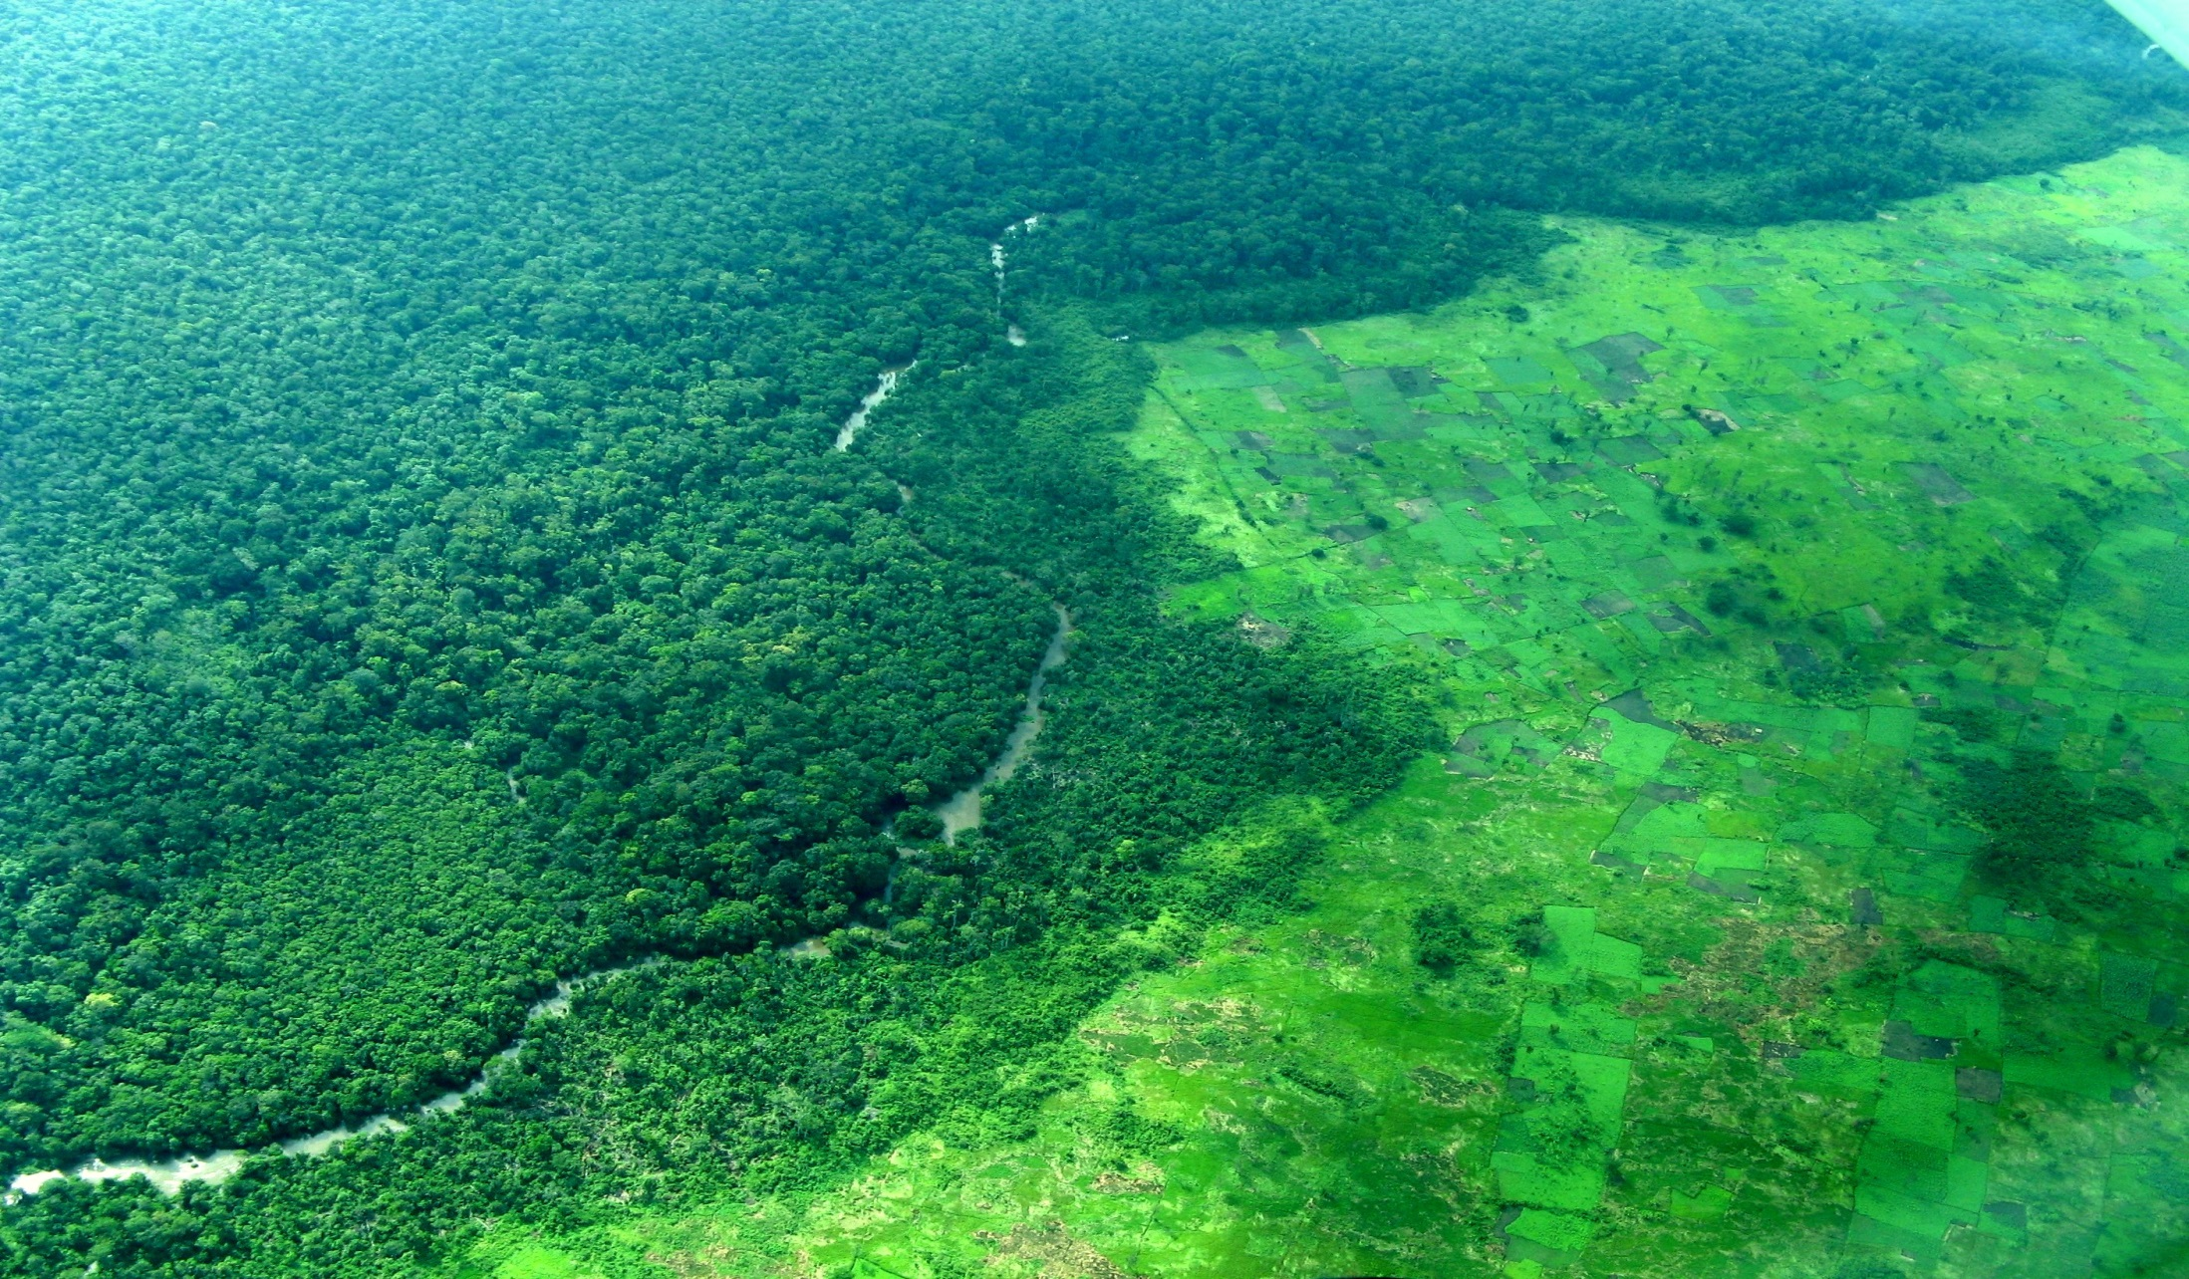
2013 Annual Report
SNA Highlights

Slide 17
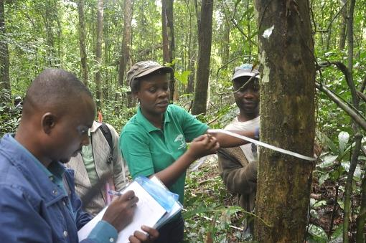
SNA Progress and Results
Countries significantly progressed on the NFMS pillars and MRV with enhanced knowledge and capacity in 17 countries with National Programmes and in further 12 countries with targeted support.
Increased and stronger Indigenous Peoples and civil society participation in REDD+ mechanisms and platforms; Strengthened in 15 countries and more than 2,900 country level stakeholders in 22 countries informed about REDD+ issues.
Notes:
2,900 country level indigenous peoples and CSO stakeholders.

Slide 18
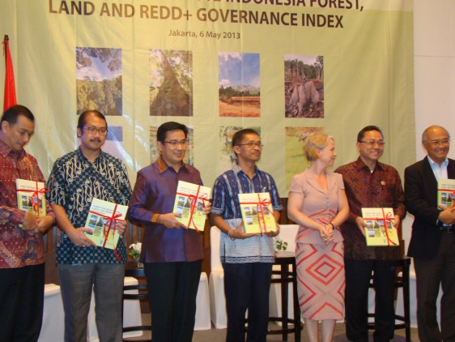
SNA Progress and Results
36 countries progressing towards credible and inclusive national processes to prioritise REDD+ governance issues.
Further insight on the complexity of tenure reforms and the country- specific nature of tenure systems through support to countries and development of the Policy Brief: Tenure and REDD+.
Countries conducted legal assessments to strengthen national legal frameworks for REDD+ (e.g. DRC and Kenya).
Strengthened institutional and fiduciary arrangements such as DRC’s development of its national REDD+ Fund.
Notes:
Extended support for REDD+ governance with 36 countries progressing towards credible and inclusive national processes to prioritise governance issues.
Further insight on the complexity of tenure reforms and the country- specific nature of tenure systems through support to countries and development of the Policy Brief: Tenure and REDD+ .
Countries conducted legal assessments, identifying opportunities to reforms and prioritising actions required to strengthen national legal frameworks for REDD+ (Ex. DRC and Kenya)
Strengthened institutional and fiduciary arrangements such as DRC’s development of its national REDD+ Fund.

Slide 19
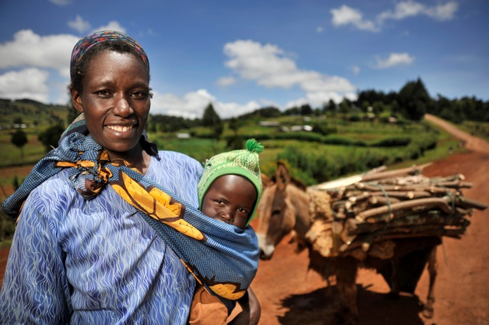
SNA Progress and Results
Important lessons learned from Panama for the Programme’s on-going work on grievance mechanisms. (Joint FCPF/UN-REDD Guidance Note on Strengthening Grievance Readiness Mechanism)
Recommendations and clarifications on development of national approaches to safeguards and on use of relevant tools through the Programme’s Conceptual Framework for Supporting the Development for Country Approaches to Safeguards.
Enhanced knowledge on green economy and wider interest in linking REDD with a wider transition to green economy:
- National validation of forest ecosystem services and options for investments developed and environmental economic accounting system piloted.
Notes:
Commenting on Panama: It will be important for Thais to highlight that this is one of the ways through which SNA draws on experiences of and supports NPs individually and then aggregately.
2,900 country level indigenous peoples and CSO stakeholders.

Slide 20
SNA Progress and Results
Independent evaluations coordinated by the Secretariat
Review of Policy Board structure.
Knowledge, learning and good practices synthesised and shared with south to south exchanges and several methodologies, approaches and guidance developed. For example:
Guidance note on Gender Sensitive REDD+
The Role of Private Sector in REDD+
Asia Pacific Lessons Learned Series,
NFMS and M & MRV in the Context of REDD
Activities, Sharing National Experiences in Strengthening Transparency, Accountability and Integrity for REDD+
See full list in Annual Report 2013.
Notes:
options for investments into sustainable landscapes developed.

Slide 21
SNA Challenges and Lessons Learned
Progress and sustainable results in areas such as MRV, stakeholder engagement and FPIC dependent on establishment of regional and national capacity
Engage in capacity building & in country activities.
Tailor the support to the country’s specific needs
Guiding frameworks and tools.
Different technical approaches co-existing at the national landscape due to multiple sources of support bring risks of overlaps and additional challenge of harmonization of approaches at country level.
Engage with other initiatives to build common understanding of differences in approaches and to promote harmonization as possible

Slide 22
SNA Overall Financial
Total allocation for SNA to up to 31 Dec 2014
(includes SNA 2014 budget revision approved at PB11): US$ 98 m
Total amount approved for SNA as to 31 Dec 2013: US$ 49.2 m
Total SNA cumulative expenditure: US$ 39.2 m

Slide 23
SNA: Financial Delivery
Overall financial delivery rate (from approved): 80%
Delivery per SNA OUTCOME:
Outcome 1. MRV and Monitoring 97%
Outcome 2. Governance 81%
Outcome 4. Stakeholder Engagement 45%
Outcome 5. Safeguards and Multiple Benefits 76%
Outcome 6. Green Economy 79%
Outcome 7. Knowledge and Capacity 95%
Outcome 8. Secretariat 97%
Notes:
The delivery rate of Outcome 4 without the extra funds agreed upon in June 2013 for Output 4.6 is 95 per cent. However low expenditure in Output 4.6 has resulted in a lower overall delivery rate of 45 per cent for the Outcome for 2013. See “Challenges” section.

Slide 24
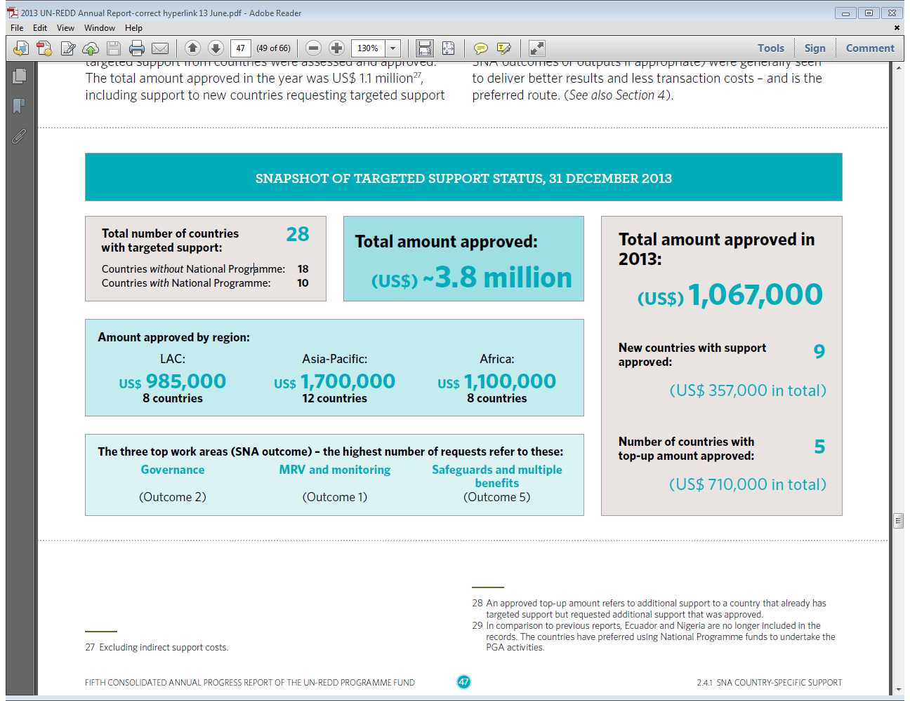
Targeted Support
(excluding Backstopping)

Slide 25
2013 Annual Report
National Programme Highlights

Slide 26
National Programme Highlights
2 new countries with NP Colombia and Bangladesh
3 NPs completed and evaluated Indonesia, Tanzania and Viet Nam (in 2012)
2 NPs closed and to be evaluated in 2014 DRC and the Philippines
3 No-cost extensions (PNG, Zambia and Ecuador)
4,458 (approximately) people trained

Slide 27
National Programme Highlights
DRC adopted its REDD+ National Strategy and established National REDD+ Fund.
Cambodia, Republic of the Congo, Paraguay and Zambia are developing their National REDD+ Strategies and advanced on key analyses such as drivers of deforestation, cost-benefit, role of private sector, economic value of forest, etc.
Nigeria, PNG, Paraguay and Zambia are advancing on creating online remote sensing NFIs that will allow obtainig data and reporting on emissions and removals.
Bolivia re-designed its NP (outcomes, workplan and budget) in line with its ‘Joint Mitigation and Adaptation Mechanism for the Sustainable Management of Forests and of Mother Earth’.
Notes:
Countries were asked to single out one achievement that they consider significative within their respective NPs. This slide provides few examples from ‘In Focus’ boxes grouping them thematically.
Extract from the Annual Report
Cambodia: The NP supported a process of ensuring full and effective participation of all relevant stakeholders. Established Consultation Group that has representatives of non-government stakeholders selected through self-selection procedure.
Paraguay: established the unique national model through which participation from key groups is facilitated. The NP is implemented through three bodies: two public sector institutions–Ministries of Environment and the National Forestry Institute, and the Federation for the Self-Determination of Indigenous Peoples.
Solomon Islands: The most outstanding achievement of the NP has been the establishment of multi-sectoral and multi-stakeholder bodies–National REDD+ Readiness Taskforce and Working groups–to guide the development of the National REDD+ Readiness Roadmap and technical guidance notes. These bodies also actively led the awareness-raising activities and invested in their own capacity development to ensure the soundness of their guidance and leadership in the national REDD+ readiness process.
Sri Lanka: The creation of a Civil Society Platform, as one of the first activities under the NP, was received positively. This Platform gives civil society organizations the means to develop and deliver focused and coordinated inputs to forest policy and decision-making processes at the national level. Indigenous Peoples’ Forum established
-------xxx------
DRC: a robust REDD+ National Strategy was validated by the Council of Ministers and presented to the international community at the UNFCCC. A national REDD+ Fund, designed in a collaborative way with the Government and donors, has been established.
-------xxx--------
PNG: initiated the process of designing PNG’s first multipurpose NFI. Once implemented, this NFI will allow PNG to report nationally generated data on emissions and removals from the land use and forestry sector to the UNFCCC through its GHG inventory.
Paraguay: The National Forest Information System (NFIS) and the NFI were started using the Open Foris Collect database. By the end of A variety of maps were developed, including accessibility to forests, distribution of 60 sampling units, deforestation (years 1990-2011), and forest dynamics as well as base maps of protected areas, eco-regions, wetlands, river networks, population density and roads.
Zambia: A web portal is under development that will provide an interface for a wide range of information and data sets related to NFMS, REDD+ activities and relevant safeguards. The portal will feature a REDD+ Wiki/ Database. The information includes land cover classification efforts that estimate land uses in 1990, 2000 and 2010 and greenhouse gas emission data that help identify components for the country’s greenhouse gas inventory. The web portal will be launched by the first quarter of 2014 but a beta-version is available.

Slide 28
National Programme Highlights
Cambodia, Republic of the Congo, Paraguay, Solomon Island and Sri Lanka established structures for more inclusive and effective participation of key stakeholders in national REDD+ processes and progresses.
Ecuador and Zambia advanced on creating an enabling legal and policy environment for REDD+ implementation.
Nigeria has developed an adequate approach to foster coherence between the federal and state level (Cross River State, first pilot state) implementation of REDD+.
Panama succeeded in revising and re-launched its NP following active dialogues and agreement between the Government and COONAPIP.

Slide 29
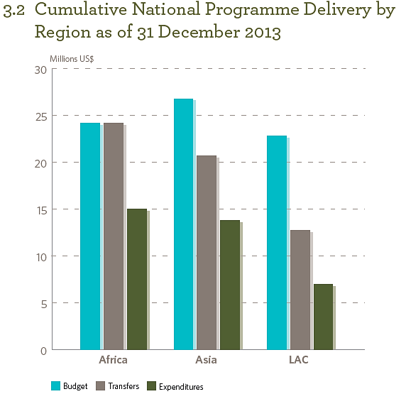
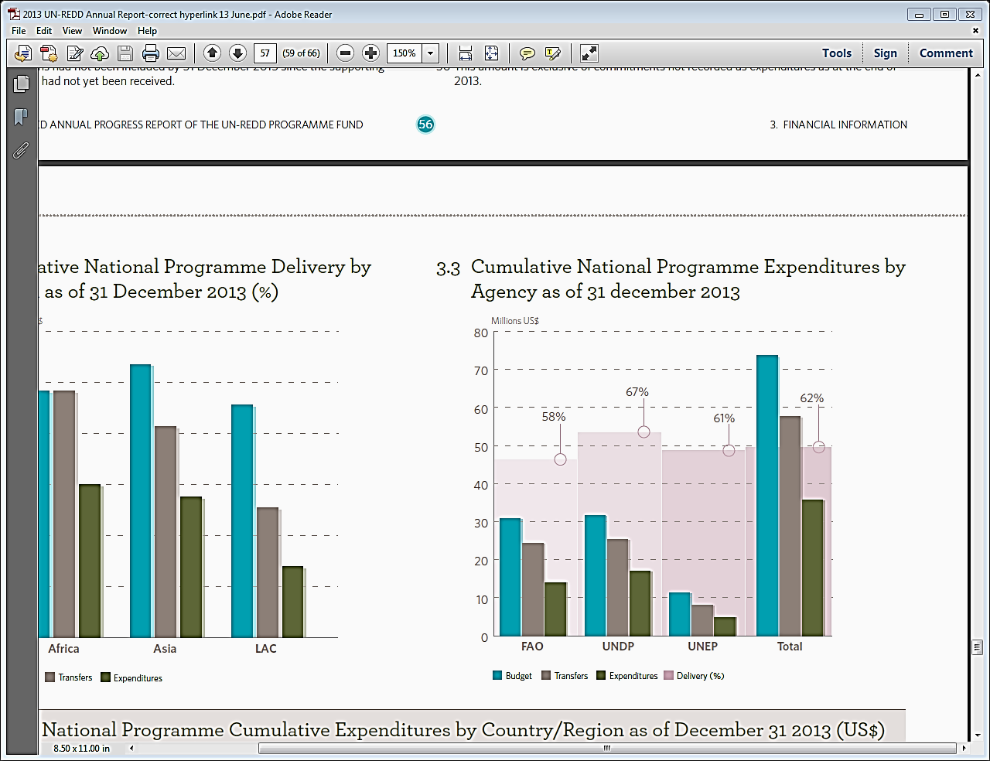
National Programme Financial
Total amount approved for NP: US$ 73.6 million
Total cumulative expenditure for NP: US$ 35.7 million
Overall financial delivery: 62%

Slide 30
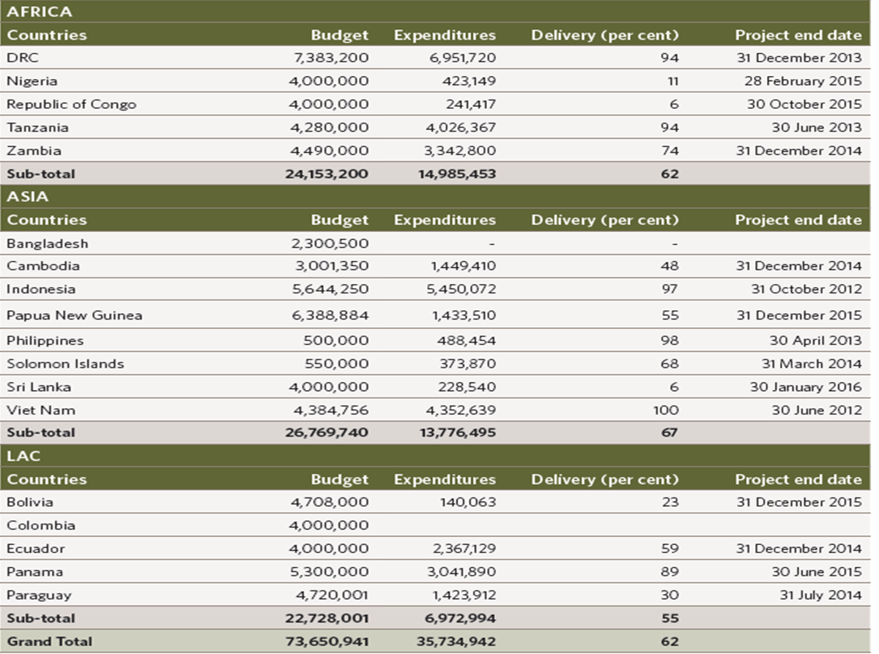
National Programme Financial

Slide 31
National Programme
LESSONS LEARNED
3 year implementation period is not sufficient:
On average NP implementation, from inception to operational closure, is 4 years.
Slow start up due to the following (most reported) reasons :
Lack of qualified personnel
Takes times to establish the NP institutional infrastructure and team (e.g. Nigeria)
NPs need to adjust to dynamic institutional settings at national level (e.g. Cambodia)
Closure of NP is not equivalent to completed readiness (e.g. DRC and Ecuador):
Transition along REDD+ phases is not linear but iterative
Continued support needed to countries completing NPs
Notes:
Nigeria - Challenges
NP implementation faces delays due to a longer than anticipated inception process. The NP Steering Committee convened only in the 2nd quarter of 2013 (note: NP approved mid 2011). Further, the national REDD+ team required time and training to adopt and integrate UN-REDD Programme funding and implementation procedures
Cambodia - Challenges
The NP has a slow decision-making process that requires approval by four people representing the two national implementing partners. First the Head and Vice- Head of the REDD+ Taskforce Secretariat approve the decision, followed by the Director and Deputy Director of the NP.
---------XXXX---------
DRC - Challenges
The institutional arrangements for the transition from REDD+ readiness to REDD+ implementation are yet to be defined and represent a challenge. In particular, there is no real experience on how to better support an institutional transition from readiness to implementation, partly because readiness and implementation are likely to overlap for a certain period of time.
Ecuador – Challenges
The conclusion of the NP in 2014 represents important challenges for identifying outstanding aspects for a more effective REDD+ implementation. In addition, the challenge to transfer and retain capacity, teams and information to the MAE persists. To ensure the institutionalization of the Programme’s results, a phase-out strategy for the NP will be drafted as part of country’s transition from the REDD+ readiness phase to the implementation of result-based activities.

Slide 32
National Programme: Lessons Learned
Under estimation of REDD+ complexity
Over ambitious design of the NP (e.g. Ecuador and Zambia )
NP design and planning must be carefully assessed, and adjusted to match national capacity and needs:
Comprehensive readiness support is not warranted
Many other players providing readiness and REDD+ support
Need to correspond to country’s needs and progress on readiness
Need more flexible programming and adaptive management:
accomodate changes of circumstances and of counterparts during the lifetime of a NP (Bolivia and Paraguay)
Notes:
- Under estimation of REDD+ complexity – please make a link and reference to other presentations from previous sessions (e.g. evaluation and strategy) that discuss the same issue.
Ecuador – Lessons Learned
The original NP document was overly ambitious. Annual plans are the best adaptive management tool provided. Implementing teams are given sufficient authority.
Zambia – Challenges
As in many other countries, the initial NP design for Zambia was overly ambitious–too many outputs, activities and sub-activities overlapped, and were not properly coordinated or sequenced. The Zambia National REDD+ Programme requested a 16-month no-cost extension until December 2014.
Paraguay – In Focus
During three years of implementation of the NP, the greatest achievement lies in the reaffirmed commitment of all parties to continue striving towards the common goal of preparing the country for REDD+ processes. In view of the changes in government and periodic changes in the members of all parties to the programme (except for FAPI), this is an achievement to be recorded permanently.
Bolivia
Bolivia National Programme (NP) was initially signed in October 2010. Government’s subsequent request to change the NP objectives, scope and activities, focusing the NP only on the most technical activities linked to the NFMS and the related technical support from FAO. The Policy Board was promptly informed and an intense dialogue with the Government followed, resulting in the re-planning of the Programme, its budget, and participation of UN agencies. It is also important to note that during 2012 and 2013 the country undertook a major revision of its institutions and authorities dealing with environment and forests and the NP will align to these as they are finalized. It is expected that 2014 election will affect the composition of counterparts.

Slide 33
National Programme
Challenges and Strategic Issues
Over the course of 2013, National Programmes reported on following challenges and important issues:
the critical value and time requirement of broad based consultation
emerging need to define the scope of REDD+ with proper analyses of drivers of deforestation and delineation of a REDD+ vision for the country
more realistic expections on technical dimensions such as MRV
finding right balance among coordination, harmonization, alignment and technical integrity of the UN-REDD Programme and other initiatives providing similar supports
As many donors moving towards performance-based payments countries feel pressure to fast-track meeting of performance requirements.

Slide 34
Decision Proposed
The Policy Board takes note of the update of the Funding Framework of the UN-REDD Programme Fund and approves the 2013 Annual Report of the UN-REDD Programme Fund.

Slide 35
PB12 SURVEY
Your feedback on the Policy Board meeting and 2013 Annual Report is invaluable
12th UN-REDD Policy Board Feedback Form Lima, July 2014
English: https://www.surveymonkey.com/s/UNREDD_PB12_EN
Français: https://www.surveymonkey.com/s/UNREDD_PB12_FR
Español: https://www.surveymonkey.com/s/UNREDD_PB12_ES
Notes:
We would encourage participants to complete the survey online and the participants will receive an email immediately after the meeting.

Slide 36
Thais Linhares-Juvenal
Thais.Juvenal@un-redd.org
Mirey Atallah
Mirey.Atallah@-un-redd.org
Thank You
Website: http://www.un-redd.org

Slide 37
DRAFT WORK SLIDES FOR LATER DELETE

Slide 38
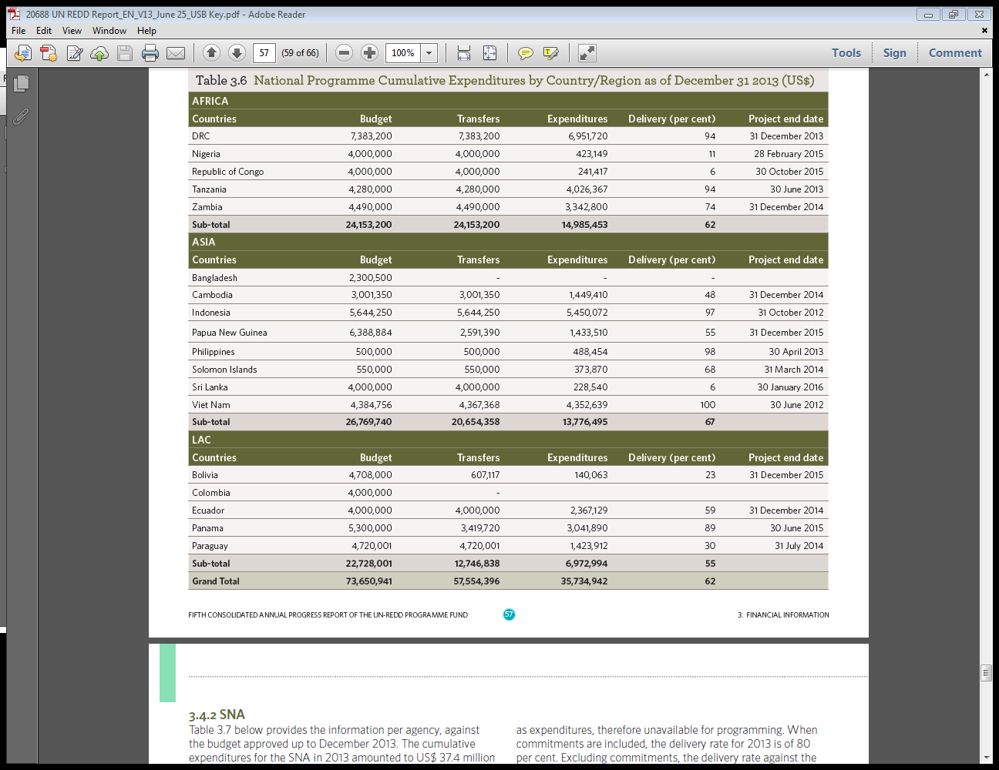
Notes:
Sri Lanka Country Page – integrated reporting on all support provided by the UN-REDD Programme. Not just the NP but also TS under the SNA.

