Slide 1
Financial Status of the UN-REDD Programme Fund
Lima, Peru
8 July 2014

Slide 3
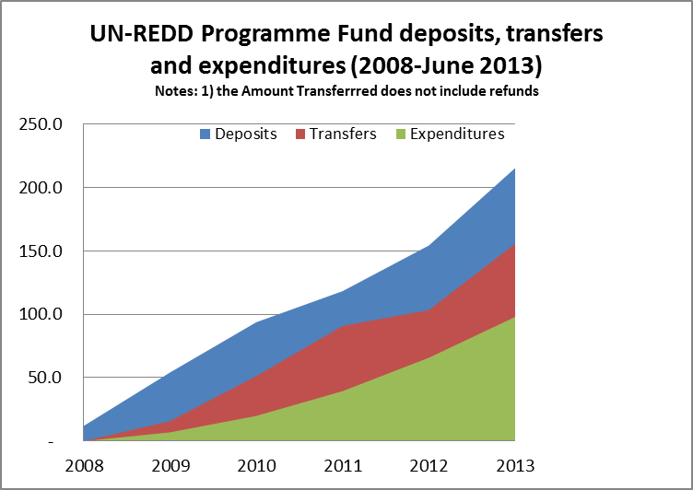
2013
Commitments: US$60m
Deposits: US$ 60m
Transfers: US$ 52m
Expenditures: US$ 32m

Slide 4
UN REDD Deposits, Transfers and Expenditures 2008-2013

Slide 5
Oversight System
Policy Board
Monitoring activities
Programme Implementation
Programme Approvals
Reporting

Slide 6
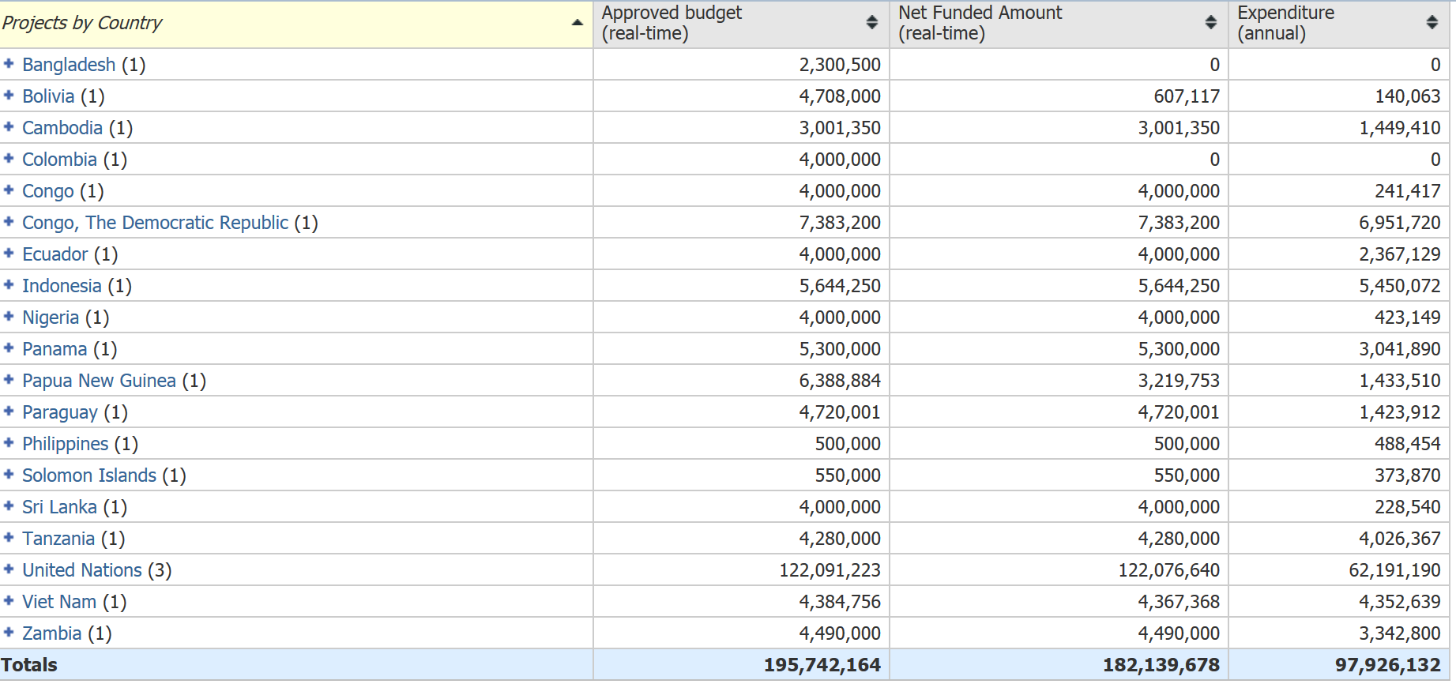

Slide 8
Funds Available for Programming

