Slide 1
UN-REDD Programme
Overview of Progress
Twelfth Policy Board meeting
Lima, Peru
8-9 July 2014

Slide 2
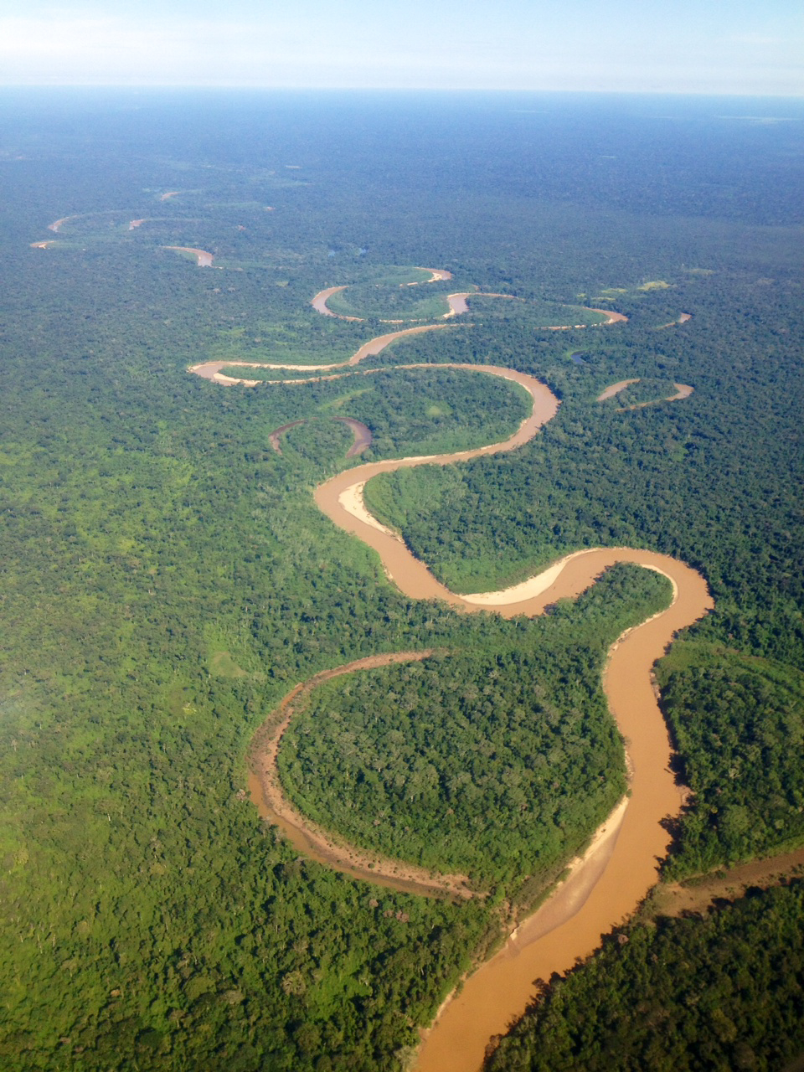
Programme Progress since PB11

Slide 3
Overview
since PB11
Eleventh Policy Board
Key Decisions
Bangladesh’s fund allocation request of US$ 2.3 million for its National Programme approved
Proposed changes to and no-cost extension of Panama’s National Programme approved until June 2015, leading to reopening of Panama’s National Programme
Decision on the Review of the Policy Board Structure:
Rotation of countries: 2 new members per region at PB12
Sponsorship of observers : 2 country observers per region at each PB
Agreed process for development of SNA workplan and budget
Agreed roadmap for dealing with ‘longer term’ issues in 2015
2014 SNA Work Plan and Budget revision of US$ 24.7 million approved
Notes:
Can also mention:
- Independent evaluations of Indonesia and Tanzania’s NPs
Argentina and Cote D’Ivoire gave progress update re R-PP and presented estimated budget needs
SNA workplan and budget: budget revision of US$ 24.7 resulting from additional NOR funding. Main objectives:
enhance backstopping to National Programmes
increase the funds available for targeted support
strengthen work on private sector engagement
strengthen knowledge management
improve the efficiency and timeliness of Secretariat services.
Two new outputs: Output 7.3 “Design, develop and deliver a REDD+ Academy with associated resources and tools for REDD capacity development”
Output 8.7 “Secretariat effectively provides for country leadership towards (Including individual country needs assessments covering all six SNA work areas)
The percentage of the overall budget allocated for country specific support under the budget revision would rise from 55 per cent to 64 per cent in comparison with the original budget for 2014.

Slide 4
Overview
since PB11
Inter-sessional decisions
Decision 30 – Malawi accepted as a partner
Decision 31 – Colombia no-cost extension
Decision 32 – Guinea Bissau accepted as a partner
Decision 33 - the Republic of Equatorial Guinea and the Republic of Chad accepted as partners
Notes:
Now 53 partner countries

Slide 5
Overview
since PB11
Highlights of Progress
Panama’s National Programme resumed implementation
A 19 point agreement beyond the UN-REDD was signed between ANAM and the traditional indigenous authorities
COONAPIP was integrated into the national UN-REDD steering committee as a full member with full rights
Notes:
The main progress was the signing of an agreement between ANAM and the traditional indigenous authorities.
It is remarked that the signing of this agreement goes beyond the UN-REDD framework and integrates 19 points proposed by indigenous peoples that aim to safeguard their culture, rights and territories.
COONAPIP was integrated into the national UN-REDD steering committee as a member with full membership rights.
The CBR+ process has been initiated in Panama with full ownership of indigenous peoples, civil society, and government and takes the name of “Bosques de Vida” in Panama, aiming to develop intergenerational capacities: as it is the responsibility of this generation to maintain life in the forests for the generations to come.

Slide 6
Overview
since PB11
Highlights of Progress
Regions completed rotation of seats: 6 new country members
Regional capacity building workshops (May 2014)
Learning from delivery
  Completion of Programme Evaluation
  Launch of 5 Year Report (2008-2013): On the Road to REDD+
Notes:
Highlights of progress: starting with the UN-REDD Programme…
New member countries:
LAC: Honduras & Argentina
Africa: Cote D’Ivoire & Republic of Congo
AP: Sri Lanka & Bangladesh
Evaluation: will be talking more about later in the morning
On the Road to REDD+: The UN-REDD Programme's Support to REDD+ Readiness 2008-2013
This report highlights the achievements and challenges of the UN-REDD Programme during its first five years (2008-2013) in an evolving REDD+ landscape.
And now starting to think about Development of the Programme Strategy beyond 2015:
Based on outcomes and recommendations from the Programme Evaluation
(and other lessons learned and inputs – can mention the Transparency International assesment)
Transition to a new strategy that incorporates Cancun Agreement and Warsaw Framework

Slide 7
Overview
since PB11
Highlights of Progress
Announcement of The East Africa Initiative on Illegal Timber Trade and REDD+ that unites Kenya, Uganda and Tanzania
Support for the preparation of the Secretary General’s Climate Summit 2014 and the preparatory Abu Dhabi Ascent
Ongoing upgrade of information communications technology platforms, with launch of new collaborative online platform for knowledge sharing (expected August 2014)

Slide 8
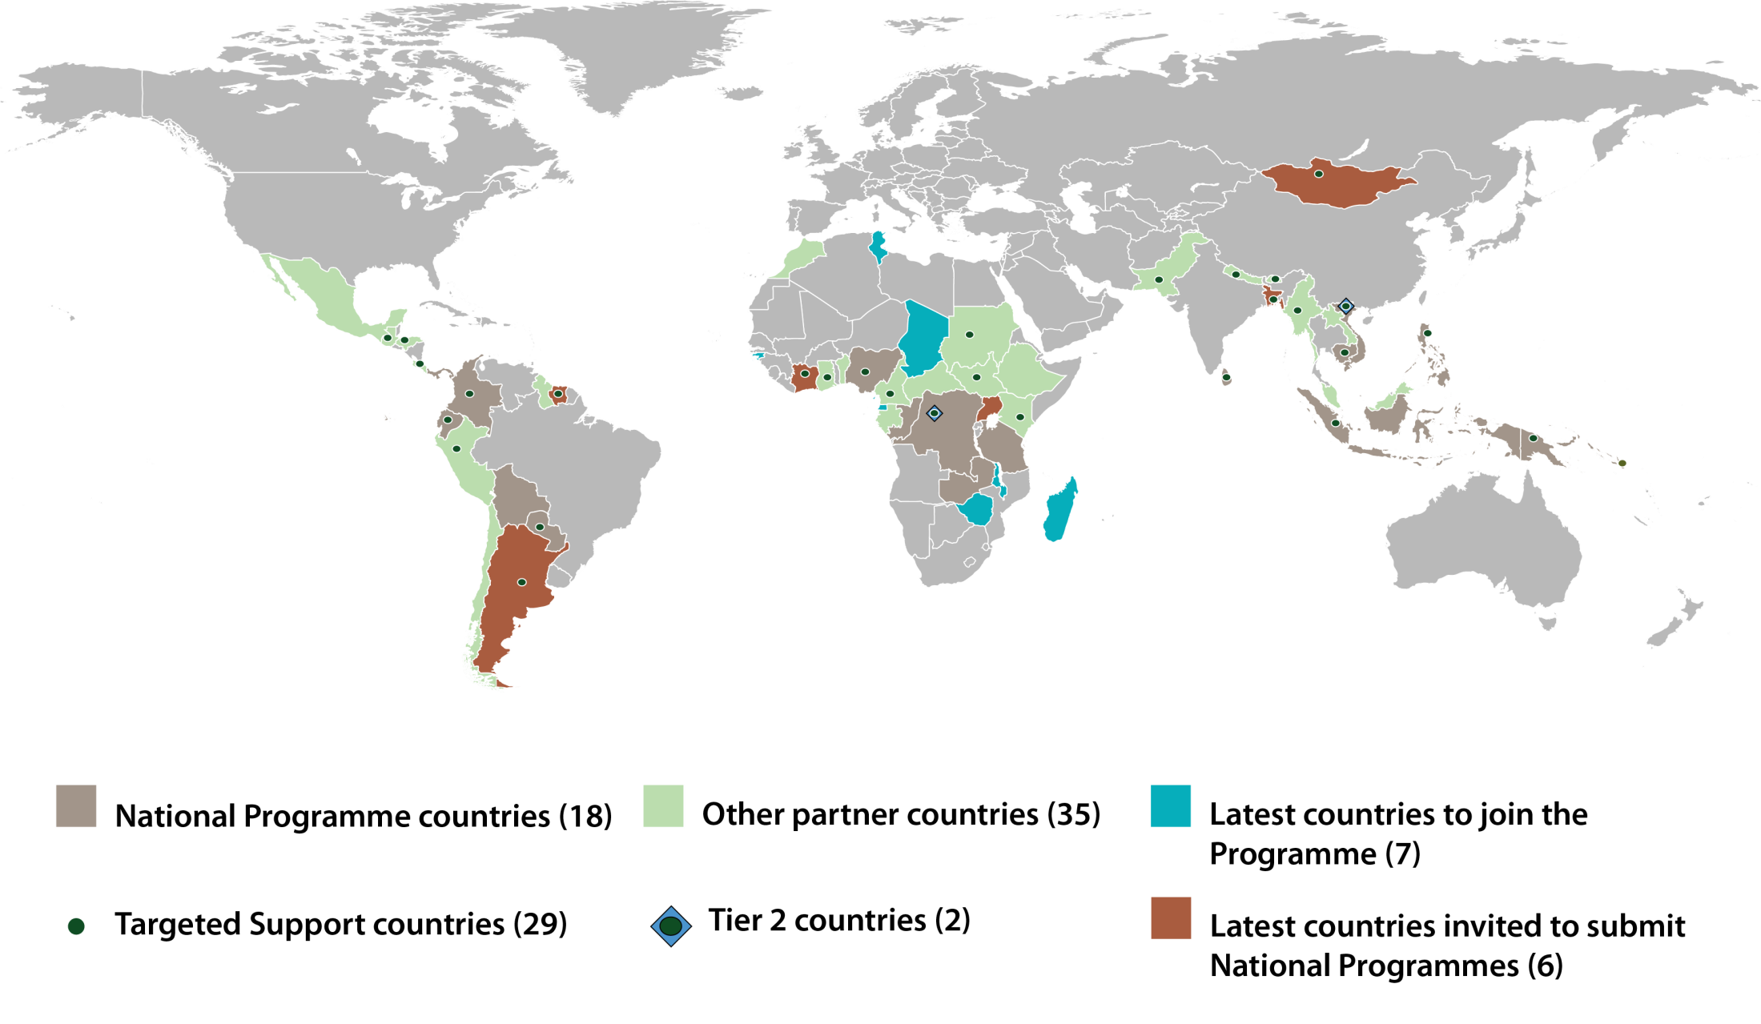
Overview
since PB11
Notes:
With the 4 new countries (Malawi, Guinea Bissau, the Republic of Equatorial Guinea and the Republic of Chad), now have 53 partner countries

Slide 9
SNA Progress Update

Slide 10
Overview
since PB11
Key Decisions on SNA
Work plan and budget revision of 2014 approved at PB11 provided the following novelties to SNA:
  Strengthened support to private sector engagement through partnership with UNFI and the UNDP’s Green Commodity Facility
  REDD+ Academy
  Country Needs Assessment
  Increased provision of support through Targeted Support

Slide 11
Overview
since PB11
SNA Progress Update
CBR+: invitation to pilot countries and national workshops for setting up steering committees and strategy for delivery – The CBR+ process was initiated in Panama
REDD+ Academy Design Workshops conducted
PGA Practical Guide updated and launched on 17 June, Oslo
8 countries (+ Pacific Islands) submitted targeted support requests - approved for a total amount of US$ 4.7 million
UN-REDD Country Approach to Safeguards Tool – CAST
Significant safeguards advancement in Costa Rica, Ecuador and Papua New Guinea
Notes:
:Oslo-based REDD+ and governance actors and relevant Norad and NICFI staff were invited
PGA coordinators from Indonesia, Nigeria and Vietnam presented from their experience with piloting the PGAs: key findings, challenges and the anticipated use and preliminary results (mostly from Indonesia).

Slide 12
Overview
since PB11
SNA Progress Update
Kenya published its legal framework for REDD+ and recommendations for legal reforms
Panama analyzed policy options for achieving zero net emissions from the forestry sector and carried out national forest ecosystem valuation study
Enhanced UN-REDD Annual Report following results based approach and focusing on achievements, assessment of progress and lessons learned

Slide 13
National Programme
Progress Update

Slide 14
Overview
since PB11
NATIONAL PROGRAMMES

Slide 15
Overview
since PB11
NATIONAL PROGRAMMES
Possibility of further harmonizing of UN-REDD and FCPF reporting towards streamlining at country level and synchronizing were explored where possible:
Agreed to synchronize timing: March 15 (annual report) and August 15 (semi annual update) as common deadlines for country progress reports (beginning August 2014).
    Content of FCPF and UN-REDD reporting templates harmonized:
    Concluded that it is not resource effective to harmonize reporting templates
    FCPF and UN-REDD country programs reports cross-checked for overlaps:
    FCPF FMT and UN-REDD Programme Secretariat will work together with countries to come up with a reporting approach that minimizes effort at the country level.
Notes:
Explored the possibility of further harmonizing FCPF and UNREDD- towards streamlining country level reporting
Assessed the various country reporting requirements and synchronize where possible
Agreed to synchronize timing of country reports: Not withstanding UN-REDD reporting on calendar year cycle, & FCPF on fiscal year, agreed on March 15 (annual report) and August 15 (semi annual update) as common deadlines for country progress reports (beginning August 2014).
Analyzed content of FCPF and UN-REDD reporting templates
Agreed on a proposed way forward
Conclusion: it is not resource effective to harmonize reporting templates
For those countries with FCPF and UN-REDD program reporting requirements, the FMT and UN-REDD Programme Secretariat will work together with those countries to come up with a reporting approach that minimizes effort at the country level. For example, on a case by case basis, introducing flexibility to cross-reference and/or adapt the reporting template to meet a country’s circumstances.

Slide 16
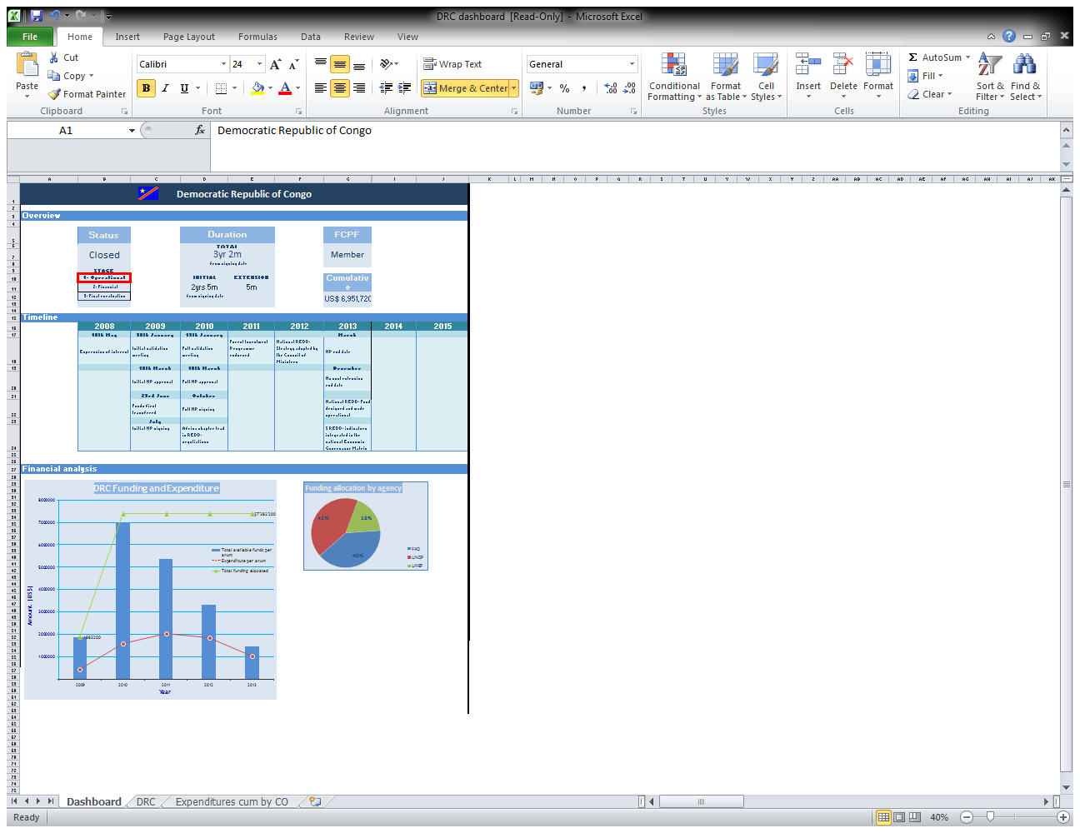
Overview
since PB11
NATIONAL PROGRAMME
Dashboard
Overview
Timeline
Financial performance

Slide 17
Mario Boccucci
Mario.Boccucci@un-redd.org
Thais Linhares-Juvenal
Thais.Juvenal@un-redd.org
Mirey Atallah
Mirey.Atallah@un-redd.org
Thank You, Merci, Gracias!
Website: http://www.un-redd.org

