Slide 1
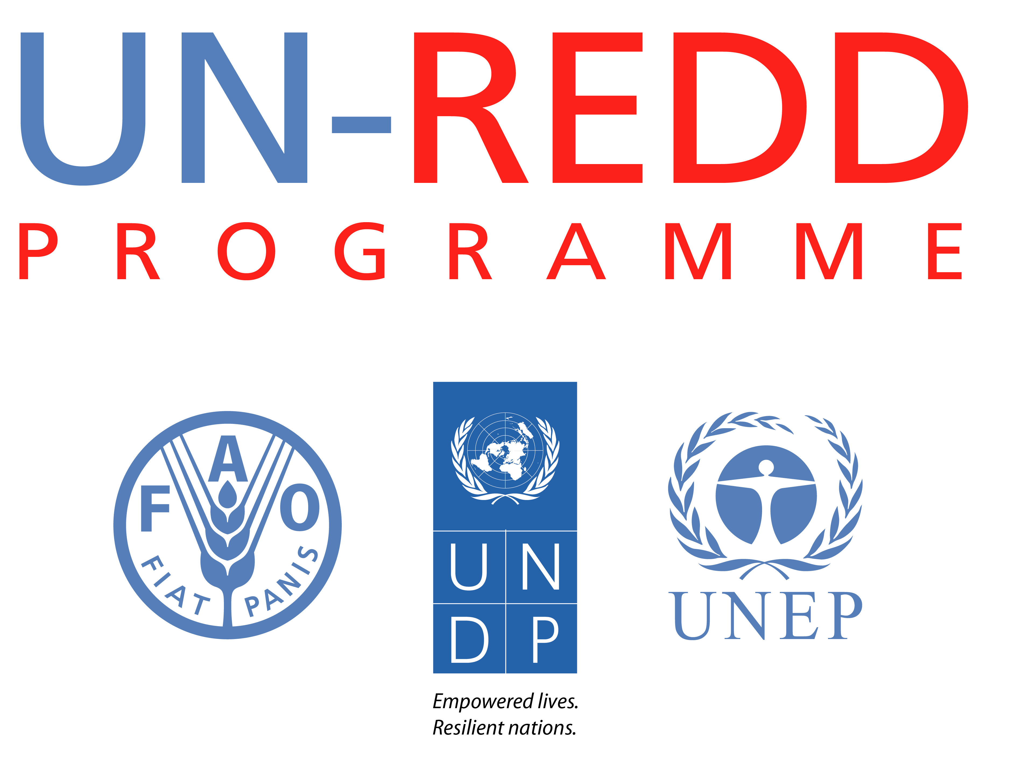
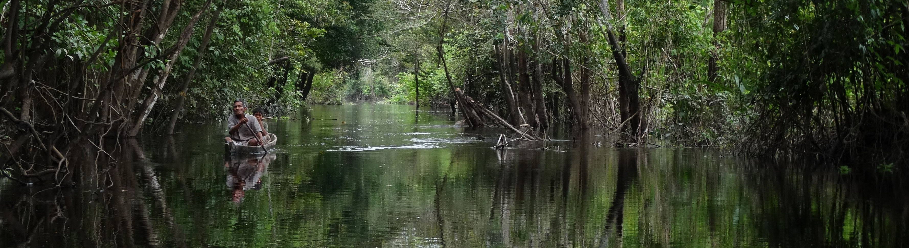
Strengthening inclusive governance of the REDD+ mechanism:
Experiences from Peru

Slide 2
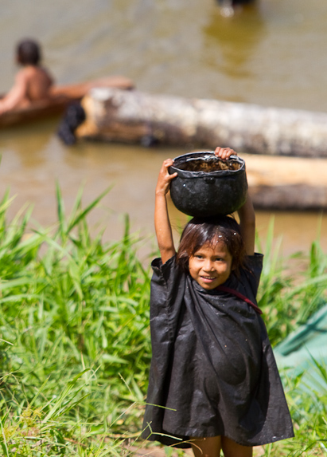
Main Objective
Strengthen the informed participation of Indigenous Peoples and other groups and institutions from civil society in the preparation phase of REDD+
by supporting the participatory design and initial application of the mechanisms and instruments
to ensure the equitable engagement of stakeholders during the implementation of REDD+ in the country

Slide 3
Background
Following the violent conflict that occurred in Bagua (5 June 2009), the UNDP conducted a series of meetings to build a climate of trust and dialogue with the Peruvian government and the representatives of the two organizations of Indigenous Peoples in the country, AIDESEP and CONAP
These coordinations led the Indigenous Peoples to request UNDP’s support
Technical support
in the sustainable human development of the indigenous communities
Institutional strengthening
of their organizations

Slide 4
Background
Emphasis
The need for understanding and preparation to participate in the construction of REDD+ in Peru.
In parallel, the Ministry of Environment (MINAM) expressed its interest in having the support of the UN-REDD Programme to develop mechanisms for Indigenous Peoples’ participation and governance related to the implementation of a REDD+ national strategy.

Slide 5
Project implementation arrangements
National counterpart
Ministry of Environment as Implementing Partner
Technical Committee
Ministry of Environment, UNDP, AIDESEP, CONAP, Vice Ministry of Interculturality
Public Ombudsman’s Office
Ministry of Environment: technical focal points; logistics support
UNDP: Project Coordination
AIDESEP: Technical focal point
CONAP: Technical focal point
Technical team

Slide 6
Budget
Total Budget | US$ 295,150
UN-REDD (Targeted support) | US$ 155,150
UNDP REDD Regional Programme | US$ 30,000
UNDP Peru | US$ 110,000

Slide 7



Results of the project
Strengthened…
Communication between the government and the organizations of Indigenous Peoples
Knowledge among the organizations of Indigenous Peoples and civil society about REDD+ (responsabilities, rights and risks)
Access to information for the local Indigenous communities
in the Amazon

Slide 8
Results of the project
Anti-corruption
Analysis of corruption risks related to REDD+ and mitigation strategies
Safeguards
Proposal for a participatory monitoring system of REDD+ activities by Indigenous Peoples
Benefits distribution
Analysis of existing legal framework and proposal for REDD+ BDS, including contractual arrangements

Slide 9
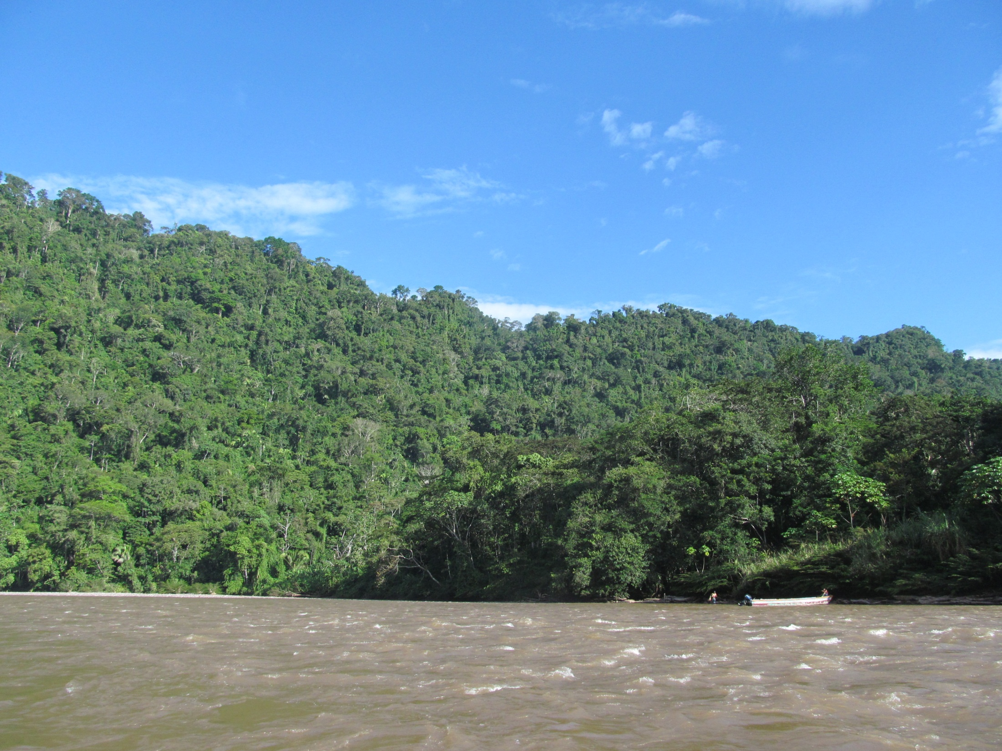
THANK YOU!
Results of the project
Contribute
To capacitate and prepare the actor for other REDD+ processes
Open spaces
For dialogue and participation where none existed before
Establish
An important precedent for indigenous participation in processes related to REDD+ and forest conservation that can be replicated beyond REDD+

